Slide 1
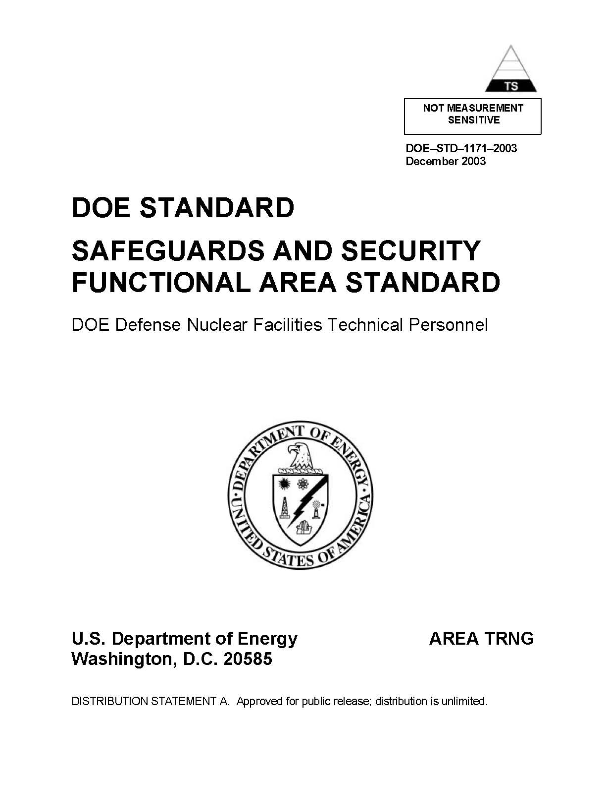
DOE - NNSA
Functional Area Qualification Standards for Security Professionals
Winnie Lehman
May 14, 2008

Slide 2
Objectives
Update Functional Area Qualification Standard for Security Professionals (DOE-STD-1171-2003)
Competencies developed by experienced, subject matter experts and fully coordinated through RevCom
Recognized professionalism among security personnel
Measurable personal achievement for individuals
Career advancement based on technical qualification
Assurance, through periodic re-qualification, that individuals continue to be proficient in their area(s) of expertise

Slide 3
Security FAQS Development
Bill Desmond, CDNS Sponsor
Debbie McNeilly, DNS Sponsor
Winnie Lehman, NASC Co-Chair
Evan Dunne, DOE Co-Chair
  (NA-70 detailee)

Slide 4
8 Topical Areas &
Working Group Membership
Program Management & Support
Jon Todd, NNSA Service Center (Team Lead)
Mary Gallion, DOE Office of Policy
Cathy Tullis, NNSA HQ
Ralph Garcia, NNSA LASO
Protective Force
Del Kellogg, NNSA PSO (Team Lead)
Sabeena Khanna, DOE Office of Policy
William A. (Bill) Morgan, NNSA PXSO

Slide 5
Topical Areas &
Working Group Membership (cont)
Physical Security
Sharon Daly, NNSA YSO (Team Lead)
Rich Faiver, DOE Office of Policy
Information protection
Laurel Hautala, NNSA KCSO (Team Lead)
Linda Rhuno, DOE Office of Policy
Cathy Tullis, NNSA HQ

Slide 6
Topical Areas &
Working Group Membership (cont)
  Cyber Security
  Mary Helen Hitson, NNSA YSO (Team Lead)
  Wayne Jones, DOE HQ, CIO
  Personnel Security
  Jim Packett, DOE HQ HSS 1.4 (Team Lead)

Slide 7
Topical Areas &
Working Group Membership (cont)
Unclassified Visits & Assignments by Foreign Nationals
Nancy Duzor, NNSA SSO (Team Lead)
Vicky Sinkler, NA-70
  TBD, DOE HSS
  Nuclear Material Control & Accountability
  Debbie McNeilly, DNS (Team Lead)
  Debarah Holmer, DOE Office of Policy
  Scott Boeke, DOE SROO
  David Young, NNSA YSO

Slide 8
Path Forward
SME working groups are created to address the 8 security topical areas and update competencies in current DOE-STD-1171-2003
Working Groups conduct Gap Analysis between DOE-STD-1171-2003 and current DOE security program manual requirements to create updated standards
Working Groups identify supporting knowledge and skills to fulfill competencies at appropriate levels (familiarity, working, expert)
March/April 2008
May/July 2008
August/October 2008

Slide 9
Path Forward (continued)
Working groups review DOE/ NTC PEP program and other available training to support competencies
NNSA S&S Directors, Training Advisory Committee, Leadership Team and others are briefed on updated FAQS
FAQS are distributed for review and comment (expected 30 days)
November/December 2008
January/February 2009
March 2009

Slide 10
Path Forward (continued)
Comments are incorporated to complete final FAQS for security
A point of contact is designated for continued implementation, Q&A, and complex tracking (sponsor or designee)
April/May 2009
June 2009

Slide 11
Basic Assumptions
Standards are applicable to DOE Federal employees only.
All Security Professionals required to meet General Technical Base through CBT or formal training at the NTC.
Experienced individuals in current positions who have met site specific program requirements will be considered qualified for a designated period of time before the additional FAQS are required to be met.
Personnel will be required to re-qualify on a periodicity not to exceed 5 years including, as a minimum, items added since the individual’s last qualification or re-qualification.
Method of confirmation of qualification will include: written exam, oral exam, facility walk through, oral board, demonstration of ability, equivalent level experience, or a combination of evaluation methods.
Goals for completion of individual training requirements will be: 18 months (familiarity level); 30 months (working level); and 48 months (expert level).

Slide 12
Basic Assumptions (cont.)
NNSA Site Office Manager, Service Center Director, NA-10, NA-20, NA-40, HQ will be responsible for:
  Identifying TQP eligible personnel
  Identifying and approving individual core competencies
  Supporting training requests
  Maintaining and approving individual Qualification Cards
  Identifying appropriate evaluation method for each competency
  Grading, testing, boarding individuals
  Awarding qualification certificates
  Requiring personnel to re-qualify on a period not to exceed 5 years.

Slide 13
ISSUES TO BE RESOLVED
Maintaining separations between safety and security standards
  1171 Standards apply to Federal personnel with contractor oversight

