Slide 1
California’s Fiscal Outlook
Jennifer Kuhn
Director, K-12 Education
Legislative Analyst’s Office
April 15, 2007
www.lao.ca.gov

Slide 2
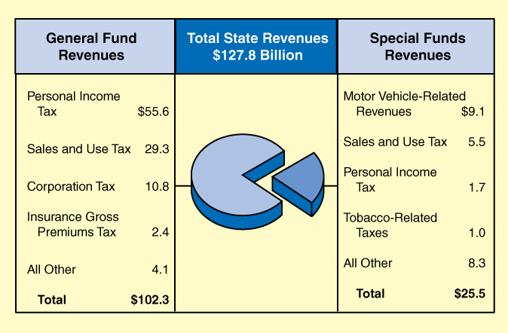
Estimated State Revenues in 2007-08
In Billions

Slide 3
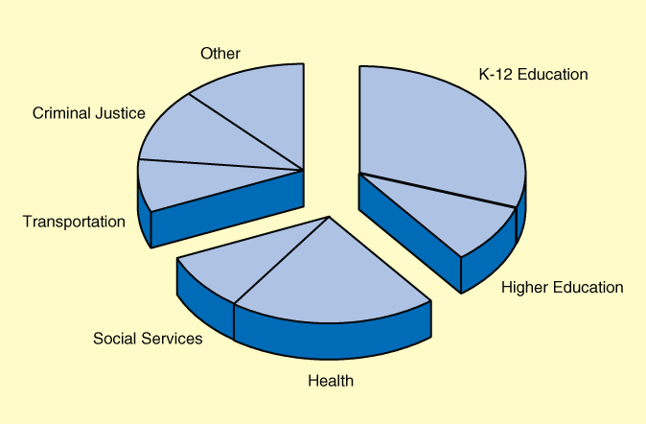
Proposed State Spending in 2007-08
2007-08

Slide 4
Key LAO Budget Findings
2007-08 Ends With $726 Million Deficit
Structural Shortfall Continues
State Faces Major Risks and Pressures

Slide 5
Lower LAO Revenues
2006-07−Down $939 Million
2007-08−Down $1 Billion
Reduction in Revenues Related to Personal Income Taxes, Tribal Gambling, and Pension Obligation Bonds

Slide 6
LAO Spending−Up $825 Million
Proposition 98
  Higher Guarantee
  Lower Property Taxes
Pension Obligation Bonds

Slide 7
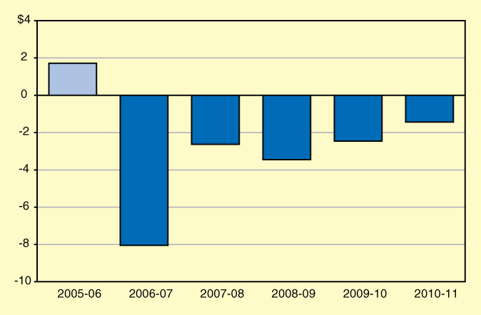
Significant Operating Shortfalls Remain
General Fund (In Billions)

Slide 8
Major Risks in Governor’s Budget
Home-to-School/Public Transportation Account Proposal
State Lawsuits Involving:
  COLA for CalWORK Grants
  Application of Limited Liability Company Fee
Federal Lawsuits Related to State’s Correctional Health Care System

Slide 9
Major Cost Pressures Related to Retiree Health Care Costs
State Faces Estimated Unfunded Liability of Between $40 Billion and $70 Billion
Local Governments Face Large Unfunded Liabilities

Slide 10
Action Steps
Increase Resources
Reduce Spending
Reduce Supplemental Payments

Slide 11
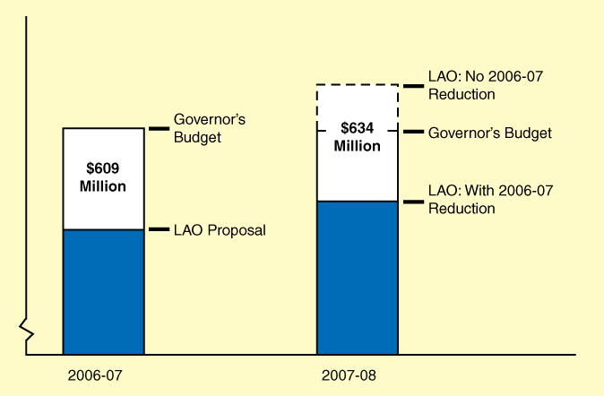
Proposition 98: Taking Action in 2006-07 Achieves Major Budgetary Savings

Slide 12
Supplemental Debt Repayments
Proposition 58 and the Budget Stabilization Account:
  $1 Billion Supports General Fund Expenditures
  $1 Billion for Supplemental Debt Repayments
Accelerated Repayments
  $595 Million

Slide 13
March Economic Update
Through February, Cumulative Tax Revenues Down $847 Million
Through March, Cumulative Tax Revenues Down $1.1 Billion
Housing Market and Energy Prices Remain Factors to Watch

Slide 14
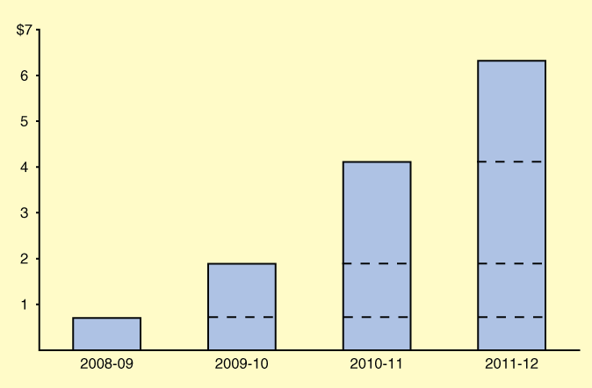
Proposition 98:
Substantial Increases on Horizon
In Billions

Slide 15
Link New Monies With Reform Plan
New Monies Offer Opportunity to Buy Reform
New Monies Used in Same Ways Might Result in No Improvement
Without Assessment and Accountability Reforms, State Will Not Be Able to Measure Effect of New Monies

Slide 16
Benefits of a Reform Plan
Identifies Long-term Priorities
Ensures Ways to Measure Progress
Couples New Monies With Reforms
Provides Local Agencies Time to Develop and Implement Reforms
Strengthens Legislature’s Role in Budget Process

Slide 17
Performance-Based Approach to Building K-12 Reform Plan
Identify Performance Challenges
Invest in Services Designed to Address Those Challenges
Ensure Accurate, Reliable, Reasonable Ways to Measure Performance

Slide 18
LAO Suggested K-12 Roadmap
Preschool for All Low-Income Children
Additional Resources for Special Education, Low-Income, and English Learner Students
Fiscal Solvency Block Grants

Slide 19
Systemic Approach to
Building K-12 Reform Plan
Focus on Building Blocks of K-12 System:
  Governance
  Finance
  Assessment
  Accountability
Make Holistic Reforms to Underlying Structures

