Slide 1
ATV Operational Review Splinter
September 12, 2007
B. Gainey / ATV SMM

Slide 2
Agenda
Mission Overview
Network Test
Interim Support Instructions (ISI)
C-band Tracking
FDF Support
FDF Staffing
NIC Staffing
SN Support
WSC TOA Staffing
Proposed Activities/Open Discussions

Slide 3
Mission Overview
Launch is scheduled for January 31, 2008, from the French Guyana launch site at Kourou
Launch window TBD
Automated Transfer Vehicle (ATV) docking is planned to occur at Launch plus 36 hours
C-band radar will track orbits (TBS)
ATV separations occurs at Launch plus (TBS)
Space Network (SN) initial acquisition on TD?? is expected at (TBS)
SN support continues through docking

Slide 4
Network Test Status
The following SN test have been completed:
  1. ISS End-to-End Testing of ESTL/MCC/ESA
    ATV Docking Video test
  2. ATV 5.1 (End-to-End) Scheduling Test, February 9, 2007
    Drop box and scheduling test
  3. ATV SVT-4B (End-to-End) Test, December 9, 2004
    TDRS link, encryption and link interruption, recovery of lost TM flow
  4. ATV Pointing Calibration Test, December 7, 2004
    Verify the S-band RF interface between the ESTEC rooftop antenna and the SN (TDS) in preparation for the upcoming ATV SVT4B Test

Slide 5
Network Test Status (cont’d)
The following SN test have been completed: (continued)
  5. ATV-MCC-H Joint End-to-End Test, November 17 and 19, 2004
    ATV ground segment to process 8 and 64 kbps ATV telemetry from WSC to ATV-CC using the MCC-H bent-pipe and IGS configuration
  6. ATV SVT4A (End to End) Test, May 24, 2004
    End-to-End (ETE) command and telemetry
  7. ATV Transponder/TDRSS Capability Test, May 17-21, 2004
    Verify the S-Band RF interface between the (Bremen ATV) rooftop antenna and the SN (TDRS) in preparation for upcoming ATV Transponder/TDRSS Compatibility Test
  8. ATV Pre-capability RF Test, April 19, 2004

Slide 6
Network Test Status (cont’d)
Remaining Space Network (SN) Test is a SVT5
  Objectives as follows:
    Final ETE interface test of TDRS link; Final encryption test over one of the links (TDRS or ARTEMIS) to confirm that the encryption keyset plugs have been correctly installed in the ATV
    Final ETE check of parallel TM flows through TDRS and ARTEMIS links to be active simultaneously
    Test will occur 30 to 60 prior to launch.

Slide 7
Interim Support Instructions
The Networks will issue the following Interim Support Instructions (ISI) for ATV
  1. ISI 001 Premission Status L-30 days
  2. ISI 002 Launch Count L-7 days
  3. ISI 003 Critical Mission Period Restrictions L-7 days
  4. ISI 004 Mission Termination after Reentry is confirmed

Slide 8
C-band Tracking
A minimum of five C-band passes will be scheduled via the Eastern Range
Three C-band sites will be scheduled
Orbits TBD

Slide 9
FDF Support
ATV orbit determination using available TDRS and C-band tracking data. Orbit determination will be performed after ATV injection and just prior to and after planned ATV maneuvers
FDF will send ATV vectors based on FDF orbit determination to ESA via JSC
For the first ATV mission, provide ESA (via JSC) with ATV ephemeris data based on FDF orbit determination after separation so ESA can verify ATV GPS results
Provide ATV acquisition data to supporting SN sites. Acquisition data will be based on ESA-provided ATV vectors (via JSC) or on FDF orbit determination, depending on mission phase
Provide ESA (via JSC) with TDRS vector data

Slide 10
FDF Staffing
Launch through launch + 3 orbits
(Scheduled maneuver - 1 orbit) through (scheduled maneuver plus 3 orbits)
(Docking - 4 hours) through docking
During docked ops, FDF will follow nominal ISS support schedule, Monday/Wednesday/Friday
(Undocking - 1 hour) through the de-orbit burns (approximately undocking + 6 hours)
Contingency support: as needed, best effort basis

Slide 11
NIC Operations
SMM responsibilities:
  Will work schedule conflicts with SN scheduling
  The central point of contact for all ATV SN anomalies
  Will monitor all SN events when console is staffed
  Will insure all steps in the launch count are followed
  Will generate any required ISIs during the ATV mission
  Will conduct a shift briefing for each shift

Slide 12
NIC Staffing
SMM coverage will begin 4 hours prior to launch and through docking
SMM will cover all critical periods during the docking
SMM will support undocking through reentry

Slide 13
SN Support
The WSC complex will provide continuous support of the ATV mission
ATV will schedule SSA and MAF/MAR SHOs as low-data rate, non-coherent, and two-way tracking. MAR SHOs will be scheduled low-data rate, non-coherent, one way tracking
GCMRs will be required to get the SHOs to high-data rate and coherent. Coordination of the SHO configuration will be covered in the prepass briefings between ATV-CC GC and ISS GC
All of ATVs SSA and MAF/MAR SHOs will have two-way tracking scheduled, but will be non-coherent by default since ATVs transponder will not always be in coherent mode. WSC stated this deliberate mismatch is OK. The scheduling system will take the SHO, but the tracking data will just get tagged as invalid. ATV-CC understands that FDF will not be performing OD unless ATVs transponder mode is commanded to coherent, and the SHO is GCMR’d to coherent

Slide 14
WSC TOA Staffing
WSC TOA will staff for the following activities:
  Launch and any early burns
  Any critical periods
  Docking and undocking
  Will be on-call for ATV contingency

Slide 15
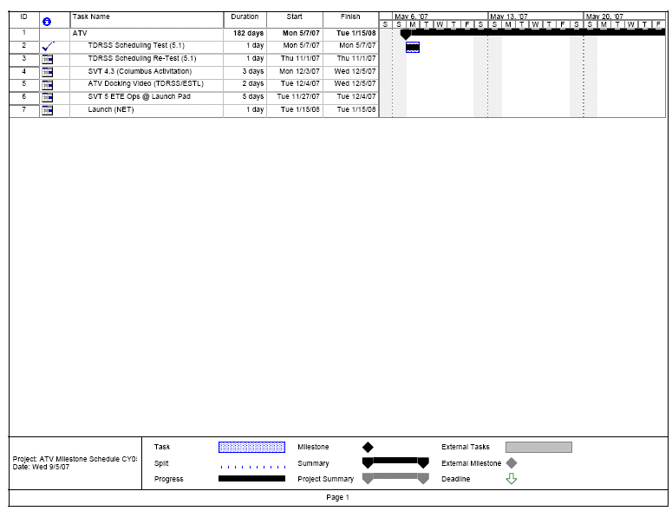
2007 ATV Milestones

Slide 16
Proposed Activities/Open Discussions
ATV 5.1 (End-to-End) Scheduling Test
  Scheduling, drop box, and GCMRs training

