Slide 1



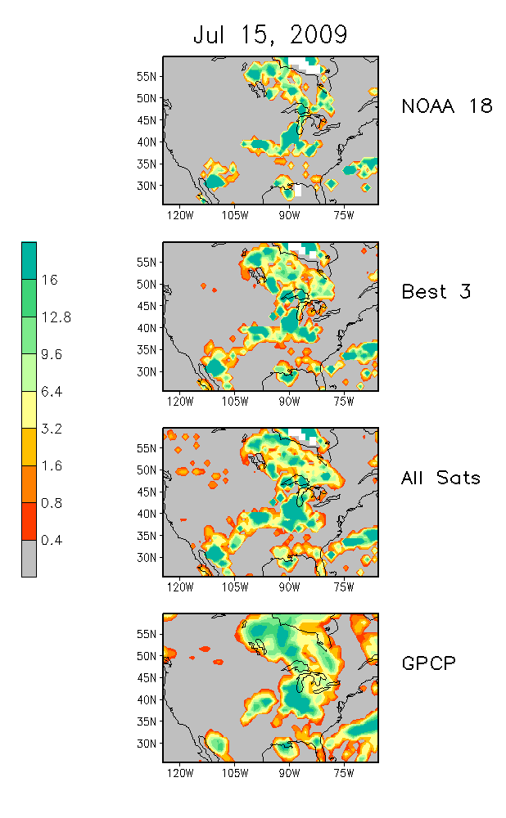
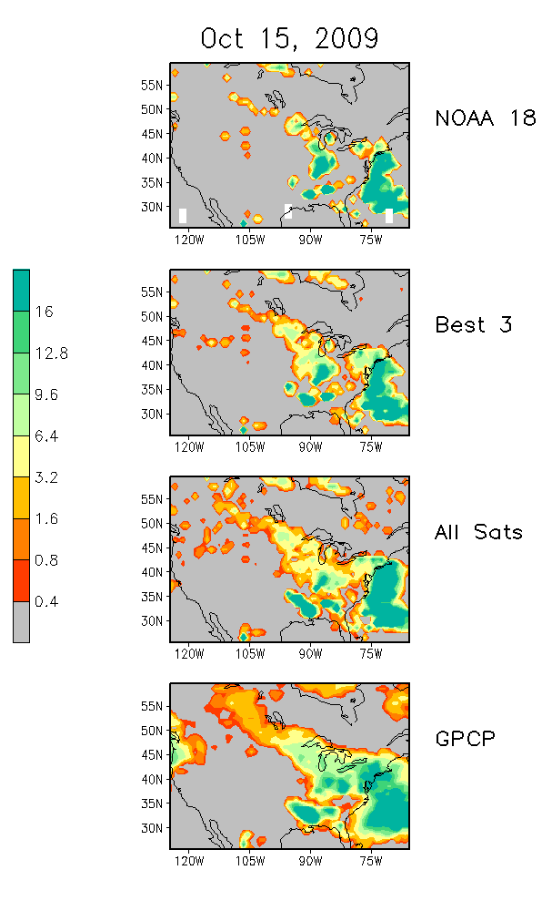
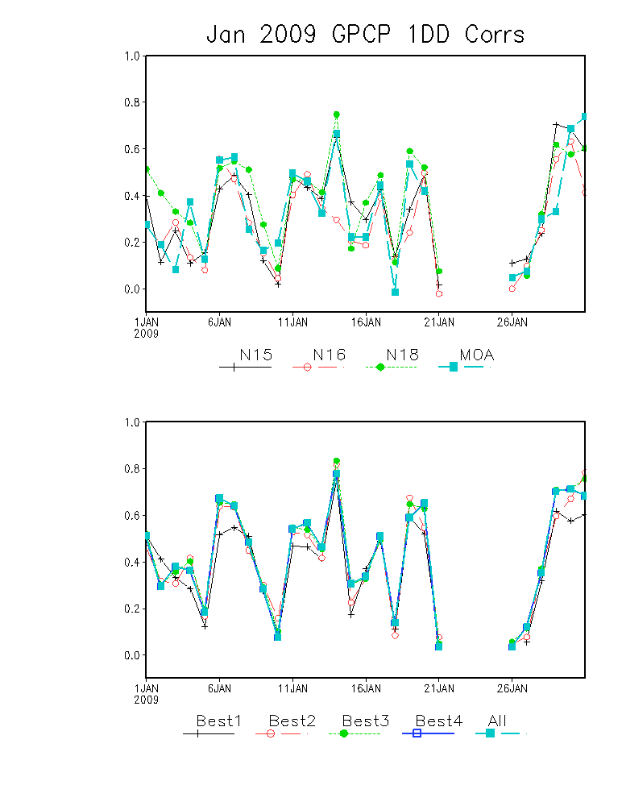
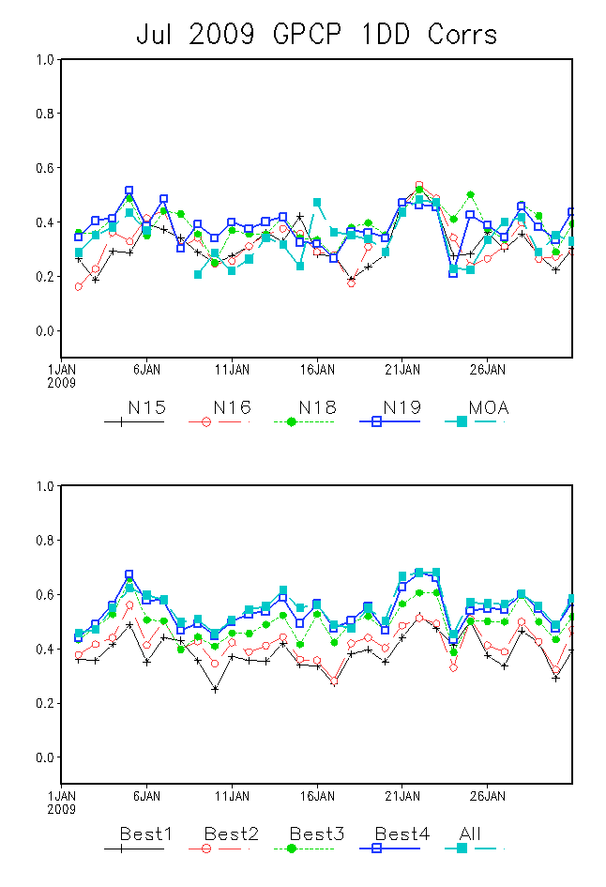
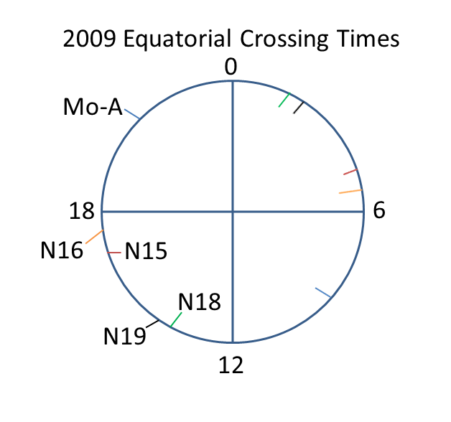
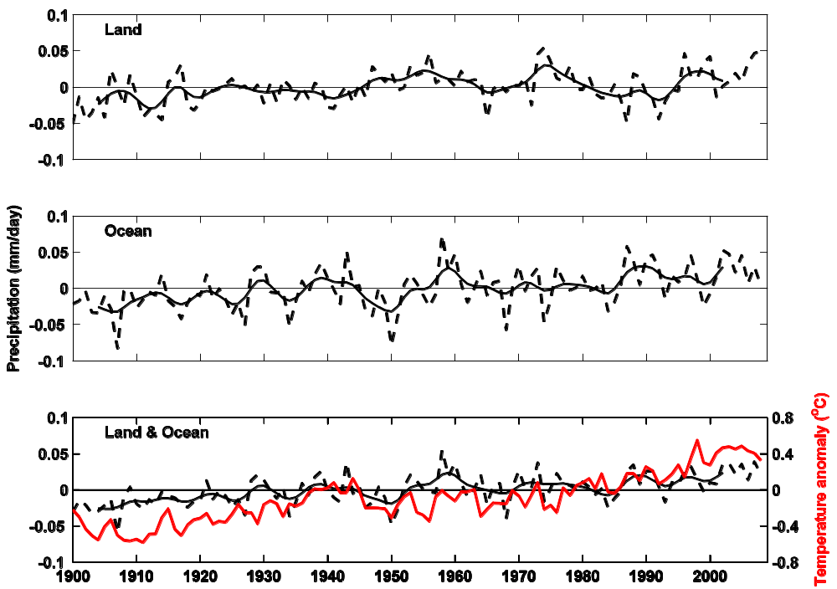
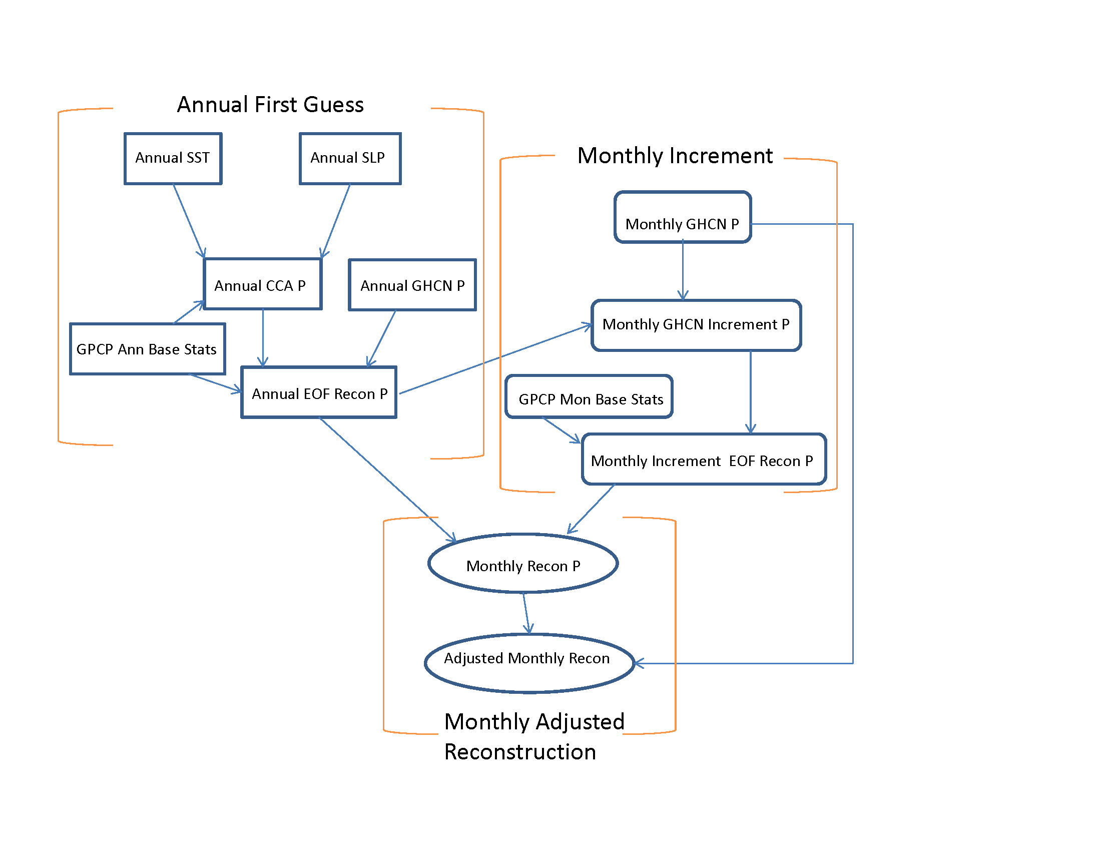

Impact of AMSU Derived Hydrological Products on Merged Precipitation Products
Thomas Smith^{1,2}, Ralph R. Ferraro^{1,2}, Huan Meng^{1,2}, and Wenze Yang²
1. NOAA/NESDIS/STAR/CoRP/SCSB, 2. ESSIC/CICS, University of Maryland
ABSTRACT
Table 1. Average of daily spatial correlations for 2009 and the given month.
NOAA 15 NOAA 16 NOAA 18 NOAA 19 MetOP-A All Merged
Jan 0.33 0.28 0.39 UnDef 0.33 0.42
Apr 0.37 0.31 0.45 0.44 0.38 0.57
Jul 0.32 0.32 0.39 0.38 0.34 0.55
Oct 0.40 0.37 0.45 0.45 0.42 0.59
Satellite precipitation estimates are used to complement surface reports from radars and gauges. In regions with limited or no surface reports satellites are the source of most or all precipitation information. Over the past decade blended precipitation products have demonstrated their importance to global precipitation estimates. The most successful products combine satellite microwave and IR measurements and anchor them with high quality rain gauges where they exist. Satellite sampling tends to be biased towards one part of the day, such as morning or afternoon, when the satellite is over a region. Therefore the diurnal cycle of precipitation may not be well sampled. Although individual techniques have a known level of accuracy, the diurnal sampling bias can dominate the error of global, daily or longer-period precipitation products.
Here the impact of AMSU precipitation estimates on a merged estimate is evaluated using products from multiple satellites. The region containing the continental US (25°N-60°N by 125°W-65°W) is chosen so that adequate surface observations are available to document the impact. Data from NOAA 15, NOAA 16, NOAA 18, NOAA 19 and MetOP-A are binned onto a daily 1° grid for several months of 2009. Evaluations are performed using individual satellite estimates and merged combinations of satellite estimates. Comparisons are made against GPCP daily estimates, which contain satellite and gauge estimates. Comparisons to GPCP are best when more satellites are used, especially when the satellites have a large difference in overpass times.
INTRODUCTION
We use AMSU precipitation estimates from NOAA 15, NOAA 16, NOAA 18, NOAA 19 and MetOP-A binned to a 1° daily grid over 25°N-60°N by 125°W-65°W. Evaluations are made of individual AMSU estimates and combinations . Evaluations are against the GPCP 1° daily precipitation product (Huffman et al. 2001). The GPCP data merge gauge and satellite estimates that have been adjusted to minimize biases. We evaluate four months of 2009 representative of the seasons: Jan, Apr, Jul, Oct. Daily estimates are evaluated for individual AMSU satellites and combinations. We consider combinations of the two best estimates merged, the three best estimates, etc. The estimates are ranked best, second best, etc., using their spatial correlation with GPCP. Daily spatial correlations are averaged over the month to define the rankings. Here merging is done by simply averaging. Our goal is to show the value of additional data. Better analyses such as Joyce and Xie (2011) could produce greater improvements.
Regional Averages
Figure 2: Jul 15 (left) and Oct 15 (right) daily precipitation estimates from the indicated individual and merged AMSU estimates and GPCP. Units are mm/day.
SPATIAL CORRELATIONS
Figure 1: Jan (left) and Jul (right) daily spatial correlations with GPCP for individual AMSU estimates (upper) and combinations (lower). Ranking of best are based on average correlations. All indicates using all AMSU inputs.
First consider spatial correlations with GPCP. For each AMSU estimate daily correlations are averaged over the month to rank them. Table 1 shows the monthly averages of daily correlations. NOAA 19 is not available for Jan. Highest average correlations for each month are in bold and lowest are italicized. NOAA 18 is always best, and when available NOAA 19 is second best. NOAA 15 and NOAA 16 always have the lowest average correlations.
Individual satellite spatial correlations and spatial correlations of merged estimates indicate greater day-to-day change in the cool season (Fig. 1). Both months indicate that the monthly average correlation is representative of most days, although there are times when the ranking would change for individual days. In these examples the greatest increase in correlation tend to be when going from 2 to 3 or 4 satellite estimates.
EXAMPLES
Jan AMSU estimates have reduced spatial coverage due to snow and ice. As examples we show the 15th of Jul and Oct (Fig. 2). Change are clear between 1 and 3 merged satellites. NOAA 18 has the highest spatial correlation and indicates much of the spatial distribution. Because each satellite represents a snapshot at the time of overpass it cannot fully represent the daily average. Adding two more satellites improves the representation of the daily average, largely due to better sampling of the diurnal cycle, as indicated by equatorial overpass times (RSS 2015). In 2009 NOAA 18 and 19 had similar overpass times, but NOAA 18 and MetOP-A overpasses were separated by about 8 hours (Fig. 3). The NOAA 15 and 16 satellites had similar overpass times about 4 hours different from NOAA 18, and their addition gave a smaller increase in skill. These examples show how sampling the diurnal cycle can influence daily-precipitation representativeness and the importance of diurnal sampling. However, even using all AMSU satellites several hours of the day are not sampled. These examples indicate that applications requiring accurate daily precipitation should use multiple sources of information. Where gauges or more satellites are not available the daily cycle could cause large errors in estimates of daily averages.
Figure3: Approximate equatorial crossing times in 2009 for the satellites examined here for both ascending and descending orbits.
References
Huffman, G.J., R.F. Adler, M. Morrissey, D.T. Bolvin, S. Curtis, R. Joyce, B McGavock, J. Susskind, 2001: Global Precipitation at One-Degree Daily Resolution from Multi-Satellite Observations. J. Hydrometeor., 2, 36-50.
Joyce, R.J., and P. Xie, 2011: Kalman filter-based CMORPH. J. Hydrometeor., 12, 1547-1563
RSS, 2015: Remote Sensing Systems Crossing Times. http://www.remss.com/support/crossing-times.
Acknowledgments. This research was supported in part by NCDC’s Climate Data Record program. This study was also partially supported the Cooperative Institute for Climate and Satellites (CICS) at the University of Maryland/ESSIC. The contents of this poster are solely the opinions of the authors and do not constitute a statement of policy, decision, or position on behalf of NOAA or the U.S. Government.

