Slide 1
The Impact of Medicare Part D on
Pharmaceutical Prices and Utilization
Mark Duggan
University of Maryland, MPRC, and NBER
Fiona Scott Morton
Yale University and NBER
February 2008

Slide 2
Introduction
Medicare created in 1965 and now insures 43+ million
Insurance for most health care services
  Part A: hospital inpatient care and some long term care
  Part B: hospital outpatient care and physician services
Most (85%) Medicare recipients in fee-for-service
  Thousands of FFS prices set and updated periodically
For first 40 yrs – most prescription drug expenses uncovered
  Certain physician-administered drugs the exception
Changed in Jan 2006 with enactment of Medicare Part D
  Largest expansion of Medicare since its inception
  Projected to cost $780 billion in first ten years (2006-15)
This paper: estimate impact on RX prices and utilization

Slide 3
Medicare Before Part D
Created for those 65+ by Soc Sec Amendments of 1965
  Provides insurance for most health care expenditures
  By 1967 19 million elderly individuals enrolled
  Expanded to include Social Security Disability recipients in 1973
  Currently insures 43 million U.S. residents
Two main components – Part A and Part B
  Hospital Insurance - deductible of $900
  Supplementary Medical Insurance - monthly premium, 20% copay
Fee-for-service reimbursement
  Thousands of prices set and updated periodically
Essentially no coverage for prescription drugs
  Physician-administered drugs the one exception

Slide 4
Medicare Part D
Medicare Modernization Act passed in December 2003
  Part D took effect January 1, 2006
Several key features
  Private insurance plans compete for enrollees
  Medicare recipients have option to enroll and pay monthly premium
  Premiums subsidized by the federal government (~70 percent)
  Out-of-pocket costs a non-linear function of RX spending
  Premiums increase for those who delay enrollment
Plan instruments
  Formulary (list of covered drugs) - need 2+ in each of 146 categories
  Prices in the “donut hole” and co-pays in the coverage areas
  Degree to which enrollees are steered to certain drugs

Slide 5
Medicare Part D (continued)
Two Part D plan types
  Prescription Drug Plans (PDPs) – stand-alone plans
  Medicare Advantage Drug Plans (MA-PD) – all services incl. drugs
Low-income Medicare recipients
  Dual eligibles (also on Medicaid) required to enroll in a plan
  Subsidies if not on Medicaid but income below 135% of poverty line
Firms subsidized to continue providing own coverage
  Included to reduce crowd-out of existing insurance
  Equal to 28 percent of cost to employer
Six protected therapeutic classes – includes HIV ARVs
Plans submit bids – cost over average borne by recipient
  Can serve one or more of the 34 coverage regions in U.S.

Slide 6
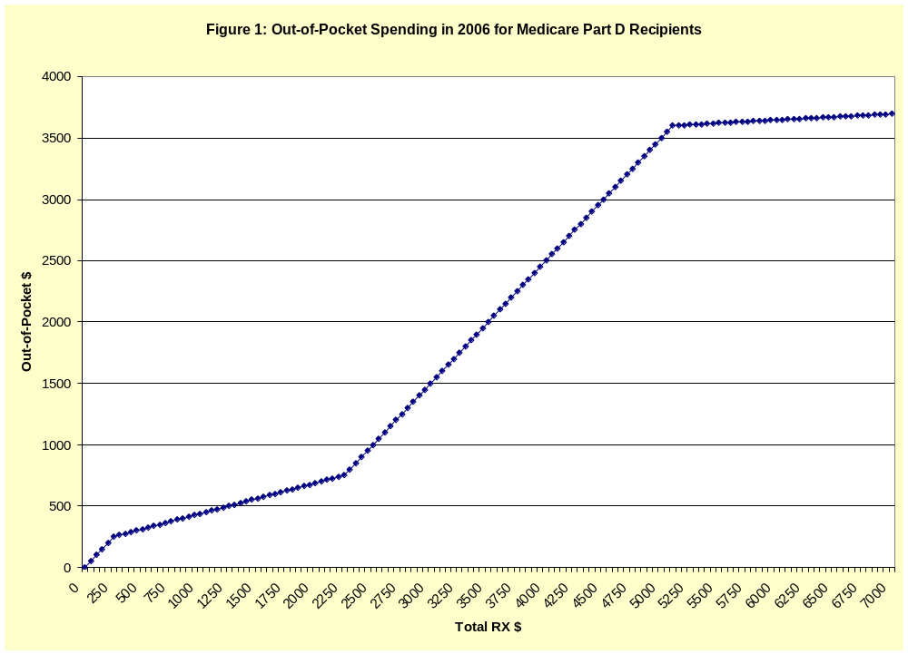

Slide 7
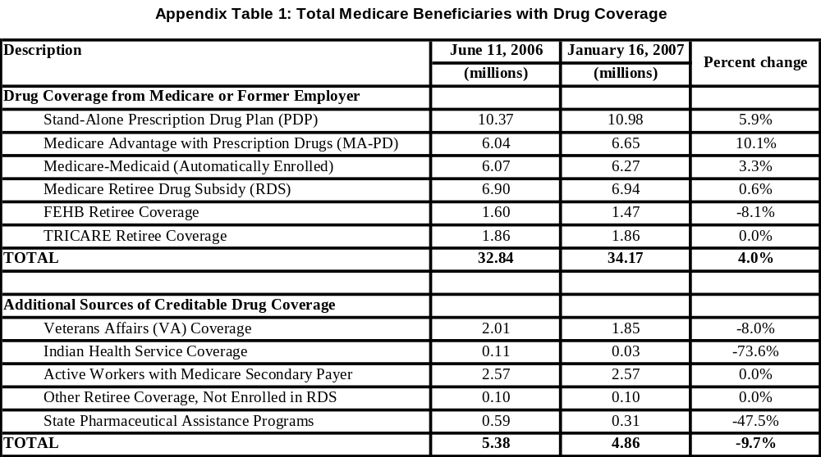
Medicare Part D Enrollment as of January, 2007

Slide 8
Part D Plan Market Characteristics in 2006
226 organizations offered plans by end of 2006
  Top two (UHC-Pacificare and Humana, Inc.) had 44 percent
  Next eight had 28 percent
Total of 3873 region-plan combinations in 2006
  1678 PDPs and 2195 MA-PDs
  Firm can offer several in each region
Just 14 percent of enrollees in plans with standard benefit
  51 percent in actuarially equivalent and rest in enhanced plans
80 percent of enrollees have no coverage in “donut hole”
  94 percent if restrict to PDPs
  9-10 million dual eligible / low-income subsidy have full coverage by the federal government

Slide 9
Related Literature
Medicare Part D
  Lichtenberg (2007) and Simon and Lucarelli (2007)
Drug procurement (Medicaid)
  Duggan and Scott Morton (2006) and Scott Morton (1997)
Impact of Medicare
  Acemoglu et al (2006), Card et al (2006), and Finkelstein (2007)
Prescription Drug Cost Sharing and Out-of-Pocket Costs
  Gibson et al (2005) and Pavcnik (2002)
Crowdout of Private Insurance
  Cutler and Gruber (1996) on Medicaid eligibility expansions
Contracting out to private insurers
  Duggan (2004) on Medicaid HMOs

Slide 10
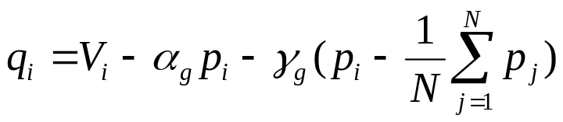
Theoretical Framework
Part D may affect firm’s profit-maximizing price
  Our measure will be average product-specific price
Two key forces– theoretically ambiguous which dominates
  More insurance => lower demand elasticity => higher price
  Plans compare price/efficacy => negotiate discounts => lower price
Consider linear differentiated products demand curve
  Similar to Deneckere and Davidson (1985) or Shubik (1980)
i indexes drugs and N is number of therapeutic substitutes
α_{g} and γ_{g} likely to change with switch from cash to Part D

Slide 11
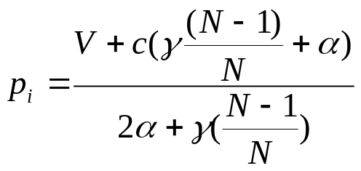
Theoretical Framework (continued)
Part D likely to reduce α_{g} and increase γ_{g} (substitutability)
  This will influence prices as follows:
Change in avg price will be linear function of MMS
  Change allows us to difference out time invariant omitted factors
  Should see bigger effects for uninsured Medicare recipients
  Protected versus all other therapeutic categories
  Determining substitutes – still in progress
Do prices change differentially for Medicare-intensive drugs?

Slide 12
IMS Data on U.S. Sales and Quantity
Total sales in the U.S. for all pharmaceutical products
  Annual data from 2001 to 2006
  Sales increased from $162.6 billion to $223.9 billion (2006 $)
Also includes utilization data
  Total standardized units and units per daily dose
Divided into therapeutic categories and subcategories
  14 therapeutic categories (e.g. cardiovascular)
  260 subcategories (e.g. cholesterol reducers)
Aggregate different versions of the same product
  Example: Prozac and Prozac Weekly
  Do not include generic versions when doing this – different firm

Slide 13
Medical Expenditure Panel Survey
Publicly available constructed by AHRQ
Detailed information on health care utilization
  For nationally representative sample of U.S. pop (using weights)
Prescribed Medicines file in 2003
  304,324 prescriptions for 20,475 individuals
  Lines up reasonably well with IMS rankings (Table 1)
Consolidated Data File (CDF)
  Data on age, gender, health insurance coverage, etc.
  There are 34,215 people in 2003 MEPS
  Can be linked to Prescribed Medicines file
Fraction on Medicare increases sharply at 65 (Figure 2)
  15 percent at 64 to 96 percent at 65

Slide 14
Medicare Recipients in the MEPS
Medicare recipients have much greater RX utilization
  Average of 28.0 prescriptions filled and $1789 in spending
  Compare to 6.5 and $412 for those not on Medicare
  14.4 percent of pop but 40.3 percent of prescriptions
Source of payment in 2003 also differs (Table 1)
  Larger share out-of-pocket for Medicare recipients
  Medicare recipients less private but more public insurance
  Just 8 percent paid for by Medicare prior to MMA
Substantial variation in Medicare market share
  Anti-depressant Zoloft (ranked #5 in sales) at 27.1 percent
  Heart treatment Plavix (#16) at 72.9 percent

Slide 15
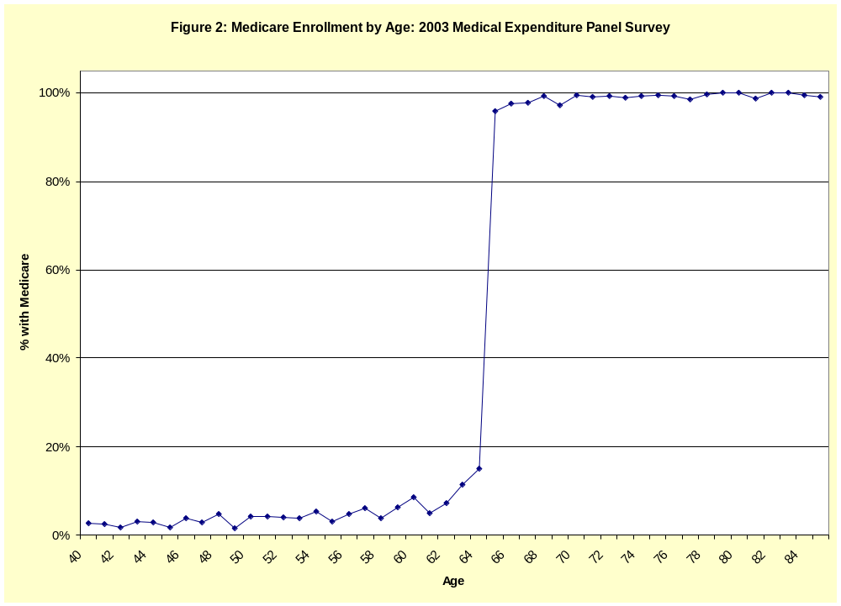

Slide 16
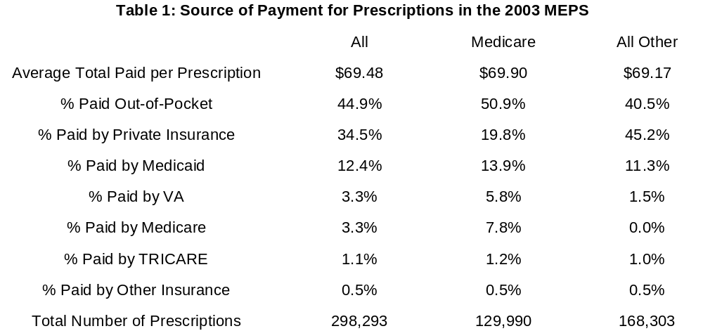
Medicare vs. All Other RX Spending: 2003 MEPS

Slide 17
Constructing the Analysis Sample
Consider price and utilization changes from 2003 to 2006
  Medicare Modernization Act passed in Dec 2003
  Part D does not take effect until 2006
Focus on top 1000 drugs in IMS data by 2003 sales
  97.2 percent of the $196.0 billion in sales
Use 2002 and 2003 MEPS to increase accuracy of MMS
Sample restrictions
  Drop 113 over-the-counter drugs – not covered by Part D
  Drop 194 generic drugs – difficult to measure accurately in MEPS
  Drop 125 products not in MEPS
  Drop 20 products with no sales in 2002 or 2003 or missing FDA year
Final sample of 548 drugs – accounts for 78 percent of 2003 $

Slide 18
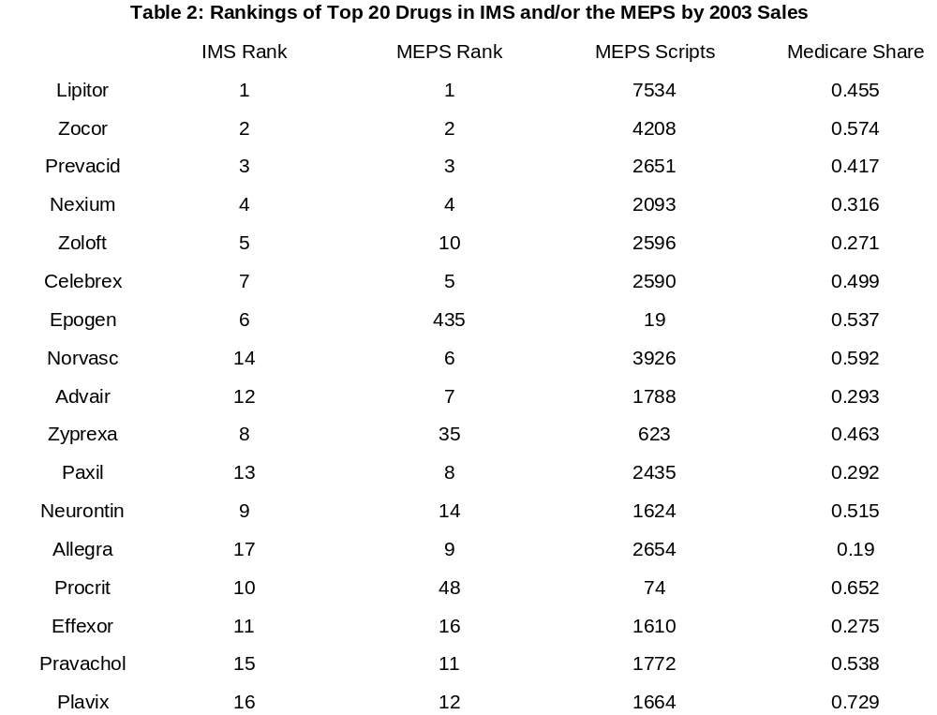

Slide 19
Empirical Framework
Exploit variation across drugs in the Medicare market share
Consider change from 2003 to 2006
  Differences out time-invariant omitted factors
MMS_{j,2003} represents potential Part D enrollment
Impact of Part D modeled here as common effect β
ΔP_{j,2003-06} = α + βMMS_{j,2003} + γΔP_{j,2001-02} + μX_{j,2003} + ε_{j,2006}
Key assumption: MMS_{j,2003} is orthogonal to other unobserved determinants of average price changes
  Also assumes no “spillover effect” to non-Medicare recipients
Use log instead of level in prices
  Reduces skewness and proportional impacts more plausible

Slide 20
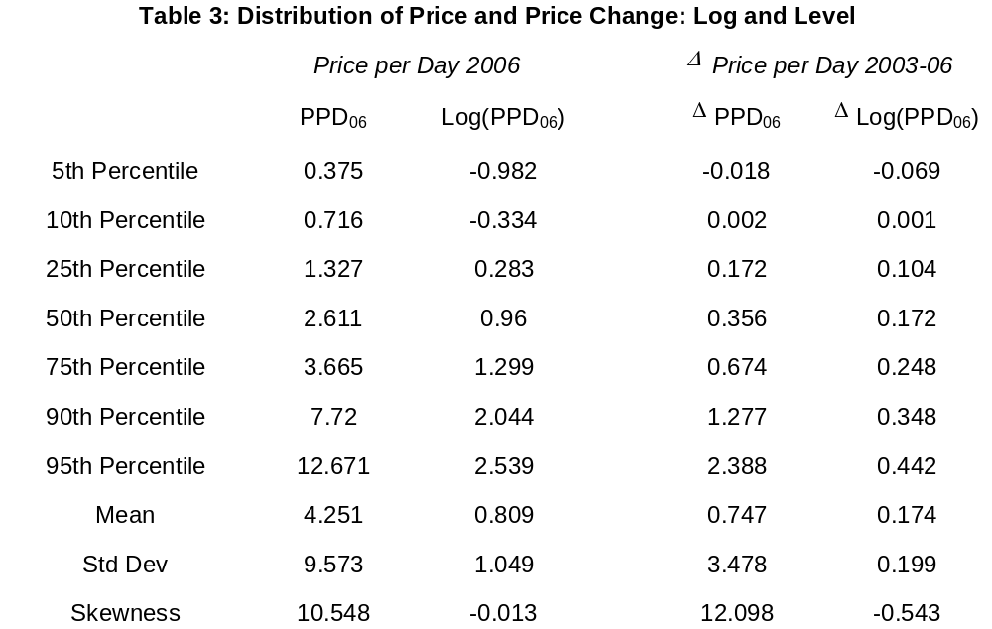
Level of and Change in Price is Highly Skewed

Slide 21
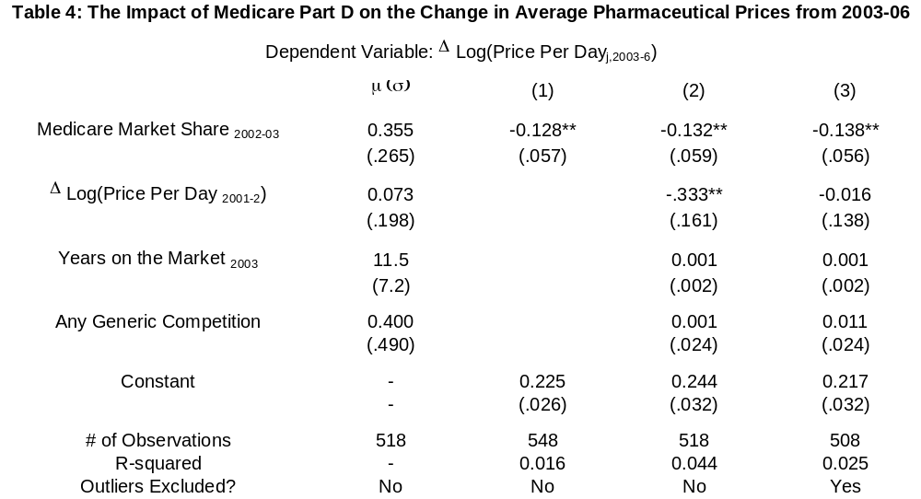
Average Price of Medicare-Intensive Drugs Declines

Slide 22
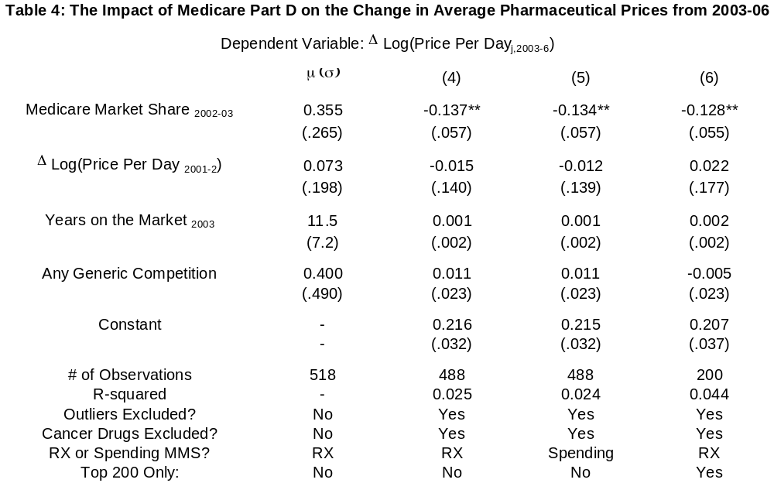
Robust to Excluding Cancer Drugs and Restricting to Top 200

Slide 23
Interpretation of Baseline Price Results
Estimates imply 12% decline in prices for Medicare recipients
If driven by Part D – actual effects nearly twice as large
  Slightly more than half enroll in a Part D plan
Assumes no “spillover effect” to non-Medicare prices
Out-of-pocket costs would have declined even more
  25 percent co-pay from $250 to $2250
  100 percent co-pay from $2250 to $5100
  5 percent co-pay past $5100
Next test for corresponding effect on utilization
  Recent work examines impact of Part D on utilization at one large pharmacy chain (Lichtenberg, 2007)
  Complicated due to variation in co-pay with RX spending

Slide 24
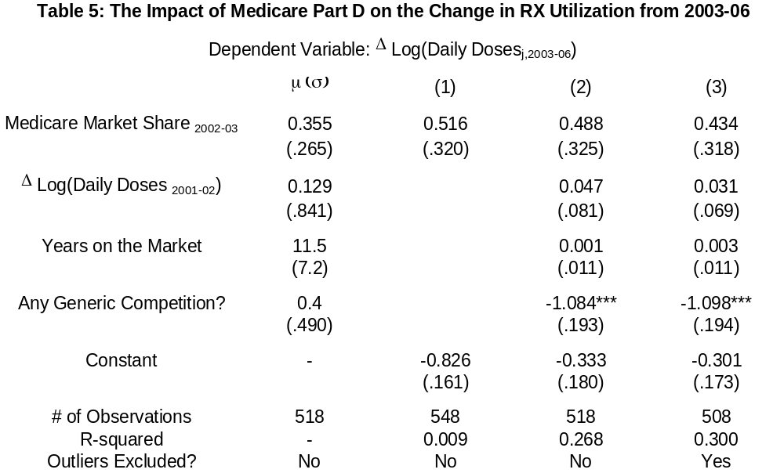
Utilization Estimates Less Precise & Suggest Large Impact

Slide 25
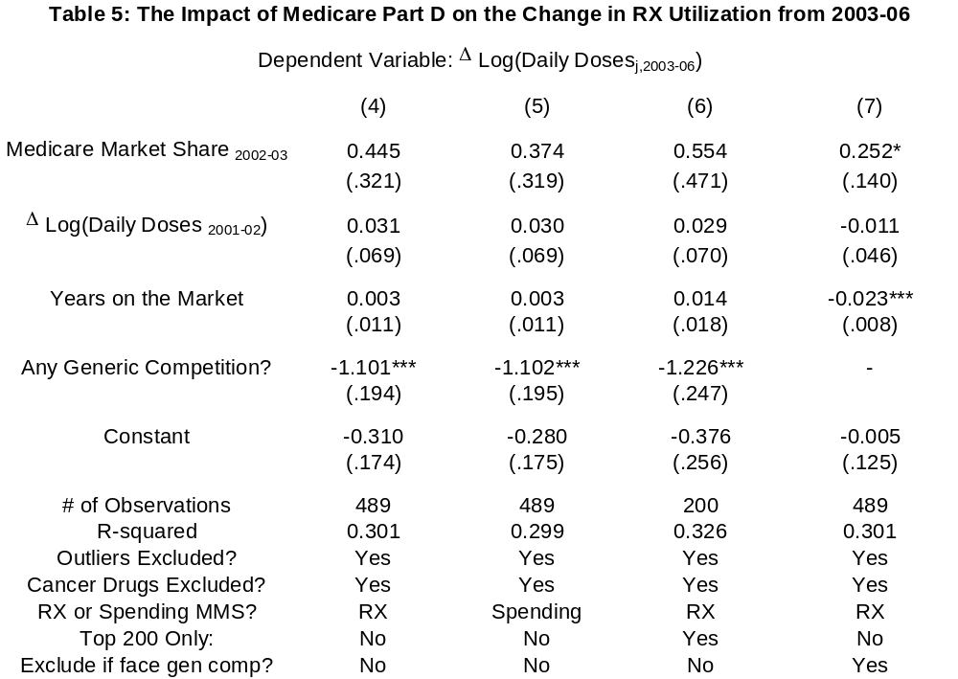
Main Utilization Results (continued)

Slide 26
Summary of Main Results
Decline of 12% in average prices for Medicare recipients
Impact of Part D likely greater
  Many do not enroll or stick with existing coverage
Out-of-pocket prices not observable in our data
  Large declines in coverage areas from 250-2250 and 5100+
Back-of-the-envelope estimate suggests elasticity ~0.5
  Out-of-pocket price change depends on where in coverage gap
Limitations
  Aggregate rather than individual-level data
  Do not observe drug-specific Part D enrollment
Have assumed common impact
  Next explore how effect varies

Slide 27
Insured and Uninsured Medicare Recipients
Do not observe drug-specific Part D enrollment
Likely to be larger for those uninsured in 2003
  Many retained existing coverage with past or current employer, etc.
Use MEPS to differentiate Medicare uninsured & insured %
  Averages of .249 and .152 for 548 sample drugs
ΔY_{j,2006} = α + β₁MMS_Self_{j,2003} + β₂MMS_Ins_{j,2003} + γΔY_{j,2003} + μYrs_{j,2003} + ε_{j,2003}
Expect larger estimate, in terms of magnitude, for β₁
Also explore effects for dual (Medicaid-Medicare) share
  Dual eligibles shifted from Medicaid RX coverage to Medicare plans
  Reduces Medicaid market share - Duggan and Scott Morton (2006)

Slide 28
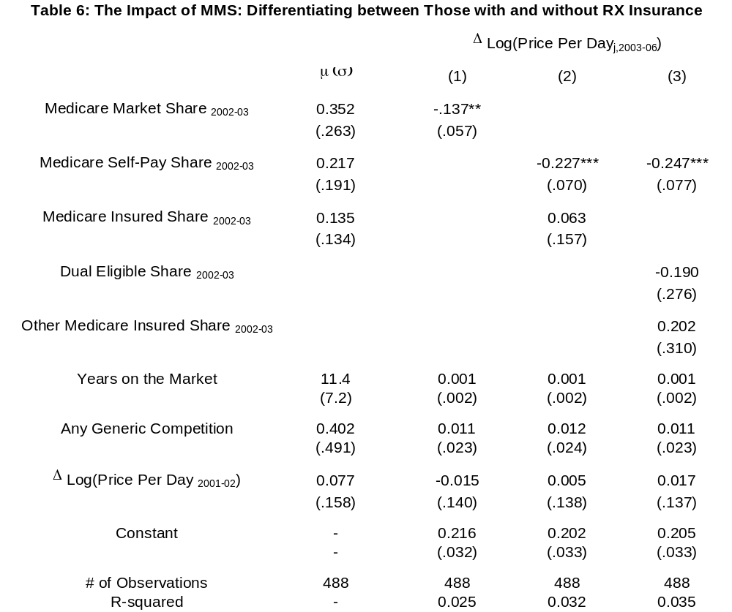
Price effects driven by impact on the uninsured

Slide 29
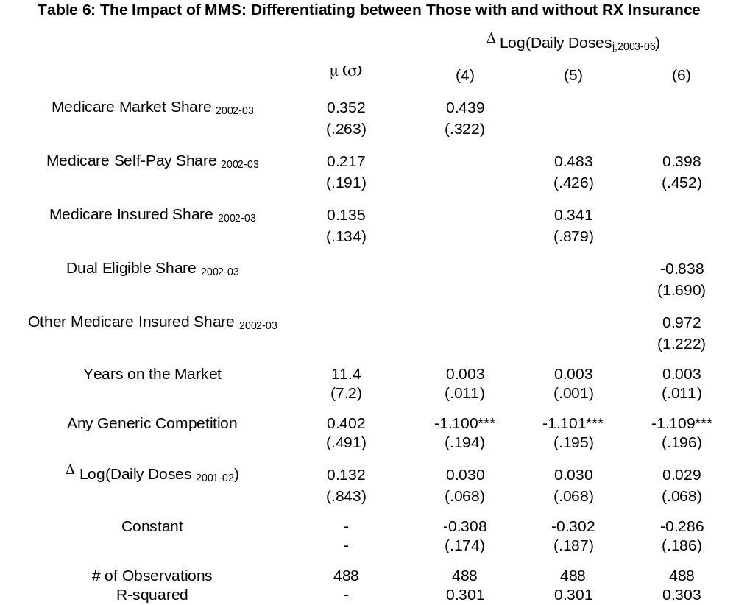
Utilization Estimates also Larger for Uninsured

Slide 30
Protected and “Small” Therapeutic Categories
CMS requires plans to cover all drugs in these 6 categories:
  Anti-depressant, anti-psychotic, HIV anti-retroviral, anti-convulsant, immunosuppressant, anti-cancer
Main motivation: to reduce ability to cream skim
Less ability to “move market share” in these categories
  Do we see smaller price declines (σ positive)?
Similar if just 1 or 2 treatments in a category
  Plans required to cover one or both
Estimate specifications of following type
ΔY_{j,2006} = α + βMMS_{j,2003} + λProt_{j} + σMMS_{j,2003} * Prot_{j} + γDY_{j,2003} + ε_{j,2003}

Slide 31
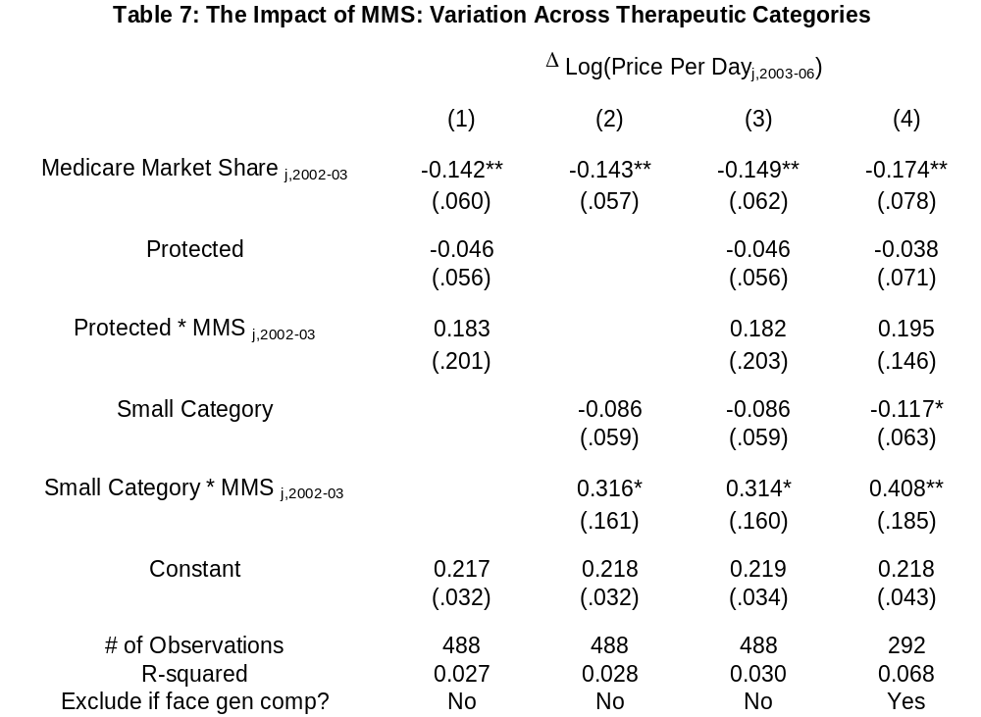
Less Price Reduction in Protected and Small Categories

Slide 32
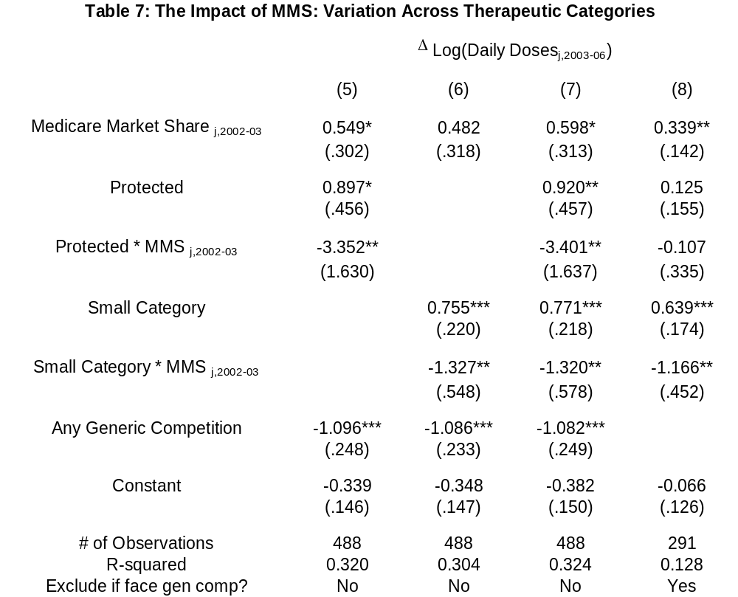
Utilization Shifting Away from “Small” Categories

Slide 33
Summary / Conclusions
Medicare Part D reduced pharmaceutical prices and increased utilization of prescription drugs
  Partially explains why spending much lower than anticipated
  Elasticity estimates of approximately 0.5 after accounting for mechanical effect of insurance
Effects driven by uninsured Medicare recipients
  Imprecise estimates for those shifted from Medicaid
Suggestive evidence of no price decline for protected drugs
Price increase for treatments in “small” categories
  Consistent with plan’s financial incentives
Utilization shifts away from treatments in small categories

Slide 34
Limitations
Aggregate sales and utilization data
Drug-specific Part D enrollment unobserved
Just one year of post-program data
Omitted factors correlated with Medicare market share?
Spillover effects may be present – especially for Medicaid
Behavior of pharmacies and wholesalers not considered
Effect on new drugs, generic use, shifting across categories

Slide 35
Future Research Possibilities
Do effects persist in subsequent years?
Individual-level data on RX utilization
Effects on private (and other public?) insurance coverage
Effects on use of other health care
Effects on health outcomes
Variation in effects with plan market power
Do Medicare recipients optimize plan choices?

