Slide 1
State of Washington
Auditor’s Office
Human Resource
Management Report
Plan & Align Workforce
Hire Workforce
Deploy Workforce
Reinforce Performance
Develop Workforce
October 15, 2007

Slide 2
Managers’ Logic Model for Workforce Management
Auditor’s Office
Outputs
Initial Outcomes
Intermediate Outcomes
Plan & Align Workforce
Articulation of managers HRM accountabilities. HR policies. Workforce planning. Job classes & salaries assigned.
Managers understand HRM accountabilities. Jobs, staffing levels, & competencies aligned with agency priorities.
Foundation is in place to build and sustain a productive, high performing workforce.
Hire
Workforce
Qualified candidate pools, interviews & reference checks. Job offers. Appts & per-
formance monitoring.
Best candidate hired & reviewed during appointment period. Successful performers retained.
The right people are in the right job at the right time.
Ultimate Outcomes
Employees are committed to the work they do & the goals of the organization
Productive, successful employees are retained
State has workforce depth & breadth needed for present and future success
Deploy
Workforce
Work assignments& requirements defined. Positive workplace environment created. Coaching, feedback, corrections.
Workplace is safe, gives capacity to perform, & fosters productive relations. Staff know job rqmts, how they’re doing, & are supported.
Time & talent is used effectively. Employees are motivated & productive.
Develop Workforce
Individual development plans. Time/ resources for training. Continuous learning environment created.
Learning environment created. Employees are engaged in develop-
ment opportunities & seek to learn.
Employees have competencies for present job & career advancement
Agencies are better enabled to successfully carry out their mission. The citizens receive efficient government services.
Reinforce Performance
Clear performance expectations linked to orgn’al goals & measures. Regular performance appraisals. Recognition. Discipline.
Employees know how performance contributes to success of orgn. Strong performance rewarded; poor performance eliminated
Successful perf is differentiated & strengthened. Employees are held accountable.

Slide 3
Standard Performance Measures
Auditor’s Office
Plan & Align Workforce
Percent supervisors with current performance expectations for workforce management
Management profile
Workforce planning measure (TBD)
Percent employees with current position/competencies descriptions
Time-to-fill funded vacancies
Candidate quality
Hiring Balance (Proportion of appointment types)
Separation during review period
Percent employees with current performance expectations
Employee survey ratings on “productive workplace” questions
Overtime usage
Sick leave usage
Non-disciplinary grievances/appeals filed and disposition (outcomes)
Worker safety
Percent employees with current individual development plans
Employee survey ratings on “learning & development” questions
Competency gap analysis (TBD)
Percent employees with current performance evaluations
Employee survey ratings on “performance & accountability” questions
Disciplinary actions and reasons, disciplinary grievances/appeals filed and disposition (outcomes)
Reward and recognition practices (TBD)
Ultimate Outcomes
Hire
Workforce
Employee survey ratings on “commitment” questions
Turnover rates and types
Turnover rate: key occupational categories
Workforce diversity profile
Retention measure (TBD)
Deploy
Workforce
Develop Workforce
Reinforce Performance

Slide 4
Plan & Align Workforce
Outcomes:
Managers understand workforce management accountabilities. Jobs and competencies are defined and aligned with business priorities. Overall foundation is in place to build & sustain a high performing workforce.
Performance Measures:
Percent supervisors with current performance expectations for workforce management
Management profile
Workforce Planning measure (TBD)
Percent employees with current position/ competency descriptions
Auditor’s Office
Workforce Management Expectations
Percent supervisors with current performance expectations for workforce management = 100%
Analysis:
Managers are provided expectations for workforce management as part of the PDP process.
The agency has developed specific written expectations for workforce management.
Action Steps:
HR will monitor supervisor Performance and Development Plan to ensure they consistently contain workforce management expectations
*Based on 101 of 101 reported number of supervisors
Data as of June 30, 2007
Source: Agency Tracked Data

Slide 5
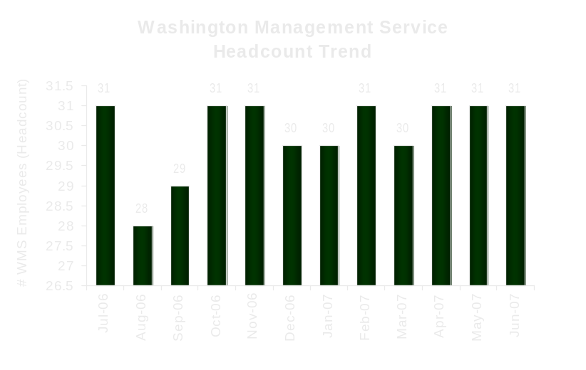
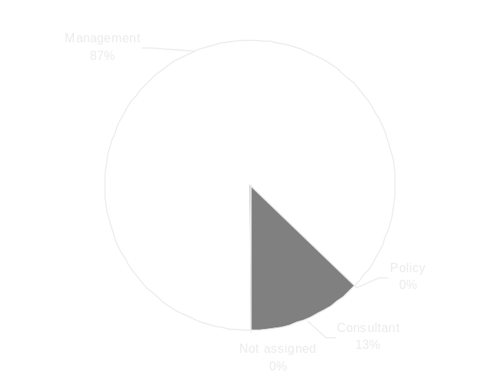
Plan & Align Workforce
Outcomes:
Managers understand workforce management accountabilities. Jobs and competencies are defined and aligned with business priorities. Overall foundation is in place to build & sustain a high performing workforce.
Performance Measures:
Percent supervisors with current performance expectations for workforce management
Management profile
Workforce Planning measure (TBD)
Percent employees with current position/ competency descriptions
Auditor’s Office
Management Profile
WMS Employees Headcount = 31
Percent of agency workforce that is WMS = 7.6%
Managers* Headcount = 28
Percent of agency workforce that is Managers* = 7.1%
* In positions coded as “Manager” (includes EMS, WMS, and GS)
Analysis:
The 7/07 baseline WMS % established by DOP for our agency was 7.6%. This number was calculated using a staff count of 406, which includes 29 summer interns. These are seasonal hires that work an average of 3 months per year. This baseline % also did not take into account two vacant WMS position the agency was currently recruiting for.
Action Steps:
HR will continue to monitor the number of management positions in order to maintain the appropriate ratio
Management 27
Consultant 4
Policy 0
Not Assigned 0
Data as of 6/2007
Source: HRMS BW

Slide 6
Plan & Align Workforce
Outcomes:
Managers understand workforce management accountabilities. Jobs and competencies are defined and aligned with business priorities. Overall foundation is in place to build & sustain a high performing workforce.
Performance Measures:
Percent supervisors with current performance expectations for workforce management
Management profile
Workforce Planning measure (TBD)
Percent employees with current position/ competency descriptions
Auditor’s Office
Current Position/Competency Descriptions
Percent employees with current position/competency descriptions = 97%*
Analysis:
HR has worked with each team on the process of updating their Position Descriptions to the new format, as well as create boilerplate descriptions for Auditor positions that teams can use and update as appropriate to meet their individual needs.
Remaining 3% of position descriptions needing completion are currently in a draft format and pending finalization.
Action Steps:
HR will continue to work with managers to ensure all positions have updated and completed position descriptions including competencies for any new positions or where changes have been made to work duties.
HR will distribute a monthly report to agency directors indicating the status of this project by work group.
*Based on 341 of 352 reported employee count
Applies to employees in permanent positions, both WMS & GS
Data as of June 30, 2007
Source: Agency tracked data

Slide 7
Hire Workforce
Outcomes:
Best candidates are hired and reviewed during appointment period. The right people are in the right job at the right time.
Performance Measures
Time-to-fill vacancies
Candidate quality
Hiring Balance (proportion of appointment types)
Separation during review period
Auditor’s Office
Time-to-fill / Candidate Quality
Time-to-fill Funded Vacancies
Average number of days to fill*: 40.43
Number of vacancies filled: 100
*Equals # of days from creation of the requisition to job offer acceptance
Time Period: July 1, 2006 – June 30, 2007
Analysis:
This average does not include internships or other temporary positions.
SHRM Human Capital Benchmarking Report indicates the median time to fill in 2004 for government positions was 51 days, which as our number indicates we are still below the industry average.
Action Steps:
HR and agency Directors will strongly promote the internship program, in order to increase the number of graduates applying for auditor positions.
HR will continue to monitor the effectiveness of college presentations and interviews to include tracking how many candidates we attract from various presentations.
HR accurately tracks each hiring process from the
time the Request to Fill is received to when the
candidate was offered the position. This ensures
accurate data and allows us to monitor time to fill
and gives us the ability to make adjustments in our
process as necessary.
HR has increased staff time dedicated to college presentations and interviews as an effort to increase the number of graduates interested in Assistant State Auditor positions.
Candidate Quality
The State Auditor’s office developed a candidate quality questionnaire that we began sending out to manager’s upon conclusion of a recruitment effective September 1, 2007.
Measures will be available on April 2008 HR Mgmt Report
Data as of June 30, 2007
Source: Agency tracked data

Slide 8
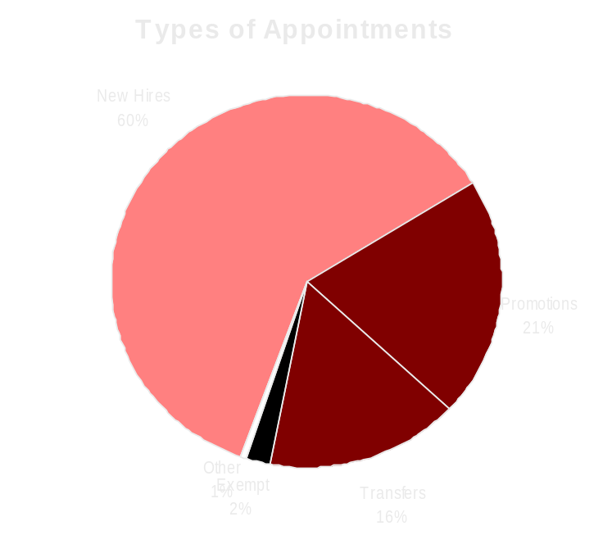
Hire Workforce
Outcomes:
Best candidates are hired and reviewed during appointment period. The right people are in the right job at the right time.
Performance Measures
Time-to-fill vacancies
Candidate quality
Hiring Balance (proportion of appointment types)
Separation during review period
Auditor’s Office
Hiring Balance / Separations During Review Period
Analysis:
The agency uses an exit interview program to gather input from employees leaving the agency
The agency has established detailed expectations and competencies, and a program of regular work product review in order to monitor employees during the probationary period
Action Steps:
HR will develop and provide updated to training to hiring managers regarding the hiring process beginning in November 2007.
HR will continue to provide managers a monthly report of probationary and trial service employees.
HR will continue to work with managers to ensure that employees performance is being properly evaluated during their probationary and trial services periods as well as annually.
Total number of appointments =167*
Time period = July 2006 through June 2007
Includes appointments to permanent vacant positions only; excludes reassignments
“Other” = Demotions, re-employment, reversion & RIF appointments
Separation During Review Period
Probationary separations - Voluntary 13
Probationary separations - Involuntary 1
  Total Probationary Separations 14
Trial Service separations - Voluntary 7
Trial Service separations - Involuntary 0
  Total Trial Service Separations 7
Total Separations During Review Period 21
Time period = July 2006 through June 2007
Data as of 6/2007
Source: HRMS BW

Slide 9
Deploy Workforce
Outcomes:
Staff know job expectations, how they’re doing, & are supported. Workplace is safe, gives capacity to perform, & fosters productive relations. Employee time and talent is used effectively. Employees are motivated.
Performance Measures
Percent employees with current performance expectations
Employee survey ratings on “productive workplace” questions
Overtime usage
Sick leave usage
Non-disciplinary grievances/appeals filed and disposition (outcomes)
Worker safety
Auditor’s Office
Current Performance Expectations
Percent employees with current performance expectations = 92.1%
Analysis:
A large percentage of employees without current written performance expectations are concentrated in a few teams. Several of these teams also experienced management vacancies during this reporting period.
Action Steps:
HR will work directly with the new managers of these teams to provide training on the PDP process and complete PDP Part 1 expectations by January 31, 2008.
HR will continue to distribute a monthly report to agency directors regarding Performance and Development Plan status.
*Based on 328 of 352 reported employee count
Applies to employees in permanent positions, both WMS & GS
Data as of June 30, 2007
Source: Agency Tracked Data

Slide 10
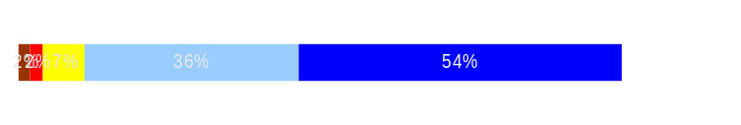
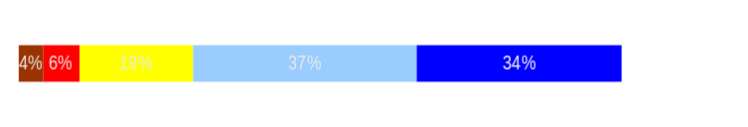
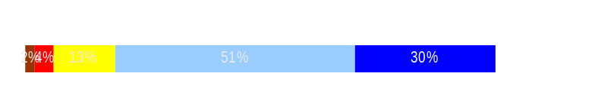
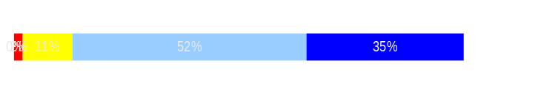
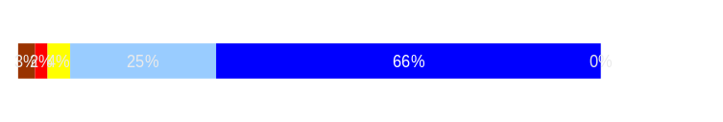
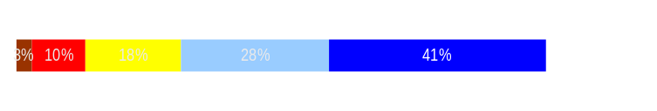
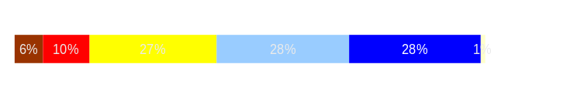
Deploy Workforce
Outcomes:
Staff know job expectations, how they’re doing, & are supported. Workplace is safe, gives capacity to perform, & fosters productive relations. Employee time and talent is used effectively. Employees are motivated.
Performance Measures
Percent employees with current performance expectations
Employee survey ratings on “productive workplace” questions
Overtime usage
Sick leave usage
Non-disciplinary grievances/appeals filed and disposition (outcomes)
Worker safety
Auditor’s Office
Employee Survey “Productive Workplace” Ratings
Avg
Q4. I know what is expected of me at work.
Q1. I have opportunity to give input on decisions affecting my work.
Q2. I receive the information I need to do my job effectively.
Q6. I have the tools and resources I need to do my job effectively.
Q7. My supervisor treats me with dignity and respect.
Q8. My supervisor gives me ongoing feedback that helps me
improve my performance.
Q9. I receive recognition for a job well done.
Analysis:
The agency survey results were higher than statewide averages in every category
Supervisors treat employees with dignity and respect (91%) and I know what is expected of me at work (90%) were the 2 highest rated categories
I receive recognition for a job well done (56%) and my supervisor gives me ongoing feedback that helps me improve my performance (69%) were the 2 lowest rated categories
HR has worked to develop a Recognition website as well as a variety of tools that managers can use to recognize staff
25 SAO Managers attended the Leadership Speaker Series Recognizing and Retaining Employees with Beverly Kaye
Action Steps:
HR will continue to develop recognition tools and ideas to have available to managers as well as educate managers on the importance of recognition for a job well done and the impact it has on staff morale
4.4
3.9
4.0
4.2
4.5
3.9
3.6
Never
Seldom
Occasionally
Usually
Always
Overall average score for Productive Workplace Ratings: 4.1
Data as of 6/2007
Source: 2006 Employee Survey

Slide 11
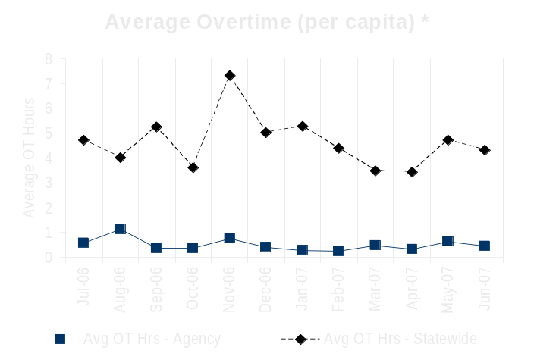
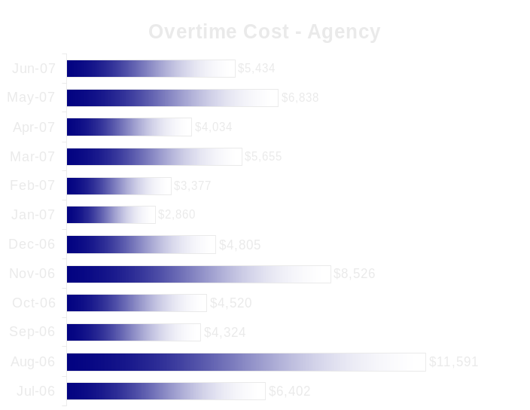
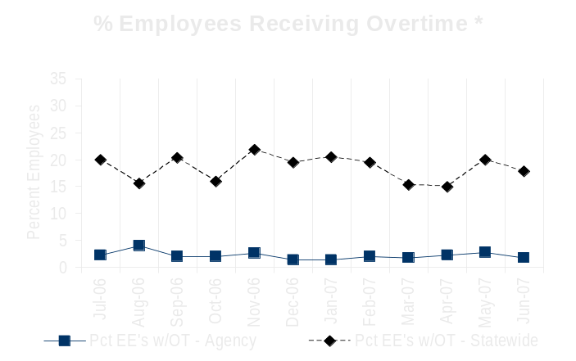
Deploy Workforce
Outcomes:
Staff know job expectations, how they’re doing, & are supported. Workplace is safe, gives capacity to perform, & fosters productive relations. Employee time and talent is used effectively. Employees are motivated.
Performance Measures
Percent employees with current performance expectations
Employee survey ratings on “productive workplace” questions
Overtime usage
Sick leave usage
Non-disciplinary grievances/appeals filed and disposition (outcomes)
Worker safety
Auditor’s Office
Overtime Usage
Overall agency avg overtime usage – per capita, per month: 0.51
*Statewide overtime values do not include DNR
**Overall agency avg overtime usage – per capita, per month = sum of monthly OT averages divided by number of months
[DOUBLE CLICK ON THE CHARTS TO ENTER YOUR AGENCY’S DATA IN THE DATASHEETS]
Analysis:
Agency overtime was minimal
Overtime paid for the time period was mostly due to additional hours spent on HRMS implementation.
Action Steps:
Continue to monitor overtime use
Overall agency avg employees receiving overtime per month: 2.33%
*Statewide overtime values do not include DNR
**Overall agency avg employees receiving overtime per month = sum of monthly OT percentages divided by number of months
Data as of 6/2007
Source: HRMS BW

Slide 12
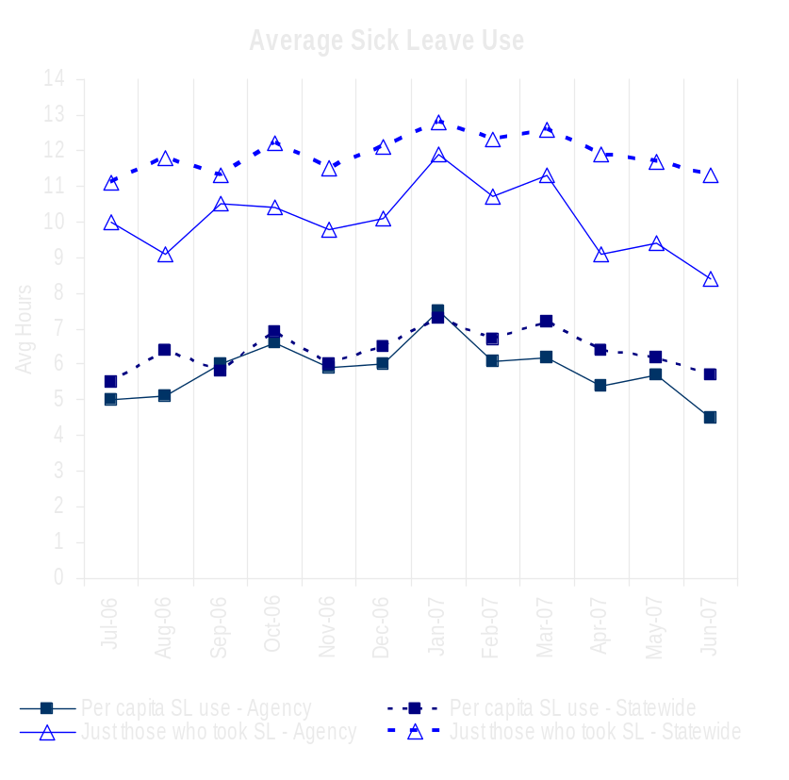
Deploy Workforce
Outcomes:
Staff know job expectations, how they’re doing, & are supported. Workplace is safe, gives capacity to perform, & fosters productive relations. Employee time and talent is used effectively. Employees are motivated.
Performance Measures
Percent employees with current performance expectations
Employee survey ratings on “productive workplace” questions
Overtime usage
Sick leave usage
Non-disciplinary grievances/appeals filed and disposition (outcomes)
Worker safety
Auditor’s Office
Sick Leave Usage
Analysis:
We have revised our leave request form, which now requires employees to accurately reflect the reason for S/L use to enable more detailed reporting.
HR has taken significant steps to enhance the agencies wellness programs, including promoting active participation in the statewide Wellness program.
Action Steps:
Fiscal will continue to provide a monthly sick leave usage report for team managers and Directors
HR will continue to work with the managers of teams with higher than average S/L use to address potential individual issues.
Sick Leave Hrs Used / Earned (per capita)
Avg Hrs SL Used (per capita) - Agency | % of SL Hrs Earned (per capita) - Agency
5.8 Hrs | 75.4%
Avg Hrs SL Used (per capita) – Statewide* | % of SL Hrs Earned (per capita) – Statewide*
6.4 Hrs | 82.5%
Sick Leave Hrs Used / Earned (those who took SL)
Avg Hrs SL Used (those who took SL) - Agency | % SL Hrs Earned (those who took SL) - Agency
8.4 Hrs | 105.5%
Avg Hrs SL Used (those who took SL) – Statewide* | % SL Hrs Earned (those who took SL) – Statewide*
11.9 Hrs | 148.4%
Sick Leave time period = July 2006 through June 2007
* Statewide data does not include DOL, DOR, L&I, and LCB
Source: DOP Sick leave file

Slide 13
Deploy Workforce
Outcomes:
Staff know job expectations, how they’re doing, & are supported. Workplace is safe, gives capacity to perform, & fosters productive relations. Employee time and talent is used effectively. Employees are motivated.
Performance Measures
Percent employees with current performance expectations
Employee survey ratings on “productive workplace” questions
Overtime usage
Sick leave usage
Non-disciplinary grievances/appeals filed and disposition (outcomes)
Worker safety
Auditor’s Office
Non-Disciplinary Grievances (represented employees)
N/A
* There may not be a one-to-one correlation between the number of grievances filed (shown top of page) and the outcomes determined during this time period. The time lag between filing date and when a decision is rendered can cross the time periods indicated.
Data as of June 30, 2007
Source: Agency Tracked Data

Slide 14
Deploy Workforce
Outcomes:
Staff know job expectations, how they’re doing, & are supported. Workplace is safe, gives capacity to perform, & fosters productive relations. Employee time and talent is used effectively. Employees are motivated.
Performance Measures
Percent employees with current performance expectations
Employee survey ratings on “productive workplace” questions
Overtime usage
Sick leave usage
Non-disciplinary grievances/appeals filed and disposition (outcomes)
Worker safety
Auditor’s Office
Non-Disciplinary Appeals (mostly non-represented employees)
Filings for DOP Director’s Review
Time Period = July 2006 through June 2007
0 Job classification
0 Rule violation
0 Name removal from register
0 Rejection of job application
0 Remedial action
0 Total filings
Filings with Personnel Resources Board
Time Period = July 2006 through June 2007
0 Job classification
0 Other exceptions to Director Review
0 Layoff
0 Disability separation
0 Non-disciplinary separation
0 Total filings
Non-Disciplinary appeals only are shown above.
There is no one-to-one correlation between the filings shown above and the outcomes displayed in the charts below. The time lag between filing date and when a decision is rendered can cross the time periods indicated.
Total outcomes = N/A
Time Period = 7/2006 through 6/2007
Total outcomes = N/A
Time Period = 7/2006 through 6/2007
Source: Dept of Personnel

Slide 15
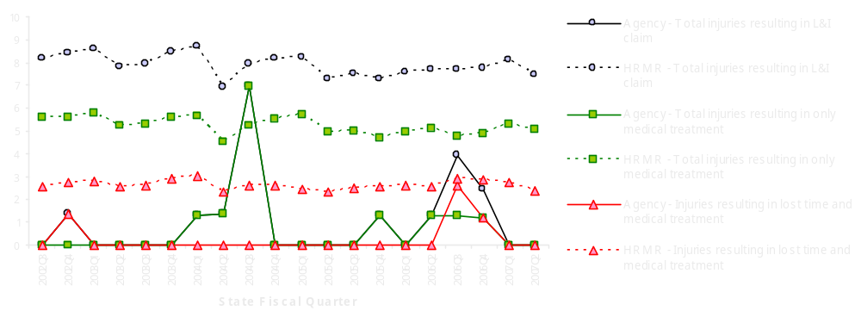
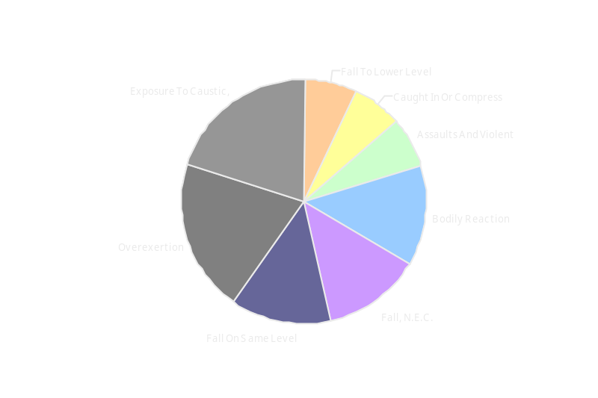
Deploy Workforce
Outcomes
Staff know job expectations, how they’re doing, & are supported. Workplace is safe, gives capacity to perform, & fosters productive relations. Employee time and talent is used effectively. Employees are motivated.
Performance Measures
Percent employees with current performance expectations
Employee survey ratings on 'productive workplace' questions
Overtime usage
Sick leave usage
Non-disciplinary grievances/appeals filed and disposition outcomes
Worker Safety
Auditor’s Office
Worker Safety: Auditor’s Office
Analysis:
HR sends periodic reminders to staff on safety related items.
HR maintains a safety website with useful information pertaining to workplace safety items.
Action Plan:
Continue to take proactive steps to avoid workplace injuries.
HR is in the process of reviewing an on-line defensive driving course to be offered to employees by Jan 31, 2008.
Allowed Annual
Claims Rate*^:
Agency vs. All HR
Management Report
(HRMR) agencies
*Annual claims rate
is # claims / 100 FTE
1 FTE = 2000 hours
^Due to natural lag
in claim filing, rates
are expected to
increase significantly
over time
Injuries by Occupational
Injury and Illness
Classification (OIICS)
event:
For fiscal period 2002Q3
through 2007Q2
(categories under 3% or not
adequately coded are grouped
into 'misc.')
Oiics Code | Oiics Description | Percent | Number
61 | Assaults And Violent | 7% | 1
21 | Bodily Reaction | 13% | 2
03 | Caught In Or Compress | 7% | 1
34 | Exposure To Caustic, | 20% | 3
13 | Fall On Same Level | 13% | 2
11 | Fall To Lower Level | 7% | 1
19 | Fall, N.E.C. | 13% | 2
22 | Overexertion | 20% | 3
Source: Labor & Industries, Research and Data Services (data as of 09/03/2007 )
Notes:
HRMR Safety Report Overview
The HRMR Safety Reports are:
- PowerPoint slides created by the Department of Labor and Industries
- Created for each state agency that is reporting their employee safety program results bi-
annually as part of their Human Resources Management Report (HRMR).
- Snapshots of five years of worker’s compensation claim data specific to that agency, as
well as a comparison to the combined data for agencies completing HRMR reports.
- There is a two quarter lag at the end of the five years.
This allows each agency’s payroll data to be entered into L&I’s computer system. This
payroll data is used to compute the number of workers per agency and quarter.
Definitions
Claim – When a covered worker sustains an occupational injury or illness, that worker files a
'claim’ for benefits. A 'claim number' is assigned, and all wage replacement payments, medical
provider bills, etc, for that worker and injury, are associated with that claim number.
Report Detail
'Allowed Annual Claim Rate'
This chart shows your agency's rate of injuries resulting in allowed
claims, by injury quarter, for on-the-job injuries and occupational illnesses. The rate for all
reporting agencies is shown for comparison.
- The rate is the number accepted claims per 200,000 annual worker hours (100 workers)
Three rates are included in this chart:
A)The total rate for all injuries resulting in a claim; the two groups listed below are
exclusive of each other.
B)The rate of injuries which required medical care, but no compensation for lost
time.
C)The rate of injuries which resulted in compensation for lost time in addition to
medical care.
'Injuries by Occupational Injury and Illness Classification (OIICS) Event’
This section contains a pie chart which shows your agency's injuries by type* and a table which
shows the percent and number of accepted claims by OIICS Event description and code.
This information is useful in identifying what causes injuries so prevention can occur. Prevention
might include root cause analysis, education, and hazard mitigation.
* Injury Type is based on the 2 digit Major Group code of the Event or Exposure section of the Occupational
Injury and Illness Classification System (OIICS). Groups with less than 3% of the
total injuries are combined into the 'Misc' category.
How to get this report for your agency:
All worker compensation reports will be available on the L&I website by the 20th of September or
the 20th of March of each year. The data will be provided in a PowerPoint slide to which you will
add your own analyses and action plans.

Slide 16
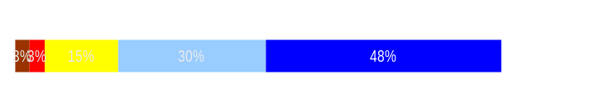
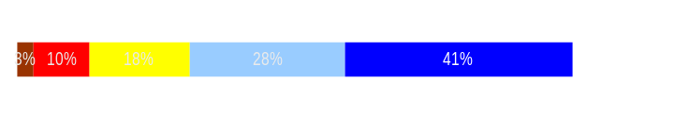
Develop Workforce
Outcomes:
A learning environment is created. Employees are engaged in professional development and seek to learn. Employees have competencies needed for present job and future advancement.
Performance Measures
Percent employees with current individual development plans
Employee survey ratings on “learning & development” questions
Competency gap analysis (TBD)
Auditor’s Office
Individual Development Plans
Percent employees with current individual development plans = 77.3 %*
Analysis:
The agency survey results were higher than statewide averages in each category.
83 employees currently in an Auditor in-training program with the agency.
Higher than normal vacancies in management positions have caused our percentage of completed plans to decrease.
Action Steps:
HR will continue to provide a monthly report to agency directors indicating Performance and Development plan status.
HR will provide training to new managers on the PDP process and assist with getting all plans up to date.
*Based on 272 of 352 reported employee count
Applies to employees in permanent positions, both WMS & GS
Employee Survey “Learning & Development” Ratings
Q5. I have opportunities at work to learn and grow.
Q8. My supervisor gives me ongoing feedback that helps me
improve my performance.
Avg
4.2
3.9
Overall avg score for Learning & Development Ratings: 4.1
Data as of June 30, 2007
Source: 2006 Employee Survey and Agency tracked data

Slide 17
Reinforce Performance
Outcomes:
Employees know how their performance contributes to the goals of the organization. Strong performance is rewarded; poor performance is eliminated. Successful performance is differentiated and strengthened. Employees are held accountable.
Performance Measures
Percent employees with current performance evaluations
Employee survey ratings on “performance and accountability” questions
Disciplinary actions and reasons, disciplinary grievances/appeals filed and disposition (outcomes)
Reward and recognition practices (TBD)
Auditor’s Office
Current Performance Evaluations
Percent employees with current performance evaluations = 74.7%*
Analysis:
100% of performance evaluations will be current in July 2005, but has not been able to maintain that percentage.
We have had an significant number of turnover in our manager positions this reporting period which has resulted in a lower than expected number of employee evaluations being completed.
Agency directors have communicated their expectation that performance evaluations be completed on time.
Action Steps:
HR will continue to distribute a monthly report to agency directors indicating Performance and Development plan status.
HR will provide PDP training to managers at
agency led supervision training beginning in
November 2007.
HR will continue to provide assistance to
managers of teams with a low percentage of
evaluations completed.
*Based on 263 of 352 reported employee count
Applies to employees in permanent positions, both WMS & GS
Data as of June 30, 2007
Source: Agency Tracked Data

Slide 18
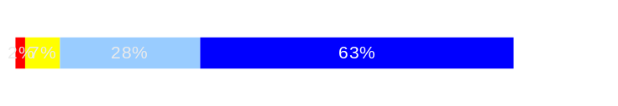
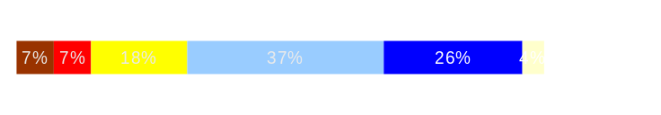
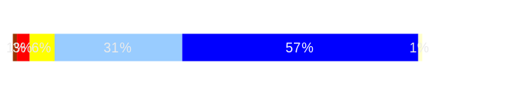
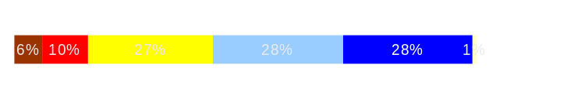
Reinforce Performance
Outcomes:
Employees know how their performance contributes to the goals of the organization. Strong performance is rewarded; poor performance is eliminated. Successful performance is differentiated and strengthened. Employees are held accountable.
Performance Measures
Percent employees with current performance evaluations
Employee survey ratings on “performance and accountability” questions
Disciplinary actions and reasons, disciplinary grievances/appeals filed and disposition (outcomes)
Reward and recognition practices (TBD)
Auditor’s Office
Employee Survey “Performance & Accountability” Ratings
Avg
Q3. I know how my work contributes to the goals of my agency.
Q10. My performance evaluation provides me with meaningful information about my performance.
Q11. My supervisor holds me and my co-workers accountable for performance.
Q9. I receive recognition for a job well done.
Analysis:
The agency wide results were higher than statewide averages in every category
91% of employees indicated that they know how their work contributes to the goals of the agency.
56% of employees indicated that they receive recognition for a job well done, making this the lowest rate category.
HR has developed a variety of tools for managers to use to recognize employees.
Action Steps:
HR will continue to provide managers with tools and resources to effectively recognize employees
Recognition ideas will be incorporated into agency leadership training at annual conference in Oct 2007 as well as agency supervision training beginning in November 2007.
4.5
3.7
4.4
3.6
Never
Seldom
Occasionally
Usually
Always
Overall average score for “Performance & Accountability” ratings: 4.1
Data as of 6/2007
Source: 2006 Employee Survey

Slide 19
Reinforce Performance
Outcomes:
Employees know how their performance contributes to the goals of the organization. Strong performance is rewarded; poor performance is eliminated. Successful performance is differentiated and strengthened. Employees are held accountable.
Performance Measures
Percent employees with current performance evaluations
Employee survey ratings on “performance and accountability” questions
Disciplinary actions and reasons, disciplinary grievances/appeals filed and disposition (outcomes)
Reward and recognition practices (TBD)
Auditor’s Office
Formal Disciplinary Actions
Disciplinary Action Taken
Time period = July 2006 through June 2007
Analysis:
N/A
Action Steps:
N/A
Dismissals | 0
Demotions | 0
Suspensions | 0
Reduction in Pay* | 0
Total Disciplinary Actions* | 0
* Reduction in Pay is not currently available in HRMS/BW.
Issues Leading to Disciplinary Action
N/A
Data as of 6/2007
DateSource: HRMS BW

Slide 20
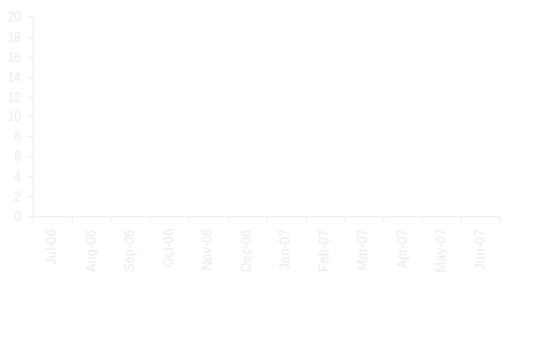
Reinforce Performance
Outcomes:
Employees know how their performance contributes to the goals of the organization. Strong performance is rewarded; poor performance is eliminated. Successful performance is differentiated and strengthened. Employees are held accountable.
Performance Measures
Percent employees with current performance evaluations
Employee survey ratings on “performance and accountability” questions
Disciplinary actions and reasons, disciplinary grievances/appeals filed and disposition (outcomes)
Reward and recognition practices (TBD)
Auditor’s Office
Disciplinary Grievances and Appeals
Disciplinary Grievances
(Represented Employees)
Disciplinary Appeals
(Non-Represented Employees
filed with Personnel Resources Board)
Time Period = 7/2006 through 6/2007
0 Dismissal
0 Demotion
0 Suspension
0 Reduction in salary
0 Total Disciplinary Appeals Filed with PRB
Total # Disciplinary Grievances Filed: N/A
There is no one-to-one correlation between the filings shown above and the outcomes displayed in the charts below. The time lag between filing date and when a decision is rendered can cross the time periods indicated.
Disposition (Outcomes) of Disciplinary Grievances
Time period = 7/2006 through 6/2007
Disposition (Outcomes) of Disciplinary Appeals*
Time period = 7/2006 through 6/2007
N/A
*Outcomes issued by Personnel Resources Board
Data as of 6/2007
Source: Agency Tracked Data

Slide 21
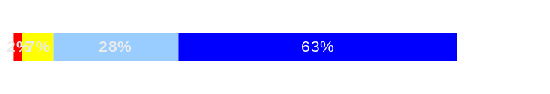
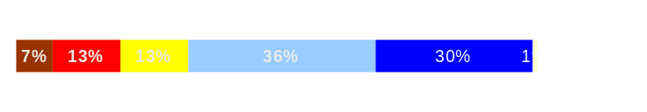
ULTIMATE OUTCOMES
Employees are committed to the work they do and the goals of the organization
Successful, productive employees are retained
The state has the workforce breadth and depth needed for present and future success
Performance Measures
Employee survey ratings on “commitment” questions
Turnover rates and types
Turnover rate: key occupational categories
Workforce diversity profile
Retention measure (TBD)
Auditor’s Office
Employee Survey “Employee Commitment” Ratings
Avg
Analysis:
See Analysis and Action Steps on Slide 17
Action Steps:
The agency Strategic Plan is currently being updated and will be shared with employees to communicate agency measures for success.
Q3. I know how my work contributes to the goals of my agency.
Q12. I know how my agency measures its success.
Q9. I receive recognition for a job well done.
4.5
3.7
3.6
Never
Seldom
Occasionally
Usually
Always
Overall average score for Employee Commitment ratings: 3.9
Data as of 6/2007
Source: 2006 Employee Survey

Slide 22
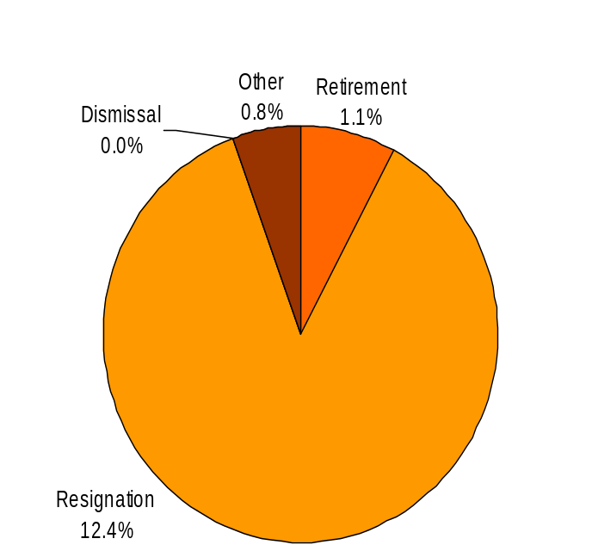
ULTIMATE OUTCOMES
Employees are committed to the work they do and the goals of the organization
Successful, productive employees are retained
The state has the workforce breadth and depth needed for present and future success
Performance Measures
Employee survey ratings on “commitment” questions
Turnover rates and types
Turnover rate: key occupational categories
Workforce diversity profile
Retention measure (TBD)
Auditor’s Office
Turnover Rates
Total % Turnover (leaving state)
Time Period: July 2006 through June 2007
Analysis:
78% of turnover was for auditor positions
AICPA Recruiting/Retention study indicates top reasons accounting professionals stay with their employer: (1) Respect for mission statement (2) career growth opportunities (3) salary (4) accessible management style (5) interesting/challenging work (6) flexible work schedule
The agency regularly conducts exit interviews with feedback given to the Directors and Chief of Staff.
HR has developed a variety of recognition tools that have been provided to managers to utilize.
Action Steps:
Additional career tracks in areas such as performance auditing will continue to be offered to staff in 2007/08
HR will continue to collect data related to turnover reasons through the exit interview program and provide feedback to the Directors and Chief of Staff.
Total Turnover Actions: 50 Total % Turnover: 14.3%
Note: Movement to another agency is currently not available in HRMS/BW
Data as of June 30, 2007
Source: HRMS BW

Slide 23
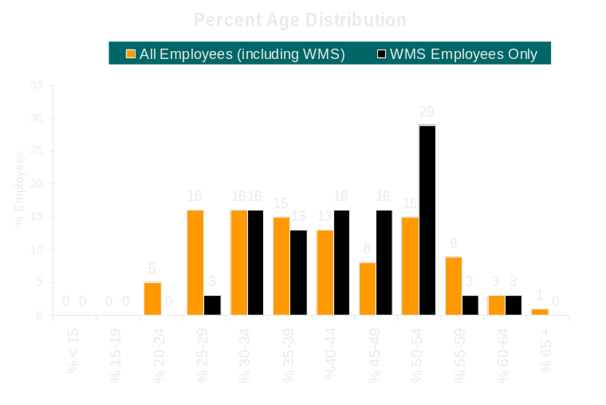
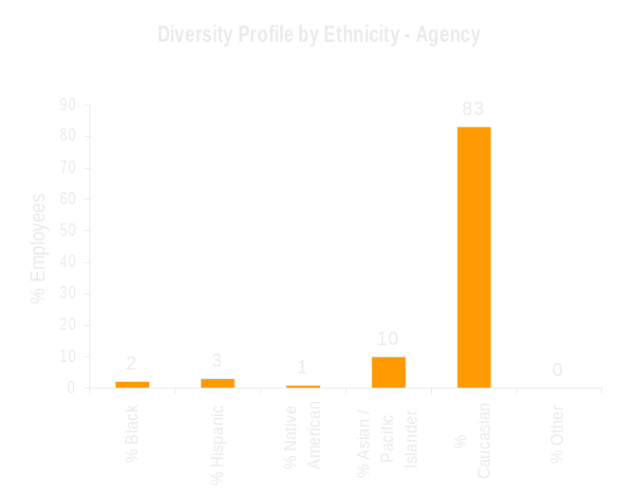
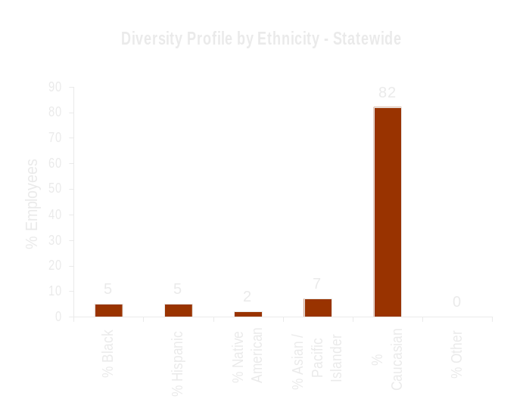
ULTIMATE OUTCOMES
Employees are committed to the work they do and the goals of the organization
Successful, productive employees are retained
The state has the workforce breadth and depth needed for present and future success
Performance Measures
Employee survey ratings on “commitment” questions
Turnover rates and types
Turnover rate: key occupational categories
Workforce diversity profile
Retention measure (TBD)
Auditor’s Office
Workforce Diversity Profile
Agency State
Female 60% 53%
Disabled 4% 5%
Vietnam Vet 3% 7%
Disabled Vet 2% 2%
People of color 17% 18%
Persons over 40 48% 75%
Analysis:
The agency has actively participated in the UW Minority Career Fairs from 2004 to current.
Agency HR staff met with DOP to discuss diversity recruitment to gain ideas and brainstorm methods for recruiting a diverse pool of candidates.
Agency Affirmative Action Plan was completed in June 2007.
Action Steps:
SAO is meeting with DOP staff to implement new GAAPCom recommendations.
Data as of 6/2007
Source: HRMS BW

