Slide 1
Joint CEC/CPUC Proceeding on Advanced Meters, Dynamic Pricing, and Demand Response in California
Utility Energy Forum
Granlibakken May 9, 2003
Arthur H. Rosenfeld, Commissioner
California Energy Commission
916 654 4930
Arosenfe@Energy.State.CA.US
www.Energy.CA.gov
www.utilityforum.com

Slide 2
Starting 2001, during the California Electricity Crisis
California Legislature authorized $ 32 million for 15-minute interval meters
23,000 meters for customers with loads >200kW, (if a building, floor area > ~40,000 sq.ft. )
5,000 customers >500 kW already on Time-of-Use (TOU) rates
so 18,000 new customers, many new to TOU
now cover 1/3 of California’s peak load

Slide 3
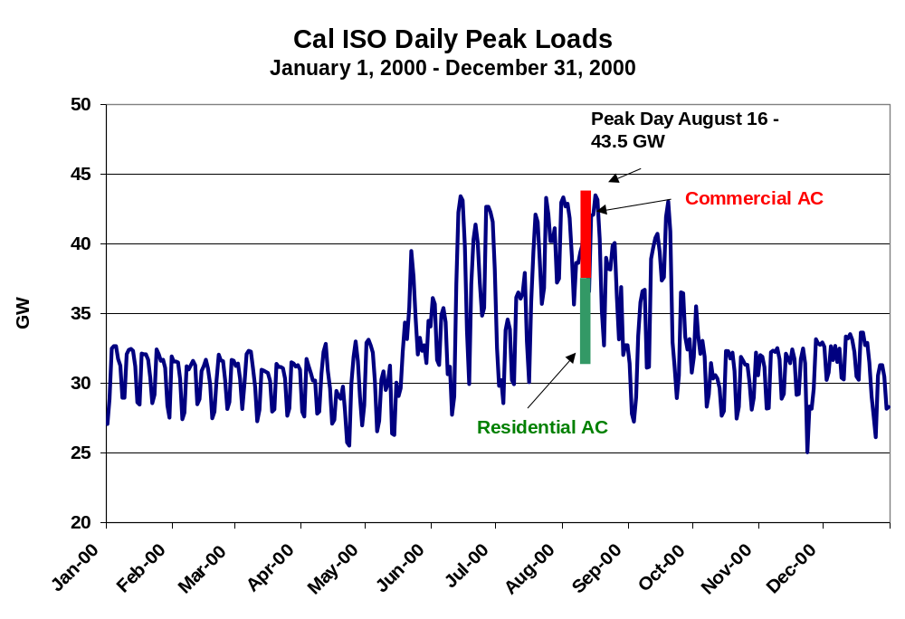

Slide 4
Top Ten California Peak Energy Uses/Sectors
(assumes a 50,000 MW peak)
8,000
15%
14%
7,000
6,000
11%
11%
5,000
Megawatts
4,000
7%
6%
3,000
4%
4%
4%
4%
2,000
1,000
0
Com AC
Res AC
Com Light
Com Misc
Res Misc
TCU Buildings
Res Refrigerator
Assembly Industry
Process Industry
Ag & Water Pumping
End-Use/Sector

Slide 6
ISO Actual Loads -- Three Summers
Highest 50 Hours of Load in Each Summer
46,000
summer 1999
45,000
summer 2000
1999
summer 2001
44,000
summer 2000 if no
curtailments (estimated)
43,000
2000
mw
42,000
41,000
40,000
2001
39,000
38,000
1
3
5
7
9
11
13
15
17
19
21
23
25
27
29
31
33
35
37
39
41
43
45
47
49

Slide 7
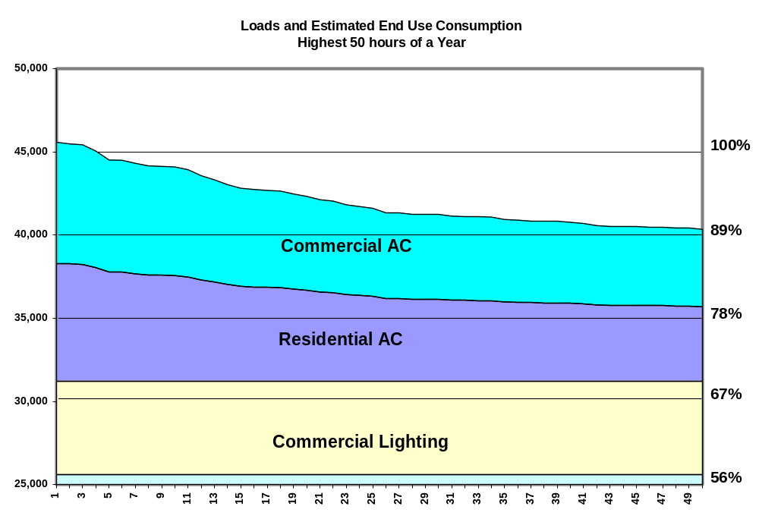
1999 ISO Loads

Slide 8
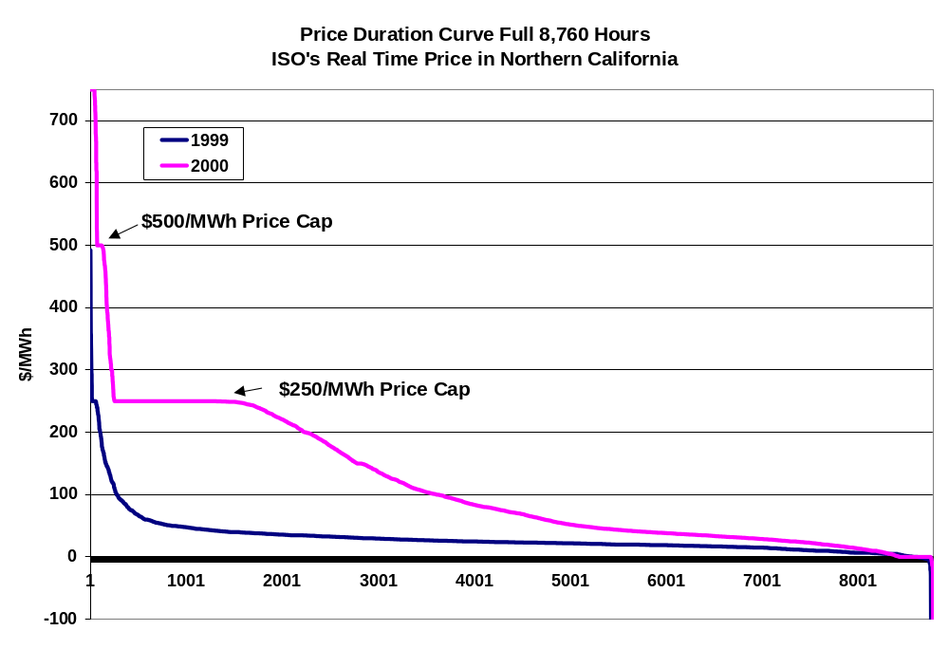

Slide 9
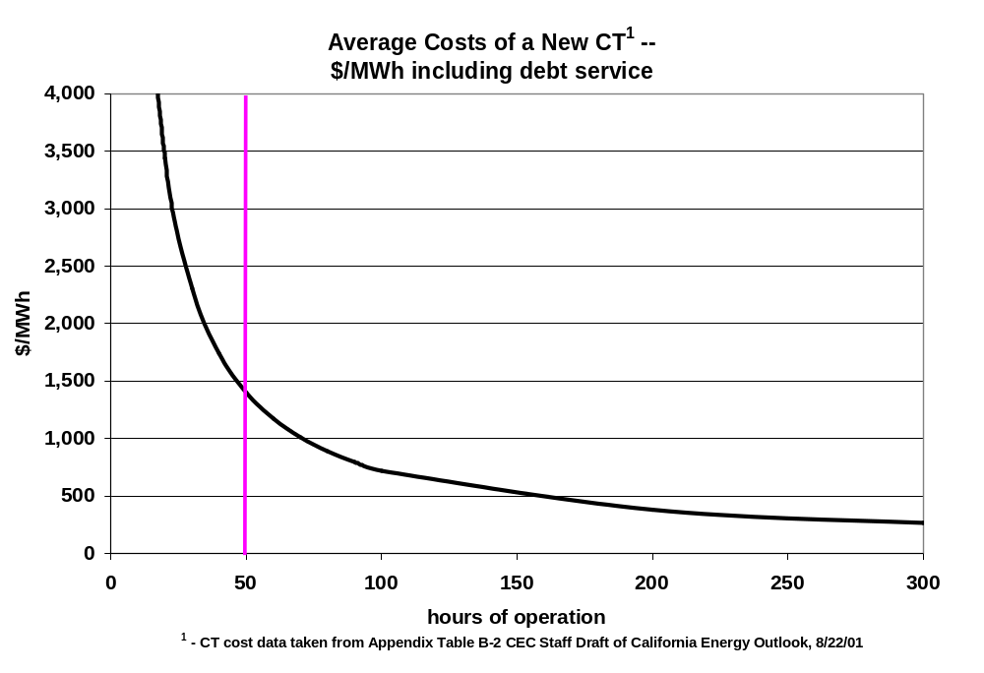

Slide 10
Measured Hourly Average A/C Loads - at SMUD Office
Bldg
.
Curtailment =
Setpoint
+ 4
Degress
(1 to 5 PM) + Dimmed Lights
4
Baseline
3.5
3
2.5
IMPACTS / 1000
sf
:
Avg
. kW (1-5PM) = 1.0,
Load (kW/1000 Square)
Curtailment
= 30% of Baseline a-c
2
1.5
1
0.5
0
9
10
11
12
13
14
15
16
17
18
19
20
21
22
23
24
Hour
Source: Ed
Hamzawi
, SMUD, Oct. 20, 2000

Slide 11
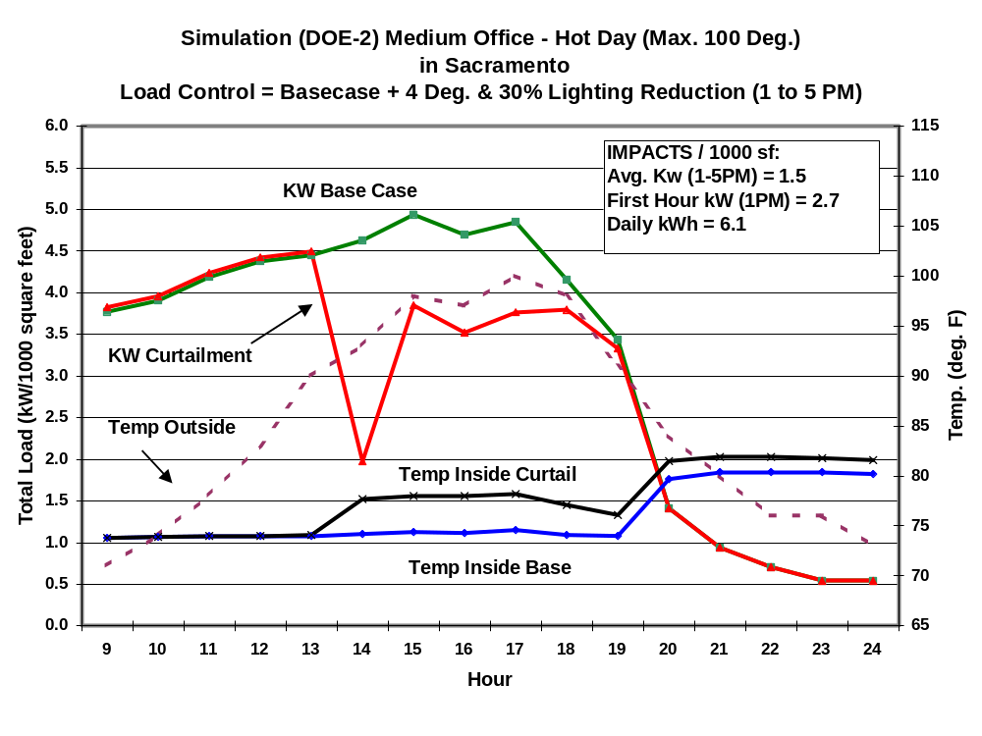

Slide 12
CEC Experience with Peak Load Reduction
In 2000 and 2001, the California legislature allocated to the Energy Commission funds for peak load reduction programs
The Energy Commission offered grants, loans and rebates. Specifically, $ 21 million for “enhanced automation”
Due to problems with electricity supply in California during 2000 and 2001, these programs were designed and implemented in a very fast manner before any dynamic tariffs were provided (e.g. CPP, RTP)
The next two slides provide a summary of program results during 2001

Slide 13
CEC Contracts for Peak Reduction Summer 2001
% Load Curtailed
All 1,800 Projects
Specific Case Histories
Macanan Investments
Doubletree Hotel
Hewlett-Packard
Foothill College
Staples
0%
5%
10%
15%
20%
25%

Slide 14
CEC Contracts for Peak Reduction Summer 2001
Cost per kW curtailed
All 1,800 Projects
Specific Case Histories
Macanan Investments
Doubletree Hotel
Hewlett-Packard
Foothill College
Staples
$0
$200
$400
$600
$800
$1,000
$1,200

Slide 15
TOU Pricing vs. Dynamic Pricing (CPP & RTP)
Time-of-Use (TOU) is typically 3 time blocks published in advance for entire season
  Peak, Shoulder, Off-Peak
  Cannot address unforeseen weather or equipment failures
Critical Peak Pricing (CPP) is a high price imposed on a few days a year when energy is expensive or system conditions are critical or near critical
  Non-CPP hours are less expensive as a result
  Customer pays the critical price when invoked by the utility
    day-ahead forecast of CPP offers added time for response
Real-Time Pricing (RTP) is the hourly marginal cost of a kWh
  Reflects hot weather, scarcity, or equipment failure
    day-ahead forecast of RTP offers added time for response

Slide 16
CEC/CPUC Vision: Dynamic Prices & Choice
Always TOU or Better if digital meters available and if economic
“CPP” is an extension of TOU
Residential and Small Commercial
  Default = CPP
  Hedge = TOU
Intermediate Size Customers (perhaps 200 kw to 1 MW)
  Default = CPP
  Hedge = TOU
  Option = RTP (voluntary)
Large (perhaps > 1 MW)
  Default = RTP
  Hedges to CPP or perhaps TOU
Goal of an additional 1% of Load Response per year

Slide 17
Gulf Power GoodCents Select Tariff
2000 homes in Pensacola FL
Reduces need during critical or near critical periods (emergencies -- present or expected --, very high prices)
  Summer Peak Load Reductions of 2.1 kW per house (1st hour)
  Winter Peak Load Reduction of 2.7 kW per house (1st hour)
4-hour reduction roughly 1 kW
96% Customer Satisfaction Rating
  Cost savings, greater control and better information
Improves competitive position of Gulf Power in wholesale markets

Slide 18
Critical Peak Pricing (CPP) e.g. Gulf Power residential GoodCents Select tariff with a limit of 87 hours per year of CPP prices
35
Standard TOU
30
Critical Peak Price
Standard Rate
25
20
Price (cents/kWh)
15
10
5
0
Sunday Monday Tuesday Wednesday Thursday Friday Saturday

Slide 19
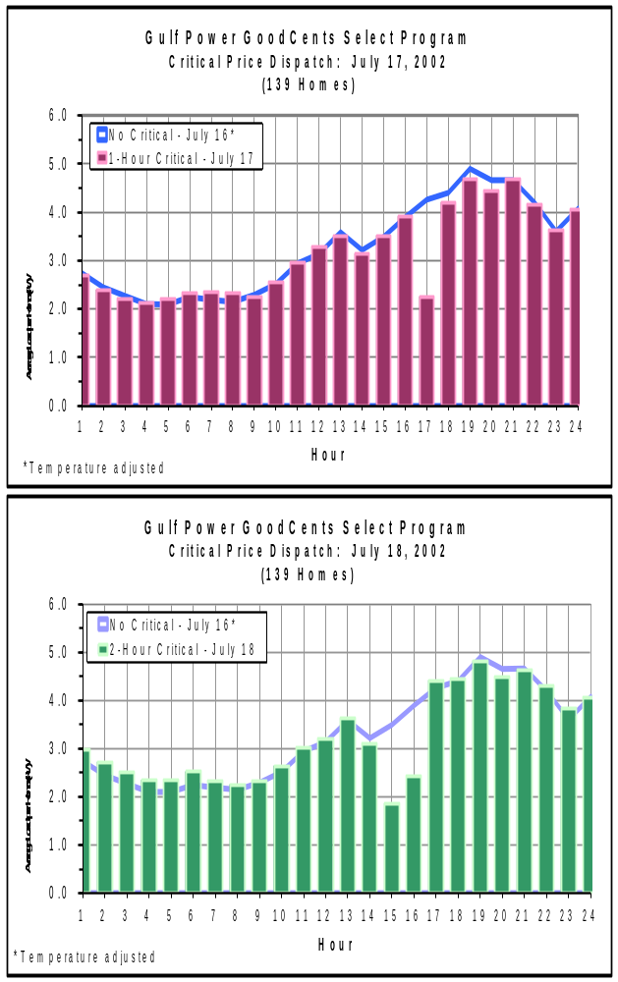
Gulf Power
Residential
July 2002

Slide 20
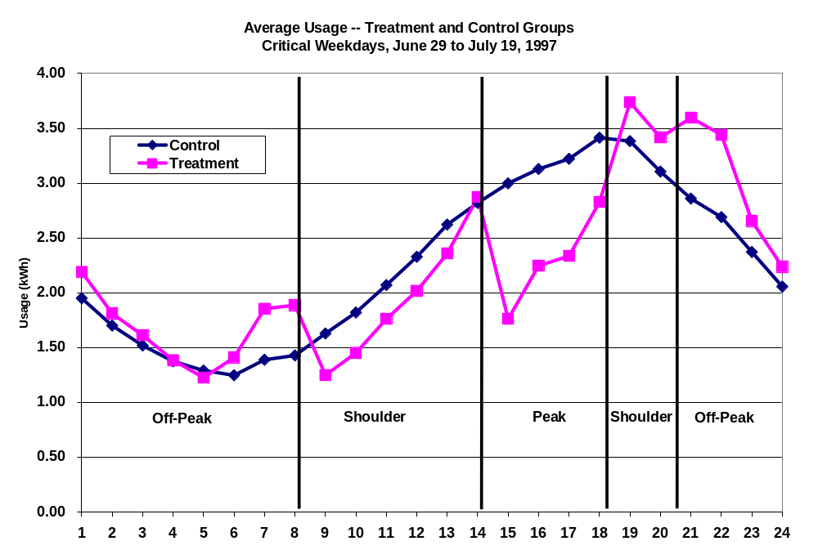
Residential Critical Peak Pricing Results
Source: Chris King, eMeter

Slide 21
Georgia Power’s Voluntary 2-part RTP Program
Customer bill = Part 1 + Part 2
  Part 1 based on historical load profile (customer baseline load -- CBL). CBL is a list of hourly loads for entire year
  Part 2 based on price responsive departures from load profile
Part 1 is the CBL x TOU tariff
  What you expect to pay if you don’t respond to real-time price
Part 2 is the hourly departures from CBL
  Enables customer to buy additional kWh when prices are low
  And sell back kWh when prices are high
Saves 17% of participant’s load at ~$1/kWh on hot afternoons

Slide 22
Example of Incremental Energy
Charges (Relative to Baseline)
Customer
“sells”
load at
high
RTP prices
MWh
CBL
Customer
“buys”
load at
low
Actual
RTP prices
load
1
Hour of Day
24

Slide 23
Real Time Pricing
at Georgia Power
❑
1,650 commercial and industrial
customers, totaling 5,000 MW
❑
Two-part, day-ahead and hour-ahead
hourly pricing
❑
High customer satisfaction; low
turnover
❑
Up to 1,000 MW of load response
during critical high-price conditions
❑
Related risk management products called Price Protection Policies

Slide 24
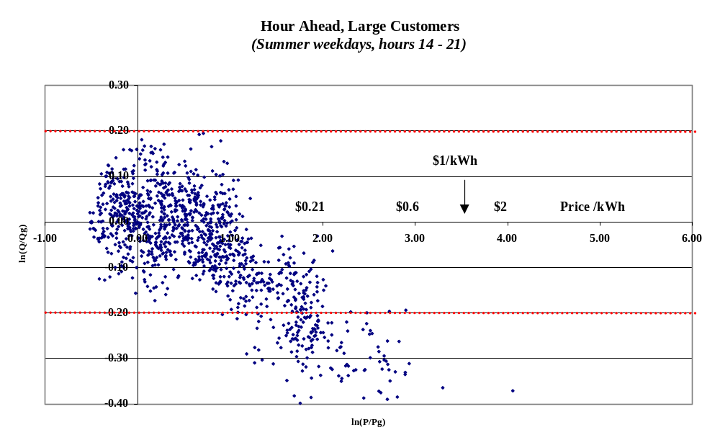
Source: Steve Braithwait, Christensen and Associates

Slide 25
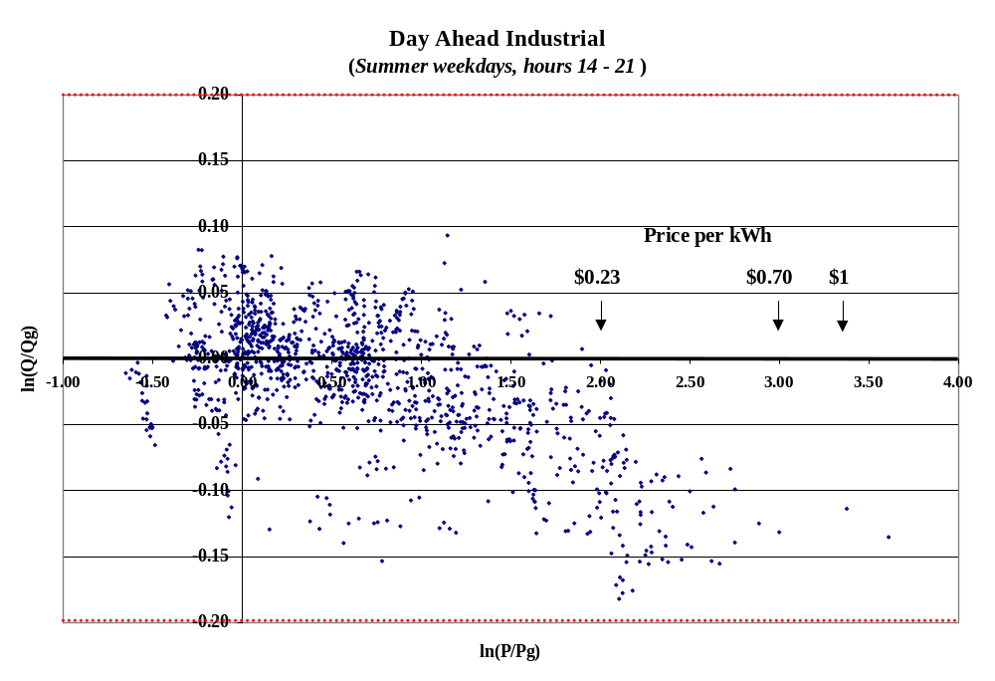
Source: Steve Braithwait, Christensen and Associates

Slide 26
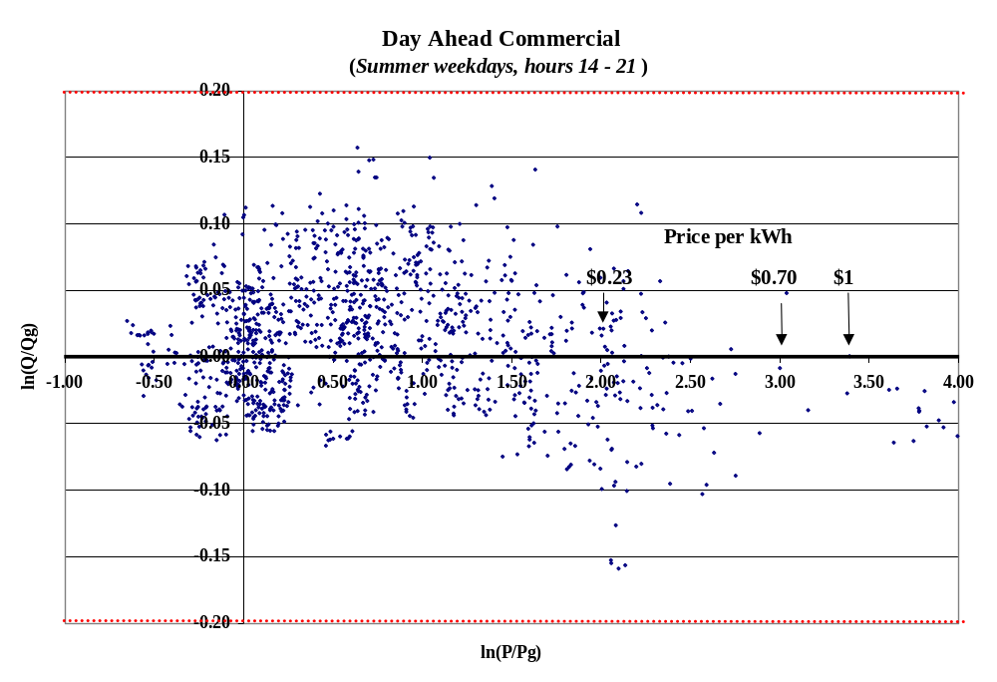
Source: Steve Braithwait, Christensen and Associates

Slide 27
California’s Energy Agencies Promote Demand Response to Retail Price
Beginning in the Summer of 2002, the Energy Commission, Public Utilities Commission, and the Power Authority began a joint proceeding to promote demand response to retail prices and tariffs
Divided into three parts:
  Working Group 1: Policy Issues
  Working Group 2: Large Customers
  Working Group 3: Small Customers
Decisions regarding how to proceed are being made
  Initially, regarding tariffs for large customers and experimental design to assess response to price from small customers

Slide 28
Working Group 2: Large Customers (>200 kW)
Coordinator, Mike Jaske (mjaske@energy.state.ca.us)
Original goal was a “quick win” to take advantage of the interval meters already in place through tariffs or programs for Summer 2003
Products will include: dynamic tariffs (this summer, 2003), demand bidding tariffs (also this summer), and a group is formulating a two-part RTP (Real Time Price) tariff.
A CEC objective was to include commercial buildings since these were the ones where the customers getting advanced metering systems.
The initial utility proposals discriminated against “peaky” commercial buildings, so WG2 modified its approach and developed CPP tariff proposals.

Slide 29
Joint Utility CPP Tariff Applied to PG&E Summer A 10
$1.40
Prices on CPP Days
$1.20
$1.00
$0.80
$/KWh
$0.60
$0.40
TOU Prices
$0.20
Prices on non-CPP days
$0.00
0:00
1:00
2:00
3:00
4:00
5:00
6:00
7:00
8:00
9:00
10:00
11:00
12:00
13:00
14:00
15:00
16:00
17:00
18:00
19:00
20:00
21:00
22:00
23:00
hour of day

Slide 30
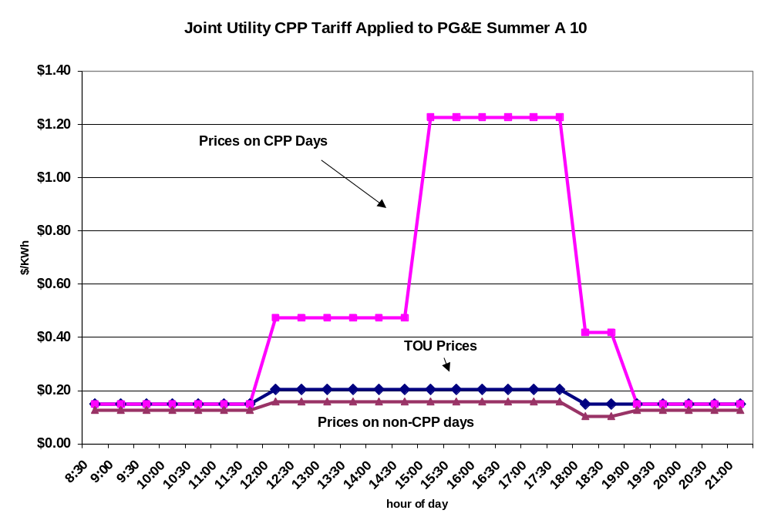

Slide 31
Working Group 3: Small Customers
Coordinator: Mike Messenger (mmesseng@energy.state.ca.us)
Scope
  All three IOU service territories in California
  Residential, small commercial & industrial <200kW
Goals
  Identify information needed to decide whether deployment of advanced meters is cost-effective
    for all or some subset(s) of small customers
  Collect existing and new data needed to allow educated decisions on meter and tariff policy by early 2004

Slide 32
Working Group 3: Small Customers
Statewide Pricing Pilot
Sample
  2,060 participants (after 20% opt-out)
    1,520 residential; 540 commercial
Treatments
  TOU & CPP rates; information & technology types
Objectives
  Short-term price elasticities
  Customer acceptance and preferences
Cost: ~ $10 million

Slide 33
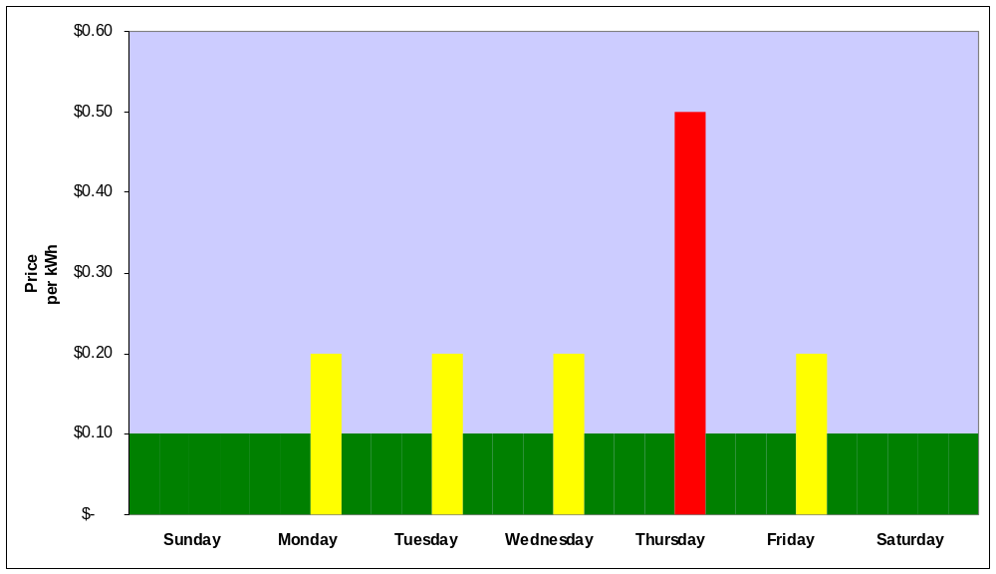
Critical Peak Pricing - Residential
Critical Peak (2pm-7pm)
Critical Peak Notification to Customer (by 5 p.m.)
Peak (2pm-7pm)
Off-Peak

Slide 34
Concluding Remarks
Price responsive demand will enhance the competitiveness of electricity markets
A direct link between wholesale and retails markets is essential
However, other types of electrical system emergencies may require instantaneous load response
California had a separate proceeding dealing with interruptible load programs
We plan to merge price-sensitive demand response and interruptible programs
  For example, one approach could involve a curtailment signal that a customer would not have the option to over ride.
  The next graph illustrates how this might work

Slide 35
Critical Peak Pricing (CPP) with additional curtailment option
40
?
Standard TOU
35
Critical Peak Price
Price Signal
Standard Rate
30
Extraordinary Curtailment Signal
25
Price (cents/kWh)
20
15
10
5
0
Sunday Monday Tuesday Wednesday Thursday Friday Saturday

Slide 36
For more details see
PUC R.02-06-001
  http://www.cpuc.ca.gov/static/industry/electric/demand/index.htm
CEC 02-Demand Response-01
  http://www.energy.ca.gov/demandresponse/documents/index.html
Dynamic Pricing, Advanced Metering and Demand Response in Electricity Markets
  The Hewlett Foundation Energy Series Foundation monograph by Severin Borenstein, Mike Jaske and Art Rosenfeld, September 2002
  http://www.energy.ca.gov/commission/commissioners/rosenfeld. html, http://www.ef.org/energyseries_dynamic.cfm
How and Why Customers Respond to Electricity Price Variability: A Study of NYISO and NYSERDA 2002 PRL Program Performance
  Neenan, B., et.al., January 2003 http://certs.lbl.gov/PDF/NYISO.pdf

