Slide 1
List of figure titles
Treatment with insulin or oral medication among adults with diagnosed diabetes, United States, 2004–2006
Estimated prevalence of diagnosed and undiagnosed diabetes in people aged 20 years or older, by age group, United States, 2007
Estimated number of new cases of diagnosed diabetes in people aged 20 years or older, by age group, United States, 2007
Rate of new cases of type 1 and type 2 diabetes among youth aged < 20 years, by race/ethnicity, 2002–2003

Slide 2
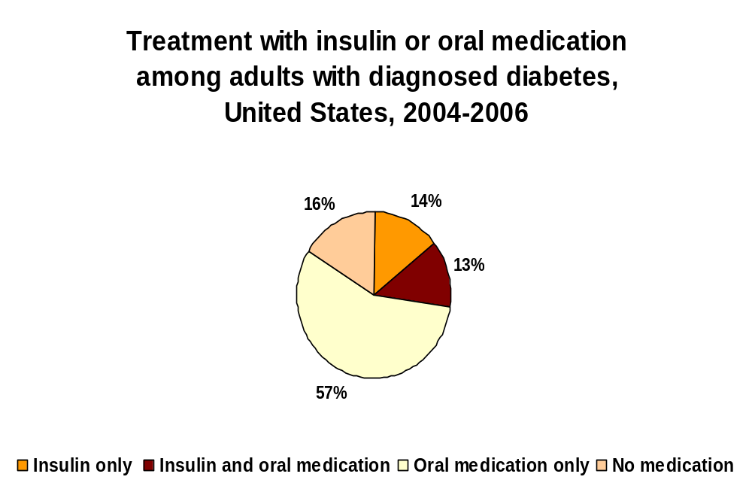
CDC. National Diabetes Fact Sheet, 2007.
Source: 2004–2006 National Health Interview Survey

Slide 3
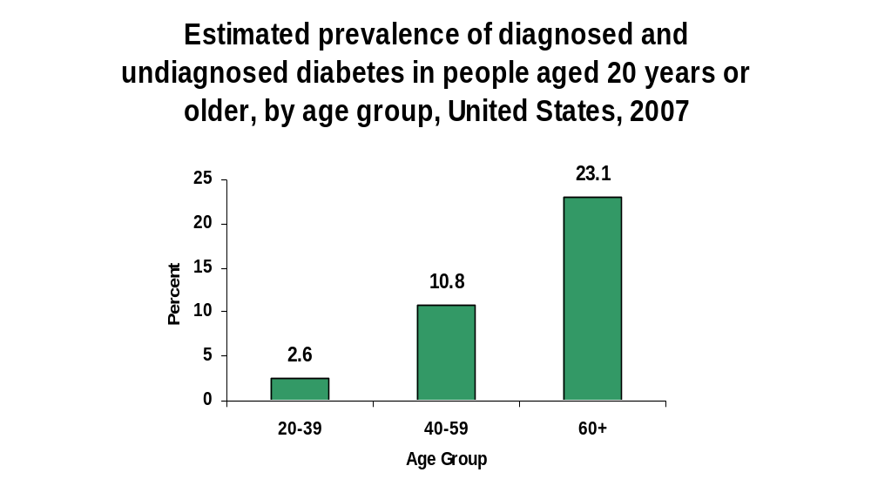
CDC. National Diabetes Fact Sheet, 2007.
Source: 2003–2006 National Health and Nutrition Examination Survey estimates
of total prevalence (both diagnosed and undiagnosed) were projected to year 2007.

Slide 4
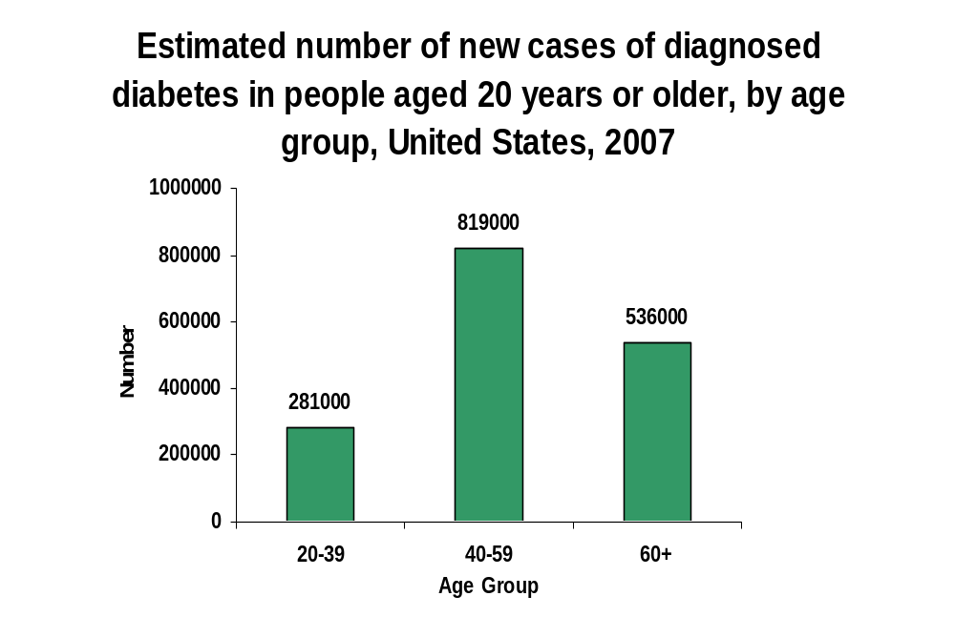
CDC. National Diabetes Fact Sheet, 2007.
Source: 2004–2006 National Health Interview Survey estimates projected to year 2007.

Slide 5
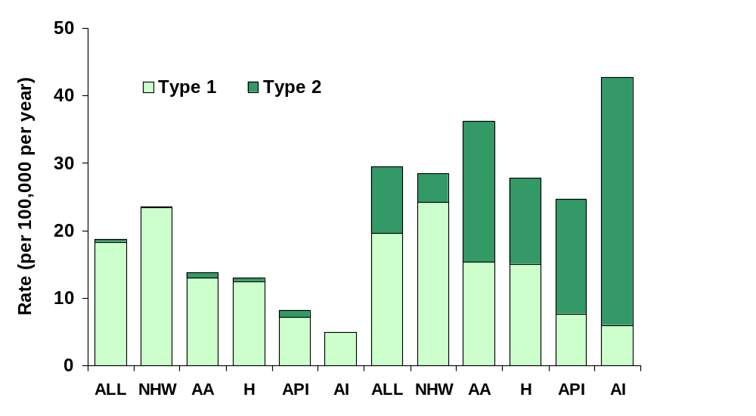
Rate of new cases of type 1 and type 2 diabetes among youth aged <20 years, by race/ethnicity, 2002–2003
<10 years
10–19 years
CDC. National Diabetes Fact Sheet, 2007.
Source: SEARCH for Diabetes in Youth Study
NHW=Non-Hispanic whites; AA=African Americans; H=Hispanics; API=Asians/Pacific Islanders; AI=American Indians

