Slide 1


Volcanic Ash Collaboration Tool (VACT)
Jeff Osiensky, NOAA/NWS Anchorage VAAC
Lynn Sherretz, NOAA Forecast Systems Laboratory
Greg Pratt, NOAA Forecast Systems Laboratory
David J. Schneider, USGS Alaska Volcano Observatory
2nd International Conference on Volcanic Ash and Aviation Safety
Alexandria, Virginia
June 22, 2004

Slide 2
A Look Back 15 Years Ago…
During the Redoubt Eruption…satellite data was limited
Volcanic Ash forecasting was but another duty assigned to the general forecaster
VAACs ??

Slide 3
Changes Since the Redoubt Eruption
“We’ve come a long way…”
Huge advances in technology
Rapid development of the internet
“World” getting smaller – greater interaction with partners
Need to rapidly assimilate huge quantities of data and decide upon a single representative solution

Slide 4
VACT
Relatively inexpensive means to display meteorological data and share that data amongst several users
Runs on either XP or LINUX platforms
Can support a number of users (30 users were connected simultaneously in system tests)
Those interested may view a demo of the VACT!!

Slide 5
Why the need for VACT?
Excellent “team” in Alaska with the AVO, FAA ARTCC/CWSU, and Anchorage VAAC – good site for development work
Need to communicate and share data with adjacent VAACs and MWOs
Be proactive in developing ways to work better with our partners (e.g. Tokyo VAAC, Elizovo MWO, etc.)

Slide 6
VACT
Shared situational awareness
Data sharing through NWS AWIPS (operational meteorological workstation), internet, or local database
Graphical drawing tools
Chat capability

Slide 7
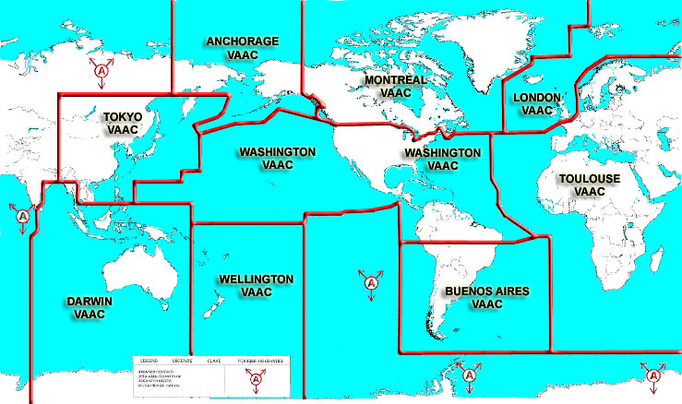

Slide 8
VAAC Coordination
Future integration of multi-lingual chat capabilities
Improve VAAC to VAAC hand-off and coordination despite language differences
Share data between the VAACs
Gain a better understanding of each others perspective

Slide 9
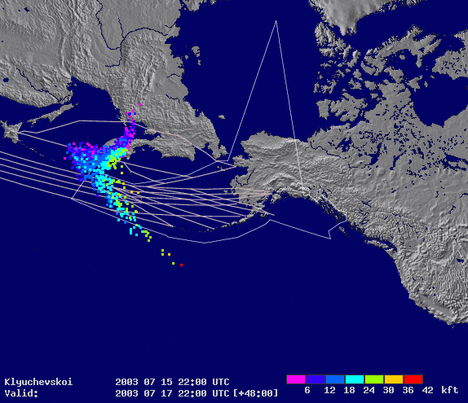
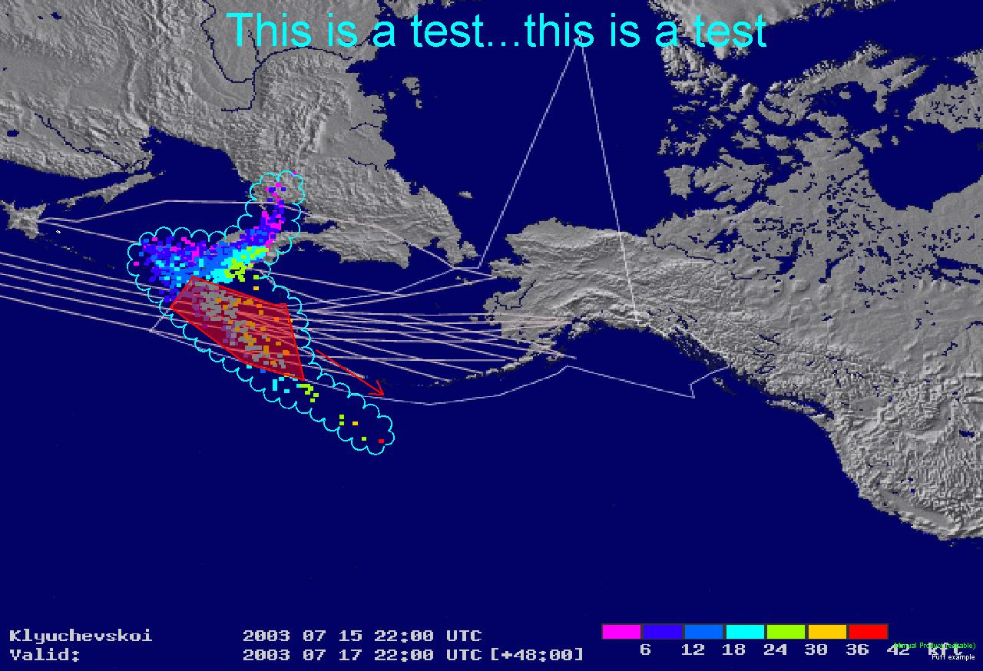
VACT Capabilities
Graphics Enhanced
Unmodified

Slide 10
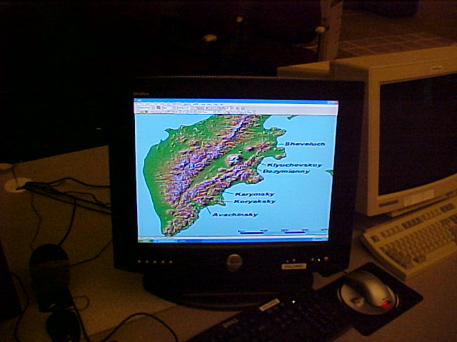
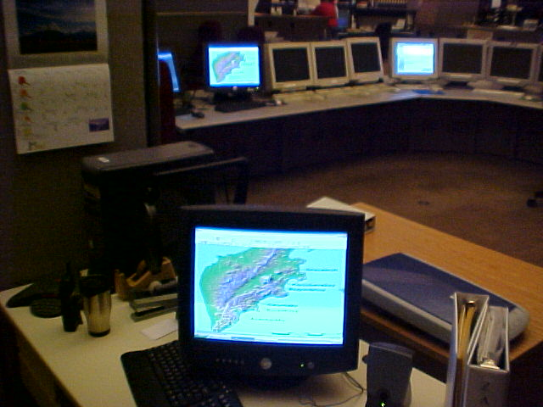
Data Sharing

Slide 11
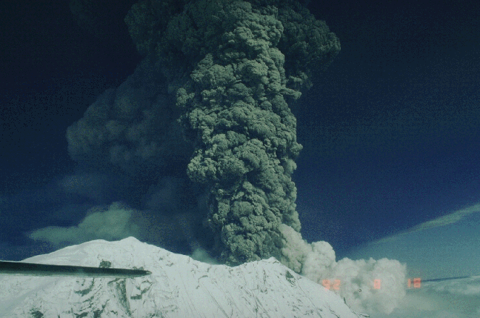
Benefits of the VACT
Beneficial in larger, long-lasting events
Useful briefing tool
Archive for case studies
Post-event analysis

Slide 12
Summary
Shared situational awareness
Data sharing
Briefing/archive capabilities
Please stop by the NOAA exhibit to see a demo of the VACT!

Slide 13


Thanks
VACT project funding support through the NWS Aviation Initiative and the FAA Aviation Weather Research Program
Thanks to our partners who have contributed to the development of the VACT
Forecast Systems Laboratory
National Weather Service - Alaska Region
USGS – Alaska Volcano Observatory

