Slide 1
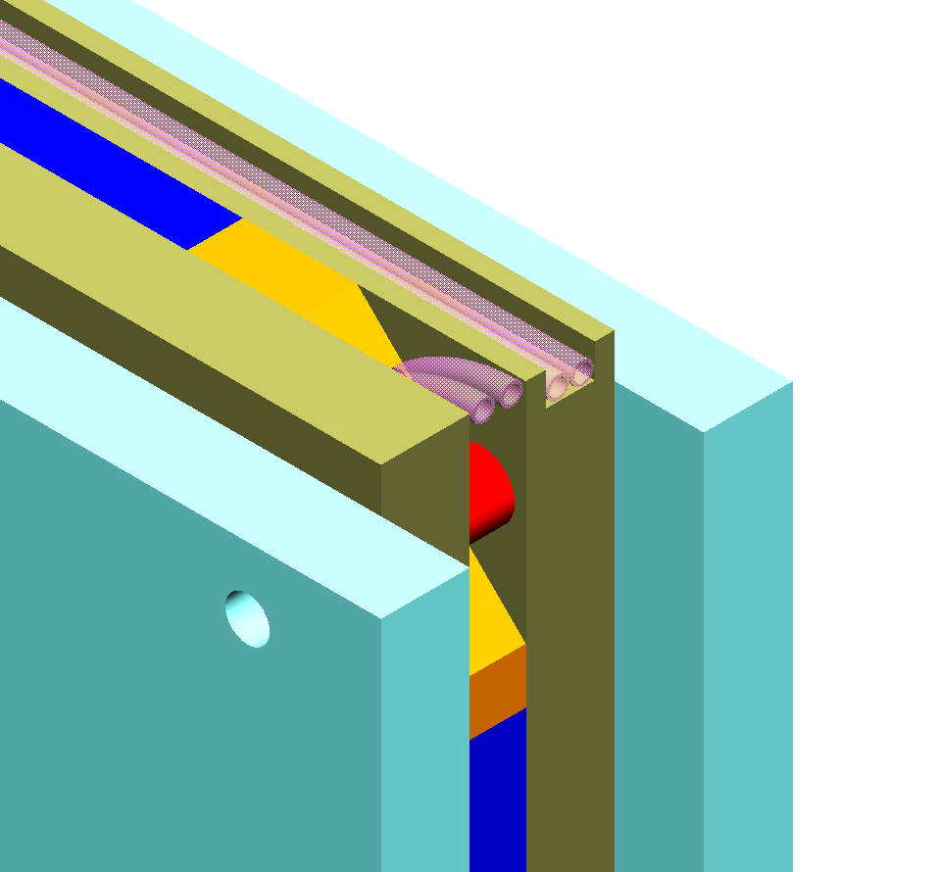
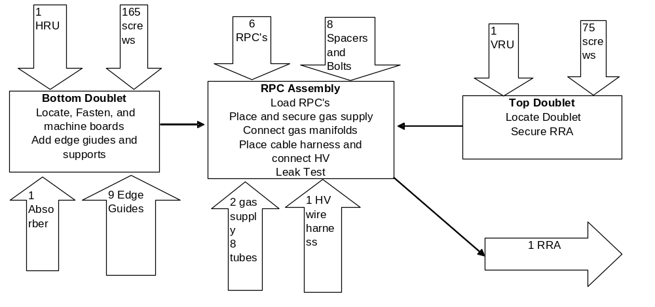
RRA
Mechanical Assembly
Jim Grudzinski
ANL
September 12, 2003
IV NuMI Off_Axis Workshop, FNAL
http://gate.hep.anl.gov/jjg/OffAxis.html

Slide 2
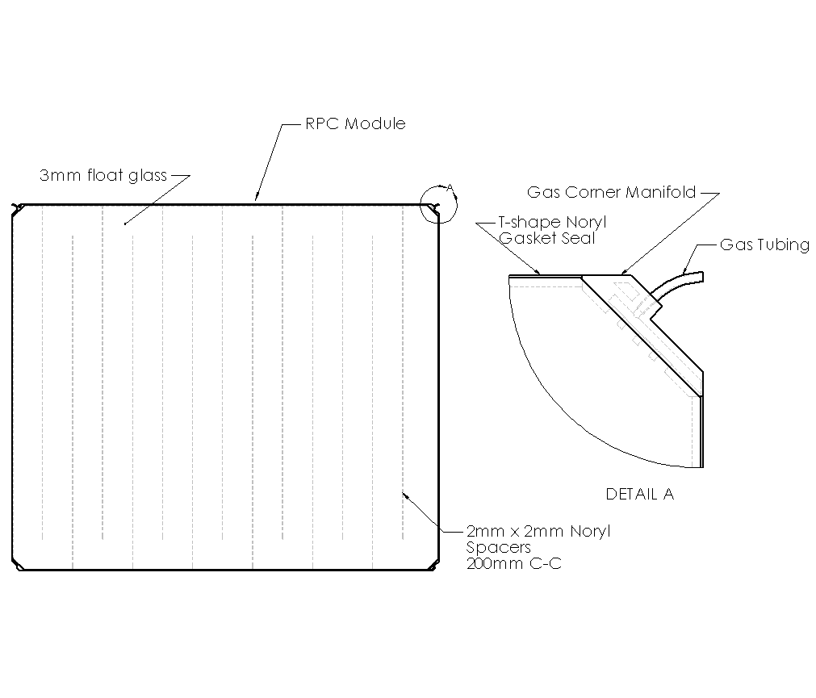
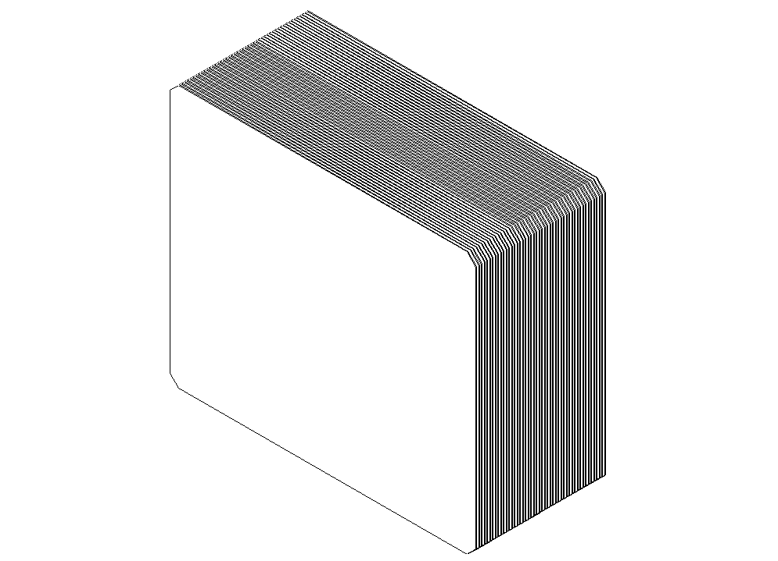
RPC Assembly
RPC’s shipped vertically to RRA factory in containers of 48.
Covered with 0.5mm insulating material which also protects glass and allows easier handling

Slide 3
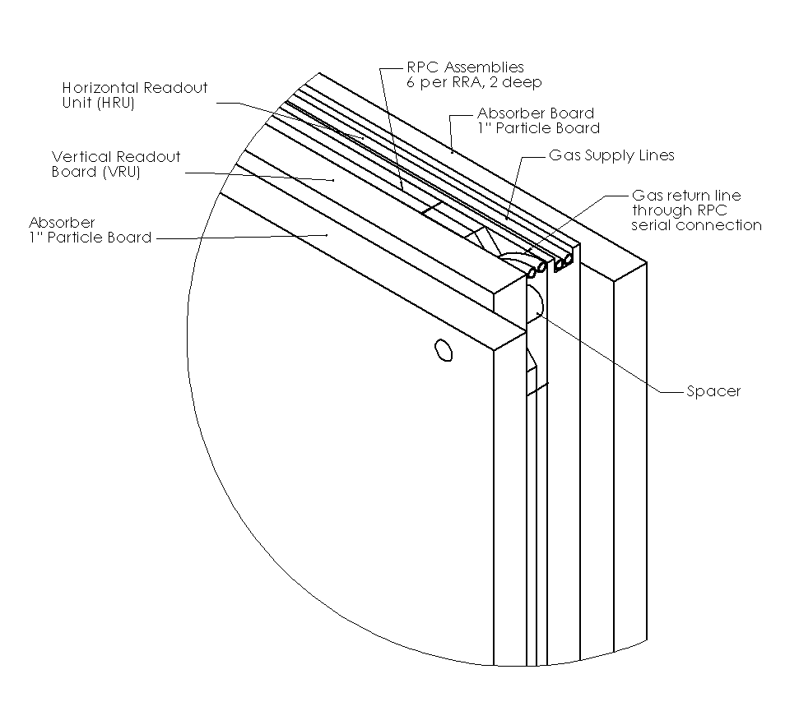
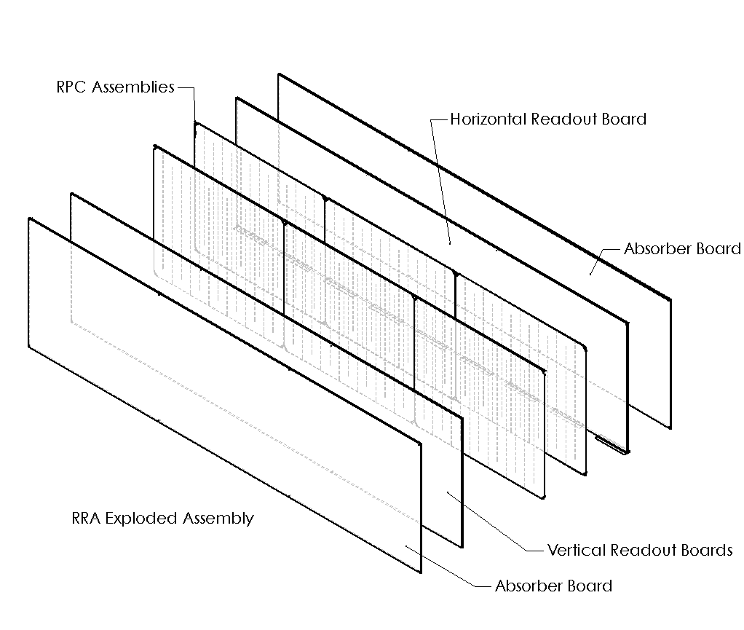
RRA
(RPC Readout Assembly)
RRA Overall dimensions [mm]
2445 x 8560 x 122
6 RPCS (2 layers of 3 each)
4 inches of particle board. Outer absorbers protect readout connector
Electronics, gas connections all come to outside edge

Slide 4
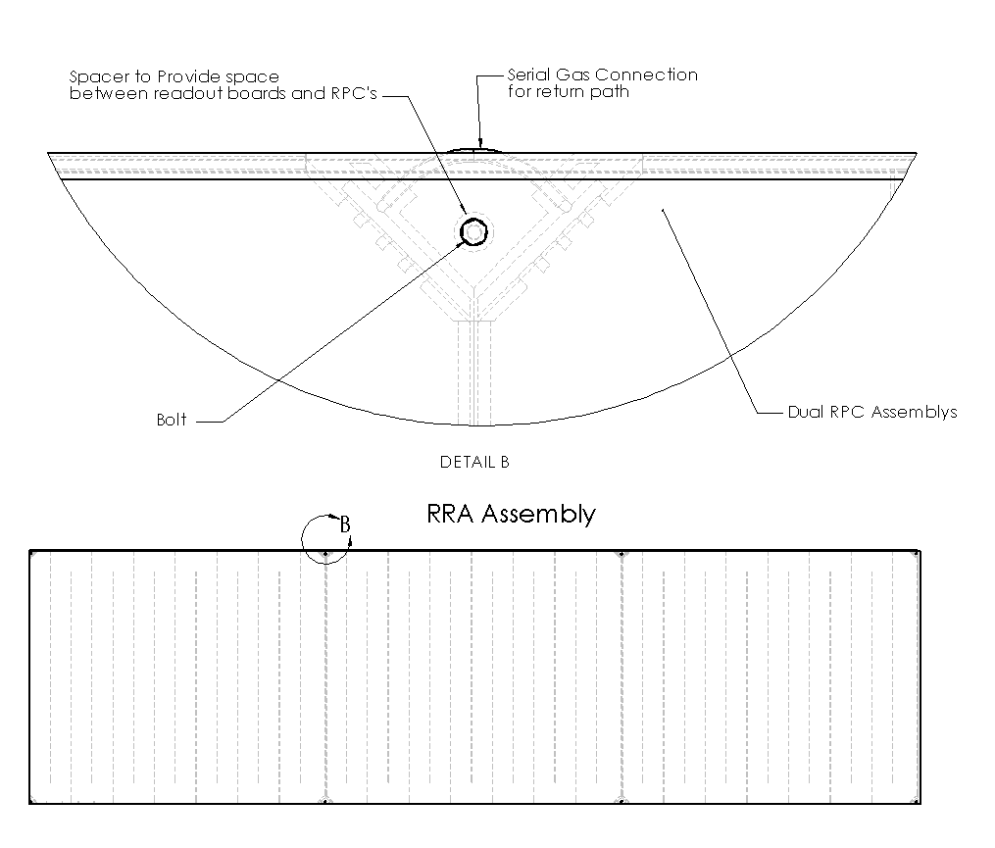
RRA Front View –Corner Gas Manifold Detail
Corner gas manifolds provide access space
  Gas Connection
  Spacer to separate boards, protect RPC’s from compression
  Location for HV wires
  Space to insert bushing for pick points

Slide 5
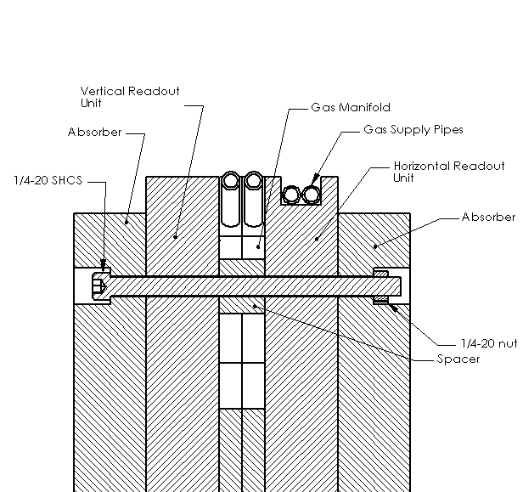
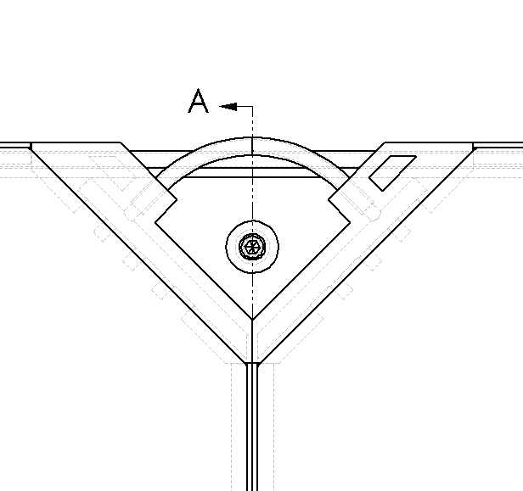
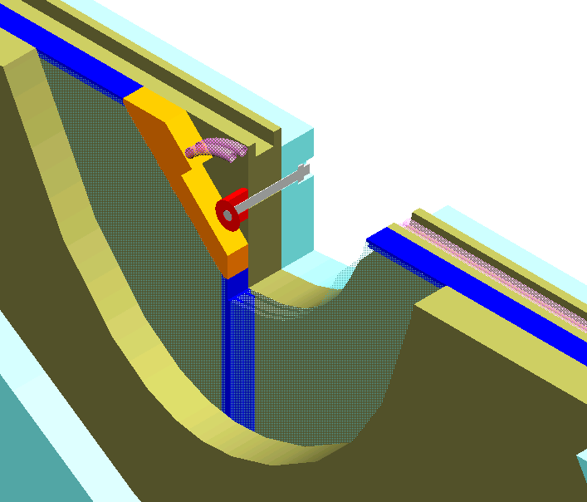
RRA Bolt Connection Detail
Bolts compress absorber through spacer leaving protective space for RPC

Slide 6
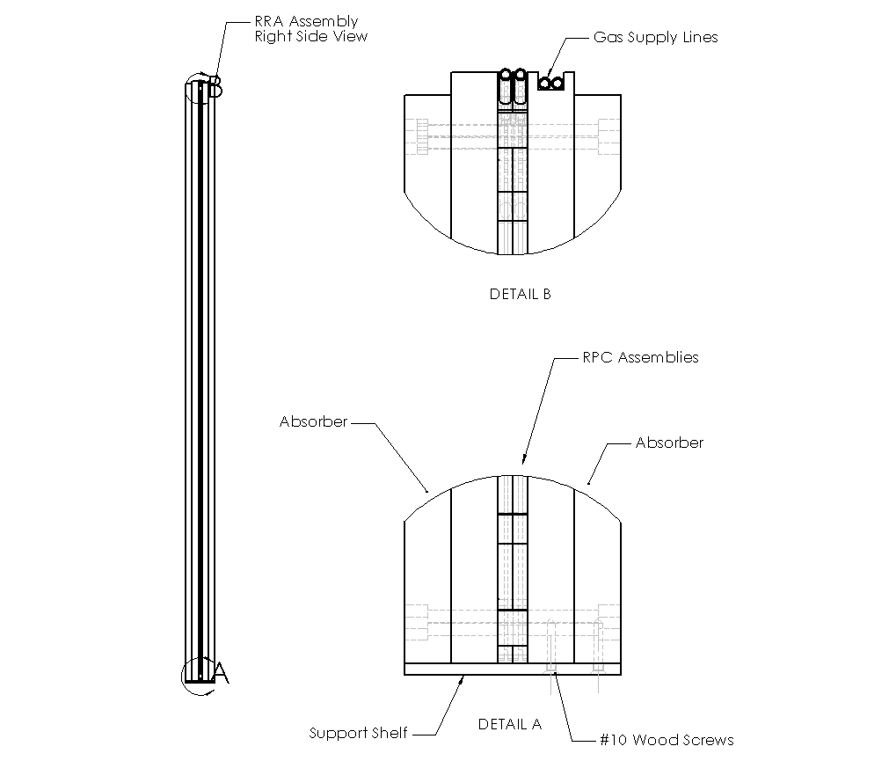
RRA Side View
Individual serial gas connection for each layer
RPCS supported at bottom by 9 support shelves across the bottom edge

Slide 7
Flow through RRA Assembly Process

Slide 8
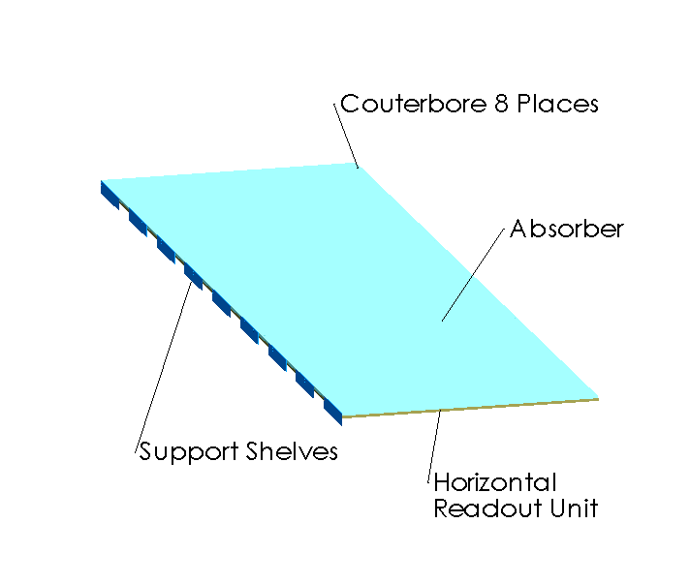
Bottom Doublet Assembly
HRU first on fixture
Absorber fastened to HRU with screws

Slide 9
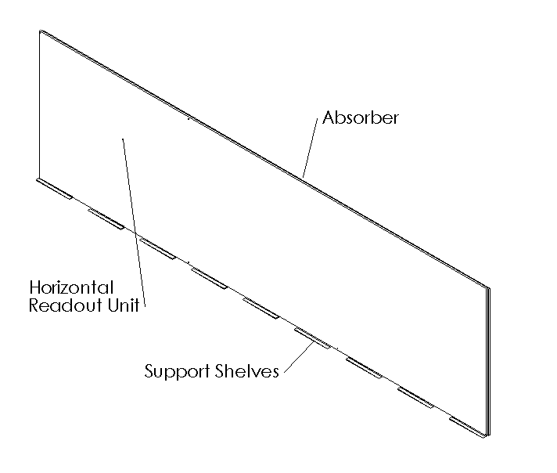
Move doublet to RPC Assembly Stand

Slide 10
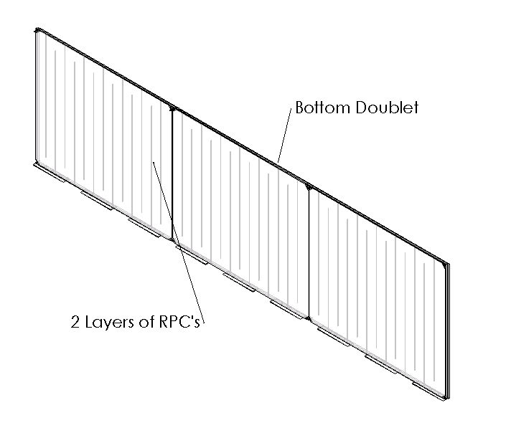
Add RPC’s

Slide 11
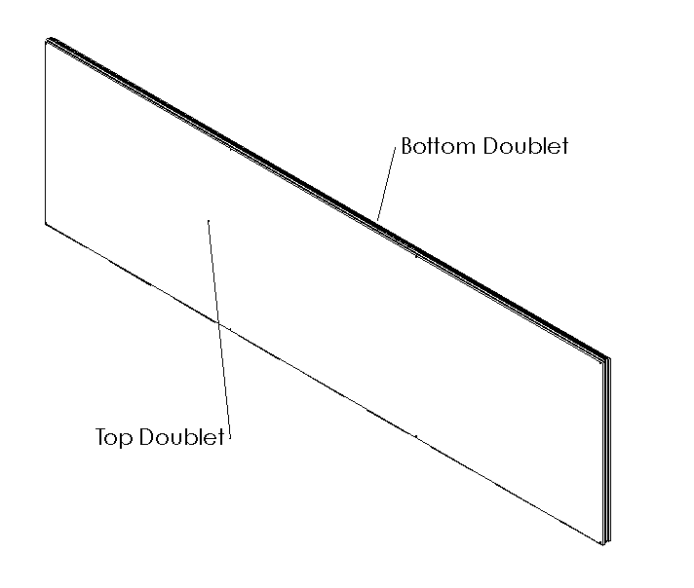
Add Top Doublet

Slide 12
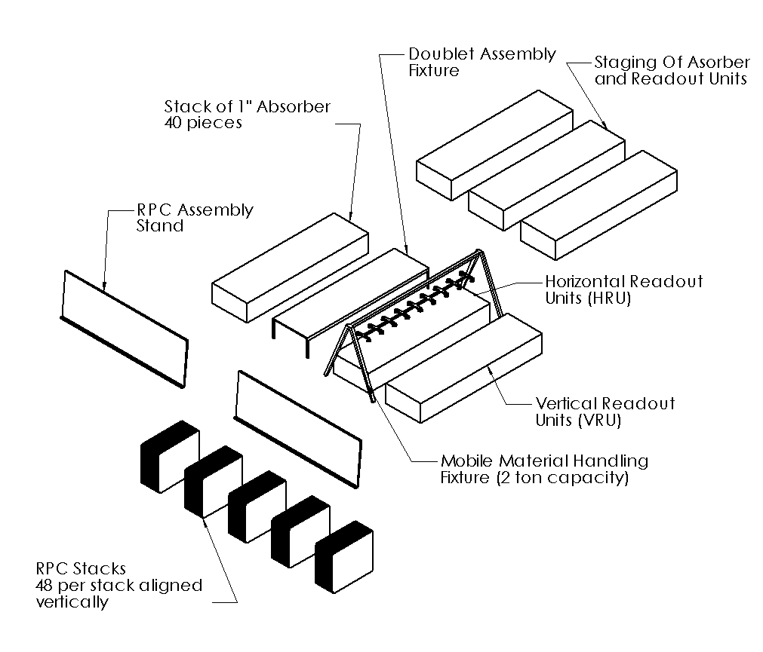
RRA Assembly Station

Slide 13
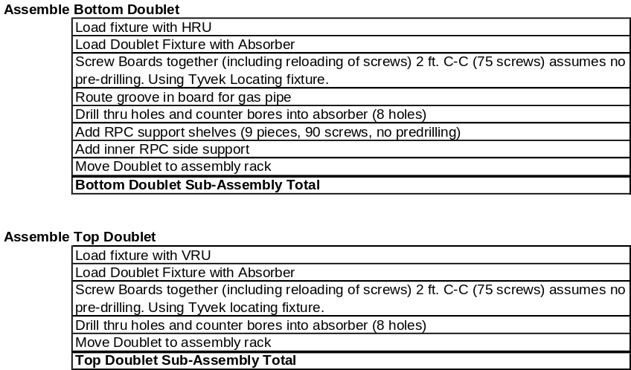
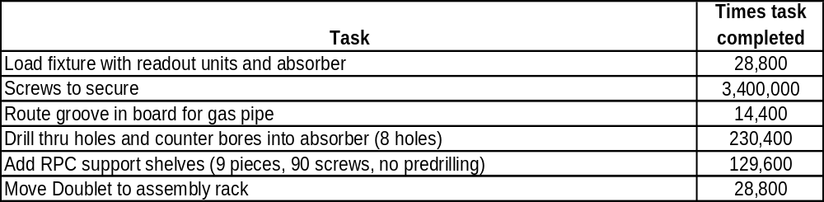
RRA- Doublet Fixture
Tasks
  Attach readout boards
    Screws every 2 feet
  Route groove in top of horizontal readout board
  Drill 8 counter bored holes
  Attach 9 support shelves
Tools
  Automatic screw guns
  Roll-out Tyvek screw template
  Router and drills built into fixture
  Custom material handling
    Locating fixturing on vacuum fixture for quick connection
Current time estimate based on conservative efficiency predictions
Potential Effort Reductions that need further investigation
  Frequency of screws in boards
  Stamped support shelf with internal fasteners for quicker connection
  Sliding Absorber/Readout units

Slide 14
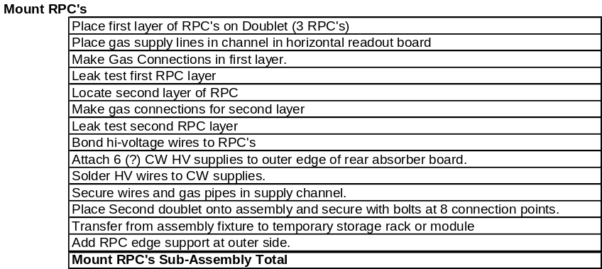
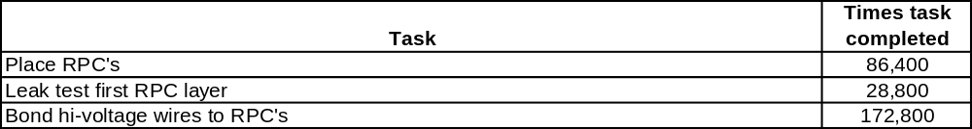
RPC Assembly Fixture
RPC’s are shipped and stored vertical, so why not assemble vertical
  (or at slight angle from vertical to prevent tipping)
Custom material handling device to safely and efficiently move RPC’s
Two RPC assembly fixtures required per doublet fixture for constant rate

Slide 15
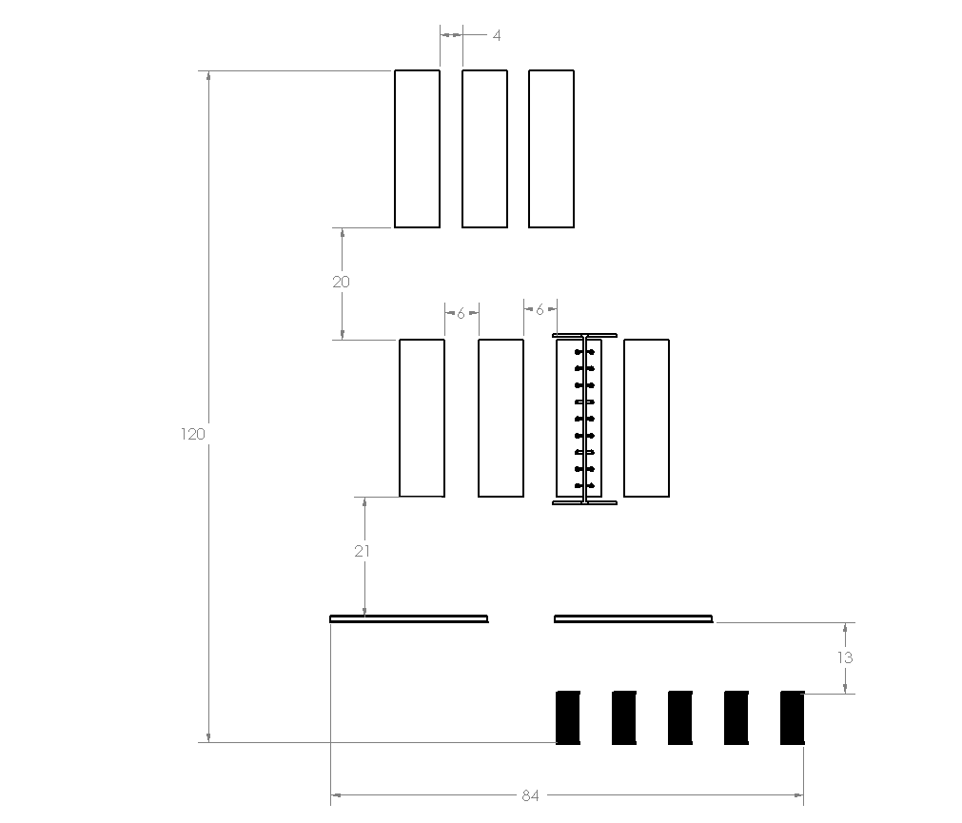
Rough Layout for One Assembly Line
Assumes week worth of material storage
Major components represented
Space and clearances not optimized, intended to provide a a view at space needed

Slide 16
Equipment List to produce 8 RRA/day in a single shift
Doublet Fixtures (2)
Doublet storing rack (1)
RPC Assembly Fixture (3)
RRA storing rack (1)
Gas Leak Tester (3)
Misc. Tools; Screw guns, small clamp fixtures, standard hand tools, etc.
Material Handling Equipment

Slide 17
Conclusions
RRA base design is reasonably complete
  Minor details remain, no “showstoppers”
  Quantity lends itself well to mass production techniques for parts; stamping, injection molding, extrusion, etc.
Relatively simple assembly techniques
  Material handling issues dominate and will require efficient tooling
  Straight forward fixturing/tooling will provide needed efficiencies due to the volume of repeated tasks
    Further concentrated effort on assembly techniques and tolling will inevitably increase this

Slide 18
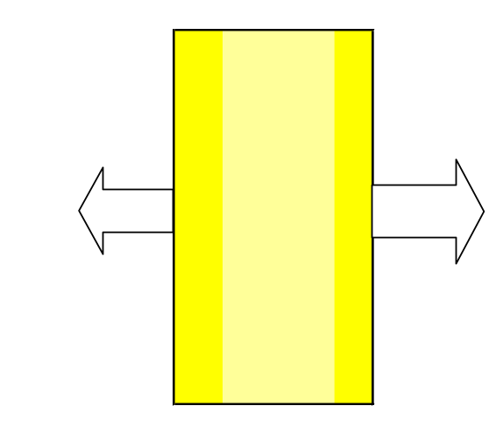
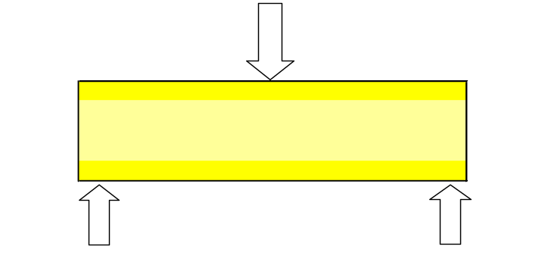
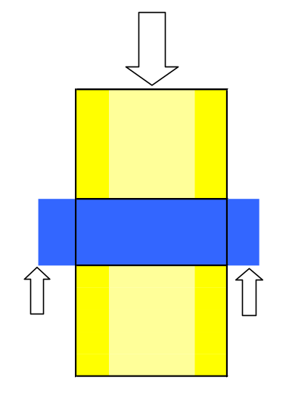
ASTM Tests for Particle Board ratings given for GP MicroFine Particle Board (ANSI A208.1 Class M-3)
Test for modulus of Rurpture
2500 psi
Internal Bond
80 psi
Shear
Not rated by GP

Slide 19
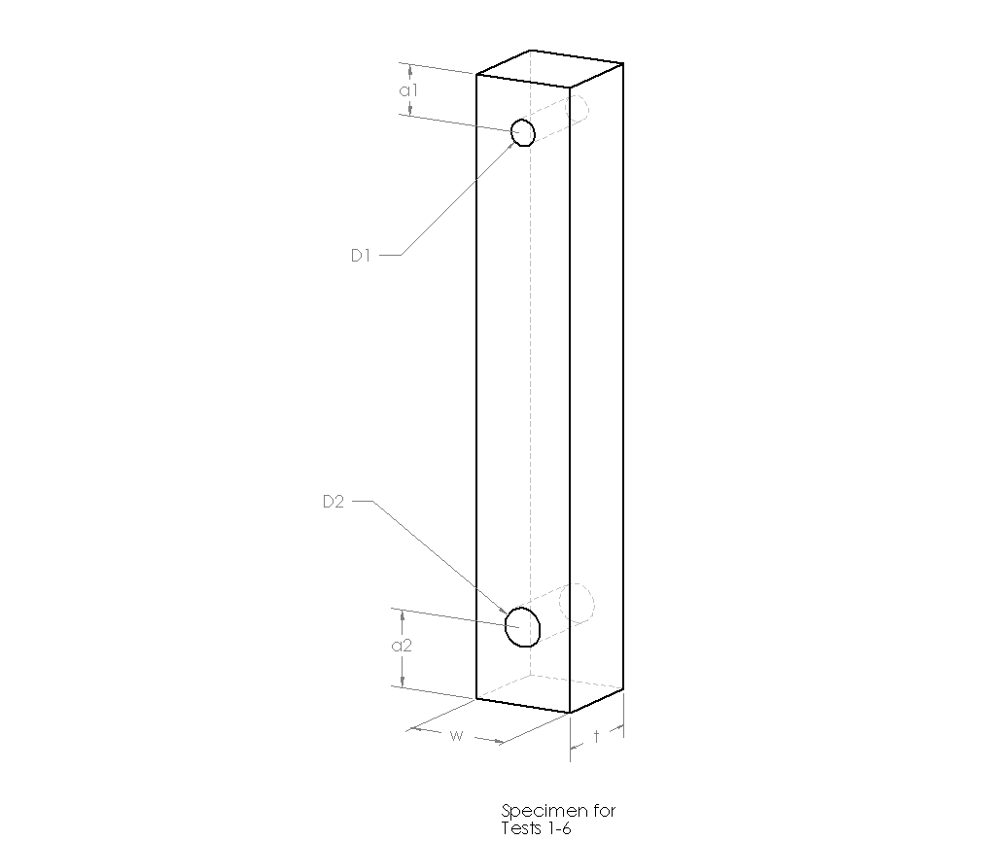
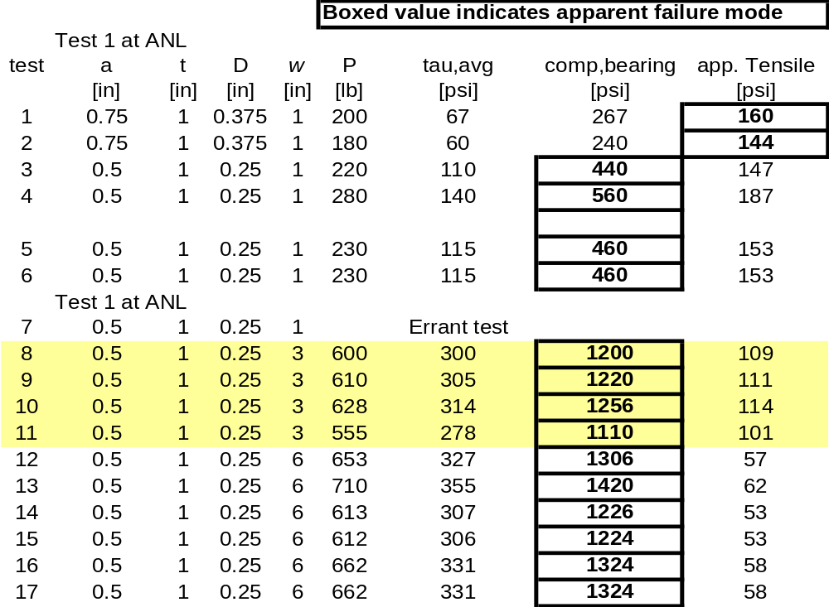
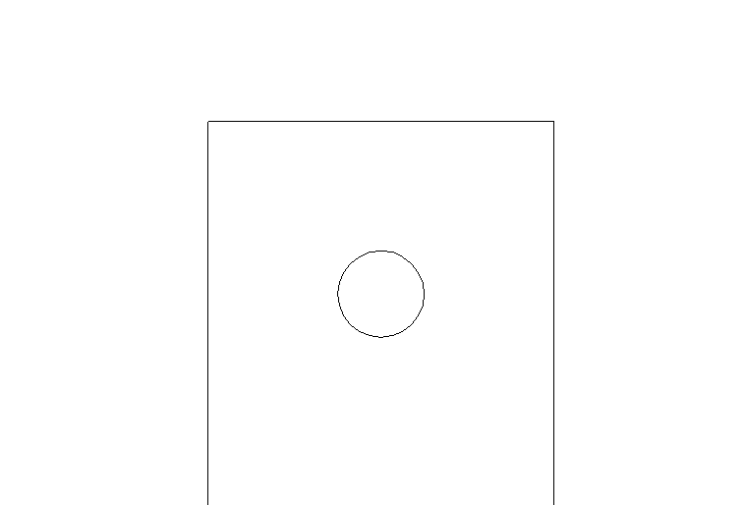
Particle Board Stress Tests
Manufacturers produce values that are valid for very specific loadings. Varying density across thickness prohibits trivially generalizing test results. Must provide our own tests.
Currently using internal bond (80psi) as stress limit in design. This value that will cause mid plane failure (where it is least dense) when applying tension perpendicular to the faces.
We need to provide our own data for physical constants
Preliminary test results at ANL indicate this value is conservative by at least a factor of 4 for the types of loading we care about (high tensile stresses can be avoided)

