Slide 1


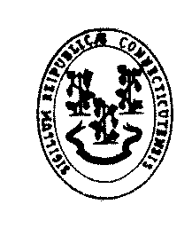
Sample of Connecticut’s Recent Election Performance

Slide 2
VOTER REGISTRATION
Current number of registered voters in Connecticut is 2,150,633
Current voting age population according to US Census is 2,757,082
Percentage of Connecticut residents registered to vote is 78%

Slide 3
Voting Age Population
It is important to note that our percentage may be even higher as Voting Age Population often includes individuals who are over 18 years old but may not be US Citizens or may be convicted of a felony.

Slide 4
Percentage of Registered Voters Who Voted
2008 Presidential Election
  2,104,989 Registered Voters
  1,644,845 Citizens Voted
  Overall Turnout 78.14%
2010 Gubernatorial Election
  2,024,924 Registered Voters
  1,163,320 Citizens Voted
  Overall Turnout 57.45%
2009 Municipal Election
  2,152,320 Registered Voters
  Overall Turnout 36.4%

Slide 5
Voter Participation in the State
2008 Presidential Election
Large Town/City
Hartford 69.59%
Bridgeport 58.97%
New Haven 66.00%
Stamford 81.65%
Waterbury 63.34%
Medium Town/City
New Britain 67.33%
Manchester 74.88%
Hamden 80.74%
Meriden 70.42%
Milford 81.36%

Slide 6
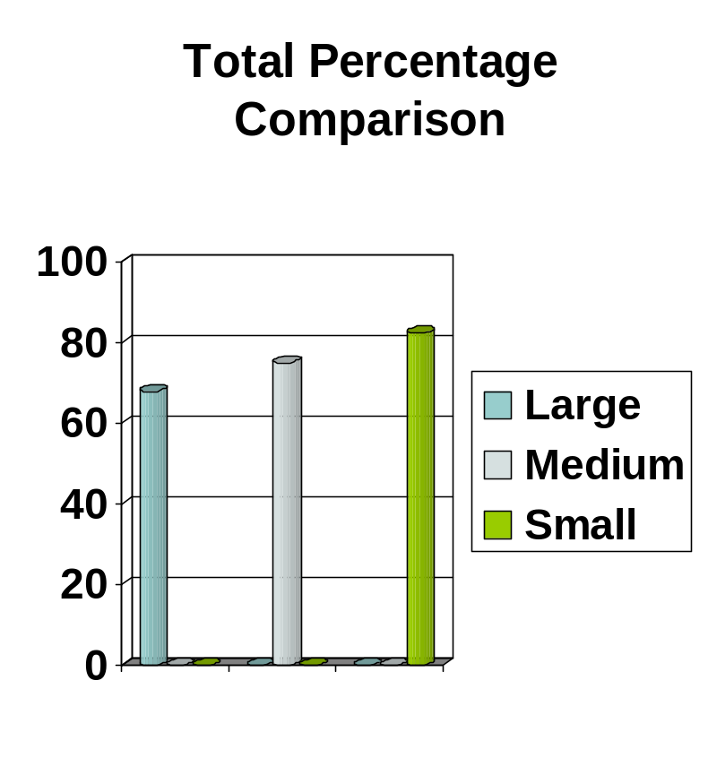
Voter Participation in the State
2008 Presidential Election
Small Town
Bridgewater 86.63%
Voluntown 79.15%
Union 87.87%
Colebrook 80.11%
Andover 77.68%

Slide 7
Voter Participation in the State
2010 Gubernatorial Election
Large Town/City
Hartford 39.36%
Bridgeport 33.93%
New Haven 42.77%
Stamford 59.90%
Waterbury 39.39%
Medium Town/City
New Britain 43.44%
Manchester 57.58%
Hamden 61.09%
Meriden 48.17%
Milford 56.89%

Slide 8
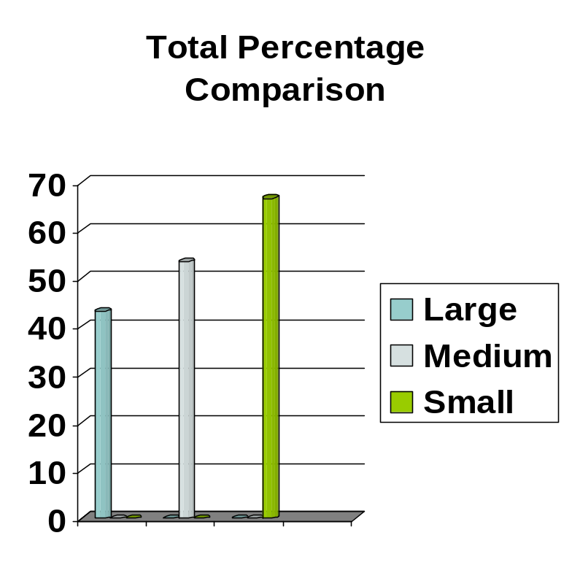
Voter Participation in the State
2010 Gubernatorial Election
Small Town
Bridgewater 73.04%
Voluntown 57.22%
Union 73.10%
Colebrook 64.07%
Andover 65.64%

Slide 9
Voter Participation in the State
2009 Municipal Election
Large Town/City
New Haven 17.6%
Stamford 41.9%
Waterbury 24.0%
Norwalk 30.7%
Danbury 38.9%
Medium Town/City
New Britain 27.9%
Middletown 36.2%
Hamden 39.7%
Meriden 23.5%
Milford 43.0%

Slide 10
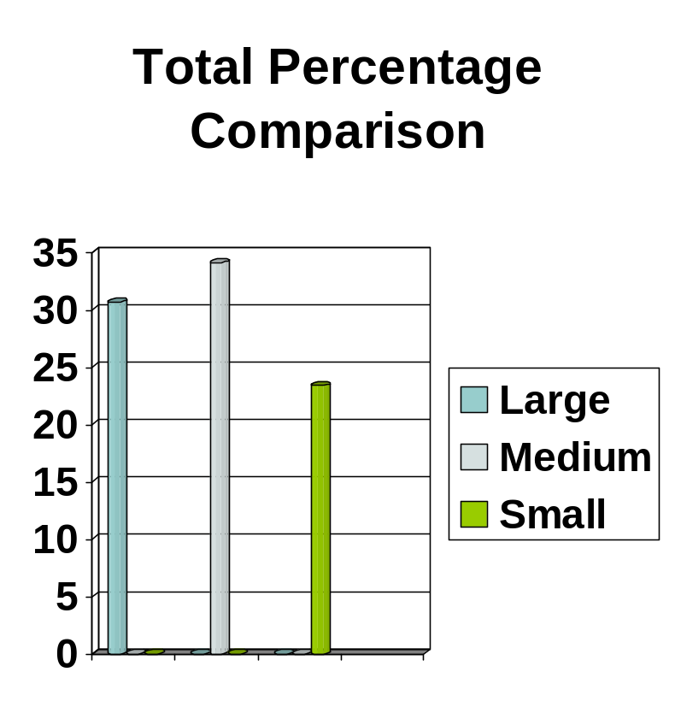
Voter Participation in the State
2009 Municipal Election
Small Town
Colebrook 16.6%
Voluntown 31.7%
Hartland 20.9%
Canaan 20.5%
Salem 27.1%

