Slide 1

State of Washington
Department of Ecology
Human Resource
Management Report
Plan & Align Workforce
Hire Workforce
Deploy Workforce
Reinforce Performance
Develop Workforce
October 2007

Slide 2
Managers’ Logic Model for Workforce Management
Department of Ecology
Outputs
Initial Outcomes
Intermediate Outcomes
Plan & Align Workforce
Articulation of managers HRM accountabilities. HR policies. Workforce planning. Job classes & salaries assigned.
Managers understand HRM accountabilities. Jobs, staffing levels, & competencies aligned with agency priorities.
Foundation is in place to build and sustain a productive, high performing workforce.
Hire
Workforce
Qualified candidate pools, interviews & reference checks. Job offers. Appts & per-
formance monitoring.
Best candidate hired & reviewed during appointment period. Successful performers retained.
The right people are in the right job at the right time.
Ultimate Outcomes
Employees are committed to the work they do & the goals of the organization
Productive, successful employees are retained
State has workforce depth & breadth needed for present and future success
Deploy
Workforce
Work assignments & requirements defined. Positive workplace environment created. Coaching, feedback, corrections.
Workplace is safe, gives capacity to perform, & fosters productive relations. Staff know job rqmts, how they’re doing, & are supported.
Time & talent is used effectively. Employees are motivated & productive.
Develop Workforce
Individual development plans. Time/ resources for training. Continuous learning environment created.
Learning environment created. Employees are engaged in develop-
ment opportunities & seek to learn.
Employees have competencies for present job & career advancement
Agencies are better enabled to successfully carry out their mission. The citizens receive efficient government services.
Reinforce Performance
Clear performance expectations linked to orgn’al goals & measures. Regular performance appraisals. Recognition. Discipline.
Employees know how performance contributes to success of org. Strong performance rewarded; poor performance eliminated
Successful perf is differentiated & strengthened. Employees are held accountable.

Slide 3
Standard Performance Measures
Department of Ecology
Plan & Align Workforce
Percent supervisors with current performance expectations for workforce management
Management profile
Workforce planning measure (TBD)
Percent employees with current position/competencies descriptions
Time-to-fill funded vacancies
Candidate quality
Hiring Balance (Proportion of appointment types)
Separation during review period
Percent employees with current performance expectations
Employee survey ratings on “productive workplace” questions
Overtime usage
Sick leave usage
Non-disciplinary grievances/appeals filed and disposition (outcomes)
Worker safety
Percent employees with current individual development plans
Employee survey ratings on “learning & development” questions
Competency gap analysis (TBD)
Percent employees with current performance evaluations
Employee survey ratings on “performance & accountability” questions
Disciplinary actions and reasons, disciplinary grievances/appeals filed and disposition (outcomes)
Reward and recognition practices (TBD)
Ultimate Outcomes
Hire
Workforce
Employee survey ratings on “commitment” questions
Turnover rates and types
Turnover rate: key occupational categories
Workforce diversity profile
Retention measure (TBD)
Deploy
Workforce
Develop Workforce
Reinforce Performance

Slide 4
Plan & Align Workforce
Outcomes:
Managers understand workforce management accountabilities. Jobs and competencies are defined and aligned with business priorities. Overall foundation is in place to build & sustain a high performing workforce.
Performance Measures:
Percent supervisors with current performance expectations for workforce management
Management profile
Workforce Planning measure (TBD)
Percent employees with current position/ competency descriptions
Department of Ecology
Workforce Management Expectations
Percent supervisors with current performance expectations for workforce management = 100%*
Analysis:
Since 2000, required leadership training for all managers and supervisors includes “Basics of Supervision” and “Understanding People Through Strengths” courses. Leadership Training Attendance is also being tracked. In 2004, “Performance Management” was added as a requirement.
Human Resources provides ongoing guidance and assistance to individual managers and management teams regarding effective ways to define and articulate behavioral, and other performance expectations, and competencies.
Agency-wide performance and conduct expectations were created and implemented in 2002.
“Conduct” expectations were amended to Ecology “Core Competencies” in 2005.
“Leadership Competencies” were developed and implemented for all Ecology managers and supervisors in 2006.
Action Steps:
Continue to articulate and hold managers accountable for effective workforce management.
Continue to provide leadership training for managers and supervisors.
*Based on 260 of 260 reported number of supervisors
Data as of 2006 Annual Evaluation cycle completion
Source: Agency Tracking System

Slide 5
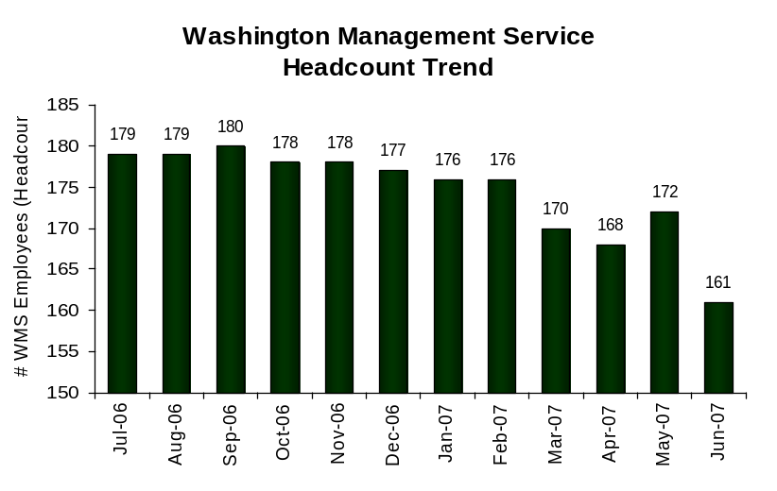
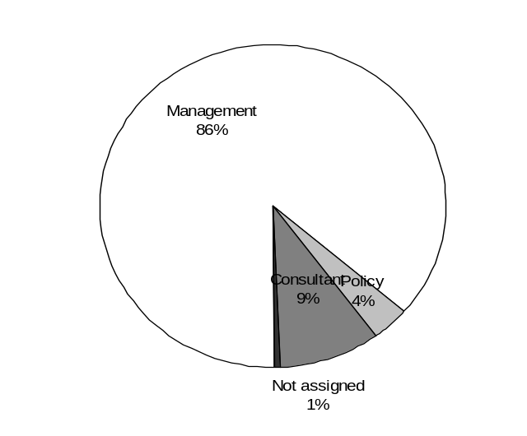
Plan & Align Workforce
Outcomes:
Managers understand workforce management accountabilities. Jobs and competencies are defined and aligned with business priorities. Overall foundation is in place to build & sustain a high performing workforce.
Performance Measures:
Percent supervisors with current performance expectations for workforce management
Management profile
Workforce Planning measure (TBD)
Percent employees with current position/ competency descriptions
Department of Ecology
Management Profile
WMS Employees Headcount = 161
Percent of agency workforce that is WMS = 9.8%
Managers* Headcount = 250
Percent of agency workforce that is Managers* = 15.2%
* In positions coded as “Manager” (includes EMS, WMS, and GS)
Analysis:
Ecology’s goal for the 2005-2007 biennium was to reduce managers in the agency by 45.5 positions, which is reflected in the headcount trend. Ecology met that goal.
Ecology’s organizational structure fits the complex nature of the work. Many of Ecology’s managers are technical working managers.
In some programs, the large span of supervision (number of staff reporting to one supervisor) creates workload challenges.
Action Steps:
Given the budget add of 90 FTE’s, Ecology expects to add some WMS positions.
Ecology will manage the addition of WMS positions to maintain the WMS baseline set by the Department of Personnel.
All requests for WMS positions will be carefully reviewed by the Deputy Director and HR Director prior to approval.
Ecology will review the agency’s organizational structures and work assignments and align resources as needed to focus on strategic priorities.
Management 139
Consultant 15
Policy 6
Not Assigned 1
Data as of June 2007
Source: Business Warehouse

Slide 6
Plan & Align Workforce
Outcomes:
Managers understand workforce management accountabilities. Jobs and competencies are defined and aligned with business priorities. Overall foundation is in place to build & sustain a high performing workforce.
Performance Measures:
Percent supervisors with current performance expectations for workforce management
Management profile
Workforce Planning measure (TBD)
Percent employees with current position/ competency descriptions
Department of Ecology
Current Position/Competency Descriptions
Percent employees with current position/competency descriptions = 96.8%*
Analysis:
“Determining Competencies Through Job Analysis” became a required class in 2005; 84% of managers and supervisors have completed to date.
All Position Description Forms (PDF’S) with competencies were completed and revised by December 31, 2006 during the annual review.
“Where, How and When” Competency training (and resources) was provided to all managers and supervisors in 2006. Purpose: for creating and defining required and desired competencies in describing positions, recruiting and assessing candidates, and articulating expectations.
Action Steps:
Ongoing update of position descriptions as duties or competencies change.
Review new PDF’s for quality and provide guidance as needed.
*Based on 1195 of 1234 reported employee count
Applies to employees in permanent positions, both WMS & GS
Data as of 2006 Annual Evaluation cycle completion
Source: Agency Tracking System

Slide 7
Hire Workforce
Outcomes:
Best candidates are hired and reviewed during appointment period. The right people are in the right job at the right time.
Performance Measures
Time-to-fill vacancies
Candidate quality
Hiring Balance (proportion of appointment types)
Separation during review period
Department of Ecology
Time-to-fill / Candidate Quality
Time-to-fill Funded Vacancies
Average number of days to fill*: E-Recruiting 66.8
Number of vacancies filled: E-Recruiting 52
Total 335
*Equals # of days from creation of the requisition to job offer acceptance. Data available for E-recruiting only.
Time Period: 7/1/2006 – 6/30/2007
Analysis:
Ecology started using E-Recruiting on a limited basis in November, 2006 and agency-wide in February, 2007. The first hire out of the new system was made in February, 2007
Vacancy statistics reflect the majority of hiring for the FY; was completed prior to implementing E-Recruiting.
Developed training materials and provided training to employees statewide on using E-Recruiting.
Training materials and help documents for employees posted on intranet.
Developed supervisor guidance document on E-Recruiting to help managers through the new referral and hiring process.
Provided resource documents to managers on recruitment and hiring.
Employees, managers and HR staff are becoming more comfortable with using E-Recruiting, as shown by a reduction in requests for help in accessing the system.
Action Steps:
Continue to provide hands-on assistance to employees as needed.
Continue to provide assistance to job-seekers in applying through E-Recruiting.
Develop processes for capturing most accurate time-to-fill data through E-Recruiting.
Continue to work with Department of Personnel to share agency best practices and candidate feedback to identify areas for E-Recruiting system improvement and solutions.
Data as of June 2007
Source: Department of Personnel/E-Recruiting

Slide 8
Hire Workforce
Outcomes:
Best candidates are hired and reviewed during appointment period. The right people are in the right job at the right time.
Performance Measures
Time-to-fill vacancies
Candidate quality
Hiring Balance (proportion of appointment types)
Separation during review period
Department of Ecology
Candidate Quality
Candidate Quality**
Percent Number
Candidates interviewed who had competencies
needed for the job
Hiring managers who indicated they could hire best
Candidate
**DOP E-Recruiting Survey data. Data not available yet.
Analysis:
Data not available yet.
Developed recruitment feedback form to capture DOP survey questions to send to supervisors since they are not using E-Recruiting directly. Survey data has been entered into E-Recruiting since June 2007.
Action Steps:
Monitor comments from feedback form for ways to improve process and candidate quality.
Data as of June 2007
Source: Department of Personnel/E-Recruiting

Slide 9
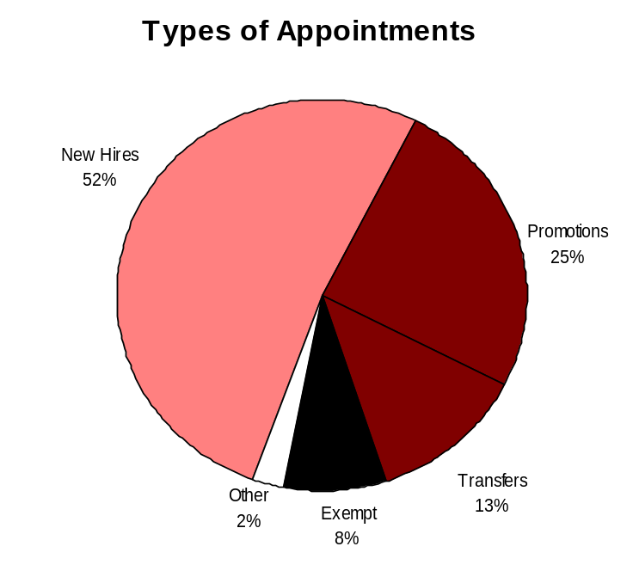
Hire Workforce
Outcomes:
Best candidates are hired and reviewed during appointment period. The right people are in the right job at the right time.
Performance Measures
Time-to-fill vacancies
Candidate quality
Hiring Balance (proportion of appointment types)
Separation during review period
Department of Ecology
Hiring Balance / Separations During Review Period
Analysis:
Priority focus has been on hiring positions received from the budget adds for the 07-09 biennium to achieve agency priorities:
  Puget Sound Restoration and Protection
  Water for Local Communities and Healthy Watersheds
  Reducing toxic threats
  Environmental Mitigation
  Climate Change and Air Quality
Action Steps:
Continue outreach to colleges, universities and organizations to build candidate pools.
Continue to analyze exit interview data from employees voluntarily leaving Ecology for trends and feedback information.
Ongoing review and update of position descriptions as duties or position-specific competencies change.
Provide opportunities for Ecology employees to discuss the career development process.
Total number of appointments = 247*
Time period = July 2006 through June 2007
Includes appointments to permanent vacant positions only; excludes reassignments
“Other” = Demotions, re-employment, reversion & RIF appointments
Separation During Review Period
Probationary separations - Voluntary 6
Probationary separations - Involuntary 8
  Total Probationary Separations 14
Trial Service separations - Voluntary 4
Trial Service separations - Involuntary 0
  Total Trial Service Separations 4
Total Separations During Review Period 18
Time period = July 2006 through June 2007
Data as of June 2007
Source: Business Warehouse

Slide 10
Deploy Workforce
Outcomes:
Staff know job expectations, how they’re doing, & are supported. Workplace is safe, gives capacity to perform, & fosters productive relations. Employee time and talent is used effectively. Employees are motivated.
Performance Measures
Percent employees with current performance expectations
Employee survey ratings on “productive workplace” questions
Overtime usage
Sick leave usage
Non-disciplinary grievances/appeals filed and disposition (outcomes)
Worker safety
Department of Ecology
Current Performance Expectations
Percent employees with current performance expectations = 96.8%*
Analysis:
Director expectations for completion of performance evaluations articulated for over ten years; since 1989. Since 1999, Ecology has had completion rates over 90%.
Ecology provides training support to employees and supervisors each year for the annual review cycle.
Employee survey results indicate employees do not always feel they are getting meaningful feedback from their supervisors, both annually and ongoing.
Action Steps:
Revising 2007 Performance and Development Plan (PDP) training for management teams agency-wide; emphasis on quality and relevance of the results expected and overall performance management.
A random sample of performance development plans will be reviewed each year by human resource staff.
Discussions with supervisors about recognition, coaching and regular feedback, in addition to training on the annual performance evaluations.
Established and communicated a 100% PDP completion goal agency-wide by Deputy Director for the 2007 annual evaluation cycle.
*Based on 1195 of 1234 reported employee count
Applies to employees in permanent positions, both WMS & GS
Data as of 2006 Annual Evaluation cycle completion
Source: Agency Tracking System

Slide 11
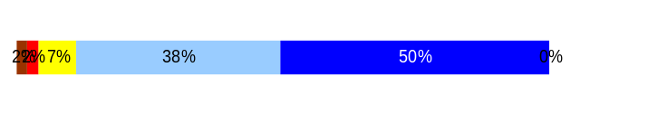
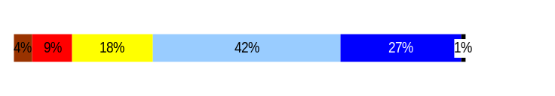
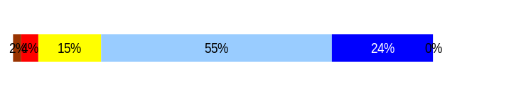
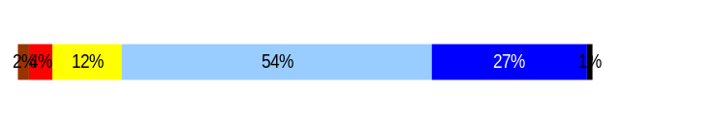
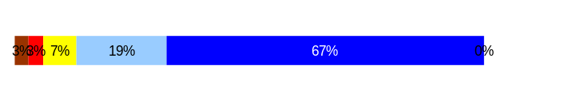
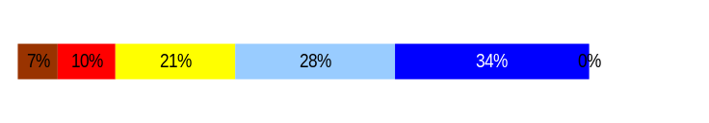
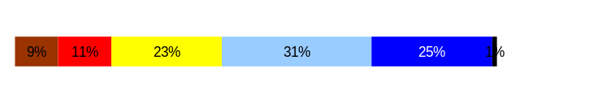
Deploy Workforce
Outcomes:
Staff know job expectations, how they’re doing, & are supported. Workplace is safe, gives capacity to perform, & fosters productive relations. Employee time and talent is used effectively. Employees are motivated.
Performance Measures
Percent employees with current performance expectations
Employee survey ratings on “productive workplace” questions
Overtime usage
Sick leave usage
Non-disciplinary grievances/appeals filed and disposition (outcomes)
Worker safety
Department of Ecology
Employee Survey “Productive Workplace” Ratings
Avg
Q4. I know what is expected of me at work.
Q1. I have opportunity to give input on decisions affecting my work.
Q2. I receive the information I need to do my job effectively.
Q6. I have the tools and resources I need to do my job effectively.
Q7. My supervisor treats me with dignity and respect.
Q8. My supervisor gives me ongoing feedback that helps me
improve my performance.
Q9. I receive recognition for a job well done.
Analysis:
60% response rate on the Employee Survey.
High rating (4.4 out of 5.0) for “My supervisor treats me with dignity and respect.”
Recognition for work well-done (Q9) and ongoing feedback (Q8) were identified as opportunities for improvement.
Every program and office obtained specific results and feedback to discuss results with employees and management teams and develop action plans.
Every program and office defined relevant action items for implementation in 2006.
Action Steps:
Agency all-staffs are being held to communicate and discuss our current state, agency goals, how success is measured, and how each employee contributes to that.
The 2007 Employee Survey is planned for October with results expected by late December; review of results and action planning early 2008.
4.3
3.8
4.0
3.9
4.4
3.7
3.5
Never
Seldom
Occasionally
Usually
Always
Overall average score for Productive Workplace Ratings: 3.9
Data as of April 21, 2006
Source: 2006 Employee Survey

Slide 12
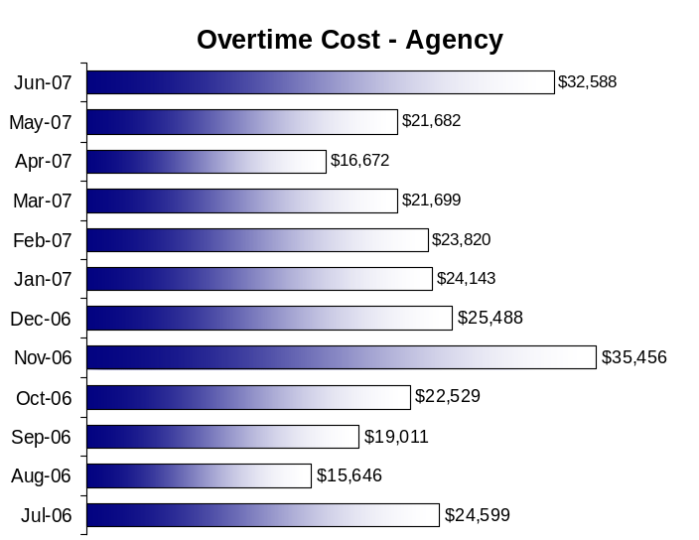
Deploy Workforce
Outcomes:
Staff know job expectations, how they’re doing, & are supported. Workplace is safe, gives capacity to perform, & fosters productive relations. Employee time and talent is used effectively. Employees are motivated.
Performance Measures
Percent employees with current performance expectations
Employee survey ratings on “productive workplace” questions
Overtime usage
Sick leave usage
Non-disciplinary grievances/appeals filed and disposition (outcomes)
Worker safety
Department of Ecology
Overtime Usage
Analysis:
Most of Ecology’s workforce are Overtime Exempt, only 21% are Overtime Eligible.
In FY 2007, Ecology paid out about $378,600 in overtime costs, up from $250,000 in 2006. Prior years were $410,000 in FY 2005 and $325,000 in FY 2004. Overall, Ecology’s overtime costs are significantly below the statewide average.
Spill response and the Washington Conservation Corp (WCC) accounted for 80% of Ecology’s Overtime in FY 2007. Overtime is expected due to emergency response to hazardous spills and marine vessels that impact public health and the environment, such as removing the derelict vessel “Catala”. Deployment of multiple WCC crews to help with national and local disasters, such as recovery from tornados in Florida in spring 2007, also require overtime.
Biennium close-out activities required additional overtime in the Fiscal office.
As expected, overtime use by the Payroll office was significantly reduced as staff became more familiar with the new Human Resource Management System. Overtime was reduced from 403 hours in the first half to 63 hours in the last half of FY2007.
Data as of June 2007
Source: Business Warehouse

Slide 13
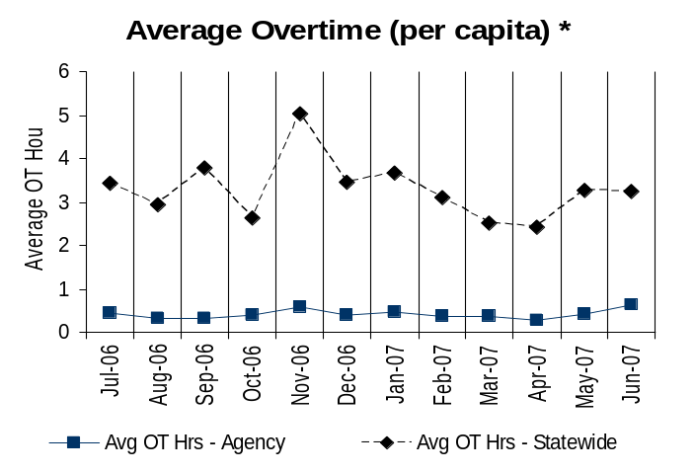
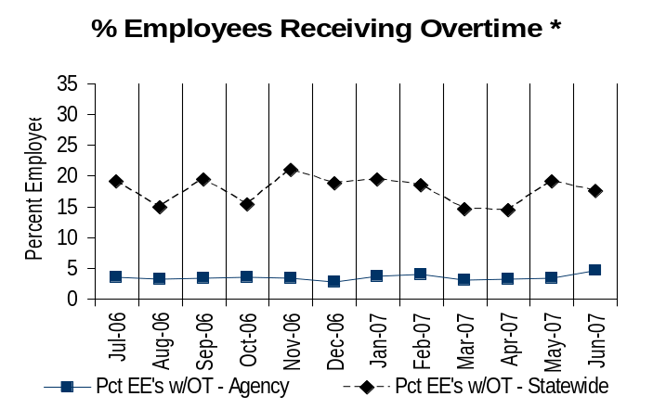
Deploy Workforce
Outcomes:
Staff know job expectations, how they’re doing, & are supported. Workplace is safe, gives capacity to perform, & fosters productive relations. Employee time and talent is used effectively. Employees are motivated.
Performance Measures
Percent employees with current performance expectations
Employee survey ratings on “productive workplace” questions
Overtime usage
Sick leave usage
Non-disciplinary grievances/appeals filed and disposition (outcomes)
Worker safety
Department of Ecology
Overtime Usage
Goal: Keep Overtime (OT) usage at or below current low levels: 3.5% per capita.
Action Steps:
Ecology will continue to track and review the data trends.
Follow-up will be done to find out specific reasons for overtime usage by programs.
Overall agency avg overtime usage – per capita, per month: .42
*Statewide overtime values do not include DNR
**Overall agency avg overtime usage – per capita, per month = sum of monthly OT averages divided by number of months
Average overtime (per capita)
Avg OT hrs, per capita – Agency | Avg OT hrs, per capita – Statewide | % EE’s using OT, per capita – Agency | % EE’s using OT, per capita – Statewide
.42 | 3.3 | 3.5% | 17.7%
Overall agency avg employees receiving overtime per month: 3.5%**
*Statewide overtime values do not include DNR
**Overall agency avg employees receiving overtime per month = sum of monthly OT percentages divided by number of months
Data as of June 2007
Source: Business Warehouse

Slide 14
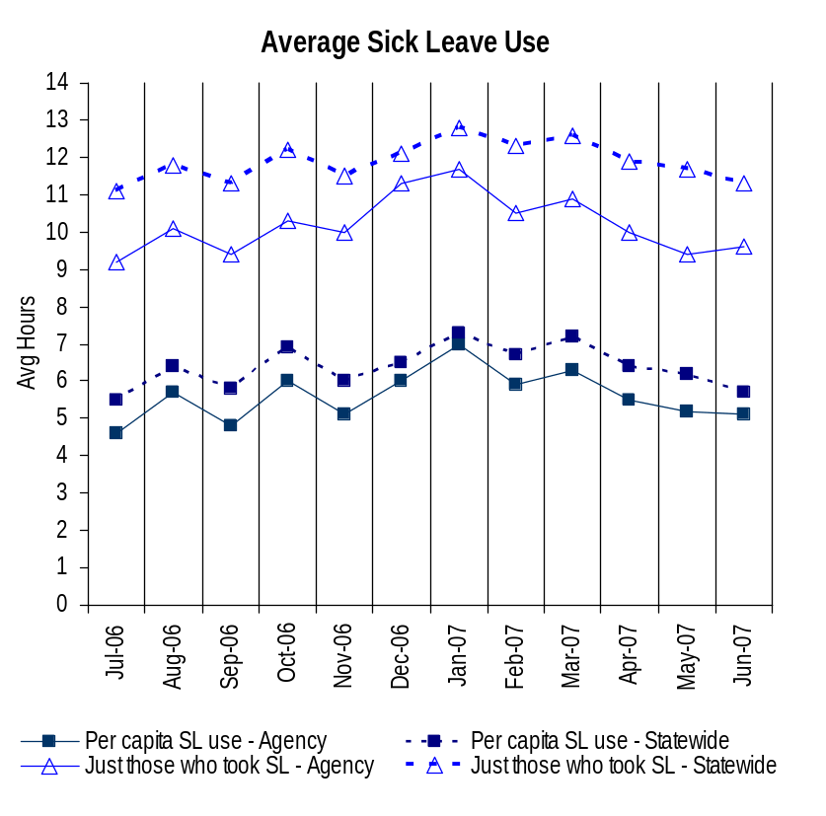
Deploy Workforce
Outcomes:
Staff know job expectations, how they’re doing, & are supported. Workplace is safe, gives capacity to perform, & fosters productive relations. Employee time and talent is used effectively. Employees are motivated.
Performance Measures
Percent employees with current performance expectations
Employee survey ratings on “productive workplace” questions
Overtime usage
Sick leave usage
Non-disciplinary grievances/appeals filed and disposition (outcomes)
Worker safety
Department of Ecology
Sick Leave Usage
Analysis:
Ecology’s sick leave usage is below statewide averages.
Ecology’s concern focuses on:
  the impact of unanticipated, unscheduled sick leave usage.
  employees who don’t use sick leave when they are sick and may spread illness in the workplace, and
  employees using sick leave as they earn it, leaving little or no sick leave balance.
Due to the nature of Ecology’s overtime, a correlation between unplanned sick leave usage and overtime usage is not expected.
Supervisors are attending to situations where high sick leave usage exists.
Sick Leave time period = July 2006 through June 2007
* Statewide data does not include DOL, DOR, L&I, and LCB
Source: DOP-Provided Sick Leave Data

Slide 15
Deploy Workforce
Outcomes:
Staff know job expectations, how they’re doing, & are supported. Workplace is safe, gives capacity to perform, & fosters productive relations. Employee time and talent is used effectively. Employees are motivated.
Performance Measures
Percent employees with current performance expectations
Employee survey ratings on “productive workplace” questions
Overtime usage
Sick leave usage
Non-disciplinary grievances/appeals filed and disposition (outcomes)
Worker safety
Department of Ecology
Corrected 11/13/2007
Sick Leave Usage
Sick Leave Hrs Used / Earned (per capita)
Avg Hrs SL Used (per capita) - Agency | % of SL Hrs Earned (per capita) - Agency
5.6 Hrs | 72.7%
Avg Hrs SL Used (per capita) – Statewide* | % of SL Hrs Earned (per capita) – Statewide*
6.4 Hrs | 82.5%
Goal: Keep sick leave use at or below current level of 5.4 per capita, which is below the statewide per capita use.
Action Steps:
Supervisors understand the laws, rules and collective bargaining agreement regarding sick leave, and will continue to appropriately attend to situations as needed to minimize negative impact on business needs.
Review employee survey data by program to see if there are any correlations between employee satisfaction and sick leave usage.
Ecology’s active Wellness Program will continue to provide opportunities to participate in activities sponsored by the agency. The program sends positive messages to employees that we care about their health and well-being.
An agency-wide wellness message requesting employees’ completion of a health risk assessment with their health care providers will emphasize the importance of a healthy workforce and Ecology’s concern for employee’s health and productivity.
Concerns include employees misinterpreting messages about the focus on sick leave usage.
Sick Leave Hrs Used / Earned (those who took SL)
Avg Hrs SL Used (those who took SL) - Agency | % SL Hrs Earned (those who took SL) - Agency
10.2 Hrs | 127.3%
Avg Hrs SL Used (those who took SL) – Statewide* | % SL Hrs Earned (those who took SL) – Statewide*
11.9 Hrs | 148.4%
Sick Leave time period = July 2006 through June 2007
* Statewide data does not include DOL, DOR, L&I, and LCB
Source: DOP-Provided Sick Leave Data

Slide 16
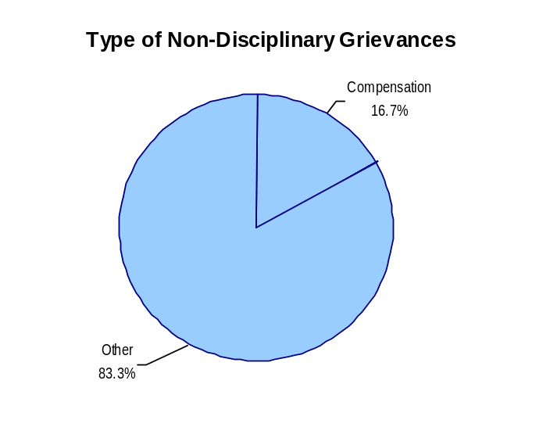
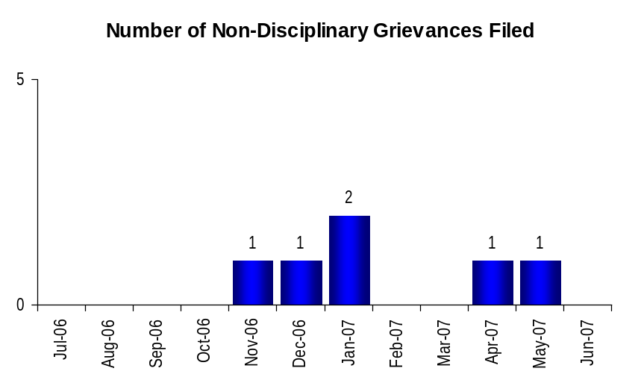
Deploy Workforce
Outcomes:
Staff know job expectations, how they’re doing, & are supported. Workplace is safe, gives capacity to perform, & fosters productive relations. Employee time and talent is used effectively. Employees are motivated.
Performance Measures
Percent employees with current performance expectations
Employee survey ratings on “productive workplace” questions
Overtime usage
Sick leave usage
Non-disciplinary grievances/appeals filed and disposition (outcomes)
Worker safety
Department of Ecology
Non-Disciplinary Grievances (represented employees)
Total Non-Disciplinary Grievances = 6
Analysis:
One Article 9 – Licensure and Certification grievance is a rehash of issues previously resolved through the Personnel Resources Board. Employees are electing to have the issue addressed through the American Arbitration Association (AAA) as a new venue.
One Article 36 – Employee Rights grievance was filed and settled at the pre-arbitration phase of Step 3.
The Union and Management continue to cooperatively resolve the majority of issues internally. The Article 9 issue will most likely require a third party neutral ruling to put the matter to rest.
Action Steps:
Continue efforts between labor and management to proactively identify areas of mutual interest and concern to resolve at the lowest level possible.
Continue to host agency Union Management Communication Meetings to discuss emerging issues.
Non-Disciplinary Grievance Disposition
(Outcomes determined during July 2006 through June 2007)
2 Resolved
2 Withdrawn
2 at Step 3
Data as of June 2007
Source: Agency tracking

Slide 17
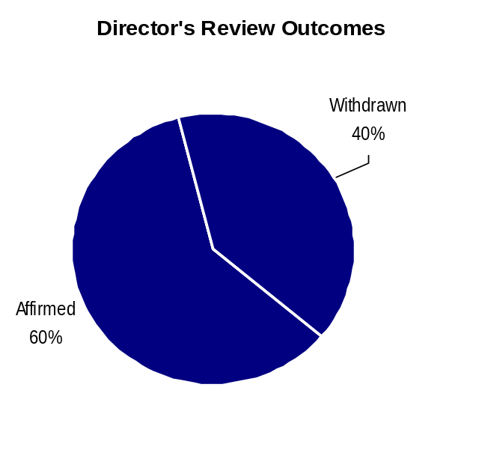
Deploy Workforce
Outcomes:
Staff know job expectations, how they’re doing, & are supported. Workplace is safe, gives capacity to perform, & fosters productive relations. Employee time and talent is used effectively. Employees are motivated.
Performance Measures
Percent employees with current performance expectations
Employee survey ratings on “productive workplace” questions
Overtime usage
Sick leave usage
Non-disciplinary grievances/appeals filed and disposition (outcomes)
Worker safety
Department of Ecology
Non-Disciplinary Appeals (mostly non-represented employees)
Filings for DOP Director’s Review
Time Period = July 2006 through June 2007
2 Job classification
2 Total filings
Filings with Personnel Resources Board
Time Period = July 2006 through June 2007
1 Job classification
1 Total filings
Non-Disciplinary appeals only are shown above.
These job classification issues were both related to the implementation of the mid-management reductions.
There is no one-to-one correlation between the filings shown above and the outcomes displayed in the charts below. The time lag between filing date and when a decision is rendered can cross the time periods indicated.
None
Total outcomes = 5
Time Period = July 2006 through June 2007
Source: Dept of Personnel
Time Period = July 2006 through June 2007

Slide 18
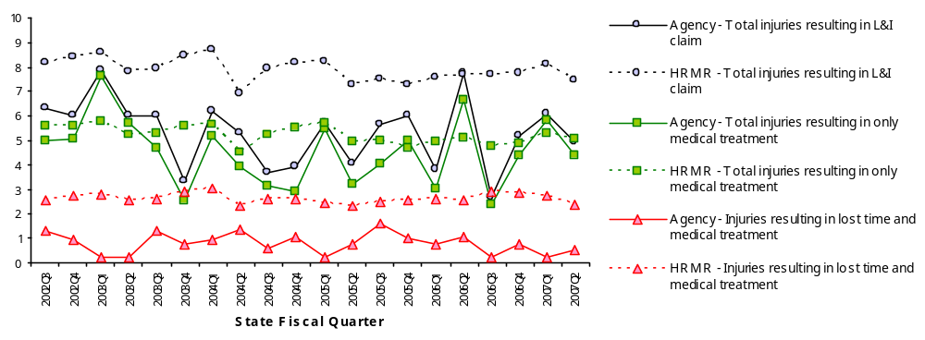
Deploy Workforce
Outcomes:
Staff know job expectations, how they’re doing, & are supported. Workplace is safe, gives capacity to perform, & fosters productive relations. Employee time and talent is used effectively. Employees are motivated.
Performance Measures
Percent employees with current performance expectations
Employee survey ratings on “productive workplace” questions
Overtime usage
Sick leave usage
Non-disciplinary grievances/appeals filed and disposition (outcomes)
Worker safety
Department of Ecology
Worker Safety
Allowed Annual
Claims Rate*^:
Agency vs. All HR
Management Report
(HRMR) agencies
*Annual claims rate
is # claims / 100 FTE
1 FTE = 2000 hours
^Due to natural lag
in claim filing, rates
are expected to
increase significantly
over time
Injuries by Occupational
Injury and Illness
Classification (OIICS)
event:
For fiscal period 2002Q3
through 2007Q2
(categories under 3% or not
adequately coded are grouped
into 'misc.')
Oiics Code | Oiics Description | Percent | Number
21 | Bodily Reaction | 9% | 38
34 | Exposure To Caustic, | 7% | 28
13 | Fall On Same Level | 9% | 38
41 | Highway Accident | 4% | 16
- | Misc | 21% | 87
22 | Overexertion | 24% | 97
01 | Struck Against Object | 10% | 40
02 | Struck By Object | 16% | 64
Action Plan:
The Action Plan as approved by Ecology’s Executive Management specified an agency-wide assessment of work-related hazards.
Agency Director Jay Manning sent e-mail to managers and supervisors to emphasize importance of participating in Hazard Assessment.
The first phase of the Hazard Assessment is nearly complete, with most programs and offices having reported the results of open discussions and brainstorming sessions with staff.
Phase Two will entail analysis of the collected data and communication with the submitting programs and offices.
Analysis:
Ecology’s accident and claims rate reflects both minor variations over time and also seasonal variations. Field work is at its peak during the summer months; injury and accident rates typically peak in August. Most Safety training and development or update of written safety plans are done during the winter months (the off-season for field work.)
This year marks the 16th consecutive year in which Ecology’s “Experience Factor” is the lowest of all state agencies, boards & commissions.

Slide 19
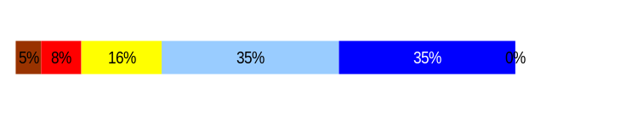
Develop Workforce
Outcomes:
A learning environment is created. Employees are engaged in professional development and seek to learn. Employees have competencies needed for present job and future advancement.
Performance Measures
Percent employees with current individual development plans
Employee survey ratings on “learning & development” questions
Competency gap analysis (TBD)
Department of Ecology
Individual Development Plans
Percent employees with current individual development plans = 96.8%*
Analysis:
Since 1989, Ecology has set expectations to have performance evaluations, including expectations and training plans, completed annually. Since 1999, Ecology has had completion rates over 90%.
Ecology provides training support to employees and supervisors each year for the annual review cycle which includes Individual Development Plans.
Employee survey results indicate employees do not always feel they have the tools and resources needed to do their jobs effectively. (Q6, 3.9 out of 5.0)
Action Steps:
Revising 2007 Performance and Development Plan (PDP) training for management teams agency-wide; emphasis on quality and relevance of the results expected and overall performance management.
A random sample of performance evaluations will be reviewed each year by human resource staff.
Discussions with supervisors about recognition, coaching and regular feedback, in addition to training on the annual performance evaluations.
Established and communicated a 100% PDP/IDP completion goal agency-wide by Deputy Director for the 2007 annual evaluation cycle.
*Based on 1195 of 1234 reported employee count
Applies to employees in permanent positions, both WMS & GS
Data as of 2006 Annual Evaluation cycle completion
Source: Agency Tracking System
Employee Survey “Learning & Development” Ratings
Q5. I have opportunities at work to learn and grow.
Q8. My supervisor gives me ongoing feedback that helps me
improve my performance.
Avg
3.9
3.7
Overall avg score for Learning & Development Ratings: 3.8
Data as of April 21, 2006
Source: 2006 Employee Survey

Slide 20
Reinforce Performance
Outcomes:
Employees know how their performance contributes to the goals of the organization. Strong performance is rewarded; poor performance is eliminated. Successful performance is differentiated and strengthened. Employees are held accountable.
Performance Measures
Percent employees with current performance evaluations
Employee survey ratings on “performance and accountability” questions
Disciplinary actions and reasons, disciplinary grievances/appeals filed and disposition (outcomes)
Reward and recognition practices (TBD)
Department of Ecology
Current Performance Evaluations
Percent employees with current performance evaluations = 96.8%*
Analysis:
Director expectations for completion of performance evaluations articulated for over ten years; since 1989. Since 1999, Ecology has had completion rates over 90%.
Ecology provides training support to employees and supervisors each year for the annual review cycle.
Employee survey results indicate employees do not always feel they are getting meaningful feedback from their supervisors, both annually and ongoing.
Action Steps:
Revising 2007 Performance and Development Plan (PDP) training for management teams agency-wide; emphasis on quality and relevance of the results expected and overall performance management.
A random sample of performance development plans will be reviewed each year by human resource staff.
Discussions with supervisors about recognition, coaching and regular feedback, in addition to training on the annual performance evaluations.
Established and communicated a 100% PDP/IDP completion goal agency-wide by Deputy Director for the 2007 annual evaluation cycle.
*Based on 1195 of 1234 reported employee count
Applies to employees in permanent positions, both WMS & GS
Data as of 2006 Annual Evaluation cycle completion
Source: Agency Tracking System

Slide 21
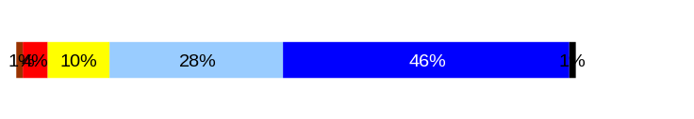
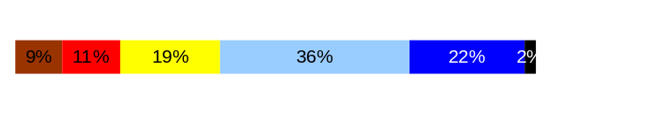
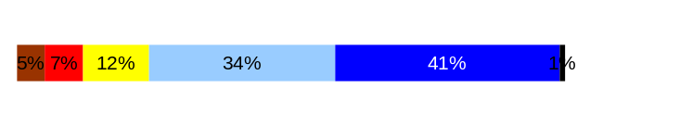
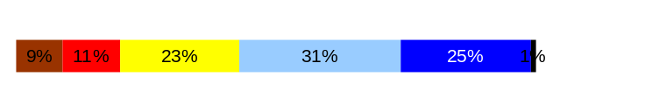
Reinforce Performance
Outcomes:
Employees know how their performance contributes to the goals of the organization. Strong performance is rewarded; poor performance is eliminated. Successful performance is differentiated and strengthened. Employees are held accountable.
Performance Measures
Percent employees with current performance evaluations
Employee survey ratings on “performance and accountability” questions
Disciplinary actions and reasons, disciplinary grievances/appeals filed and disposition (outcomes)
Reward and recognition practices (TBD)
Department of Ecology
Employee Survey “Performance & Accountability” Ratings
Avg
Q3. I know how my work contributes to the goals of my agency.
Q10. My performance evaluation provides me with meaningful information about my performance.
Q11. My supervisor holds me and my co-workers accountable for performance.
Q9. I receive recognition for a job well done.
Analysis:
Director expectations for completion of performance evaluations articulated for over 10 years. Return rate continues to climb; message is being heard.
Consistently, training is offered to all employees on effective performance evaluations.
Current evaluations in progress for the October 1, 2006 through September 30, 2007 period.
Every office and program has defined relevant action items for implementation in the areas of meaningful feedback (Q10) and recognition (Q9) in 2006.
Action Steps:
Agency all-staffs are being held to communicate and discuss our current state, agency goals, how success is measured, and how each employee contributes to that.
The 2007 Employee Survey is planned for October with results expected by late December; review of results and action planning early 2008.
Continue discussions with supervisors about recognition, coaching and regular feedback, in addition to training on the annual performance evaluations.
4.2
3.5
4.0
3.5
Never
Seldom
Occasionally
Usually
Always
Overall average score for “Performance & Accountability” ratings: 3.8
Data as of April 21, 2006
Source: 2006 Employee Survey

Slide 22
Reinforce Performance
Outcomes:
Employees know how their performance contributes to the goals of the organization. Strong performance is rewarded; poor performance is eliminated. Successful performance is differentiated and strengthened. Employees are held accountable.
Performance Measures
Percent employees with current performance evaluations
Employee survey ratings on “performance and accountability” questions
Disciplinary actions and reasons, disciplinary grievances/appeals filed and disposition (outcomes)
Reward and recognition practices (TBD)
Department of Ecology
Formal Disciplinary Actions
Disciplinary Action Taken
Time period = July 2006 – June 2007
Analysis:
Managers and supervisors are becoming familiar with the just cause process and employees are being held accountable which is resulting in more disciplinary actions being taken.
Action Steps:
Continue to strengthen Ecology’s performance management system through coaching, counseling and implementing best human resource management practices.
Continue to provide contemporary leadership training for managers and supervisors.
HRD staff is delivering training to continue educating managers on:
  Applying the Principle of Just Cause
  Addressing Performance Issues
  Addressing Attendance Issues
Actions Impacting Salary
Dismissals | 0
Demotions | 1
Suspensions | 2
Reduction in Pay | 0
Total Actions Impacting Salary | 3
Non-Salary Actions
Letters of Reprimand | 3
Oral Reprimand | 1
Total Non-Salary Actions | 4
Issues Leading to Disciplinary Action
Misuse of state resources
Manager Misconduct
Failure to follow instructions
Sleeping at workstation
Breach of security
Untimely processing of work
Data as of June 2007
Source: HRMS and Agency Tracking System

Slide 23
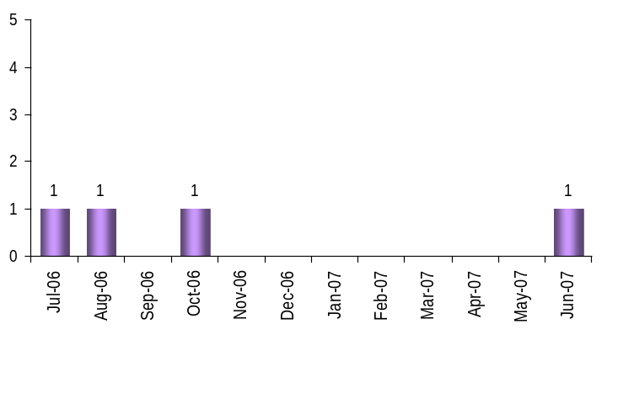
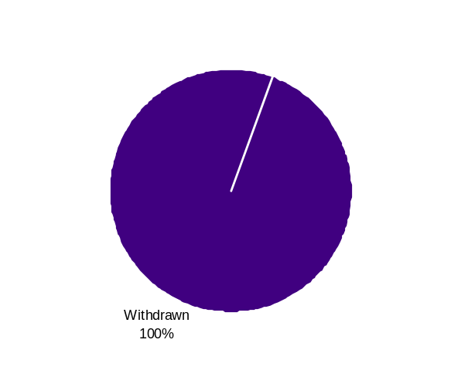
Reinforce Performance
Outcomes:
Employees know how their performance contributes to the goals of the organization. Strong performance is rewarded; poor performance is eliminated. Successful performance is differentiated and strengthened. Employees are held accountable.
Performance Measures
Percent employees with current performance evaluations
Employee survey ratings on “performance and accountability” questions
Disciplinary actions and reasons, disciplinary grievances/appeals filed and disposition (outcomes)
Reward and recognition practices (TBD)
Department of Ecology
Disciplinary Grievances and Appeals
Disciplinary Grievances
(Represented Employees)
Disciplinary Appeals
(Non-Represented Employees
filed with Personnel Resources Board)
Time Period = July 2006 through June 2007
1 Demotion
1 Total Disciplinary Appeal Filed with PRB
Total # Disciplinary Grievances Filed: 4
There is no one-to-one correlation between the filings shown above and the outcomes displayed in the charts below. The time lag between filing date and when a decision is rendered can cross the time periods indicated.
Disposition (Outcomes) of Disciplinary Grievances
Time period = July 2006 through June 2007
3 Resolved
1 at Step 1
Disposition (Outcomes) of Disciplinary Appeals*
Time period = July 2006 through June 2007
*Outcomes issued by Personnel Resources Board
Data as of June 2007
Source: Agency Tracking
Data as of June 2007
Source: Department of Personnel

Slide 24
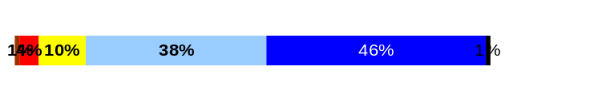
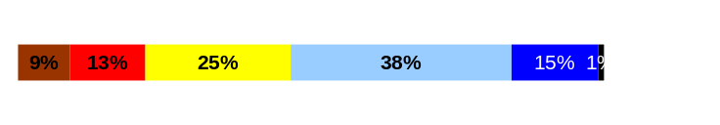
ULTIMATE OUTCOMES
Employees are committed to the work they do and the goals of the organization
Successful, productive employees are retained
The state has the workforce breadth and depth needed for present and future success
Performance Measures
Employee survey ratings on “commitment” questions
Turnover rates and types
Turnover rate: key occupational categories
Workforce diversity profile
Retention measure (TBD)
Department of Ecology
Employee Survey “Employee Commitment” Ratings
Analysis:
The new Performance and Development Plan and the Position Description Form establishes better links between the position’s duties and responsibilities and the individual contributions to the achievement of Ecology’s mission, goals and objectives.
112 nominations were received for the 2006 Agency Awards in 5 categories: Commitment to Excellent Service; Environmental Stewardship; Supportive Work Environment; Service to the Community; and Workplace Diversity.
Awards were given at an all-staff meeting on December 13, 2006.
Action Steps:
Ecology is committed to improving communication and understanding about how Ecology measures success toward agency priority goals, and each employee’s role in achieving those goals. Ecology’s Communications Office is designing and implementing new internal communication strategies.
Annual employee recognition program categories and criteria will be reviewed for 2007.
2007 internal PDP training and guidance to managers and supervisors will re-emphasize importance of linkage between individual positions and the agency mission and goals.
The 2007 Employee Survey is planned for October with results expected by late December; review of results and action planning early 2008.
Avg
Q3. I know how my work contributes to the goals of my agency.
Q12. I know how my agency measures its success.
Q9. I receive recognition for a job well done.
4.2
3.4
3.5
Never
Seldom
Occasionally
Usually
Always
Overall average score for Employee Commitment ratings: 3.7
Data as of April 21, 2006
Source: Employee Survey

Slide 25
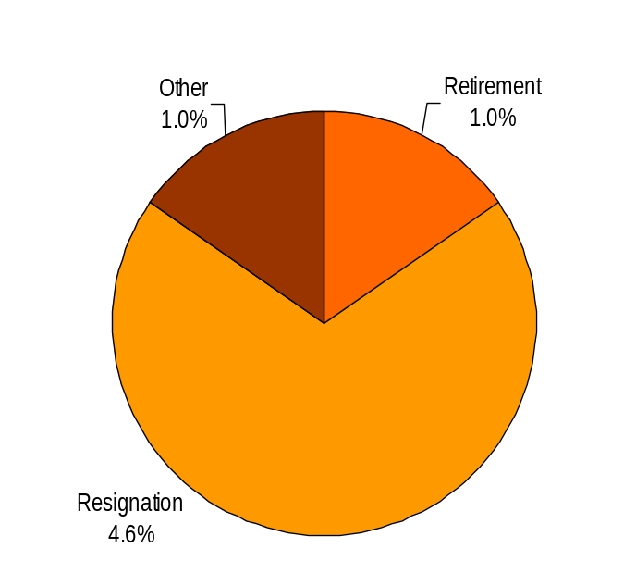
ULTIMATE OUTCOMES
Employees are committed to the work they do and the goals of the organization
Successful, productive employees are retained
The state has the workforce breadth and depth needed for present and future success
Performance Measures
Employee survey ratings on “commitment” questions
Turnover rates and types
Turnover rate: key occupational categories
Workforce diversity profile
Retention measure (TBD)
Department of Ecology
Turnover Rates
Total % Turnover (leaving state)
Time Period: July 2006 through June 2007
Analysis:
Exit interview data shows no significant trends or concerns regarding reasons for leaving the agency.
Action Steps:
Explore and discuss succession planning options with Executive Management.
Assess if there are specific programs with high turnover.
Continue with retention programs such as mentoring and Wellness Program activities.
Total Turnover Actions: 97
Total % Turnover: 6.7%
Note: Movement to another agency is currently not available in HRMS/BW
Data as of June 2007
Source: Business Warehouse

Slide 26
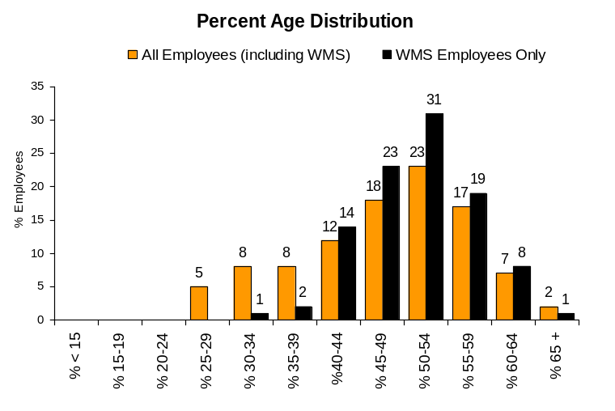
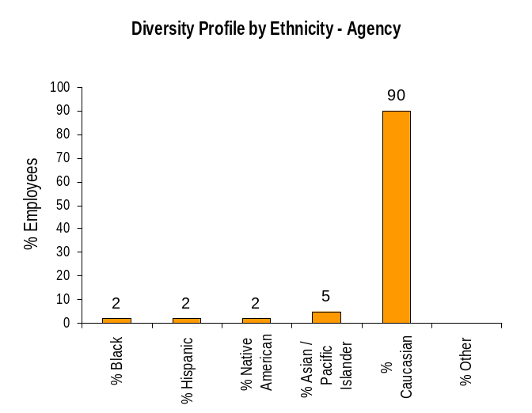
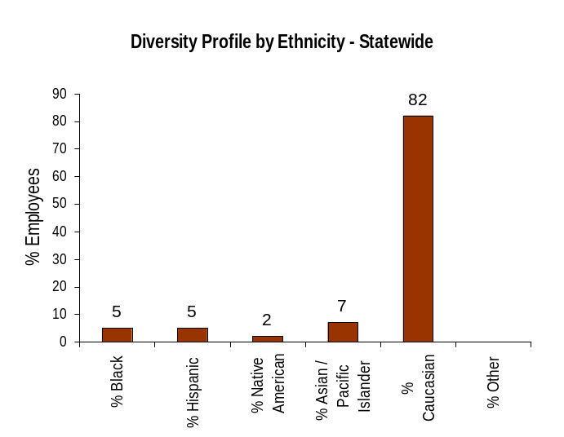
ULTIMATE OUTCOMES
Employees are committed to the work they do and the goals of the organization
Successful, productive employees are retained
The state has the workforce breadth and depth needed for present and future success
Performance Measures
Employee survey ratings on “commitment” questions
Turnover rates and types
Turnover rate: key occupational categories
Workforce diversity profile
Retention measure (TBD)
Department of Ecology
Workforce Diversity Profile
Agency State
Female 50% 53%
Disabled 3% 5%
Vietnam Vet 5% 7%
Disabled Vet 0% 2%
People of color 11% 18%
Persons over 40 78% 75%
Analysis/Action Steps:
Historically, natural resource agencies have lagged behind state government in diversity. Ecology continues to lead the natural resource agencies in percentage of people of color and women.
Continue to support Ecology’s strong diversity program, which includes extensive outreach and recruitment targeted at reaching diverse, qualified candidates.
Continue to pool resources and partner with other state agencies, the Natural Resources Agencies Recruiters team, and the statewide team sponsored by the Department of Personnel's Workforce Diversity Manager and Diversity Recruiter.
Continue with the implementation of the recommendations from the Governor's Affirmative Action Program Committee in March 2007 to: share Ecology's Diversity Program with other agencies as an example of "best practices" that work to promote diversity, and contact the State Department of Veterans Affairs for assistance in reaching out to returning Operation Iraqi Freedom/Operation Enduring Freedom veterans.
Data as of June 2007
Source: Business Warehouse

