Slide 1

Smooth Transitions:
K-12 Standards and “The Open Door”
GEAR UP Conference
Bellevue, WA
May 15, 2003
Brian Jeffries, OSPI
Sally Zeiger Hanson, SBCTC
Bill Moore, SBCTC
Notes:
Thank you—for the record, my name is Bill Moore, and I’m the coordinator for assessment, teaching and learning for the State Board for Community and Technical Colleges. I know it’s risky to throw in some grand metaphors in a 3 minute presentation, but I think it’s useful to make the point that while we’re sharing the results of a modest and limited study here, there are big ideas involved: ed reform is committed to “raising the bar” for all students, and the two-year college system is equally committed to providing open door access to college for all citizens of Washington state. The WASL plays a critical role in reflecting that “raised bar”; our placement tests play a similarly critical role in “placing” our students in courses where they have the best chance of success and if necessary developing the skills they need for college-level work. At the same time, we don’t believe these metaphors need to clash, and we’re committed to working with our K-12 partners to see that we align our systems so that they don’t. This study represents one small piece of a number of things we’re doing to address these issues.

Slide 2

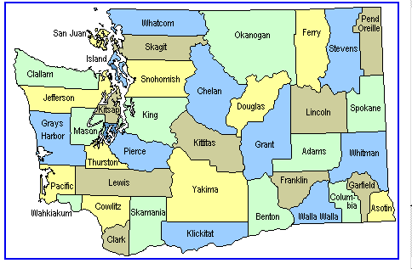
34 Community and Technical Colleges
Serving 251,000 students
48% of HS graduates take CTC classes within 3 years of graduation
Notes:
Possible narrative:
This presentation will be a quick overview of what’s new at the 34 community and technical colleges. More than a quarter of a million students enroll in the colleges at anyone time, representing 60% of the all public higher education enrollments. High school graduates elect CTCs in very large numbers:
31% of HS graduates go directly to a CTC –18,500 students
Another 17% wait a year and then attend (after time at work or at 4 year institutions)
15,400 attend a CTC while in HS (mostly in Running Start) – 9% of juniors and seniors
Note: The 251,000 number is Fall 2001 all funds – you might want add your college’s number – see page 61 in the By college – Part A section of the Fall Enrollment and Staffing Report http://www.sbctc.ctc.edu/Pub/PubFall.htm

Slide 3
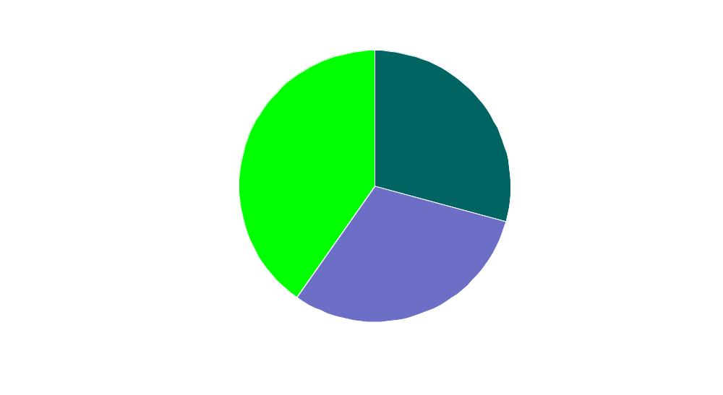
59,400 HS Graduates - Status Several Years After Leaving HS
At CTC After 1-2
Year Delay
17%
10,000 additional grads who had been at 4 year or not in college go to CTC
18%
Nearly half to CTC with in 3 years of graduation to CTC
34%
51% take dev in 1st year

Slide 4
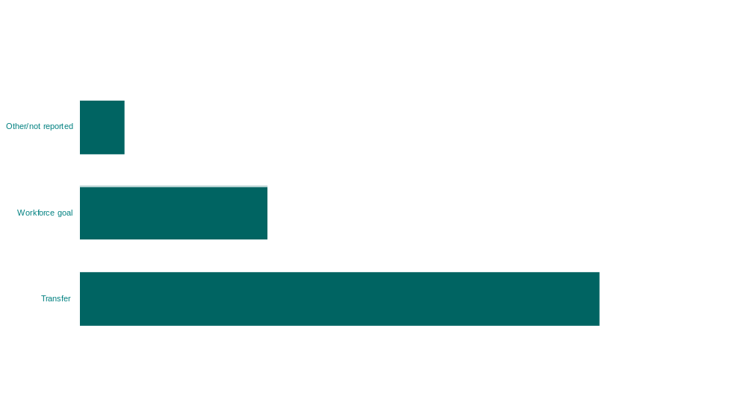
HS Graduates at CTCs
Enroll Mostly to Prepare for Transfer

Slide 5

Norm to Transfer – Public Baccalaureate Graduates –Class of 2000-01
No majority pattern
Transfer means 40+ credits from other than degree granting institution

Slide 6
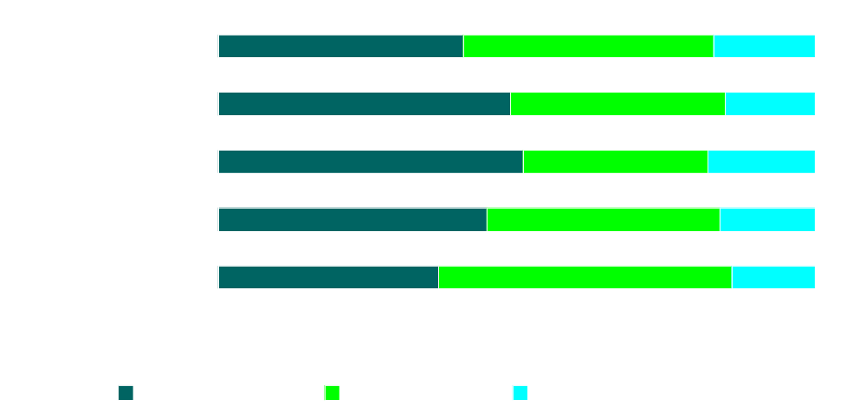
Race & Ethnic Diversity

Slide 7
HS Graduates of 2001 Attending CTC in 2001-02 – What They Take
18,786 attending – 31% of HS graduates
9,000
8,000
7,000
Dev Math + Other Dev + college-level
6,000
5,000
4,000
College-level Classes
3,000
Dev Math
+ college-
level
Dev Writing or Reading
+ college-level
2,000
Delay 1 year Dev (est)
1,000
0

Slide 8
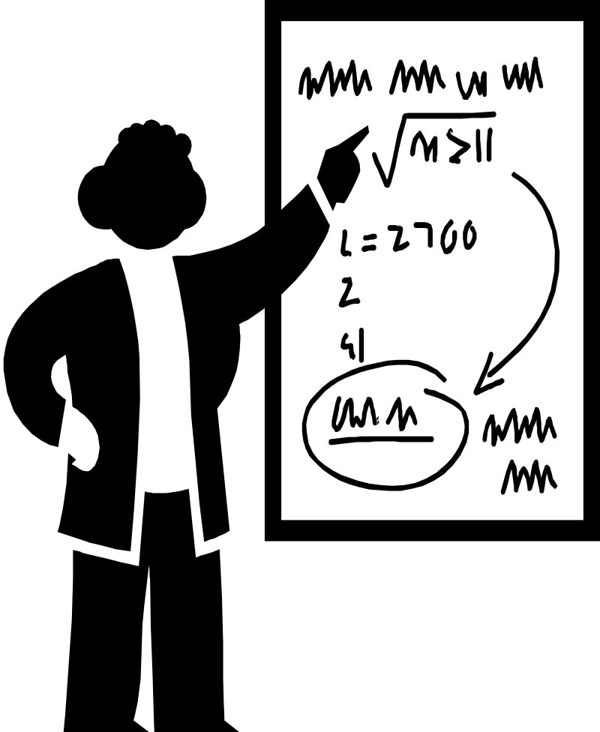
Helping Students Prepare for College-Level Math
Both Algebra II (high school) & Intermediate Algebra prepare students for college-level math
Intermediate algebra taken at two-year college does NOT count toward degree
Notes:
HS teachers/counselors need to know that:
The amount, nature and timing of math (and math-based science) courses being taken by students in HS is important for their preparation to move right into college-level programs.
intermediate algebra, often called Algebra II in high schools, is the core prerequisite course for college-level math courses but is NOT itself considered college-level (and students have to pay tuition to take it at CTC).

Slide 9
1st Math Classes at the College-Level
Math: A Practical Art or Math for Non-Math/Science Majors
Pre-calculus
Application of Calculus for Business and Economics
College Algebra or Finite Math
Math for Elementary Teachers
Calculus

Slide 10
College-Level Math Required for Most CTC Programs
Direct Transfer Agreement (DTA) (transfer to BA)
Associate of Science (transfer to BS)
Associate of Applied Science (transfer to BS in Applied Tech, Upside Down Degree or BAS at selected institutions)
Not required in workforce certificates programs nor in some technical degrees

Slide 11
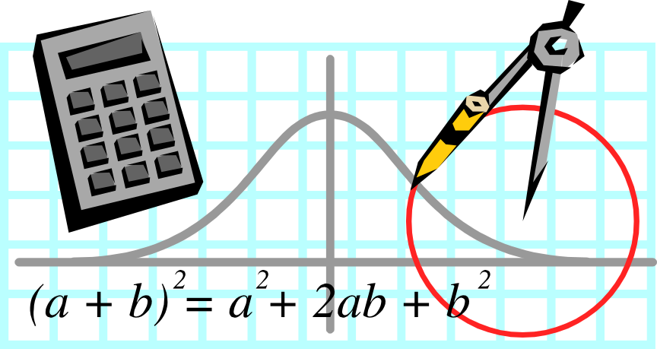
Math Skills Recede
Need refresher if no math in a year
  Students who complete math early in HS
Need math through intermediate algebra (algebra 2/ integrated math 2) in high school, though such math is not usually required for graduation

Slide 12

Summary
31% HS grads straight to CTC after HS – 48% in 3 years
54% HS grads at CTCs taking developmental classes in 1st year after HS
Most developmental courses are in math

Slide 13

High School Graduation Opens the Door to Community & Technical Colleges…
Notes:
Possible Narrative: Two-year college system takes pride in its open-door philosophy and emphasis on access to higher education, serving all students regardless of their educational background and level of skills, representing a 2nd- (or more) chance opportunity for learners
Note: This is the start of the common message that OSPI and SBCTC have developed for sharing with students, teachers, counselors and parents – Graduation opens the door, the keys to getting right into college-level work are taking plenty of math, science, English, etc right on through the senior year.

Slide 14


But Students Need the Right Keys to Access College-Level Courses
Planning, Study Skills
Level of Preparation =
Level of Opportunities
“Learn it now or pay tuition for it later”
Math skills
Writing skills
Responsibility
Notes:
Possible Narrative (this is the message worked out between OSPI and SBCTC):
In promoting that open-door message, however, what has been lost to some extent is that getting in the door is only the first step. Students need to be prepared for college, whether it be a 2-year community or technical college or a 4-year baccalaureate-granting university, in order to avoid taking college prep courses in college that could have been completed in high school.
The keys to this preparation for college involve acquiring critical thinking, writing and math skills by taking core academic courses in English, science, and social sciences, and in particular taking math (including Algebra II or Integrated Math II) as well as math-based science courses through the senior year. They also involve developing non-academic skills like self-responsibility, planning and study skills needed for success in the academic environment of college.
These keys provide students with immediate access to college-level courses and specific transfer and professional-technical programs—the academic choices (and thus potentially career and life choices) available to students at CTCs depend on the level of preparation in high school.
Graduating without these keys means that students will need to spend time and money taking college prep courses that don’t count toward a degree and that are available in high school.

Slide 15

We’re Asking High School Counselors to:
Clarify that college is college
Emphasize connection between college preparation & academic success
Encourage early, thoughtful planning for next steps
Notes:
Possible Narrative:
Keys to college success are same for 2-year colleges as for 4-year institutions (except for the foreign language requirement)
The level of preparation at high school determines level of opportunities available to students, both in college and beyond
Students (and their families) need to take responsibility in balancing various demands of high school life with planning needed to acquire the keys that will open the right doors in college

Slide 16

K-12 Standards

Slide 17

Purpose of Education Reform
“… to provide students with the opportunity to become responsible citizens, to contribute to their own economic well-being, and to that of their families and communities, and to enjoy productive and satisfying lives.”
- Basic Education Act (Goal)

Slide 18
Standards-Based K-12
Education Reform
Washington State Learning Goals 1-4
Essential Academic Learning Requirements (EALRs)
Washington Assessment of Student Learning (WASL)
Certificate of Mastery
Accountability

Slide 19
EALRs and assessments serve multiple purposes
Goal
  Establish student expectations at “internationally competitive levels.”
System
  A tool to evaluate instructional practices.
  Initiate appropriate educational support for students who have not mastered the EALRs.
Students
  To assess individual student skills/knowledge for graduation purposes.

Slide 20
What State Law says about
the Certificate of Mastery
Once State Board of Education finds the 10th grade WASL sufficiently valid and reliable as a graduation requirement, successful completion shall lead to a Certificate of Mastery (CoM).
Most students shall obtain a CoM at about the age of 16.
CoM is evidence that student has mastered the EALRS.
CoM required for graduation but not the only requirement.

Slide 21
Post-Certificate of Mastery
Rigorous Coursework That Extends Knowledge and Skills Beyond EALRs
HECB Core Minimum Requirements
Career and Technical Education Options
Career Guidance & Counseling Students to Personalize and Focus Their Learning on Their Preferred Future

Slide 22
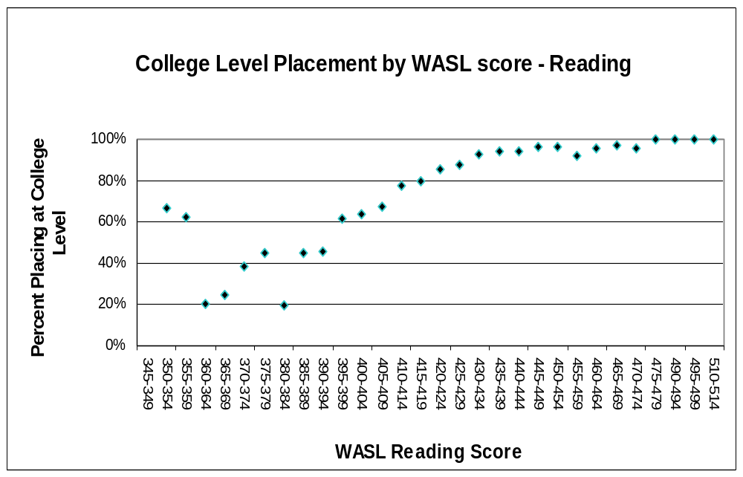
Using WASL to Predict College-Level Placement
WASL Standard
Notes:
Here’s a graphic view of the relationship we’re describing—this depicts Reading, but the overall pattern is the same for writing and math.
The line indicates the score at or above which students are considered to have met the WASL standard—you can the mark showing that 66% of students in that range of scores placed at college level (notice also that all ranges above that score placed at college level at even higher rates)
The other key point from this graph is the wider variation at the low end of the score range—this could be a function of motivational issues or other particular characteristics of this sample.

Slide 23
Using WASL to Predict College-Level Placement
Placement probability Content Area | 95% | 90% | 85% | 75% | WASL Standard
Reading | 439 | 428 | 419 | 410 | 400
Writing | 11 | 9 | 8 | 8 | 9
Math | 486 | 466 | 456 | 442 | 400
Notes:
There is a consistent trend in the data comparisons between the WASL and college placement scores: the higher the WASL score, the higher the probability that the student will place at college level [NOTE: for this sample only—we don’t know if that will hold over a longer time period than the 47-day maximum gap allowed here]. So for each content area, it’s possible to define a WASL score that would predict a given level of probability of scoring at college level on a placement test—the decision is what level of probability is most reasonable and appropriate. As an example, this table shows a range of options from 95% to 75%, along with the WASL performance standard scores for comparison purposes.
[NOTE: this is oversimplified because we’re using the recommended cut scores and talking generally rather than about specific placement tests—but the patterns and ideas would stay the same and could be done by each college for a specific test using its own cut scores if necessary (although that might be overly complicated for students). The system discussion needs to include whether or not we can make a systemwide recommendation about these scores or leave them up to individual colleges.]

Slide 24

College-placement performance can be predicted from WASL scores, but we need to:
Except for writing, use WASL score levels higher than standard
Look more closely at math connections
Study test relationships for full range of students
Notes:
Bullet 1: which makes sense—we don’t think we should be sending the message that all students are ready for college-level work at the 10th grade; we want them to understand that they have significant, rigorous coursework to complete in their junior and seniors years to prepare them for college.
Bullet 2: There’s definitely a fair amount of similarities in the content of the tests, but especially in math, there are also definite gaps—and that’s a concern for a tool designed to gauge specific areas of knowledge and skills so students can be placed appropriately in specific levels of classes.
Bullet 3: Loretta Seppanen will address this issue in her brief report, but we believe that the most significant students we “share” with K-12 are the ones who come to us right after high school (immediately or 1-2 years later), and the sample of students in this study does NOT fully represent this group. In order to have some confidence that the WASL can be useful for placement with regular admission students we need to look at students who take the WASL and then enter our colleges 2-3 years later (and even better to have information about what course they take in the interim and how they do). [Phase II of the joint study with OSPI]

Slide 25

Next Steps
Continue to Study the Relationship Between the WASL and College Success
Continue to Explore Possibilities for Use of WASL and EALRs in College Placement Decisions
Notes:
Committee includes two-year administrators and faculty, OSPI, and 4-year institution representatives
These decisions are local-college decisions, but the committee will propose options and approaches for campuses to consider and information we need to gather

Slide 26
Contact Information:
Brian Jeffries, OSPI
jeffries@ospi.wednet.edu
Sally Zeiger Hanson, SBCTC
shanson@sbctc.ctc.edu
Bill Moore, SBCTC
bmoore@sbctc.ctc.edu

