Slide 1
Transport Aircraft Wiring Practices
Brett Portwood
FAA Technical Specialist, Safety and Integration
Los Angeles Aircraft Certification Office
ANM-130L
(562)627-5350
brett.portwood@faa.gov
Notes:
08/15/99
1

Slide 2
Wiring Practices
Guidance
  AC 43.13-1b - ACCEPTABLE METHODS, TECHNIQUES, AND PRACTICES - AIRCRAFT INSPECTION AND REPAIR
    Chapter 11- Aircraft Electrical Systems
  AC 65-15A
Notes:
08/15/99
2

Slide 3
Topics Covered
Electrical Load Determination
Breaker and Wire Sizing/Selection
Wire Insulation Properties
Routing/Clamping/Bend Radii
Splicing
Wire Terminals
Grounding and Bonding
Wire Marking
Connectors and Conduits
Notes:
08/15/99
3

Slide 4
Electrical Load Determination
Load Analysis
  It should be determined that the total electrical load can be safely controlled or managed within the rated limits of the affected components of the aircraft’s electrical system.
New or additional electrical devices should not be installed without an electrical load analysis
Notes:
08/15/99
4

Slide 5
Circuit Breaker Devices
Should be sized so that it will open before the current rating of the wire attached to it is exceeded, or before the cumulative rating of all loads connected to it are exceeded, whichever is lowest.
Notes:
08/15/99
5

Slide 6
Circuit Breaker Protection
“A circuit breaker must always open before any component downstream can overheat and generate smoke or fire.”
“Circuit breakers are designed as circuit protection for the wire, not for protection of black boxes or components.”
Use of a circuit breaker as a switch is not recommended.
Notes:
08/15/99
6

Slide 7
Wire Selection
Wires must be sized so that they
  have sufficient mechanical strength
  do not exceed allowable voltage drop levels
  are protected by circuit protection devices
  meet circuit current carrying requirements
Notes:
08/15/99
7

Slide 8
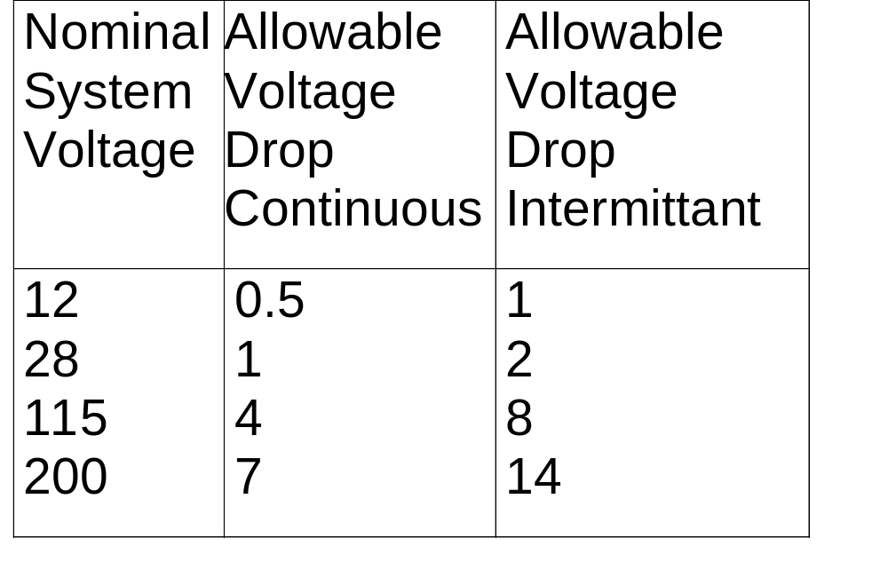
Wire Selection
Notes:
08/15/99
9

Slide 9
Wire Selection
Mechanical strength of wire sizes less than #20
  Wire with less than 19 strands should not be used
  Additional support at terminations
  Should not be used when subject to excessive vibration, repeated bending, or frequent disconnection
Notes:
08/15/99
8

Slide 10
Wire Selection
Factors for Determining Current Carrying Capacity
  Effect of insulation heat aging
  Max operating temperature
  Single wire or wires in a harness
  Altitude
Tables in Section 5 of AC 43.13-1b provide an acceptable method of calculating wire resistance and current carrying capacity of wires
Notes:
08/15/99
10

Slide 11
Wire Selection
Conductor Stranding
  Minimizes fatigue breakage
Platings
  all aircraft wiring is plated because bare copper develops a surface oxide film which is a poor conductor
    Tin < 150 degrees C
    Silver < 200 degrees C
    Nickel ---> 260 degrees C
Notes:
08/15/99
11

Slide 12
Wire Substitution
In the repair and modification of existing aircraft, when a replacement wire is required, the maintenance manual for that aircraft should first be reviewed to determine if the original aircraft manufacturer (OAM) has approved any substitution. If not, then the OAM should be contacted for an acceptable replacement
Notes:
08/15/99
12

Slide 13
Wire Insulation Selection
Characteristics should be chosen based on environment
    Abrasion resistance
    Arc resistance
    corrosion resistance
    Cut-through strength
    Dielectric strength
    Flame resistant
    Mechanical strength
    Smoke emission
    Fluid resistance
    heat distortion
Notes:
08/15/99
13

Slide 14
Selecting
Non Flame Propagation
Low-Smoke Insulation for Aircraft Wiring
SPECIAL THANKS TO
James F. Hunt
of DuPont for the information
on the next 13 slides.

Slide 15
Flame Resistance Insulating Materials
Polymer Brand Mil Spec
PTFE TEFLON® 22759/12
ETFE TEFZEL® 22759/16
Aromatic KAPTON® 81381
Polyimide
Composite OASIS® 22759/80-92

Slide 16
The Challenge:
Select the insulation system best-suited for each application

Slide 17
Fact:
There is no “perfect” insulation system for aerospace wire & cable

Slide 18
The Designer’s Task:
Consider trade-offs to secure best balance of properties
Consider influence of design, installation and maintenance
.....For Each Application!

Slide 19
HOW TO CHOOSE
Seek The Best Balance of Properties:
Electrical
Mechanical
Chemical
Thermal
Plus
Nonflammability & low smoke

Slide 20
Comparative Properties of Wire Insulation systems
Relative Ranking 1 2 3 4
Weight PI ETFE COMP PTFE
Temperature PTFE COMP PI ETFE
Abrasion Resistance PI ETFE COMP PTFE
Cut-Through resistance PI COMP ETFE PTFE
Chemical resistance PTFE ETFE COMP PI
Flammability PTFE COMP PI ETFE
Smoke generation PI COMP PTFE ETFE
Flexibility PTFE ETFE COMP PI
Creep (at temperature) PI COMP PTFE ETFE
Arc Propagation Resistance PTFE ETFE COMP PI

Slide 21
PTFE - ETFE - PI - COMPOSITE
Best Balance of Properties
Inherently resistant to Flame
Low smoke generation

Slide 22
Aromatic Polyimide (KAPTON)
(mil spec 81381)
Design Properties
  abrasion/cut-through
  low-smoke/non-flame
  weight/space
Limitations
  arc-track resistance
  flexibility

Slide 23
PTFE
(mil spec 22759/12)
Design Properties
  260 C thermal rating
  low-smoke/non-flame
  high flexibility
Limitations
  cut-through resistance
  “creep” at temperature

Slide 24
ETFE
(mil spec 22759/16)
Design Properties
  chemical resistance
  abrasion resistance
  ease of use
Limitations
  high temperature cut-through
  thermal rating (150 C)

Slide 25
Composite
(mil spec 22759/80-92)
Construction
  1st layer: Fluoro/PI/Fluoro composite
  2nd layer: PTFE tape
Design properties
  high temperature rating (260 C)
  cut-through resistance
  arc-track resistance
Limitations
  outer layer scuffing

Slide 26
Insulation Selection
Select with care
  seek proper balance of properties for each application
Consider outside influences
  design requirements
  installation conditions
  proper maintenance
Choose materials with inherent flame/smoke resistance

Slide 27
Conclusion on Insulation
Aircraft designer can choose among many polymeric materials
Physical and chemical properties are equally important
Safest system combines “Balance of Properties” with inherent flame/smoke resistance

Slide 28
Routing and Clamping
Wires should be supported by suitable clamps, grommets, or other devices at intervals of not more that 24 inches
The supporting devices should be of a suitable size and type with wire/cables held securely in place without damage to the wire or wire insulation
Notes:
08/15/99
14

Slide 29
Routing and Clamping
Stand-offs should be used to maintain clearance between wires and structure. Employing tape or tubing is generally not acceptable as an alternative
Exception: Where it is impossible to install off-angle clamps to maintain wiring separation in holes, bulkheads, floors, etc.
Notes:
08/15/99
15

Slide 30
Clamps
Wire bundles should not be able to move axially
  RF Cables-do not crush
  Clamps mounted with attachment hardware on top
  Tying should not be used as alternative to clamping
Notes:
08/15/99
16

Slide 31
Routing
Eliminate potential for chafing against structure or other components
Position wiring such that it is not likely to be used as handholds or support
Route, if practicable, to minimize exposure to damage by maintenance crews or shifting cargo
Route to avoid battery electrolytes or other corrosive fluids
Notes:
08/15/99
17

Slide 32
Routing
Protect wires in wheel wells and other exposed areas
route wires above fluid lines, if practicable
Use drip loops to control fluids or condensed moisture
Enough slack to allow maintenance, and prevent mechanical strain.
Notes:
08/15/99
18

Slide 33
Wire Bend Radii
Minimum Radius- 10 times the outside diameter of the largest wire or cable in the group
Exceptions
  terminations/reversing direction in bundle - 3 times the diameter
  RF Cables- 6 times
  thermocouple wire- 20 times

Slide 34
Unused Wires
Secured
  tied into a bundle or secured to a permanent structure
Individually cut with strands even with insulation.
Pre-insulated closed end connector or 1 inch piece of insulating tubing folded and tied back

Slide 35
Wire Replacement
Should be replaced when:
  chafed/frayed or insulation is suspected of being penetrated
  outer insulation is brittle such that flexing causes cracking
  damaged by or known to have been exposed to electrolyte, oil, hydraulic fluid, etc.
  evidence of overheating

Slide 36
Wire Replacement (cont.)
Wire should be replaced when
  bears evidence of being crushed or kinked
  shield on shielded wire ir frayed and/or corroded
  shows evidence of beaks, cracks, dirt, or moisture in plastic sleaving
  sections of wire in which splices occur at less than 10 ft intervals

Slide 37
Wire Splicing
Kept to a minimum and avoided in high vibration areas
Located to permit inspection
Staggered in bundles to minimize increase in bundle size
Self-insulated splice connector is preferred

Slide 38
Terminals
Tensile strength of the wire-to-terminal joint should be at least the equivalent tensile strength of the wire
The resistance of the wire-to-terminal joint should be negligible relative to the normal resistance or the wire

Slide 39
Terminal Strips
Barriers to prevent adjacent studs from contacting each other
Current should be carried by terminal contact surface and not by the stud
Studs anchored against rotation
Mounted such that loose metallic objects cannot fall across terminals

Slide 40
Terminal Strips
Terminal should be periodically inspected for loose connections, metallic objects, dirt, and grease accumulation. These types of conditions can cause arcing which may result in a fire or systems failure.

Slide 41
Terminal Lugs
Used to connect wiring to terminal block studs
No more than 4 lugs or three lugs and a bus bar per stud
Lug hole size should match the stud diameter
    greatest diameter on bottom, smallest on top
    Tightening terminal connections should not deform lugs

Slide 42
Terminal Lugs
Aluminum Lugs
  crimped to aluminum wire only
    Special attention needed to guard against excessive voltage drop at terminal junction
      Inadequate terminal contact area
      Stacking errors
      improper torquing
  Use calibrated crimp tools

Slide 43
Grounding
Types of Grounding
  AC returns
  DC returns
  others
Mixing return currents from various sources should be avoided because noise will be coupled from one source to another and can be a major problem for digital systems

Slide 44
Grounding
Design of ground path should be given as much attention as other leads in the system
Should provide a constant impedance
Equipment items should be externally grounded even when internally grounded

Slide 45
Grounding
Heavy current grounds
  Must be attached to individual grounding brackets that are attached to aircraft structure with a proper metal-to-metal bond.
  Must accommodate normal and fault currents of the system without creating excessive voltage drop or damage to the structure
  Special attention needed for composite aircraft

Slide 46
Wire Marking
Necessary to provide safety of operation, safety to maintenance personnel, and ease of maintenance
Common practice for wire the manufacturers to use wire material part number and the five digit/letter code identifying the manufacturer to identify performance capability

Slide 47
Wire Marking
Wire identification marks identify the wire, the circuit it belongs to, and its gauge size. All markings should be legible in size, type, and color.
15 inch maximum intervals along the wire (direct or sleeve/tag)
  >3 inches needs no marking
  readable without removing clamps, ties, or supporting devices

Slide 48
Connectors
Multitude of types. Crimped contacts are generally used. Some of the more common are
  Round cannon type
  Rectangular
  Module Blocks
Should be selected to provide the maximum degree of safety and reliability considering electrical and environmental requirements

Slide 49
Connectors
Environmental resistant connectors should be used in applications subject to fluids, vibration, thermal, mechanical shock, and/or corrosive elements
When HIRF/Lightning protection is required, special attention should be given to the terminations of individual or overall shields

Slide 50
Conduits
Primary purpose is for mechanical protection or wires or cables
Should have absence of abrasion at end fittings
Proper clamping required
Adequate drain points free of obstructions
Located to minimize damage from moving objects
Proper bend radii

Slide 51
Wiring Review
Sizing and Selecting
Routing and Clamping
Terminating
Grounding
Marking
Connectors
Conduits

