Slide 1
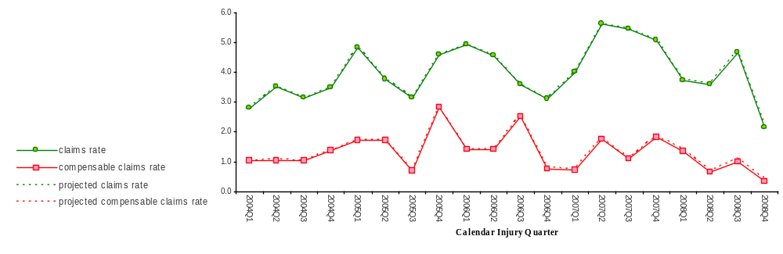
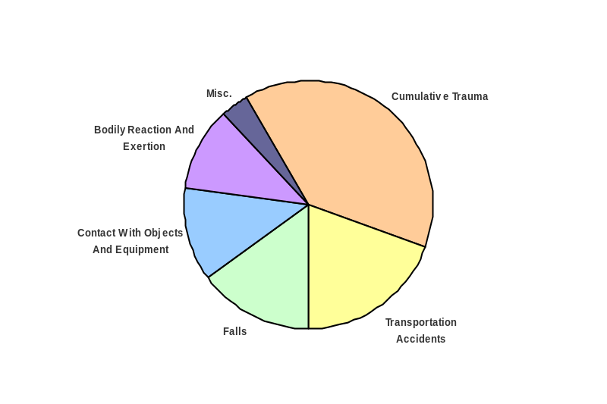
Deploy Workforce
Outcomes
Staff know job expectations, how they’re doing, & are supported. Workplace is safe, gives capacity to perform, & fosters productive relations. Employee time and talent is used effectively. Employees are motivated.
Performance Measures
Percent employees with current performance expectations
Employee survey ratings on 'productive workplace' questions
Overtime usage
Sick leave usage
Non-disciplinary grievances/appeals filed and disposition outcomes
Worker Safety
Worker Safety: Licensing, Department of
Analysis:
[xxx]
[xxx]
[xxx]
[xxx]
[xxx]
[xxx]
Action Plan:
[xxx]
[xxx]
[xxx]
[xxx]
Annual Claims Rate:
Annual claims rate is the number
of accepted claims for every 200,000
hours of payroll
200,000 hours is roughly equivalent
to the numbers of yearly payroll hours
for 100 FTE
All rates as of 06-30-2009
Accepted Claims by
Occupational Injury and
Illness Classification
System (OIICS) Event:
calendar year-quarter
2004Q1 through 2008Q4
(categories under 3% or not
adequately coded are grouped
into 'Misc.')
Cumulative Trauma Claims
Oiics Code | Oiics Description | Count
2 | Bodily Reaction And Exertion | 76
9 | Other Events Or Exposures | 11
0 | Contact With Objects And Equipment | 1
Source: Labor & Industries, Research and Data Services (data as of 06/30/2009 )

