Slide 1
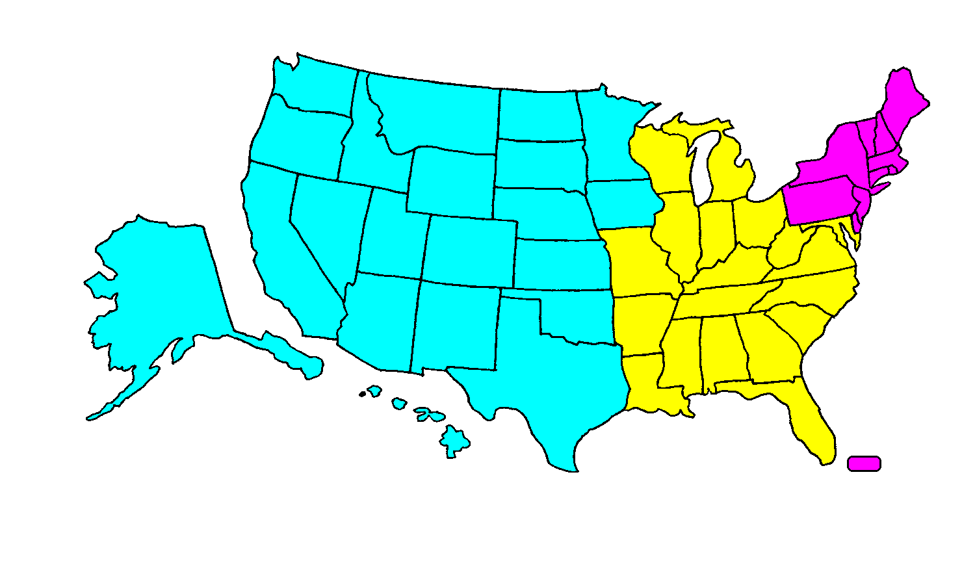
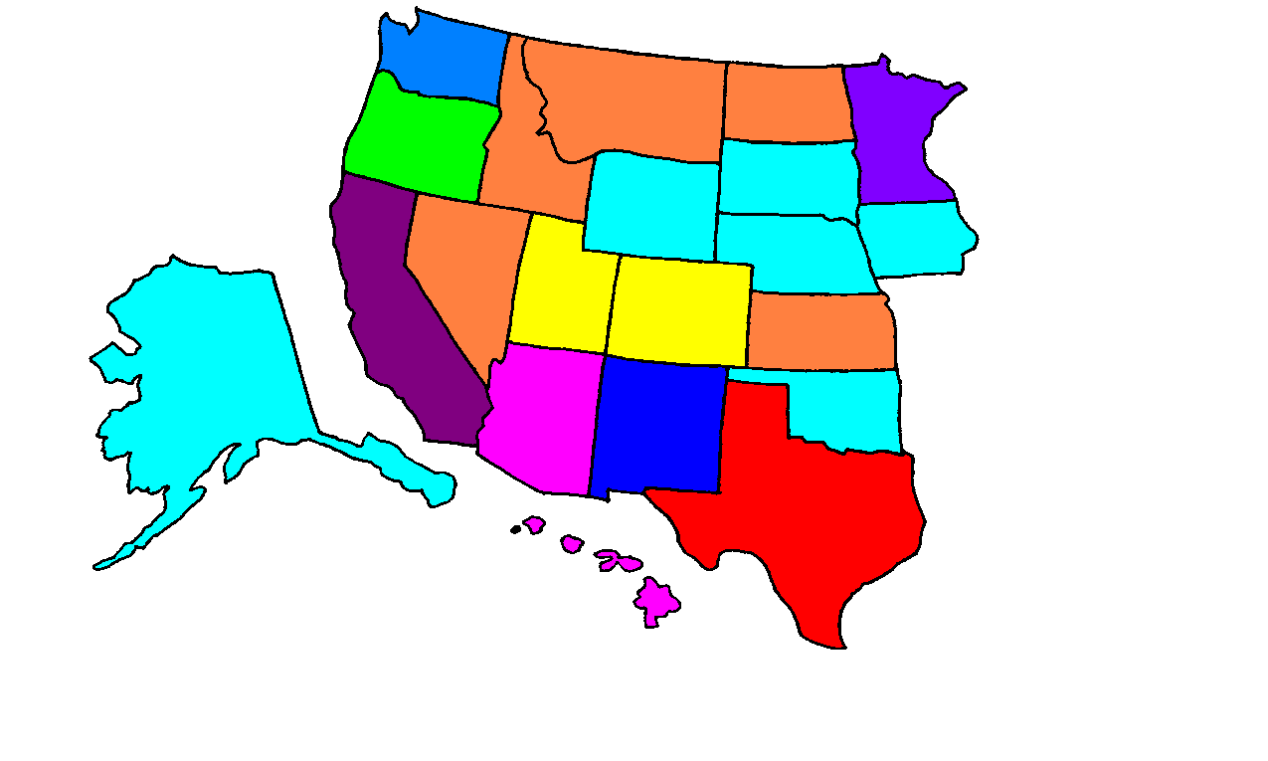
Regional Group A - West
AK, AZ, CA, CO, HI, IA, ID, KS, MN, MT, ND, NE, NM, NV,
OK, OR, SD, TX, UT, WA, WY
12/9/09
C
A
AK, IA, NE, OK, SD, WY - Jay Colbert
WA
MT
ND
OR
MN
AZ, HI - Donna Sullivan
ID
WY
SD
B
NV
NE
IA
CO, UT – Howard England
UT
CO
ID, KS, MT, ND, NV – Mollie Shea
AK
CA
KS
AZ
NM
OK
Africa, Asia, Caribbean
& South America –
As Assigned
MN – Cheryl Wall
TX
NM - Dawn Mitchum
HI
OR – Laura Amidon
CA – Deanna Ingersoll – A10, A28, A29, I4, M35, M36, M37, M38, M40, M43, M44, M47, M48, M90
– Laura Amidon - A20, A22, A25, A27, I3 (ex U’s), I7, M65, M66, M71, M74, M91
– Mildred Qualls - A24, I5, M33, M34, M46, M53
– Julie Waugh - I2, M51, M52
– Jay Colbert - I3 U’s, M92, M93, X79
WA – Tamara Kees Except:
– Mollie Shea –
A10, A18, A20, A27, M32,
M33, M36, M40, M43, M44
– Donna Sullivan –
A14, A28, M34, M37, M90
– Mollie Shea - M30, M54
– Dawn Mitchum - M31, M59, M67, M69
– Howard England - M55, M58, M60, M63
– Maggie Wells - All Others
TX – Mary Ann Garlic – All Except:
– Mildred Qualls – I1
– Mollie Shea – DMID U’s
– Dawn Mitchum – All Other U’s, P’s and SBIR/STTR’s (except I1)
– Mollie Shea – All Other I2 & I5
– Howard England – All Other S’s

