Slide 1
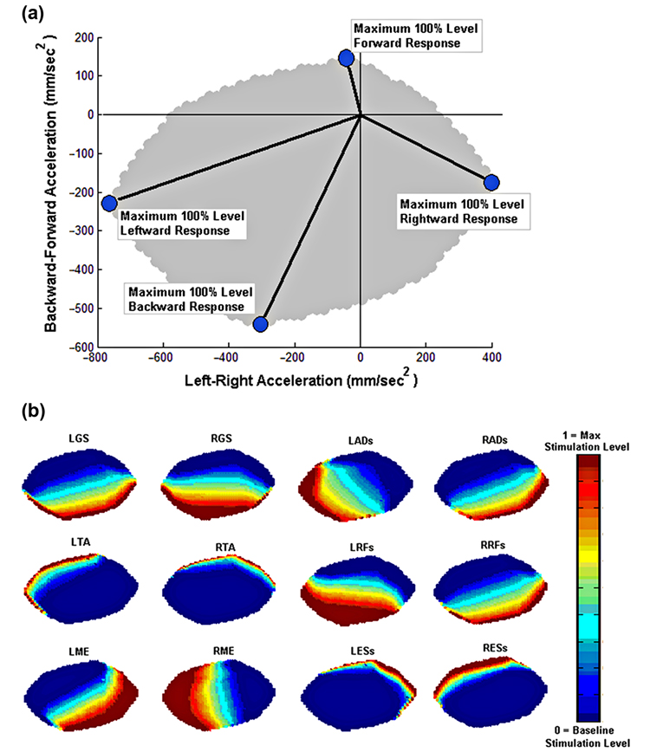

Figure 5. (a) Feasible center of mass acceleration space for subject with spinal cord injury. (b) Corresponding optimal muscle stimulation levels for each of 12 muscle groups under functional neuromuscular stimulation feedback modulation. For muscle nomenclature, “L” or “R” before muscle abbreviation denotes “left” or “right’ and “s” after denotes “surface stimulation.” AD = thigh adductors, ES = erector spinae, GS = triceps surae (soleus and gastrocnemius), Max = maximum, ME = gluteus medius, RF = rectus femoris, TA = tibialis anterior.
Nataraj R, Audu ML, Triolo RJ. Center of mass acceleration feedback control of functional neuromuscular stimulation for standing in presence of internal postural perturbations. J Rehabil Res Dev. 2012;49(6):889–912.
http://dx.doi.org/10.1682/JRRD.2011.07.0127
Notes:
Figure 5. (a) Feasible center of mass acceleration space for subject with spinal cord injury. (b) Corresponding optimal muscle stimulation levels for each of 12 muscle groups under functional neuromuscular stimulation feedback modulation. For muscle nomenclature, “L” or “R” before muscle abbreviation denotes “left” or “right’ and “s” after denotes “surface stimulation.” AD = thigh adductors, ES = erector spinae, GS = triceps surae (soleus and gastrocnemius), Max = maximum, ME = gluteus medius, RF = rectus femoris, TA = tibialis anterior.

