Slide 1
Progress on Pentaquarks
L. Littenberg
28 Oct 04

Slide 2
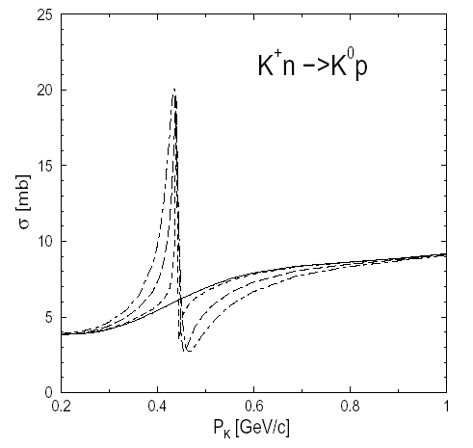
Problem
Interference peak/dip structure might integrate to zero if mass resolution not super

Slide 3
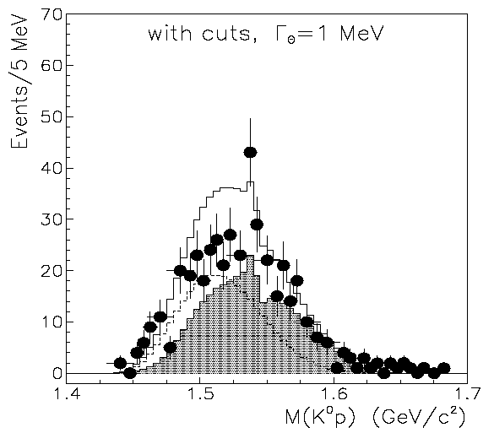
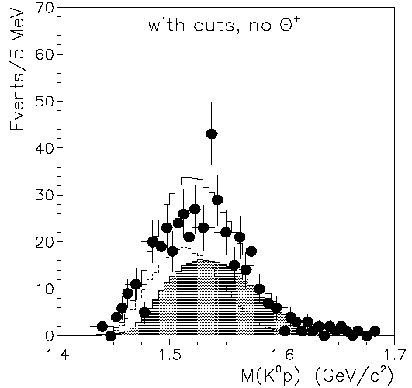
Closeup
Need to distinguish this from this with resolution of ~10MeV want to be sensitive to effect 10x smaller than on left!

Slide 4
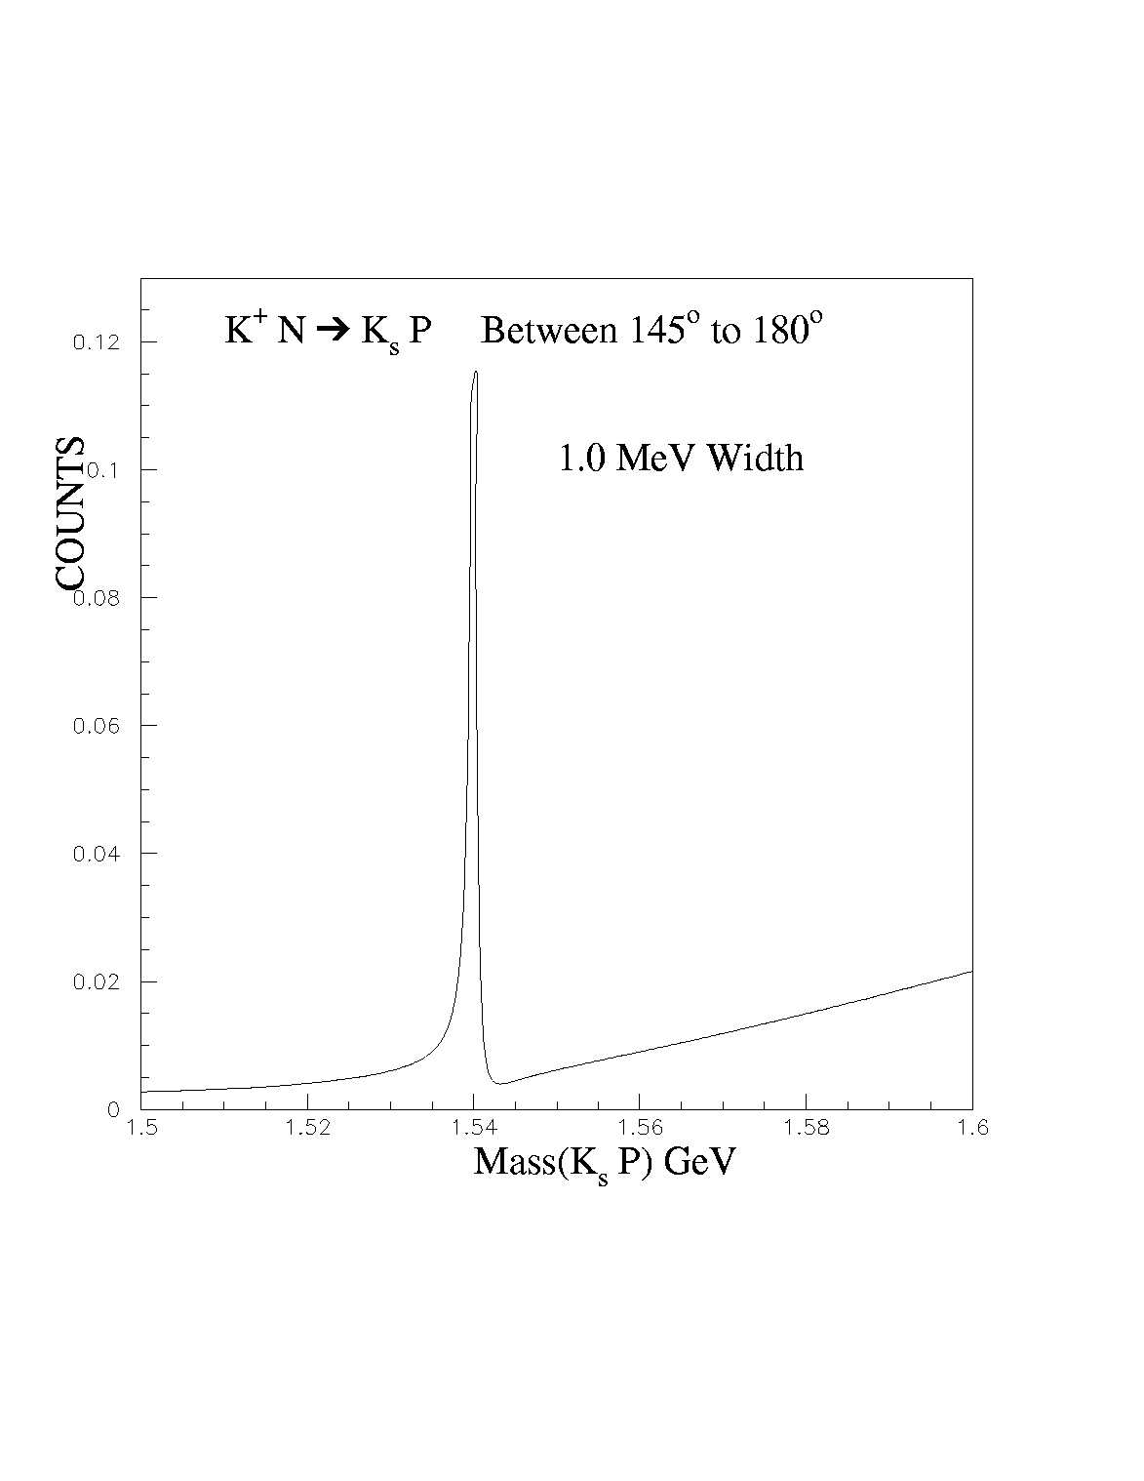
PWA from Ron Longacre
Longacre found that background waves get small in backward direction. Resonance stands out clearly w/o dip.

Slide 5
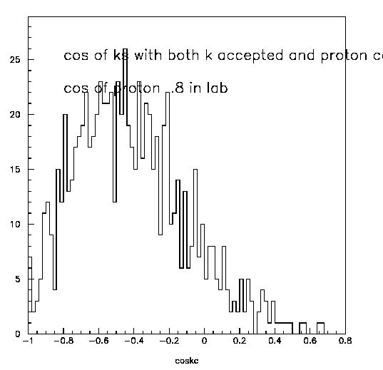
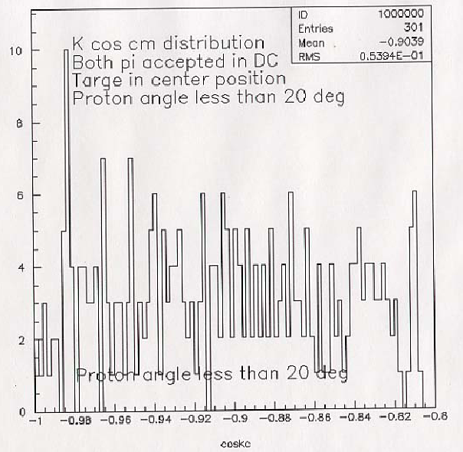
Acceptance in CM
Was ⇒ Now
Z of interaction was previously at –10cm

