Slide 1
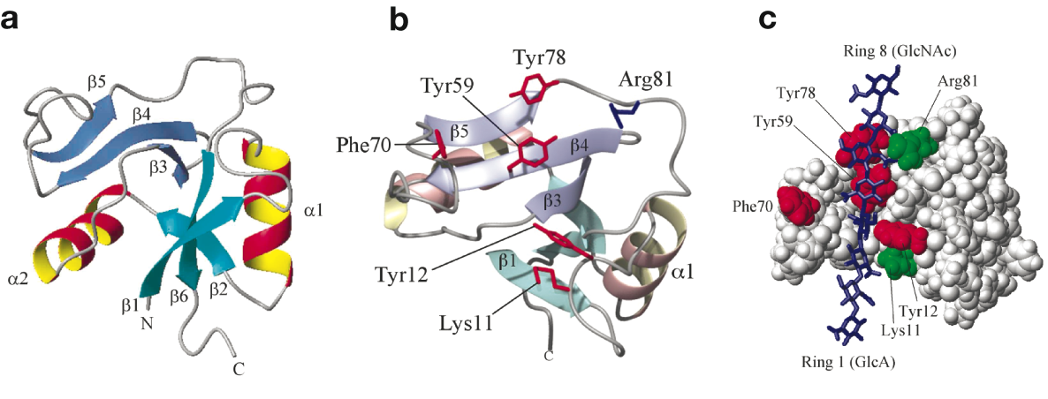


Structure of the link module
Essentials of Glycobiology
Chapter 15, Figure 4
Second Edition
Notes:
FIGURE 15.4. Structure of the link module. (a) TSG-6 contains a prototypical link fold defined by two α helices (α1 and α2) and two triple-stranded antiparallel β sheets (β1,2,6 and β3–5). (Redrawn, with permission, from Blundell C.D. et al. 2003. J. Biol. Chem. 278: 49261–49270, ©American Society for Biochemistry and Molecular Biology.) (b) The hyaluronan-bound conformation of the protein, with a view showing key amino acids and the position of hyaluronan. (Redrawn, with permission, from Blundell C.D. et al. 2004. In Chemistry and biology of hyaluronan [eds. H.G. Garg and C.A. Hales], pp. 189–204, ©Elsevier.) (c) A model of a link protein/hyaluronan complex. Binding of the hyaluronan to the protein is mediated through ionic interactions between positively charged amino acid residues (green) and the carboxylate groups of the uronic acids, and by a combination of aromatic ring stacking and H-bond interactions between the polysaccharide and aromatic amino acids (red). In addition, hydrophobic pockets (on either side of Tyr59) can accommodate the methyl groups of two N-acetylglucosamine side chains, which is likely to be a major determinant in specificity of link modules for hyaluronan. (Redrawn, with permission, from Blundell C.D. et al. 2005. J. Biol. Chem. 280: 18189–18201, ©American Society for Biochemistry and Molecular Biology.)

