Slide 1
Bottled Water, Bulk Water and Spring Water
Maine DHHS DWP Laws and Regulations
Andy Tolman, ME DWP

Slide 2
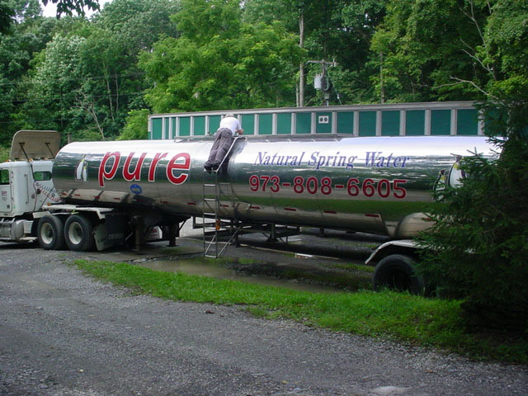
tanker

Slide 3
Bulk Water Transport
Must meet four criteria
  Not be a threat to public health, safety, or welfare
  Not naturally available at the location to which it’s transported
  Failure to authorize creates a substantial hardship
  Not have an undue adverse impact on waters of the state, either alone or in combination with other withdrawals

Slide 4
Review Agencies
Maine DEP: environmental impact
Maine Geological Survey: hydrologic effects
Maine Public Utilities Commission: influence on existing public water supplies
DWP coordinates review, recommends to Commissioner of DHHS for approval or denial.

Slide 5
Safe Drinking Water Act
Water quality
Product labeling
Facility design
Hydrogeologic evaluation
Protection of Public Health and Safety

Slide 6
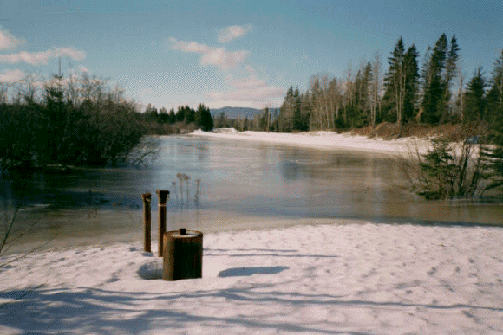
spring

Slide 7
Spring Water
Federal Food and Drug Administration definition of Spring Water incorporated into Maine Bottled Water Regulations
Water withdrawn must show a hydrogeologic and geochemical connection to an identified spring.
Withdrawal may not cause the spring to cease flowing

Slide 8
Coordination
Joint scoping meetings with applicants, LURC, DEP, MGS and DWP staff.
Coordinated permit review for bulk transport, LURC, and “spring water” designation.
Resources of all agencies are stretched thin by the current level of activity.
Ongoing review of groundwater regulations

Slide 9

closer

