Slide 1
Temporal variation of the circumstellar gas and dust
around the C-rich Mira V Oph detected by VLTI/MIDI
Keiichi Ohnaka (Max-Planck-Institut für Radioastronomie, Bonn, Germany
O-rich Mira stars
Spectroscopy + Interferometry
Warm water vapor layers
1000--2000K
Extending to 2--3 Rstar
Optically thick (τ~1000)
C-rich Mira stars
Are similar (C-rich version) extended molecular layers present?
No interferomery on optically bright (=not so dusty) C-rich Miras
→ V Oph is one of such stars
C₂H₂
ν₄ + ν₅ band (< 9 μm)
ν₅ band (> 11 μm)
Spectro-interferometry with MIDI can
probe where C₂H₂ and dust form
Dust
Amorphous Carbon
SiC (11.3 μm)

Slide 2
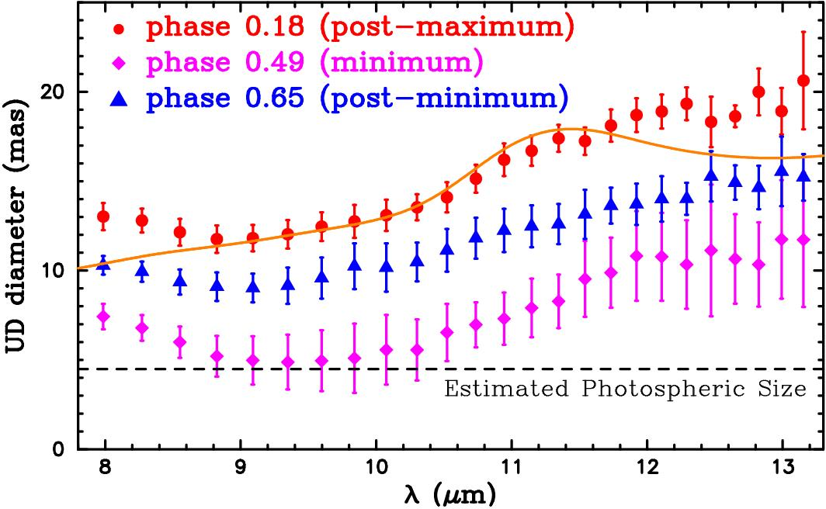
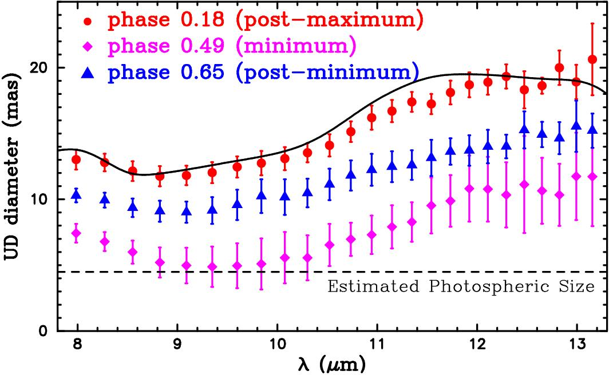
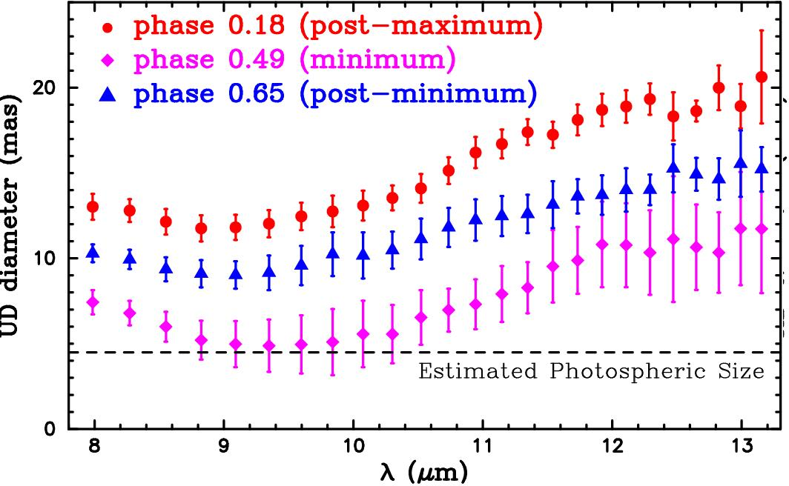
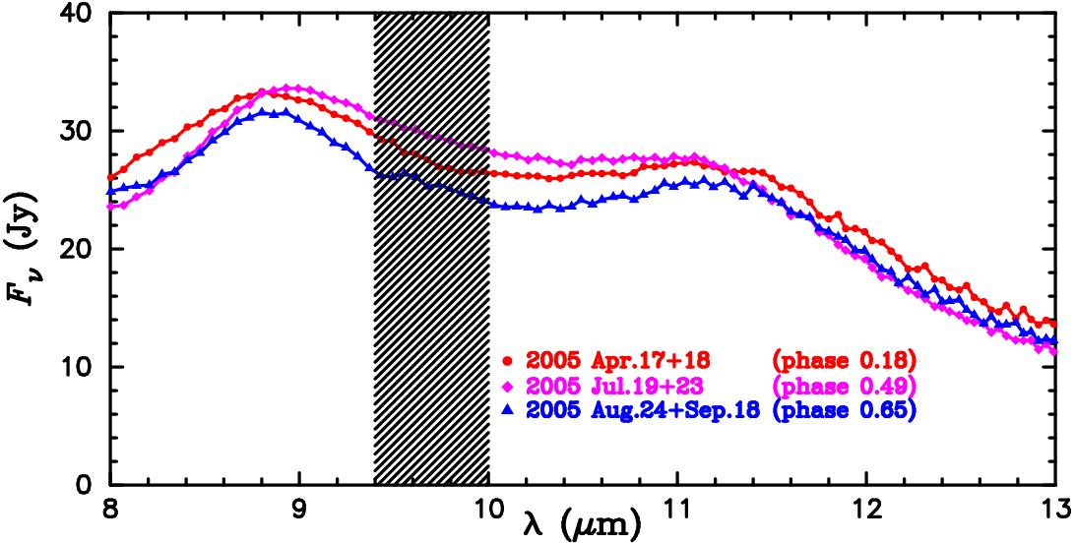
Temporal variation of N-band angular size of V Oph
N-band Uniform Disk Diameter
MIDI detects a temporal variation of
the angular size
C₂H₂ layers + dust shell
N-band size is much larger than the
photospheric size
Dust shell model
Smallest at minimum light
Dust shell model (amorphous carbon +
SiC) can explain the UD diameter at
9–11.5 μm
But discrepancy at < 9 μm
and > 11.5 μm
N-band spectra
Phase 0.18
Phase 0.49
Model with extended C₂H₂ layers +
dust shell
→ Much better agreement
C₂H₂ layers and dust shell make
the object appear larger than the
star itself
SiC
Phase 0.65
C₂H₂
ν₄ + ν₅ band
C₂H₂ ν₅ band

Slide 3
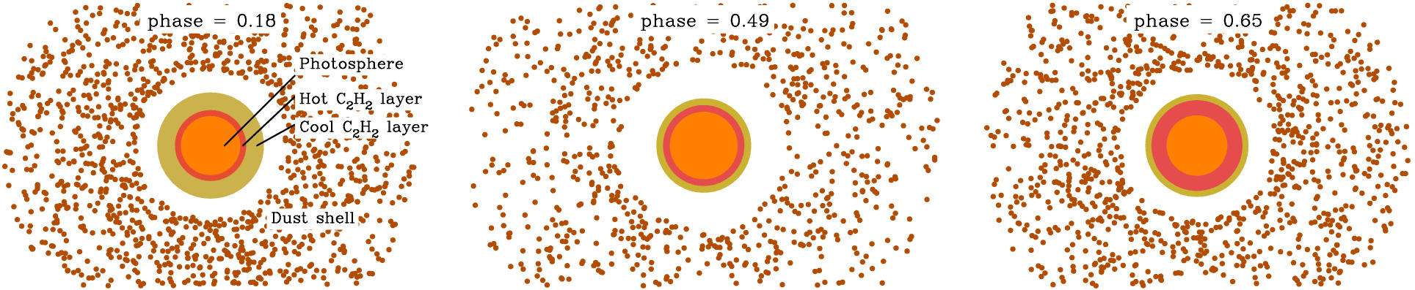
Phase dependence of the C₂H₂ layers and the dust shell
C₂H₂ layers
Smallest radius and smallest
column density at minimum light
Dust shell (amorphous carbon + SiC)
Lowest optical depth at minimum light
Detailed description of the observations and modeling
is given in Ohnaka et al. (2007, A&A, 466, 1099)

