Slide 1

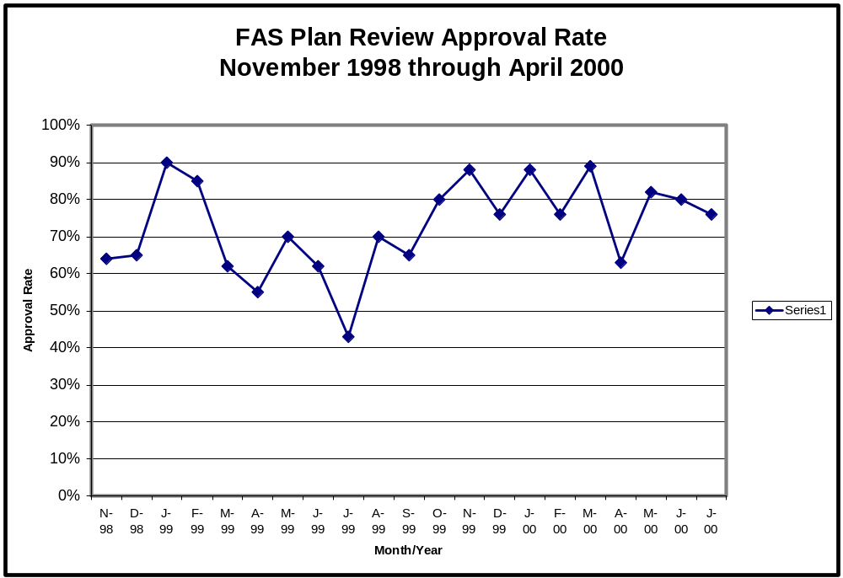

Slide 2
PLUMBING AND MECHANICAL CODE SEMINAR,
August 17th, 2000.
Problems in complying with the Uniform Plumbing and Mechanical Codes.
Notes:
The goal of out seminar today will be to familiarize the participants with the issues and problems related to the plumbing and mechanical code which we encounter when we do a plan review.

Slide 3
Introduction and overview.
The goals of this seminar:
  1). Compare what issues are currently being written up as opposed to issues that were common when our initial survey was done.
  2). Review the write ups that appear on “Plan Review Reports” (PRR’s) issued by the department.
  3). Review the new “Checklist” handout.
Notes:
While we will be discussing a few specific provisions of the Uniform Plumbing and Mechanical Codes, the purpose of this seminar is not to provide a comprehensive code training. Our prime focus will be to discuss the areas which are a consistent problem when plans are submitted to the department for review.

Slide 4
Part 1
Introduction

Slide 5
1999 Plan Review Report Analysis.
An analysis of plan review reports over a nine month period indicates that the issues raised in the reports broke down in the following manner.
Structural/engineering issues - 26%
Energy and ventilation issues - 22%
Electrical code issues - 15%
Miscellaneous - 11%
Fire & life safety issues - 11%
Plumbing issues - 8%
Handicap code issues - 4%
Mechanical code issues - 3%
There were 115 plans in the survey, with a total of 1273 corrections, issues or non-compliance items written on them.

Slide 6
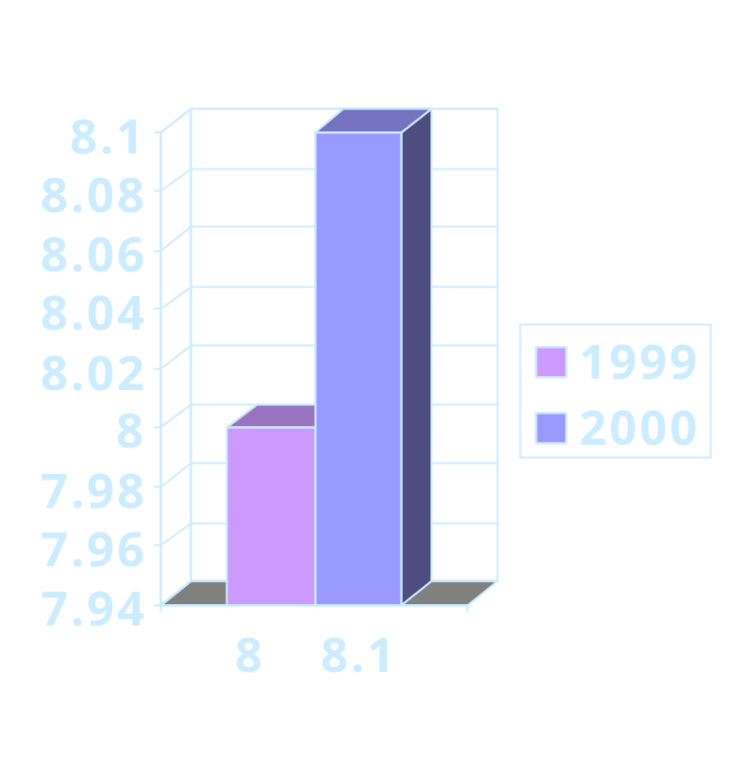
Current Rate of Plumbing Issues appearing on Reports.
In the 1999 survey, 102 of the 1273 issues on the plan review reports were related to the plumbing provisions of the building code.
In the current year, 153 of the 1888 issues are related to the plumbing provisions.

Slide 7
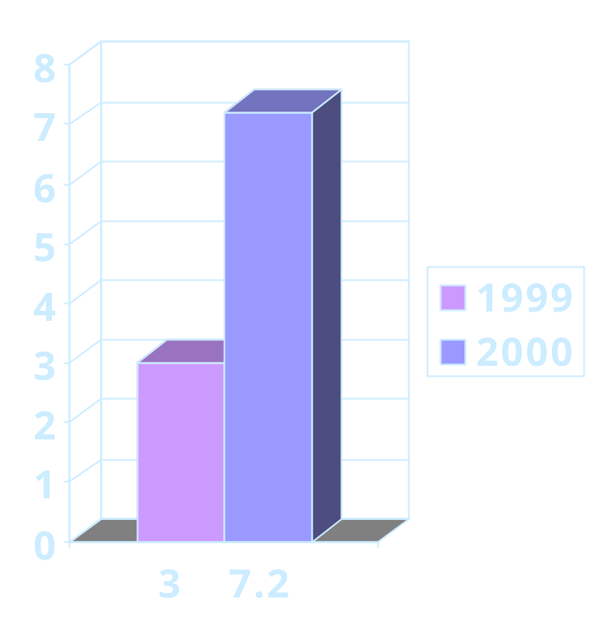
Current Rate of Mechanical Issues appearing on Reports.
In the 1999 survey, 39 of the 1273 issues on the plan review reports were related to the mechanical provisions of the building code.
In the current year, 111 of the 1888 issues are related to the mechanical provisions.

Slide 8
Part 2
Plumbing Code Plan Review Report Issues.

Slide 9
General Plan Submittal Requirements:
Plan approval request form is complete and indicates the following:
  Proper code cycles for the UPC and UMC.
  Correct type of heat and fuel.
  Operating pressure, number of fixtures and total developed length of the water supply system.

Slide 10
Plans are complete.
Floor plan showing
  All plumbing fixtures.
  Water heater location.
  Furnace location.

Slide 11
Plumbing schematics in isometric format.
Water system drawing showing:
  All plumbing fixtures indicated on the plan and listed on the application.
  Size and type of piping material.
  Sizing based on listed length and pressure of the system.

Slide 12
Plumbing schematics in isometric format.
Drain, waste and vent system drawing showing:
  All plumbing fixtures indicated on the plan and listed on the application.
  Size and type of piping material.

Slide 13
HVAC plans.
Equipment locations.
Equipment schedule.
  Equipment specifications, including efficiency and fan CFM.
  Heating and/or cooling capacities.
Duct sizing and material.

Slide 14
HVAC plans.
Gas line drawing (if applicable). Isometric format showing:
  Pipe size and material.
  Developed length.
  BTUh demand of each appliance or gas outlet.

Slide 15
Special systems.
Hydronic heating systems.
  Piping and baseboard layout, indicating size of pipe and heater units.
  Boiler schematic.
  Boiler technical information.
  Efficiency.
  Weight of boiler.

Slide 16
General Uniform Plumbing Code Provisions:
Fixtures.
  Number and types of required fixtures are determined by Chapter 29 of the UBC. (WAC 51-40)
  Meet water flow restrictions (WAC 51-46 402.3.2.2 and 402.3.2.3).
  Showerheads located on sidewall of shower compartment (UPC 412.11).
  Thermostatic mixing or pressure balance valves at all showers and tub/showers (UPC 420.0).

Slide 17
Water Heaters.
Seismic restraint anchorage provided in seismic zones 3 and 4 (UPC 510.5).
  Provide detail.
  Provide engineered design if capacity of water heater is over 52 gallons.
Minimum 24” wide x 30” high access to water heater (UPC 511.1).

Slide 18
Water Heaters.
PRV overflow drain extends to exterior of building.
  No traps in line.
  Terminal end is not threaded and points downward not more than 24” or less than 6” above the ground.
Vacuum relief valves (UPC 608.7).

Slide 19
Water supply.
Approved piping and fitting materials (WAC 51-46 604.1).
  PEX approved.
  PB not approved.
System pressures below 15 psi require booster pump and tank (UPC 608.1).

Slide 20
Water supply.
System pressures above 80 psi require a pressure regulator (UPC 608.2).
  Strainer installed upstream from regulator.
  Must be in accessible location for maintenance.

Slide 21
Water hammer arrestors
(UPC 609.10).
At all “quick acting” valves.
Dish washing machines.
Clothes washing machines.
Flush valves for toilets and urinals.
Not required at metering lavatory faucets.

Slide 22
Water hammer arrestors
(UPC 609.10).
Install in water system as close as possible to valve.
Install in both hot and cold lines as applicable.
May be a mechanical device or an air chamber.

Slide 23
Water hammer arrestors
(UPC 609.10).
Mechanical devices (UPC 609.10.2).
  Listed for use.
  Installed according to manufacturer instructions.

Slide 24
Water hammer arrestors
(UPC 609.10).
Air chambers (UPC 609.10.1).
  Accessible location.
  Accessible means of restoring air in chamber.
  See departmental procedure 99-04 for an illustration of one type of acceptable water hammer arrestor design.
    Must be at least ¾” diameter pipe.
    Must be at least 15” long.

Slide 25
Sizing of water supply systems (UPC 610).
Most systems based on tables 6-4 and 6-5 of the UPC.
  Sizing for flushometer valves using table 6-6 to modify the “water supply fixture units” values used from table 6-4.
  “Heavy-Use Assembly” category in table 6-4.
    Includes classrooms.
    See definition (WAC 51-46 218).

Slide 26
Sizing of water supply systems (UPC 610).
Large systems must be sized using Appendix A.
Engineered parallel systems may be installed.
  WAC amendment.
  Install per listing.

Slide 27
Drain/waste/vent systems.
Approved piping and fitting materials (WAC 51-46 701.1).
  ABS - use of this material is not limited to 3 story buildings, this provision of the UPC has been removed by WAC.
  Installations of ABS over 3 stories requires special fire blocking and expansion joints as detailed in the ABS installation standard.

Slide 28
Sizing of DWV systems.
Use table 7-3 to determine the "drainage fixture unit value" for each fixture.
  Revised DFU value of 2.0 and drain size of 2" for "floor drains" in the WAC.
Use table 7-5 to determine the minimum drain or vent size based on number of DFU that drain or vent through each pipe section.

Slide 29
Sizing of DWV systems - Table 7-5.
Footnote 2 requires a minimum 2" drain for sinks and urinals.
Footnote 3 requires a minimum 3" drain for water closets and 6 DFU traps (some urinals and sinks).
Footnote 4 requires a minimum 4" horizontal drain for 4 or more water closets (or 6 DFU traps).

Slide 30
Clean-outs (UPC 707).
Upper terminal of all horizontal drains on the level of the building containing the building drain and every 135 degrees of turn in the drain line.
  Not required on branch drains less than 5' long. (UPC 707.5).
On trap arms after 90 degrees of turn. (UPC 1002.3).
Minimum size per table 7-6.
Clean out fitting must open in the direction of drainage. (UPC 707.6).

Slide 31
Indirect Wastes
(UPC chapter 8).
Restaurant fixtures involved in food preparation must be installed on indirect wastes. (UPC 801.2).
Indirect waste design per section 803.
  No connection of the drain or vent piping to the building DWV system.
  Indirect waste receptors must be approved for use. (UPC 804.1)

Slide 32
Appliances. (UPC 807)
Indirect waste required for condensate waste. (UPC 807.1)
  A/C coil condensate may connect to a lavy tailpiece or bathtub overflow (UPC 807.2)
  Special piping materials per section 807.3.
Domestic (residential) dishwashing machines require the use of an approved air gap fitting when draining into a sink tailpiece. (UPC 807.4)
  High loops in the drain hose are no longer allowed.

Slide 33
Vents (UPC chapter 9).
All traps must be vented. (UPC 901)
Vent must be within distance allowed by UPC table 10-1 for trap arm length.
Materials - basically the same as for drainage. (UPC 903.1)

Slide 34
Vents.
Sizing. (UPC 904).
  Minimum pipe diameter per UPC table 7-5.
  Total area of vents to be at least as large as the minimum building drain size.
  Minimum area of any vent must be at least half the area of the drain it is connected to.
  Vent line must be undiminished in size. (UPC 905.4)

Slide 35
Vents.
Must be graded to drain back to the drain system.
Vent must take off above the centerline of the drain. (UPC 905.2)
No horizontal vents below 6" above the flood rim of the fixture. (UPC 905.3)

Slide 36
Termination of vents.
Must be above roof. (UPC 906.1)
Not within 10' of other openings or intake vents. (UPC 906.2)
Minimum 2" diameter termination in areas subject to snow or ice closure. (UPC 906.7)

Slide 37
Vertical wet vents. (UPC 908)
All fixtures on the same floor level.
Upper fixtures must be only 1 or 2 DFU.
  Bathtubs no longer allowed to drain into a wet vent.
Increase wet vent section one pipe size with a minimum of 2".

Slide 38
Island vents. (UPC 909)
Vent extends to drainboard of sink and then down to the drain line.
Vent connects to the drain line downstream of the vertical sink drain using a wye fitting.

Slide 39
Island vents. (UPC 909)
Foot vent connecting to vertical vent runs to nearest wall.
  Rises vertically to at least 6" above sink flood level before running horizontally or connecting to other parts of the vent system.
  Clean-out fitting installed in vertical vent pipe in wall.
All parts of vent system below the sink, use drainage fittings.

Slide 40
Traps (UPC chapter 10).
All fixtures require individual traps. (UPC 1001.1)
Three compartment sinks or 3 lavatories may be connected to a single trap.
  Trap under center compartment.
  All compartments are in the same room.
  Drain holes in the bottom of the sinks or lavys is no more than 30" oc.

Slide 41
Prohibited traps. (UPC 1004)
S-traps and other styles as listed in this section.
Double traps.

Slide 42
Grease traps. (UPC 1014.1)
Required on most commercial kitchen sink drains.
Design and installation per section 1014.4

Slide 43
Fuel gas piping
(UPC chapter 12).
This chapter is not adopted by WAC 51-46.
Use chapter 13 in the UMC for designing gas-piping systems.

Slide 44
Non-Residential structures - some special requirements.
Non handicap accessible lavys have metering faucets (WAC 51-46 402.4).
Elongated toilets with open front seats (UPC 409.1 and 409.2).
Floor drains provided where required by (WAC 51-46 412.2).

Slide 45
Floor Drains.
Drain inlet in full view of occupants (UPC 1006.0).
Trap within the maximum distance from vent as allowed for trap arm (UPC 1002.2).
Trap equipped with backwater valve if subject to reverse flow of sewage (UPC 1006.0).

Slide 46
Floor Drains.
Floor slopes toward drain.
  Over whole room or
  Over partial area as approved by plan review on a case by case basis.
Provide trap primer (UPC 1007.0).
  Except where not required by administrative authority (L&I).
  Automatic operation.
  Listed as approved for use.
  Primer in accessible location for maintenance.

Slide 47
Part 3
Mechanical Code Plan Review Report Issues.

Slide 48
General chapter 3 requirements.
Clearances around equipment. (UMC 304.7)
  Per listing of equipment.
  Furnaces in alcoves.
    Alcove 12" wider than furnace.
    Minimum clearance of 3" at sides and back.

Slide 49
Means of disconnect.
(UMC 306.2)
Independent of equipment (can not use built in circuit breakers or fused disconnects).
In sight of equipment (must also be accessible to service personnel).

Slide 50
Service receptacle.
(UMC 306.3)
On same level as equipment (roof, attic or exterior wall).
Within 25 feet of equipment.

Slide 51
Equipment illumination.
(UMC 306.4)
Attic or floor mounted equipment.
Not required for exterior equipment.

Slide 52
Access to equipment.
(UMC 307)
In rooms. (UMC 307.2)
  Access to room by minimum 36" x 80" door.
  Except 24" allowed for residential equipment.

Slide 53
Access to equipment.
(UMC 307)
In attics. (UMC 307.3)
  Access to attic by 22" x 30" opening.
    Bigger if necessary to remove equipment.
  Unobstructed 30" x 30" passageway.
    Bigger if necessary to remove equipment.
    Solid 24" wide floor.
    No more than 20' long.
  30" x30" service space in front of equipment.

Slide 54
Access to equipment.
(UMC 307)
Under floor. (UMC 307.4)
  Access to floor cavity by 22" x 30" opening.
    Bigger if necessary to remove equipment.
  Unobstructed 30" x 30" passageway.
    Bigger if necessary to remove equipment.
    No more than 20' long.
  30" x30" service space in front of equipment.

Slide 55
Access to equipment.
(UMC 307)
Roof top. (UMC 307.5)
  Level service platform at equipment.
    With safety railing if within 10' of a 30" drop.
  Permanent access by ladder and/or catwalk from grade level.
    See special design requirements.

Slide 56
Equipment support and restraint. (UMC 308)
The UBC (section 1632) requires equipment weighing over 400 pounds to have its support and restraint system engineered.

Slide 57
Condensate. (UMC 304.7)
Drain to an approved disposal area or plumbing fixture.

Slide 58
Ventilation Air.
(UMC chapter 4)
Supply air. (UMC 304.7)
  Minimum required quantity of supply air is specified in the VIAQ code and chapter 12 of the UBC.
Outside air. (UMC 304.7)
  Inlets no closer than 10 feet to a plumbing vent termination, chimney or appliance vent

Slide 59
Ventilation Air.
(UMC chapter 4)
Return air. (UMC 304.7)
  Prohibited sources or locations.
    Bathrooms.
    Closets.
    Kitchens.
    Hazardous or unsanitary locations.
    Fire rated corridor.
  Must be from an area at least 25% of the volume of the area supplied by the air system.

Slide 60
Exhaust Systems.
(UMC chapter 5)
Environmental air ducts. (UMC 504)
  Includes domestic range and dryer exhaust ducts and bathroom exhaust ducts.
  Must terminate at the exterior of the building and have backdraft dampers.
  Termination must be at least 3 feet from other building openings.

Slide 61
Exhaust Systems.
(UMC chapter 5)
Commercial kitchen hoods. (UMC chapter 5, part II)
  Required on all commercial cooking equipment.
  Type I hoods required at grease and smoke producing equipment.
  Type II hoods required at other equipment.
  See UMC sections 507, 508 and 509 for design requirements.
    Type I hoods require fire suppression systems.

Slide 62
Duct Systems.
(UMC chapter 6)
Plans show size, material and location of all ducts.
Fire rated corridors can not be used to convey air to or from rooms.
Minimum return air and outside air duct sizes.
  Per listing or
    2 square inches per 1000 btuh for blower furnaces.
    6 square inches per 1000 btuh for heat pumps.

Slide 63
Duct Systems.
(UMC chapter 6)
Minimum supply air duct sizes.
  Per listing or
    2 square inches per 1000 btuh for blower furnaces.
    6 square inches per 1000 btuh for heat pumps.

Slide 64
Shut off for smoke control. (UMC 608)
Required on "air moving systems" over 2000 cfm with some exceptions.
See definition of "air moving system" in chapter 2.
Provide HVAC cut sheets showing rating of equipment.
  Use largest listed CFM rating unless engineered duct design shows calculated static pressure.

Slide 65
Combustion Air.
(UMC chapter 7)
This chapter does not apply to direct vent appliances.
Opening locations at top and bottom of enclosure per section 702.
Duct to source of air as allowed by section 703.
  Dampers not allowed.
  Size ducts and openings by Table 7-A.
    Buildings meeting WSEC standards are "unusually tight construction".
Room outside thermal envelope.

Slide 66
Fuel Gas Piping.
(UMC chapter 13)
Use this chapter rather than the UPC.
Provide a drawing showing the piping schematic and indicating the piping size and material, length of run and Btuh input rating of the gas appliances.
Drip pipes. (UMC 1312.5)

Slide 67
Questions and answers.
Time for participants to ask questions.
Time for plan review staff to go over examples.
Training survey and questionnaire.

Slide 68
Future Training
November 16th, 2000.
February 15th, 2001 and after.
  Suggestions from audience and other interested parties.

Slide 69
Our Web Address.
Www.wa.gov/lni/FAS

Slide 70
Craig/ Sedlacek:
Put all master training PPTs into Shared drive directory.

