Slide 1
FDA Risk/Benefit Considerations
Eric Bastings, MD
Clinical Team Leader
Division of Neurology Products
Center for Drug Evaluation and Research
Food and Drug Administration

Slide 2
Background
Naproxen sodium 500 mg and metoclopramide hydrochloride 16 mg
Proposed indication: acute treatment of migraine headache with or without aura
Not approvable action (5/28/04) – contribution of both active drug components to the claimed effects of the product not established

Slide 3
Combination policy (CFR 300.50)
Two or more drugs may be combined in a single dosage form when each component makes a contribution to the claimed effects and the dosage of each component is such that the combination is safe and effective for a significant patient population requiring such concurrent therapy as defined in the labeling for the drug.

Slide 4
Combination policy – MT100
Factorial studies of similar design :
MT100-301 and MT100-304
Patients randomized to MT100, naproxen or metoclopramide
Primary endpoint for combination policy: Sustained Pain Response.

Slide 5
Sustained Pain Response
Moderate or severe headache pain at baseline
Mild or no headache pain at 2 hours
No relapse, no use of rescue medication 2-24 h
Mod
Sev
No relapse
No rescue
Mild
None
0 hrs
2 hrs
2-24 hrs

Slide 6
Sustained Pain Response: no significant contribution of metoclopramide
Study | MT100 | Naproxen | Metoclopramide contribution ∫
301 (n=1067) | 35.6% | 29.8% | 5.8% (p=0.064)§
304 (n=2627) | 31.8% | 27.9% | 3.9% (p=0.063) §
∫ Metoclopramide contribution to MT100 response = MT100 response minus naproxen response.
§ FDA analysis

Slide 7
2-hour Endpoints in Factorial Studies§ (not required to establish metoclopramide contribution)
Endpoint (%) | MT100-301 |  | MT100-304
 | MT100 | Naproxen | MT100 | Naproxen
2-hr pain response | 48.1 | 46.6 p=0.67 | 49.8 | 46.7 p=0.14
2-hr Nausea | 23.7 | 26.6 p=0.33 | 33.7 | 36.7 p=0.14
2-hr Photophobia | 54.5 | 52.2 p=0.50 | 54.8 | 53.9 p=0.72
2-hr Phonophobia | 45.7 | 48.0 p=0.50 | 48.0 | 48.1 p=0.98
§ Pozen analysis

Slide 8
2-hour Pain Response, Responder Relapse or Rescue Medication Use in Study 301§
Endpoint (%) | MT100 | Naproxen | Metoclopramide contribution
2-hr Pain Response | 48.1 | 46.6 ª | 1.5
Relapse or Rescue¥ | 12.6 | 16.8 | 4.2
Sustained Response | 35.6 | 29.8 ª | 5.8
§ Pozen analysis
ª Not statistically significant
¥ (After response at 2-hours)

Slide 9
2-hour Pain Response, Responder Relapse or Rescue Medication Use in Study 304§
Endpoint (%) | MT100 | Naproxen | Metoclopramide contribution
2-hr Pain Response | 49.8 | 46.7 ª | 3.1
Relapse or Rescue¥ | 17.9 | 18.8 | 0.9
Sustained Response | 31.8 | 27.9ª | 3.9
§ Pozen analysis
ª Not statistically significant
¥ (After response at 2-hours)

Slide 10
Associated Symptoms Sustained Responses in Factorial Studies (not required to establish metoclopramide contribution)
Endpoint (%) | MT100-301 |  | MT100-304
 | MT100 | Naproxen | MT100 | Naproxen
Sustained Nausea Free | 45.3 | 39.4 p=0.10 | 37.0 | 33.5 p=0.08
Sustained Photophobia free | 32.2 | 29.8 p=0.41 | 27.9 | 27.0 p=0.58
Sustained Phonophobia free | 35.3 | 30.3 p=0.17 | 32.3 | 29.3 p=0.14

Slide 11
Post-Action Meeting (Oct 6, 2004)
Presentation of exploratory subgroup analyses suggesting a contribution of metoclopramide in patients with no nausea at baseline (no pre-specified plan for correction for multiple comparisons)
Consideration by FDA of the acceptability of a prospective replication of these findings to fulfill the combination policy requirements

Slide 12
Subgroup Analyses in Study 301
(nausea present or absent at baseline)*
Endpoint (%) | All patients |  | No nausea at baseline |  | Nausea at baseline
 | MT100 (n=423) | Naproxen (n=430) | MT100 (n=231) | Naproxen (n=233) | MT100 (n=192) | Naproxen (n=197)
Sustained Pain Response | 35.6 | 29.8 p=0.064 | 38.4 | 28.5 p=0.009 | 32.3 | 31.5 p=0.78
2-hr Pain response | 48.1 | 46.6 p=0.665 | 50.7 | 45.3 p=0.40 | 45.3 | 48.2 p=0.59
*Pozen analysis

Slide 13
Subgroup Analyses in Study 304
(nausea present or absent at baseline)*
Endpoint (%) | All patients |  | No nausea at baseline |  | Nausea at baseline
 | MT100 (n=1036) | Naproxen (n=1062) | MT100 (n=342) | Naproxen (n=361) | MT100 (n=694) | Naproxen (n=701)
Sustained Pain Response | 31.8 | 27.9 p=0.063 | 36.7 | 26.7 p=0.004 | 29.6 | 28.5 p=0.622
2-hr pain response | 49.8 | 46.7 p=0.143 | 54.6 | 47.2 p=0.056 | 47.6 | 46.5 p=0.47
*Pozen analysis

Slide 14
Indication Limited to Patients with No Nausea at Baseline
In a survey of 500 self-reported migraineurs*, nausea occurred in more than 90% of all migraineurs, and nearly one third of these experienced nausea during every attack.
Only a minority of patients (<10%) consistently had migraine with no nausea at baseline (indication for which MT100 is being considered).
45-69% incidence of nausea at baseline in MT100 phase 3 studies
*Silberstein SD. Migraine symptoms: results of a survey of self-reported migraineurs. Headache. 1995 Jul-Aug; 35(7): 387-96.

Slide 15
Indication Limited to Patients with No Nausea at Baseline
Migraine patients (over 50% according to the Silberstein survey) may have some attacks with nausea, and other attacks without nausea, or nausea may develop during the attack.
Patients would therefore need two different treatments based on the presence or absence of nausea, or would treat their attacks with nausea with a combination product containing metoclopramide, which has no established contribution for efficacy for that type of attack, yet they would be exposed to the risks of metoclopramide.

Slide 16
Tardive Dyskinesia (TD)
“Tardive” originally intended to emphasize late appearance during neuroleptic treatment
TD may appear early during neuroleptic treatment*
No fundamental distinction between cases appearing early and those appearing late. *
*In: Drug Induced movement disorder 2nd Ed. (Factor SA, Land AE, Weiner WJ, eds). Blackwell Futura, 2005.

Slide 17
Tardive Dyskinesia Variants
Tardive dystonia (several cases with a few days of exposure to neuroleptics, including one non reversible case after a single dose)
Tardive akathisia (may develop early)
Tardive myoclonus
Tardive tics
Tardive tremor

Slide 18
Metoclopramide-induced
Tardive Dyskinesia
TD is a well known side effect of metoclopramide
Exact incidence of metoclopramide-induced TD remains unclear.
No case reported in MT100 database, but database too small to detect rare events.

Slide 19
TD Risks Associated to Chronic Metoclopramide Treatment.
Metoclopramide WARNING: Tardive dyskinesia …/… may develop in patients treated with metoclopramide. Although the prevalence of the syndrome appears to be highest among the elderly, especially elderly women, it is impossible to predict which patients are likely to develop the syndrome. Both the risk of developing the syndrome and the likelihood that it will become irreversible are believed to increase with the duration of treatment and the total cumulative dose. Less commonly, the syndrome can develop after relatively brief treatment periods at low doses [emphasis added]; in these cases, symptoms appear more likely to be reversible.

Slide 20
Metoclopramide:
FDA-approved Indications
Indicated for short-term therapy (4 to 12 weeks) of gastroesophageal reflux, only when conservative treatment fails, and for treatment of diabetic gastroparesis (2-8 weeks).
Recommended dose 5 to 15 mg q.i.d.

Slide 21
TD Risks Associated with Chronic Metoclopramide Treatment.
Cases reported in the literature after relatively short durations of treatment
(1 week and more)
Cases identified by FDA in the AERS database after short durations of treatment (1st quartile of TD cases = 29.5 days).

Slide 22
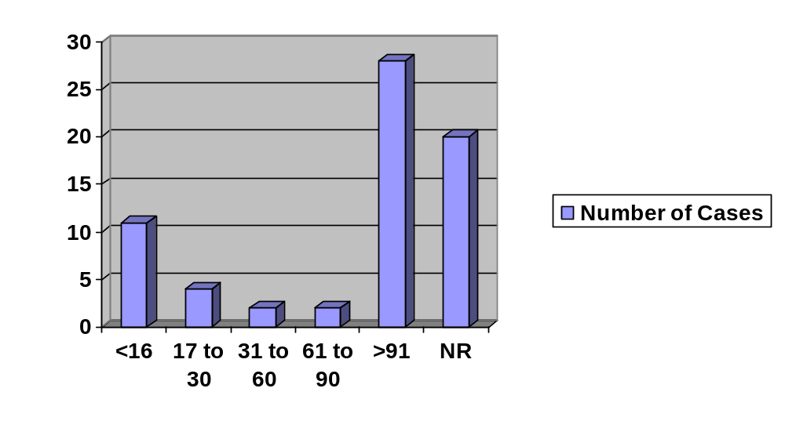
Distribution of TD cases Based on Duration of Therapy in AERS
Duration of Therapy (days)

Slide 23
Patterns of Use of Metoclopramide (IMS Health and Caremark)
Metoclopramide mostly used (>50%) for GI indications (Esophagitis 40%); Migraine use <2%
13% of patients appeared to have received prescriptions for metoclopramide for a period longer than 90 days; 7% of patients appeared to have received prescriptions for metoclopramide for over 180 days
Over a 3-year period, cumulative therapy longer than 90 days for almost 20% of the patients; cumulative therapy for more than 180 days in >10% of patients.

Slide 24
Risk Associated with Chronic-intermittent (C-I) Use of Metoclopramide
Difficult to evaluate: no current indication for C-I use, and no specific capture of C-I use in AERS.
Animal data suggest intermittent use of neuroleptics may be no safer or even riskier than continuous use*
In a psychiatric population, the number of interruptions in neuroleptic treatment was the second factor (after age) in predicting TD*
*Reference in introductory memorandum

Slide 25
Overuse of Acute Migraine Drugs
  “Medication-overuse” headache (MOH) introduced with 2004 IHS classification (8.2.3 analgesic-overuse headache)
  “Substantial evidence” that all drugs used for the treatment of migraine may cause MOH*
  MOH prevalence in general population around 1% ¥
  Overuse of symptomatic migraine drugs and/or analgesics most common cause of chronic daily headache, according to the IHS*
* In: Chronic daily headache for clinicians (PJ Goadsby, SD Silberstein, DW Dodick eds.). BC Decker, 2005. ¥ Reference in introductory memorandum.

Slide 26
Question 1
Pozen estimated an annual incidence of tardive dyskinesia (TD) of up to 0.038% for metoclopramide at a daily dose of 30-40 mg/day for 72 days/year (which corresponds to up to 380 cases of TD per million patients per year).
Do you think that this is a reasonable estimate?
If MT100 were to carry the same risk, would such a risk level be acceptable if the only contribution of metoclopramide is a 5-10% improvement on sustained headache relief (with no effect on 2-h endpoints)?
Is any risk of tardive dyskinesia acceptable for a migraine population?

Slide 27
Question 2
Is there sufficient evidence that the chronic-intermittent administration of metoclopramide does not carry a risk of tardive dyskinesia?
Is it possible to define a maximum recommended number of monthly doses of MT100 to avoid the risk of tardive dyskinesia?

Slide 28
Question 3
Do you believe that, based on the existing data on medication-overuse headache, there is evidence that a proportion of patients prescribed MT100 will likely take a number of monthly doses higher than recommended?

Slide 29
Question 4
All currently approved acute treatments of migraine are indicated without restriction regarding the presence or absence of nausea at baseline.
Given that patients may have nausea at some attacks and no nausea at others, does an indication limited to the subpopulation of migraine patients with no nausea at baseline represent a clinically meaningful and acceptable indication?

Slide 30
Question 5
If Pozen shows prospectively in a new clinical study in migraine patients with no nausea at baseline:
a significant contribution of metoclopramide on sustained headache pain relief of 5-10%
no contribution of metoclopramide at 2-hours
no contribution of metoclopramide on relapse rate or rescue medication use in the 2-24 hour period,
Would the demonstrated benefit outweigh the risks related to tardive dyskinesia?
If not, what additional data (or desired primary outcome, or desired effect on sustained relief) could provide evidence of safety and efficacy?

Slide 31
Acknowledgements
Marc Avignan, M.D., C.M.
Yeh-Fong Chen, Ph.D.
Gerald Dal Pan, M.D., M.H.S.
Kun Jin, Ph.D.
Sigal Kaplan, Ph.D., B. Pharm.
Russell Katz, M.D.
Cindy Kortepeter, Pharm.D.
Susan McDermott, M.D.
Kevin Prohaska, D.O.
Judy Racoosin, MD, M.P.H.
Mary Ross Southworth, Pharm.D.
Barry Rosloff, Ph.D.
Judy Staffa, Ph.D., R.Ph.
Robert Temple, M.D.

