Slide 1
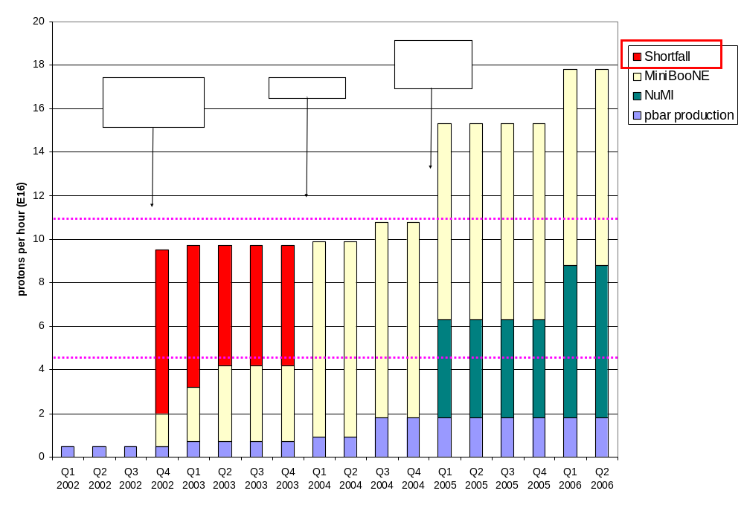
The Problem

Slide 2
Formulating a Plan
The plan is to do what we can reasonably do to maximize the throughput and reliability of the existing proton source (incl. MI), under the assumption that a Proton Driver will eventually be built.
Scope largely determined by the budgetary guidance:
  FY04: $0-2M
    depending on whom you ask and when you ask them.
  FY05: $6M
  FY06: $5M
  FY07: $5M
  FY08: $2.5M

Slide 3
Comment on the Budget
This budget is more than enough to do the basic things that we must do to keep the proton source going, provided some of it appears this year!
It precludes certain ideas that have been suggested:
  New Linac front end, or any significant 200 MHz upgrade.
  Decreasing the Main Injector ramp time
    Which means there will be very little to do with the Main Injector.
There are some “big” (>$1M) projects that must be discussed.

Slide 4
Near Term Priorities (Booster)
Optimizing Booster for improved lattice:
  Tuning and characterizing 400 MeV line (Linac to Booster).
  Tuning Booster orbit to minimize losses.
Commission Collimators:
  Estimate another month or so to bring into standard operation.
Aperture Improvments:
  Alignment (see next slide)
  Orbit control
    Abandoning our original global plan in favor of local control at problem spots for the time being.
  Prototype RF Cavities
    Two large aperture prototype cavities have been built, thanks to the help of MiniBooNE and NuMI universities.
    We will install these as soon as they are ready to replace existing cavities which are highly activated.
It’s hoped this work will allow us to reach the MiniBooNE baseline this year.

Slide 5
Vital Projects This Year
Alignment:
  Continue with the alignment of the Booster and Booster network.
  Not a lot of money, but needs priority during access opportunity.
  Collaboration with AMG very successful so far this year.
Long 13 work:
  Replace MP01 and ML01 with new septa
    In addition to helping lattice problems, addresses a critical spares vulnerability.
  Implement “dogleg fix”
    Build new dogleg magnets with spares on hand.
    Build new stands (Argonne will pay).
  When we’re done, the dogleg lattice distortion will be >4 times smaller than it was to begin with.
  In good shape for summer shutdown.
ORBUMP Power Supply
  This addresses a significant vulnerability and paves the way for high rep. rate operation if we solve our loss problems.
  Design well under way for a new supply capable of higher currents at a full 15 Hz.
  New switch network close to completion.
  Can be ready for summer shutdown with aggressive schedule and priority.

Slide 6
Vital Projects (cont’d)
ORBUMP Magnets (Run II plan??)
  Address significant vulnerability.
  Allow for higher rep. rates
  Along with new power supply, will solve injection slewing problem, effectively increasing aperture.
  New design well along based on new generation of ferrites: cheaper and easier to build.
  Can be ready for summer shutdown with aggressive schedule and priority.
We’re working on accurate costs, but the total cost of all of these projects will be the order of $600K. This is smaller than the “virtual” $2M, but cannot fit under my existing budget.
I consider these projects “no-brainers” and would like to get a go-ahead soon on all of them.

Slide 7
Maintenance, instrumentaion, and reliability projects
Linac instrumentation
  Proceeding with high-speed digitizers on old linac.
  Considering upgrading BPM system.
Booster LVPS replacements (particularly the Power-10’s).
Upgrading Booster BPM readout system.
Improved Booster tune measurement system.
Linac shielding?
  If we are able to send more beam to Booster, we will begin to trip Linac rad. monitors.

Slide 8
Some “Big” Ideas being considered
Significant Booster RF improvements
  New, large aperture cavities?
  New, solid state PA’s?
  2 Additional cavities?
Adding higher harmonic to magnets:
  Similar to extra RF?
  Still being studied?
New Linac QUAD power supplies?
  A reliability issue.

Slide 9
Selected R&D Projects
Ion source notching.
  Use for pre-notching beam into Booster
  Not compatible with current cogging scheme, but maybe with MiniBooNE.
37MHz laser chopping
  Reduce capture losses.
  A recommendation at the DOE review
Booster transition jump
  The future of the Booster and maybe it always will be.
  Some concrete commitment from Argonne.
Radiation Robot
  Lots of university interest and support ($$)
  Looks like it might be cheaper than we thought.

Slide 10
My Schedule for the Plan
By end of February:
  Gather data
  Complete project “skeleton”, including every conceivable task being discussed at least at some level.
  Have accurate cost and resource estimates for the things on my “vital” list, as well as the smaller maintenance items.
By “the summer”
  Gather enough information to make a recommendation on the bigger items
    Booster RF
    Linac shielding and Quad power supplies
    Other things that come up.

Slide 11
Some Questions that I have
Which does the lab consider to be a priority?
  Accurate costs and schedules for the “vital”, near term projects.
  A “big picture” and infrastructure, i.e. a full project format.
Is this “plan” primarily supposed to be about money, or does it also include things like studies and optimizations?
What do I do with things that are now under Run II:
  ORBUMP Magnets (but not power supply)?
  LLRF upgrades?
  Beam cogging?

