Slide 1
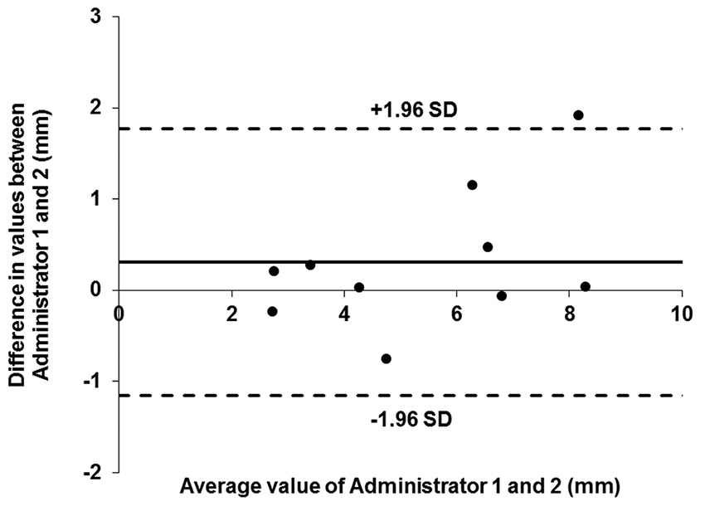

Figure 7. Bland-Altman plot for vertical linear displacement of vertical loading test. Solid black line = difference mean, solid gray line = vertical 0 axis, dashed lines = 95% limits of agreement. SD = standard deviation.
Major MJ, Johnson WB, Gard SA. Interrater reliability of mechanical tests for functional classification of transtibial prosthesis components distal to the socket. J Rehabil Res Dev. 2015;52(4):467–76.
http://dx.doi.org/10.1682/JRRD.2014.12.0300
ResearcherID: Matthew J. Major, PhD: E-7372-2012; William Brett Johnson, PhD: K-5231-2012; Steven A. Gard, PhD: D-9935-2011
Notes:
Figure 7. Bland-Altman plot for vertical linear displacement of vertical loading test. Solid black line = difference mean, solid gray line = vertical 0 axis, dashed lines = 95% limits of agreement. SD = standard deviation.

