Slide 1
Weekly Summary
Tevatron Department Meeting
Tevatron Coordinator
C.Y. Tan
Friday, Sep 10, 2010

Slide 2
Store Summary
Store | Avg Init. Lumi (E30) | Avg Deliv’d Lumi (nb⁻¹) | Time (hr) | How did it end? | Comments
8055 | 196.5 | 3750 | 10.2 | Intentional
8056 | 244.5 | 5738 | 14.5 | Intentional | Lowered vert proton tune at collisions for next store by .001
8057 | 250.2 | 5757 | 13.7 | Intentional
8058 | 259.9 | 5449 | 12.1 | Intentional
8059 | 219.7 | 4175 | 16.1 | Intentional | Adjusted E48K timing for first bunch ; large long proton blowup during scrapping
8060 | 263.8 | 607 | 2.4 | Quench | VPD 16 “spiking”. Store lost when we quenched at D17. There were no losses or orbit distortions
8064 | 269.0 | 5611 | 12.0 | Intentional | Small proton long blowup during the squeeze. Put in B0/D0 VANG bumps at Seq 14,15 and 16 to help D0 losses
8065 | 128.0 | 4531 | 13.1 | Intentional | HE34 scale factors at 0. D1 BPMs hanging and prevented scraping
8072 | 260.2S | 4926 | 10.3 | Intentional | Transverse pbar blow up at LBSEQ=25 and collisions. LMB1SD>60rad/s at LBSEQ=24.
8073 | 248.2 | 5086 | 11.2 | Intentional | Lowered horz pbar tune by 0.001 at LBSEQ=25 and collisions. Increased vert angle bump thru B0 by 0.015 mrad to help losses at LMB1SD at LBSEQ=24. Large 1mm oscillations at frame 24 because -5mm bump not closed.
Tevatron Coordinator - FNAL

Slide 3
Store Summary
Store | Avg Init. Lumi (E30) | Avg Deliv’d Lumi (nb⁻¹) | Time (hr) | How did it end? | Comments
8077 | 246.0 |  |  | Ongoing | High losses at B1Q3
Tevatron Coordinator - FNAL

Slide 4
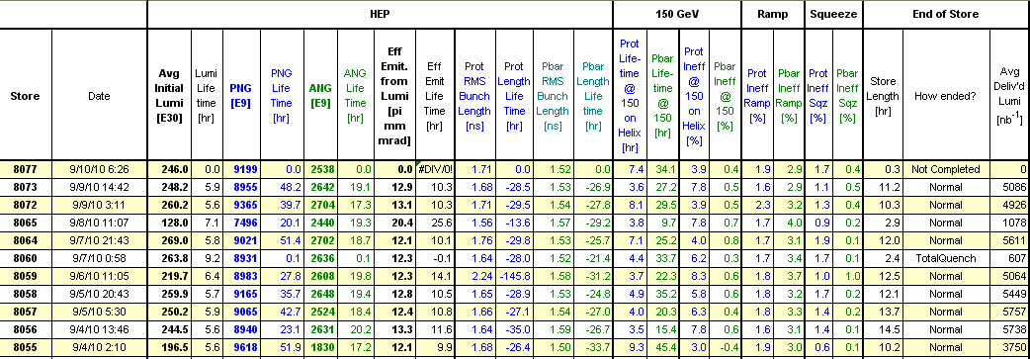
Store Numbers
Tevatron Coordinator - FNAL

Slide 5
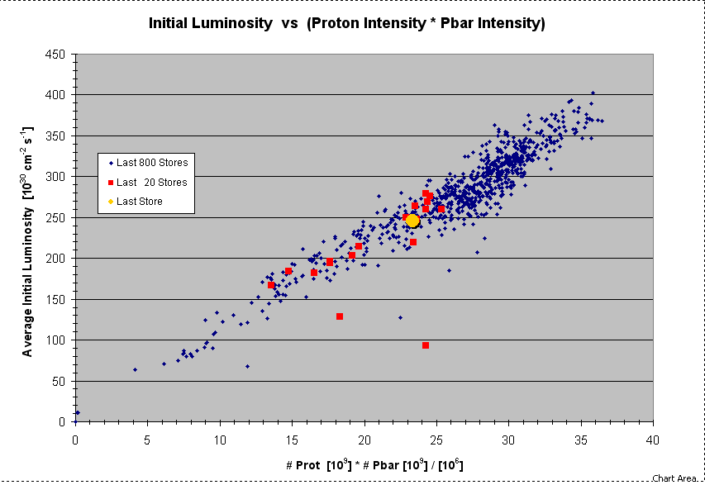

Slide 6
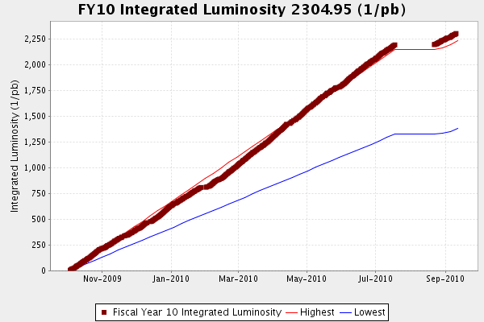

Slide 7
Problems
Store 8060 lost due to a quench at D17. Possible cry vacuum issues?
B3 roughing station is dead and needs to be replaced
D1 BPMs die frequently; timing card was replaced and a new software version was installed.
    D1 BPMs are still a problem which is affecting smoothing. Large 3 bumps added. For example store 8072.
Communications errors at E3 resulted in DFG issues at HE34 and HE38
B0 losses at Q3 is getting high at the end of the squeeze (24) after smooths.
Tevatron Coordinator - FNAL

Slide 8
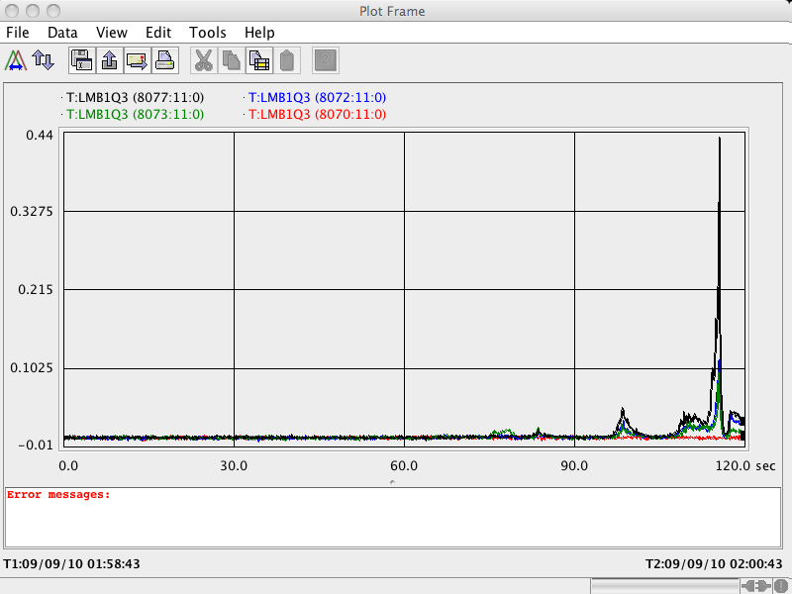
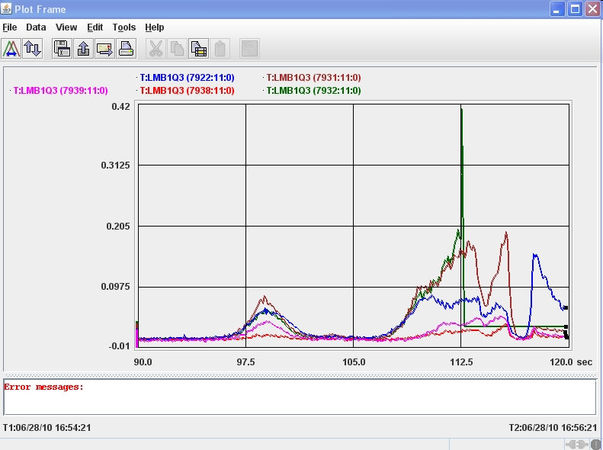
Losses at B1Q3
historical

Slide 9
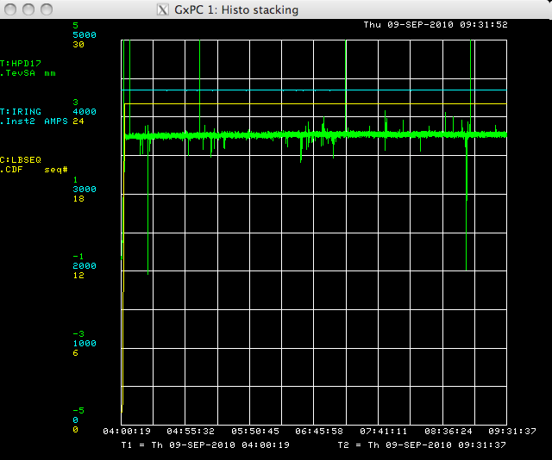
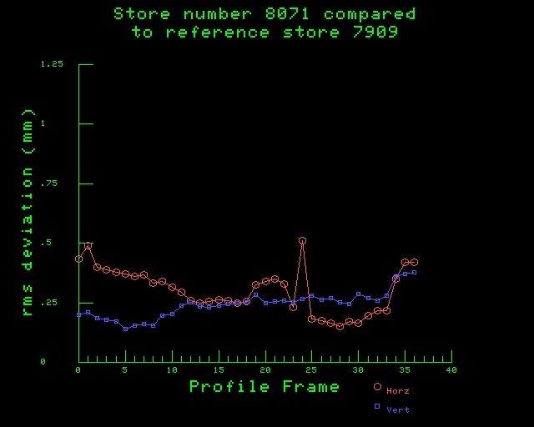
D1 BPMs are still noisy
Noisy D1 BPMs are causing us smoothing problems

Slide 10
Studies/Work Completed
Proton Only orbit smooting looks to work well; Operators can now do PO smooths without Tev experts. Still need to test In Between Store smoothing
  Transitioned to store 7909 for smoothing.
C49 bug fix.
D1 house BPM timing card change, software updates.
Tevatron Coordinator - FNAL

Slide 11
Studies Request
Quick C49 test (Ron)
Longitudinal Shaking (Tan)

