Slide 1
Archived Information
The Pathways to
College Network
and
The College Readiness for All Toolbox
Jackie Burniske, Director, Special Initiatives, Pacific Resources
for Education and Learning (PREL)
Dr. Watson Scott Swail, President, Educational Policy Institute (EPI)

Slide 2
The Pathways to
College Network
and
The College Readiness for All Toolbox
A Framework for Action featuring
Tools, Information and Resources for Practitioners

Slide 3

The Pathways to College Network
Alliance of 34 organizations
and funders launched in 2001
Goal: to advance college access and success for under-served students
Emphasis on using data and research to improve policy and practice
Focus on youth
(ages 12-25)

Slide 4
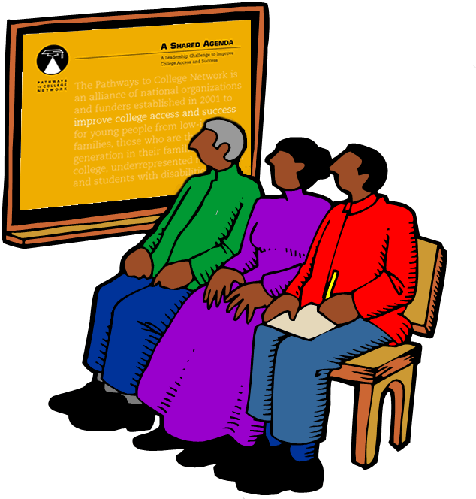
A Shared Agenda:
A Leadership Challenge to
Improve College Access and Success
Guiding principles for
improving college
access and success
Actions for key leaders
112 profiles – practices,
programs, and policies
Annotated bibliography of
over 650 studies and reports

Slide 5

Pathways Guiding Principles
Expect all underserved
students are capable of
being prepared to enroll
and succeed in college.
Provide a range of high-quality college preparatory tools for under-served students and their families.
Embrace social, cultural and learning style differences in developing learning.

Slide 6
Pathways Guiding Principles (cont.)
Involve leaders at all levels in establishing policies, programs, practices to facilitate student transitions toward postsecondary attainment.
Maintain sufficient financial and human resources to enable underserved students to prepare for, enroll, and succeed in college.
Assess policy, program, practice, and institutional effectiveness regularly.

Slide 7


College Readiness for All:
A Toolbox
Practitioner friendly and
organized by job role:
  Principal
  Counselor
  Outreach Practitioner
Provides tools along with information on how, when and why to use the tool
Provides a framework for a call to action
Includes extensive resource information

Slide 8
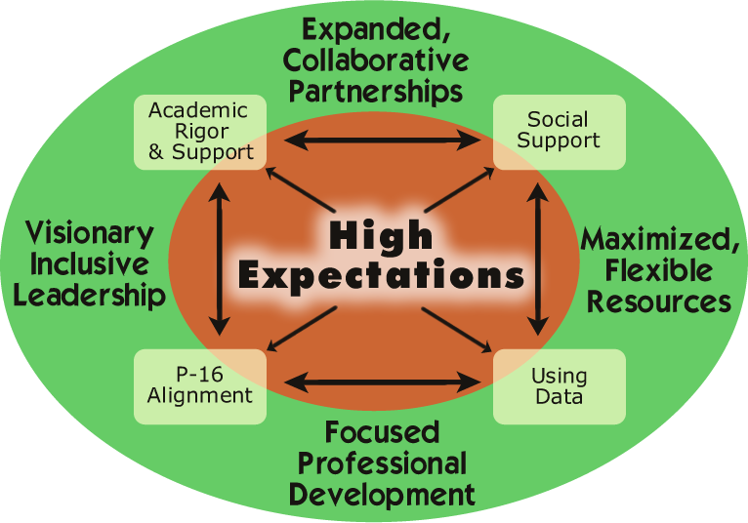

A Framework for Action
A framework for embedding the effort of increasing college readiness into the work of school improvement.
Based on a 2002 study to identify the strategies used by high schools to increase college readiness and access
Understanding of the framework and strategies will improve the number of students ready for college

Slide 9
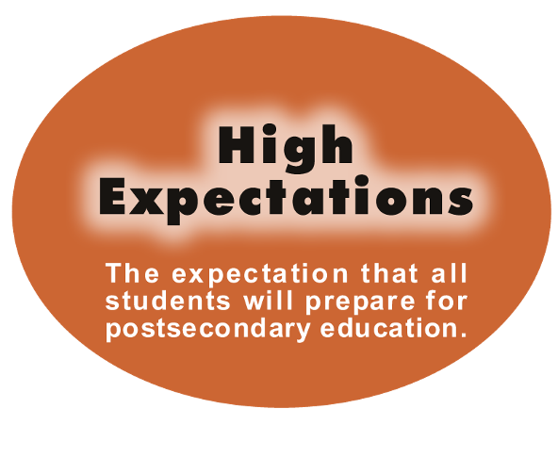
The Framework Core

Slide 10
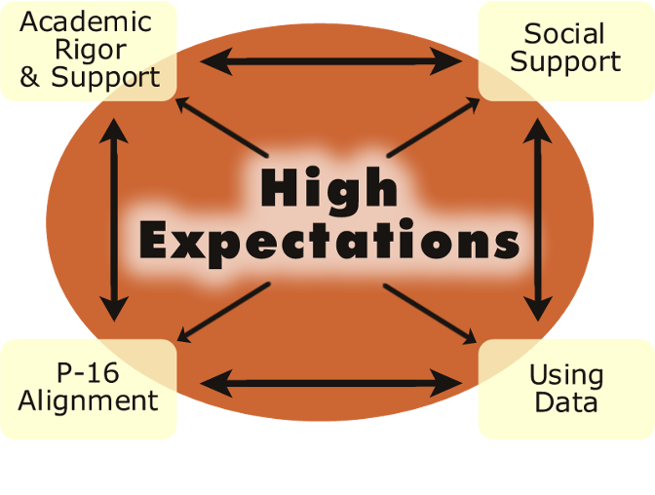
The Support Mechanisms

Slide 11
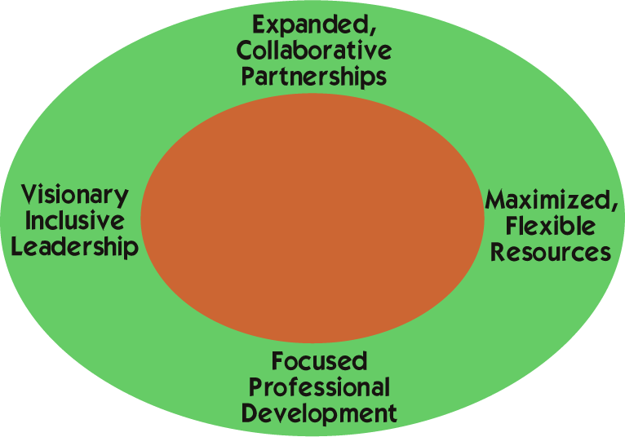
The Context for
Increasing College Readiness

Slide 12
A Framework for Action

Slide 13

The Critical Step
Schools that embed the strategies in the daily life of their school are able to increase college readiness and college going despite ongoing challenges.

Slide 14




Pathways to College Network
Website Features:
A Shared Agenda
Pathways research papers, reports, and bibliographies
Relevant reports, studies, and links
College Readiness for All Toolbox
Visit us at www.pathwaystocollege.net

Slide 15
Presenters
Dr. Watson Scott Swail, President
Educational Policy Institute
Washington Office
25 Ludwell Lane
Stafford, VA 22554
1 (877) e-POLICY
(540) 288-2322
wswail@educationalpolicy.org
www.educationalpolicy.org
WASHINGTON * TORONTO * LOS ANGELES
"Improving Educational Policy & Practice Through Research"

Slide 16
Presenters
Jackie Burniske
Director, Special Initiatives
Pacific Resources for Education and Learning (PREL)
http://www.prel.org
900 Fort Street Mall
Suite 1300
Honolulu, HI 96813
voice: 808.441.1392
fax: 808.441.1385
email: burniskj@prel.org
Building Capacity Through Education

