Slide 1

Immunization Recommendations for Employees Covered by the ATD Standard
Kathleen Harriman, PhD, MPH, RN
Vaccine Preventable Disease Epidemiology Section
California Department of Public Health
Immunization Branch
kathleen.harriman@cdph.ca.gov
510-620-3767

Slide 2
Which employees are covered by the ATD standard?
Employees whose exposure from work activity or working conditions is reasonably anticipated to create an elevated risk of contracting any disease caused by aerosol-transmissible pathogens if protective measures are not in place
“Elevated” risk means higher than what is considered ordinary for employees having direct contact with the general public outside of the facilities, service categories, and operations listed in the standard
http://www.dir.ca.gov/Title8/5199.html

Slide 3
Work settings covered by the ATD standard
Applies in health care settings, such as:
  Hospitals
  Long Term Health Care Facilities
  Primary Care
  Emergency Medical
Applies in other high risk environments
  Corrections
  Homeless shelters
  Drug treatment programs
  First receivers
  Laboratories

Slide 4
Occupational Exposure
In each included work setting covered by the standard, it is presumed that some employees have occupational exposure; for a particular employee it depends on tasks, activities, and the environment
Includes having contact with, or being within exposure range of cases or suspected cases of aerosol-transmissible diseases
Employers must identify employees with occupational exposure in order to take protective measures

Slide 5

Examples of Possible Occupational Exposures
Intake or triage of patients
Providing care to influenza patients
Testing people for TB
Taking a throat swab for strep
Cleaning patient rooms
Transporting patients

Slide 6
Where do U.S. immunization recommendations come from?
Advisory Committee on Immunization Practices (ACIP)
15 experts selected by the U.S. Secretary of HHS to provide advice and guidance to CDC on the control of vaccine preventable diseases; the only entity in the federal government that makes such recommendations
Develops written recommendations for routine administration of vaccines to children and adults in the civilian population; recommendations include age for vaccine administration, number of doses/dosing intervals, and precautions and contraindications
Recommends immunizations for healthcare personnel

Slide 7
ACIP Recommendations for Healthcare Personnel (HCP)
Employer decisions about which ACIP recommended vaccines to include in HCP immunization programs have typically been made by considering the:
  Likelihood of HCP exposure to vaccine preventable diseases and the potential consequences of not vaccinating HCP
  Nature of employment (type of contact with patients/residents and their environment)
  Characteristics of the patient/resident population within the organization

Slide 8
CDC Definition of HCP
All paid and unpaid persons working in healthcare settings who have the potential for exposure to patients with influenza, infectious materials, including body substances, contaminated medical supplies and equipment, or contaminated environmental surfaces.
HCP might include (but are not limited to):
  physicians, nurses, nursing assistants, therapists, technicians, emergency medical service personnel, dental personnel, pharmacists, laboratory personnel, autopsy personnel, students and trainees, contractual staff not employed by the health-care facility, and persons (e.g., clerical, dietary, housekeeping, maintenance, and volunteers) not directly involved in patient care but potentially exposed to infectious agents that can be transmitted to and from HCP

Slide 9
ACIP Recommended Immunizations for U.S. HCP
All HCP who are not vaccinated:
  Tdap (tetanus, diphtheria, and acelluar pertussis) vaccine
  Hepatitis B vaccine
  Influenza vaccine
All HCP who are not immune:
  MMR (measles, mumps, and rubella) vaccine
  Varicella vaccine (two doses)

Slide 10
Required Immunizations for California HCP
There are no federal or California state requirements for immunization or immunity to vaccine preventable diseases
Some healthcare facilities require immunizations/immunity as a condition of employment

Slide 11
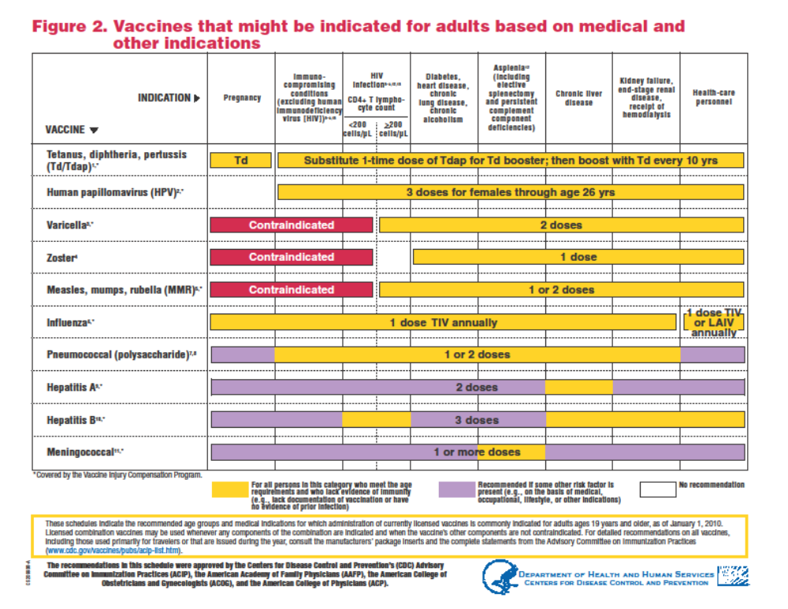
2010 ACIP adult immunization recommendations
http://www.cdc.gov/vaccines/recs/schedules/downloads/adult/2010/adult-schedule.pdf

Slide 12
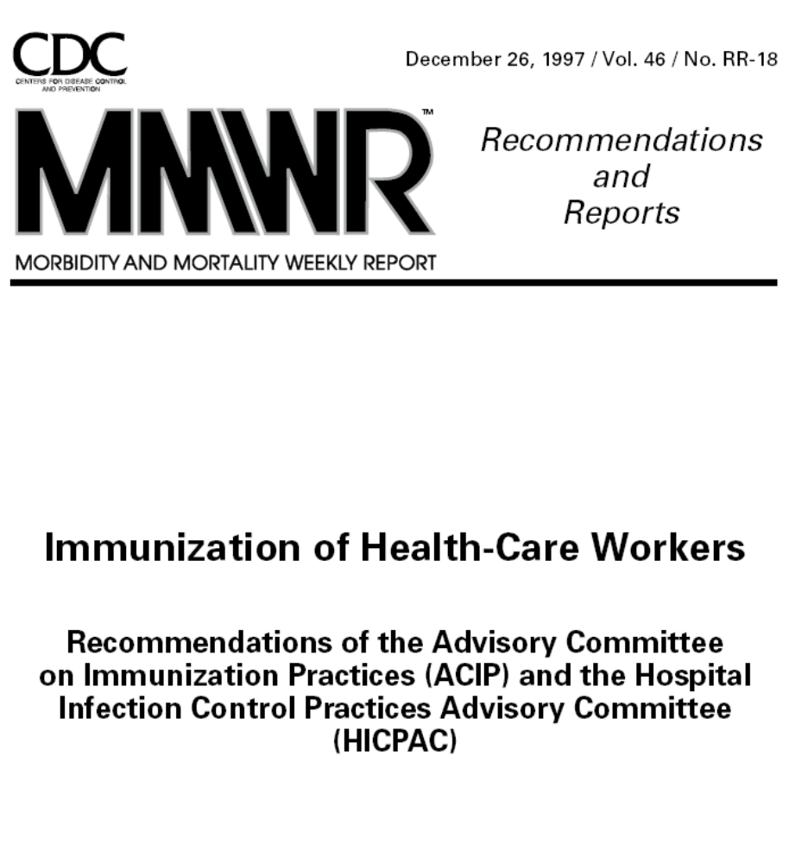

Slide 13
Vaccine that is required to be offered* per the Cal/OSHA Bloodborne Pathogen standard
Hepatitis B vaccine – three doses
* To all employees who are exposed to blood or other
potentially infectious materials as part of their job duties.
If vaccine is declined, a declination form must be signed.

Slide 14
Vaccines that are required to be offered* per the Cal/OSHA Aerosol Transmissible Disease (ATD) standard as of September 1, 2010
Vaccine
Influenza†
Measles
Mumps
Rubella
Tetanus, diphtheria, and acellular pertussis (Tdap)
Varicella-zoster (VZV)
Schedule
One dose annually
Two doses
Two doses
One dose
One dose, booster as recommended
Two doses
* To all susceptible employees who might be exposed.
If vaccine is declined, a declination form must be signed.
† Seasonal vaccine was required to be offered in 2009.

Slide 15
Diseases covered by the ATD standard
Applies to diseases classified by CDC’s Healthcare Infection Control Advisory Committee (HICPAC) as either droplet or airborne*
  Novel or unknown pathogens considered airborne
  Only “reportable diseases” under Title 17† require exposure investigation
* 2007 Guideline for Isolation Precautions:
Preventing Transmission of Infectious Agents in Healthcare Settings
http://www.cdc.gov/hicpac/2007IP/2007isolationPrecautions.html
† http://www.cdph.ca.gov/HealthInfo/Documents/Reportable_Diseases_Conditions.pdf

Slide 16
Influenza Vaccine

Slide 17
Annual Influenza Vaccination
Offer to all employees covered under the ATD standard at no cost
Educate employees about vaccination benefits and consequences of influenza illness for themselves and their patients
Obtain signed declination forms for those who choose to decline
Monitor coverage including ward, unit, and specialty-specific coverage rates
Years of efforts to increase uptake have not increased rates significantly in most facilities - mandate vaccination?

Slide 18
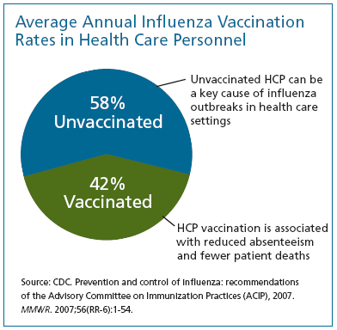
Healthy People 2010 Goal = 60%
Voluntary rates are suboptimal despite years of efforts to increase them

Slide 19
Barriers to Influenza Vaccination
Fear of vaccine side effects (particularly influenza-like illness symptoms)
Perceived ineffectiveness of the vaccine
Medical contraindication (not always valid)
Perceived low likelihood of contracting influenza
Fear of needles
Insufficient time or inconvenience
Similar barriers may apply to Tdap

Slide 20
Mandatory Influenza Vaccination
Seattle: Virginia Mason – first U.S. hospital to mandate influenza vaccination or mask wearing during influenza season
St. Louis: Barnes-Jewish – first U.S. hospital to mandate influenza vaccination and terminate noncompliant employees
New York: 2009 emergency regulation (that was withdrawn) required seasonal and pandemic H1N1 vaccination of personnel in hospitals, home care, hospice, and diagnostic/treatment facilities
  http://www.health.state.ny.us/diseases/communicable/influenza/seasonal/providers/ 2009-08-26_health_care_worker_mandatory_influenza_immunization.htm
California: hospitals must offer vaccine at no cost to employees
  Vaccination or written declination required per SB 739 and the ATD standard
  Public reporting of vaccination rates via CDC’s National Healthcare Safety Network (NHSN) required
  Some hospitals mandated vaccination or mask wearing in 2009

Slide 21
National Organization Influenza Vaccination Recommendations
IDSA 2009
  Mandatory vaccination or mask wearing
APIC 2008
  Supports requiring influenza immunization for all HCP who have direct patient contact
  Also recommends that healthcare facilities obtain informed statements acknowledging the risk to patients from employees who decline the vaccine for other than medical reasons
ACIP 2007
  Level of vaccination coverage among HCP to be one measure of a patient safety quality program
  Implement policies to encourage HCP vaccination (e.g., obtaining signed statements from HCP who decline influenza vaccination)
SHEA 2005
  Vaccination or declination
Most unions oppose mandatory vaccination

Slide 22
Joint Commission
Standard IC.02.04.01: The organization offers vaccination against influenza to licensed independent practitioners and staff.
  The hospital establishes an annual influenza vaccination program that is offered to licensed independent practitioners and staff.
  The hospital educates licensed independent practitioners and staff about, at a minimum, the influenza vaccine; non-vaccine control and prevention measures; and the diagnosis, transmission, and impact of influenza.
  The hospital provides influenza vaccination at sites accessible to licensed independent practitioners and staff.
  The hospital annually evaluates vaccination rates and the reasons given for declining the influenza vaccination.
  The hospital takes steps to increase influenza vaccination rates.

Slide 23
Hepatitis B

Slide 24
Hepatitis B Vaccination
Any person who performs tasks involving contact with blood, blood contaminated body fluids, other body fluids, or sharps should be vaccinated against hepatitis B
  Highly immunogenic – seroconversion ~95%
Incidence of hepatitis B among HCP since mid-1990s is lower than general population due to vaccination and standard precautions
Updated U.S. P.H.S. Guidelines for the Management of Occupational Exposures to HBV, HCV, and
HIV and Recommendations for Post-exposure Prophylaxis. MMWR 50 (RR11) - 6/29/01 http://www.cdc.gov/mmwr/preview/mmwrhtml/rr5011a1.htm

Slide 25

Estimated Number of Acute HBV Infections Due to Occupational Exposures, United States, 1983-2002
OSHA Requirements
Vaccine Recommended for HCP

Slide 26
Hepatitis B
Employees with potential for exposure to blood or body fluids should be immunized for hepatitis B with 3-dose vaccine series if they have not already received it
Test newly immunized employees 1-2 months after the last dose of vaccine series to determine if immune
Employees with written documentation of a complete vaccine series but without postvaccination testing do not need immunity testing unless they have an exposure to blood or body fluids
Periodic titers or booster doses of vaccine not recommended - protection is long lasting

Slide 27
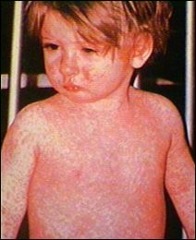
Measles

Slide 28
Measles
Control and virtual elimination of measles in the U.S. is a public health success model for immunization programs in the developed world
Last nationwide outbreak 1988-1991
Introduction of 2nd dose of vaccine in 1989
  2000: "measles is no longer endemic in the U.S.”
Concern about measles being introduced into the U.S. via travelers from parts of the world where measles is not controlled

Slide 29
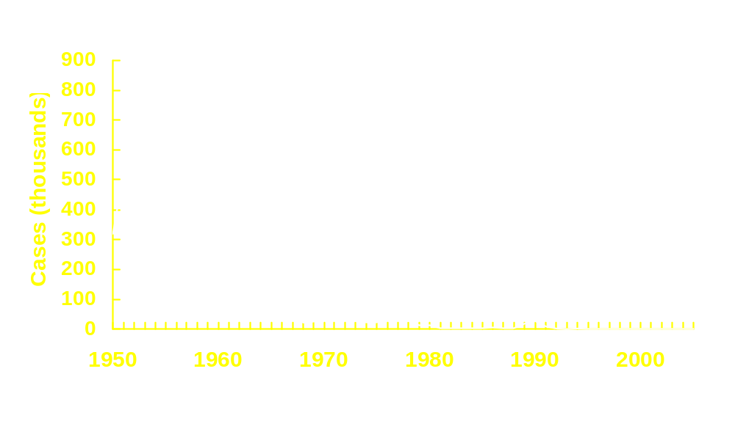
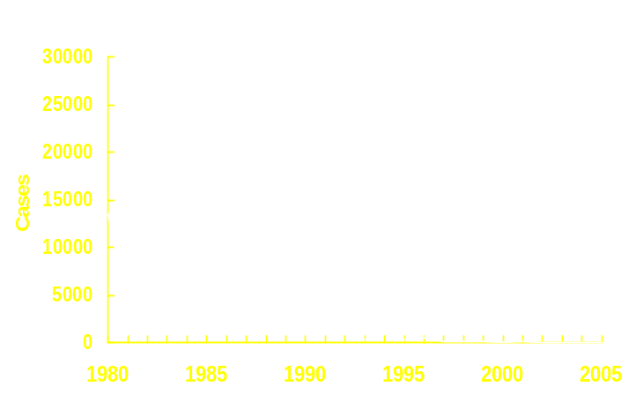
Measles—United States, 1950-2005
2nd dose
1989
Vaccine Licensed
1963
Endemic transmission interrupted
Notes:
This graph shows measles incidence from 1950 to 2005 in the US. The first measles containing vaccines were licensed in 1963 and vaccination has had a dramatic effect on measles incidence in the United States as shown here.
[CLICK] The inset graph depicts incidence from 1980 using a finer scale for the Y-axis to demonstrate the large outbreak that occurred from 1989 -1991 which caused over 55,000 cases, more than 11,000 hospitalizations and 123 deaths. Because of this resurgence, the United States introduced a 2 dose strategy of measles vaccination in 1989. By 1997, endemic transmission was successfully interrupted in the US.

Slide 30
Measles Transmission
Measles is transmitted via the airborne route and is thought to be the most infectious communicable disease
Indigenous transmission of measles in the U.S. was declared eliminated in 2000; concern over recent imported cases
Measles transmission has been documented in physician offices, emergency rooms, and hospital wards; HCP have been infected in recent outbreaks
Good documentation and high levels of immunity minimize the amount of follow-up that needs to be done in the event of an exposure
  Record review for hundreds to thousands staff
  Serologic testing and vaccination

Slide 31
Presumptive Evidence of Immunity to Measles
Documented administration of two doses of live measles virus vaccine on or after the first birthday and at least 28 days apart; or
Laboratory evidence of immunity or laboratory confirmation of disease; or
Birth before 1957*
Documentation of physician-diagnosed measles is no longer acceptable evidence of immunity
* Since ~ 5% of people born before 1957 are susceptible to measles, CDPH recommends that immunity be assessed if such HCP are exposed to measles. During an outbreak, 2 doses of MMR are recommended for unvaccinated HCP without evidence of immunity.

Slide 32
MMR Vaccination for HCP Born Before 1957
HCP born before 1957 are generally presumed to be immune to measles, mumps, and rubella, but not all are
Consider recommending 2 doses of MMR vaccine routinely for unvaccinated HCP born before 1957 who lack laboratory evidence of measles, mumps or rubella immunity or laboratory confirmation of disease
During an outbreak of measles or mumps, two doses of MMR vaccine are recommended for unvaccinated HCP born before 1957 who lack laboratory evidence of immunity or laboratory confirmation of disease; one dose of MMR recommended during rubella outbreaks

Slide 33
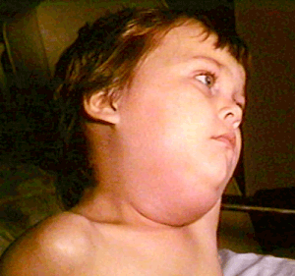
Mumps

Slide 34
Presumptive Evidence of Immunity to Mumps
Documented administration of two doses of live mumps virus vaccine; or
Laboratory evidence of immunity or laboratory confirmation of disease; or
Born before 1957
Documentation of physician-diagnosed mumps is no longer acceptable evidence of immunity

Slide 35
Mumps Vaccination
All persons who work in healthcare facilities should be immune to mumps
  HCP born during or after 1957 → 2 doses
  No vaccination/immunity → 2 doses (>28 days apart)
  Only 1 dose previously → second dose
  Birth before 1957 only presumptive evidence of immunity; consider 1 dose for unvaccinated workers without laboratory evidence of immunity
  During an outbreak, 2 doses of vaccine recommended for workers born before 1957 who do not have evidence of immunity

Slide 36
Nosocomial Transmission of Measles and Mumps in Healthcare Facilities
During 2001-8, 27 reported measles cases were transmitted in healthcare settings, accounting for 5% of all reported U.S. measles cases (CDC, unpublished data)
  In 2008, 11% of cases; considerable economic cost and public health effort to contain (~$100,000 to $400,000)
In Arizona in 2008, the largest nosocomial U.S. measles outbreak (14 cases) occurred in 20 years
  At 3 hospitals, almost 8000 HCP were exposed; 25% had no documentation of immunity so were serologically tested
    30% were born before 1957 ( 5% susceptible)
    70% born >1957 (11% susceptible)
In Tennessee in 1986-87, nosocomial transmission of mumps occurred in 2 hospital ERs infecting 6 HCP and in 2 long-term care facilities infecting 9 patients

Slide 37
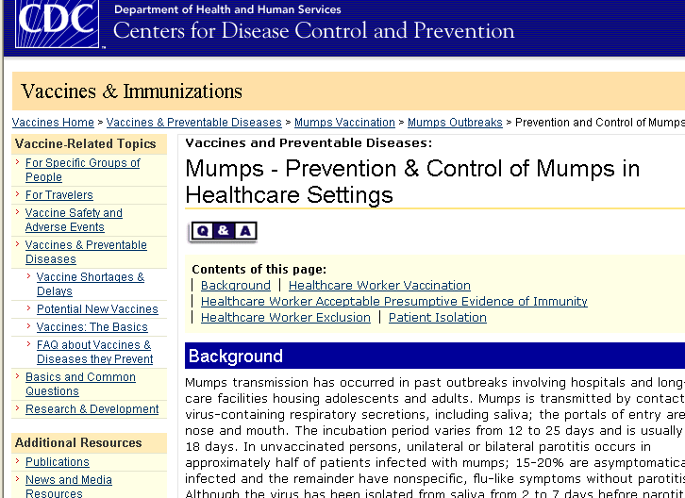
www.cdc.gov/vaccines/vpd-vac/mumps/outbreak/control-hcw.htm

Slide 38
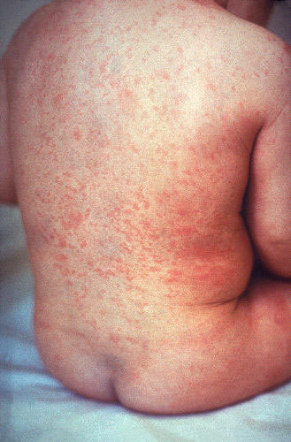
Rubella

Slide 39
Presumptive Evidence of Immunity to Rubella
Documented administration of one dose of live rubella virus vaccine; or
Laboratory evidence of immunity or laboratory confirmation of disease; or
Born before 1957 (except premenopausal women who could become pregnant)
HCP who can provide documentation of serological evidence of rubella immunity (e.g., via prenatal testing) do not need to be retested and should be presumed to be immune

Slide 40
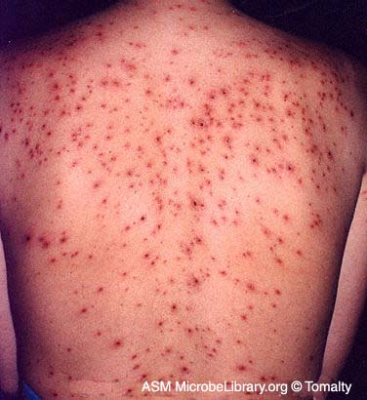
Varicella

Slide 41
Varicella Among HCP
Nosocomial transmission of is varicella (chickenpox) is well-recognized
Sources
  Patients, hospital staff, and visitors with varicella or herpes zoster (shingles)
Airborne transmission of varicella has been demonstrated
  Varicella has occurred in susceptible persons who had no direct contact with index case-patient
  Virus detected in air
  Herpes zoster may also be airborne

Slide 42
Evidence of Immunity to Varicella in HCP
  Documentation of two doses of vaccine
  Laboratory evidence of immunity or laboratory confirmation of disease
  Diagnosis or verification of history of varicella disease by a healthcare provider
  Diagnosis or verification of a history of herpes zoster (shingles) by a healthcare provider

Slide 43
2007 ACIP Recommendations
Serologic screening before vaccination
  Testing unvaccinated HCP with a negative or uncertain history of varicella is likely to be cost-effective; or
  Test all HCP, because small proportion with positive history of disease might be susceptible
Routine testing after 2 doses of vaccine is not recommended
  Available commercial assays not sensitive enough
  In sensitive tests, 99% of adults develop antibodies after 2nd dose
  http://www.cdc.gov/mmwr/pdf/rr/rr5604.pdf

Slide 44
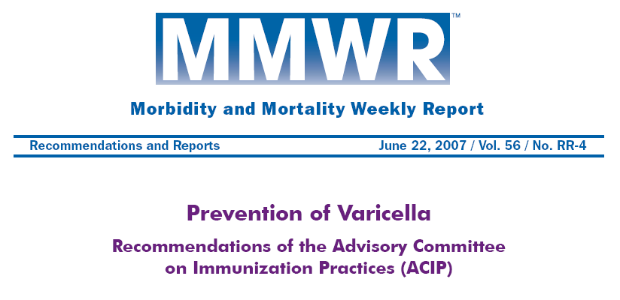
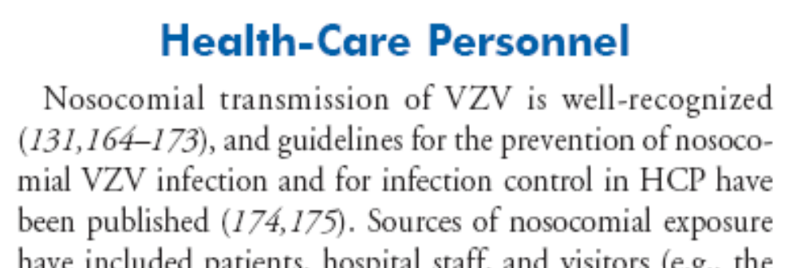

Slide 45
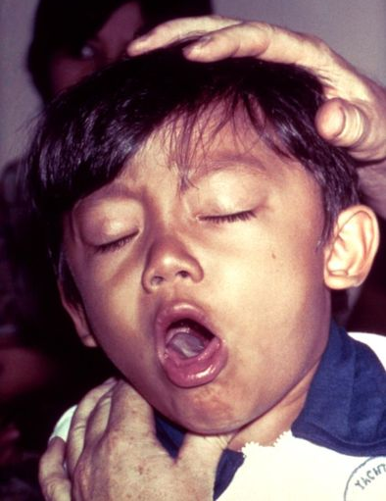
Pertussis

Slide 46
Pertussis in the United States
Least well controlled vaccine preventable disease
It is cyclical; 2005 was the last nationwide peak year and 2010 is a peak year in California
Most severe disease occurs among infants <6 months of age; almost all deaths in infants <3 months of age
Studies have shown that ~ half of the infants with pertussis were infected by a household member, most often their mother
Immunity via vaccine or disease wanes over time; most children last vaccinated at kindergarten are susceptible again by middle school
Almost all adults are susceptible; only ~6% of adults have received Tdap, which was licensed in 2005

Slide 47
Pertussis Among HCP
Nosocomial spread of pertussis documented
  Hospitals and EDs (pediatric and adult), clinics, LTCFs
Sources
  Patients, HCP with hospital- or community-acquired pertussis, visitors or family members; up to 80 infections per index case
Incidence in HCP currently ~7% per year
90% of pediatric hospitals reported HCP exposures over 5-year period; 11% reported infected physicians

Slide 48
Tdap Vaccine
In 2005, a vaccine containing tetanus and diphtheria toxoids and acellular pertussis vaccine (Tdap) was licensed in the U.S. for persons aged 11-64 years (ADACEL®)
In 2006, ACIP recommended that HCP in hospitals or ambulatory care settings with direct patient contact receive a single dose of Tdap as soon as feasible if they have not previously received it
HCP who have direct contact with infants <12 months of age or pregnant women should be strongly encouraged to be vaccinated
An interval as short as 2 years from the last dose of Td is recommended for the Tdap dose – this interval may be waived in the setting of a community outbreak
Almost all adults are susceptible to pertussis; ~ 6% have received Tdap

Slide 49
Costs of Controlling Pertussis in Healthcare Facilities
$74,870-$174,327 per outbreak
$42,000-$98,000/year for pertussis exposures
  Costs include identifying contacts among HCP and patients, providing postexposure prophylaxis for asymptomatic close contacts, and evaluating, treating, and placing symptomatic HCP on administrative leave until they have received effective treatment
MMWR December 15, 2006;55(RR17)
http://www.cdc.gov/mmwr/PDF/rr/rr5517.pdf

Slide 50
Implementing Hospital Tdap Programs
Infrastructure for vaccination exists in most hospitals
  New personnel screened and vaccinated on employment
  Can be given at same time as influenza vaccine
  A booster dose is likely to be recommended in the future
Birth hospitals are encouraged to promote postpartum Tdap vaccination of new mothers

Slide 51
California Pertussis Cases – 2010
As of 6/30/2010, 1,337 cases of pertussis have been reported in 2010 for a state rate of 3.4 cases/100,000, a 5-fold increase from the number of reported cases during the same time period in 2009 when 258 cases were reported (700 cases other possible cases are under investigation)
In the first six months of 2005 there were 1,261 pertussis cases; suggesting that the disease burden is at or above 2005 levels - if current trends continue, California will have more cases of pertussis than in over 50 years
Other states are reporting 2010 increases to CDC, but none are reporting increases similar to those in California; there may be possible differences in states with and without middle school Tdap vaccination requirement

Slide 52
California Pertussis Cases – 2010, continued
5 deaths have been reported in 2010, all in infants <2 months of age at time of disease onset; none had received any doses of pertussis-containing vaccine - the majority of infant cases in 2010 have occurred in infants <3 months of age
Rates are highest in infants <6 months of age (69.6/100,000), in children aged 7-9 years (10.2/100,000) and adolescents aged 10-18 years (9.3/100,000)
Overall rates by race/ethnicity are highest in whites (3.3/100,000), however age-specific rates indicate that the highest rates are seen in Hispanic infants <6 months of age (94.2/100,000); disproportionately high rates are also observed in whites aged 7-18 years

Slide 53
Most Recent ACIP Recommendations
Healthcare workers, 1997 (update in 2010?) http://www.cdc.gov/mmwr/preview/mmwrhtml/00050577.htm
Hepatitis B, 2006 http://www.cdc.gov/mmwr/PDF/rr/rr5516.pdf
Influenza, 2009 http://www.cdc.gov/mmwr/preview/mmwrhtml/rr58e0724a1.htm
Influenza healthcare workers, 2006 http://www.cdc.gov/mmwr/preview/mmwrhtml/rr5502a1.htm
Diphtheria, tetanus, pertussis, 2006 http://www.cdc.gov/mmwr/preview/mmwrhtml/rr5517a1.htm
Measles, mumps, rubella, 1998 and 2009 update http://www.cdc.gov/mmwr/preview/mmwrhtml/00053391.htm http://www.cdc.gov/vaccines/recs/provisional/downloads/mmr-evidence-immunity-Aug2009-508.pdf
Mumps, 2006 http://www.cdc.gov/mmwr/preview/mmwrhtml/mm5522a4.htm
Varicella, 2007 http://www.cdc.gov/mmwr/pdf/rr/rr5604.pdf

