Slide 1
Solano County Department of Environmental Management
Environmental Health Services Division
Hazardous Materials

Slide 2
Hazardous Materials
Presented by Mr. Brad Nicolet, Senior Environmental Health Specialist
Introduction
Regulatory Authority:
California Health and Safety Code (HSC)
California Code of Regulations (CCR) Title 19, 22, 23, 27
Uniform Fire Code Article 80 (Business Plans & Inventories only)

Slide 3

What We Do:
Six Programs
Hazardous Materials Mgmt CHS Ch. 6.95 Article 1
Plan and Disclosure
Underground Storage Tanks CHS Ch. 6.7
Hazardous Waste CHS Ch. 6.5
Risk Management Program CHS CH. 6.95 Article 2
(Plan)
Aboveground Storage Tanks CHS Ch. 6.67
Business Plan & Inventories UFC Article 80

Slide 4
In Addition:
Emergency Response: Unk. Substance, derail, spills, NIHIT, etc.
  Complaints:
  Residential business/hobbyist, sick Bldg
  Prop 65 Reports:
  Spills, releases, tank leaks
  Catch-All:
  Shell tanker spill, SP derail, Elmira Pipeline Leak. Contract with FF/SS Sewer District.

Slide 5
Certified Unified Program Agency
“CUPA”
Implemented in 1996.
Intent: Reduce the burden on business by eliminating multiple inspections and fees.
Consolidate six separate programs into single inspection, permit and fee.
Applies to incorporated and unincorporated areas.

Slide 6
Hazardous Materials Release Response Plan and Inventory
“Community Right to Know”
HMMP Applies to “business” only
Threshold limits:
  55 gallons, 500, pounds, 200 cu/ft
Chemical Inventory, Spill/Fire Response and notification, Site Map
Hazardous Materials Communication Labeling, MSDS, Training

Slide 7
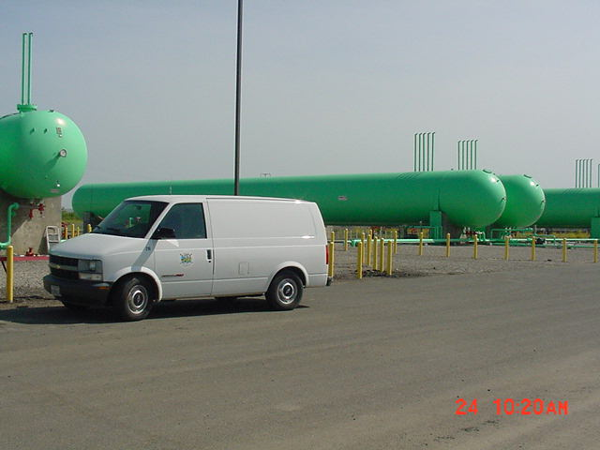

Slide 8
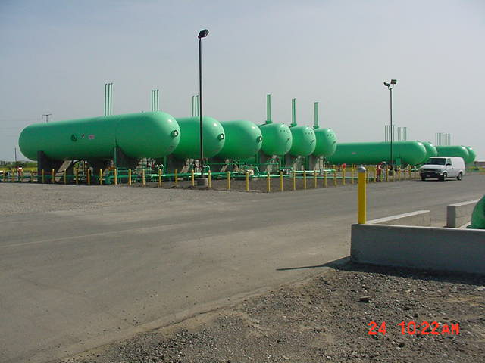

Slide 9
Underground Storage Tanks (UST)
Purpose is to protect groundwater from contamination through prevention using secondary containment and continuous monitoring systems / equipment.
  Installation of UST’s including plan checks and construction inspections
  Annual inspections
  Tank Removal inspections

Slide 10
UST Common Violations:
No leak monitoring / broken equipment
No annual certification of monitoring equipment
Failure to follow permit conditions
No approved UST monitoring/response plan
No proof of financial responsibility

Slide 11
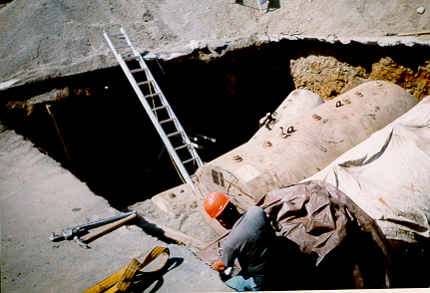
UST Excavation

Slide 12
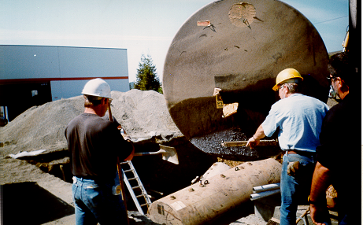
UST Removal

Slide 13
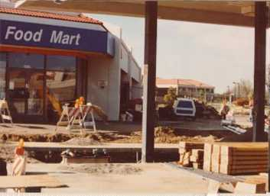
UST Installations

Slide 14
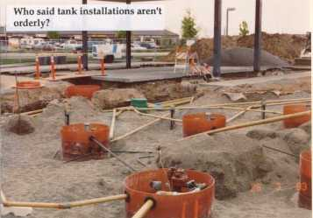

Slide 15
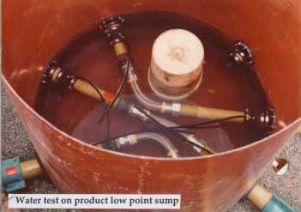
Integrity Test

Slide 16
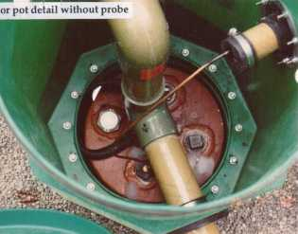
Equipment Checks

Slide 17
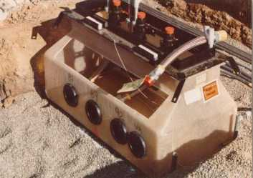
Under Dispenser Containment

Slide 18
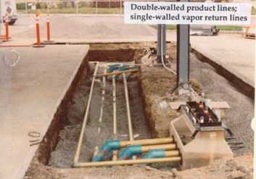
Construction Inspection

Slide 19
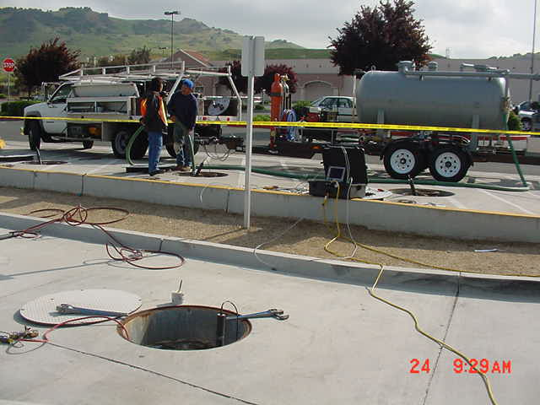

Slide 20
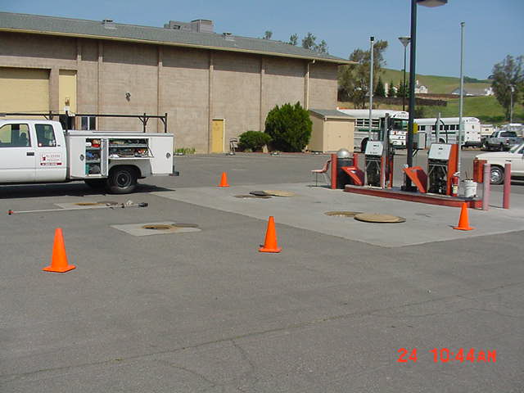

Slide 21
Waste vs. Hazardous Waste
These rules apply to everyone!
Hazardous Waste determination
EPA ID Numbers
Labeling
Chemical Incompatibility Issues
Facility Design Specifications
Management: manifests, receipts, training
Risk Communication: alarms, spill kit

Slide 22
Common Violations
Labeling, labeling, labeling
Containers not closed or secured
Waste manifests not available
No waste determination / illegal disposal
No weekly or daily inspections
Contingency/Emergency Response Plans and employee training inadequate

Slide 23
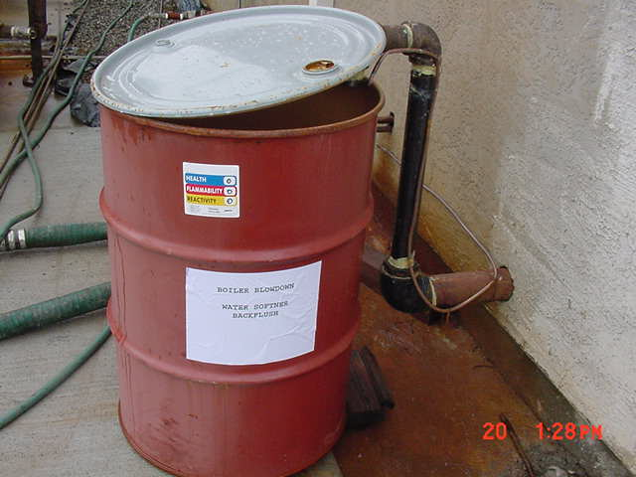
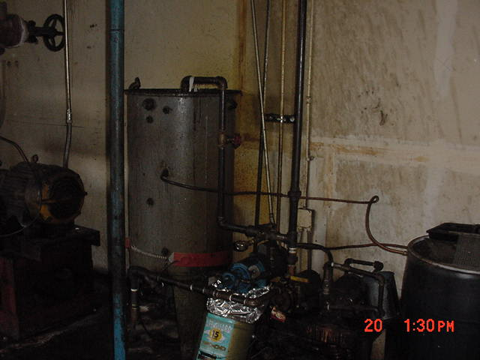
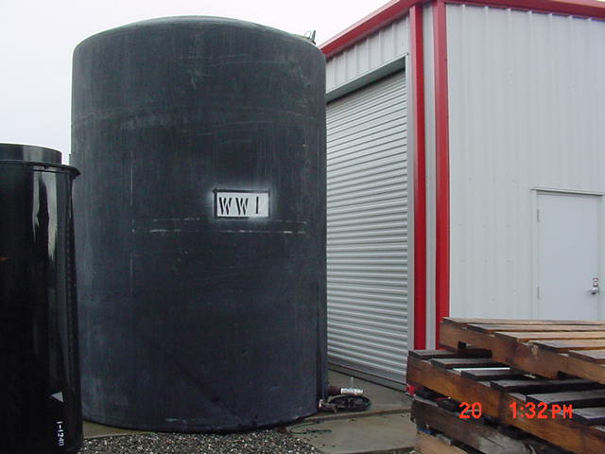
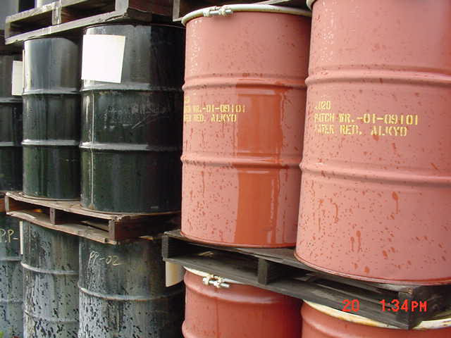
Upper left shows proper label of back flush and boiler blow down drum. Remaining photos show inadequate labeling of heat transfer oil tank, wastewater tank (WW1) and alkyd/resin product drums.

Slide 24
Risk Management Prevention Program (RMP)
Acutely hazardous materials that exceed thresholds listed on three tables.
Ex. Chlorine, Anhydrous Ammonia
Review potential for offsite consequences of airborne release
Up to one year to three years to complete

Slide 25
Risk Management Prevention Program (RMP) cont’n
Uses a professional team of experts to review processes, equipment, and training
Assess worst case and reasonable loss condition from accident, earthquake, sabotage, etc.
Subjected to third party review
Public Participation Period (45 days)

Slide 26
Emergency Response
Technical assistance to other agencies such as, fire, police, and public works
Activate “toxics” superfund cleanup for hazardous waste and illegal drug labs.
Hazcat contract for emergency Hazardous Materials Identification
Prop 65 notification

Slide 27
Additional Areas:
Complaints
Complaints of possible HAZMAT violations are reviewed ASAP. Typical examples and response:
  Disposal of Household Hazardous Wastes
  Neighbor violations: illegal disposal of waste oil or antifreeze
  Odors and Sick Building

Slide 28
Aboveground Storage Tanks (AST’s) and Article 80, Uniform Fire Code
Petroleum threat to navigable waters (AST)
Spill Prevention and countermeasure and control plans (SPCC) (AST)
Article 80 Section 8001.3 duplicates HMBP in the Fire Code and calls the document HMMP

