Slide 1


Interagency Electronic Reporting
Program Overview
November 8, 2005
Pacific Coast Marine Fisheries Committee Meeting
Portland, Or.
Notes:
Micky to start presentation
No special comment about this slide

Slide 2
The ‘Interagency’ who
Alaska Department of Fish and Game – Commercial Fisheries Division
International Pacific Halibut Commission
National Marine Fisheries Service – Alaska Region
  Sustainable Fisheries
  Restricted Access Management
Pacific States Marine Fisheries Commission

Slide 3
INTERAGENCY ELECTORNIC REPORTING
STEERING COMMITTEE MEMBERS
Project Sponsor - Dave Colpo – PSMFC
Agency Steering Committee
  David Ackley NMFS/SF
  Jessie Gharrett NMFS/RAM
  Heather Gilroy IPHC
  Gail Smith ADF&G
WAI Contractor Sponsor
  Karen Morgan WAI CEO
  Chris Keller System Designer
  Micky Kruse Project Manager/Coordinator

Slide 4
FISHERIES OF ALASKA
Large, diverse fisheries with interagency and separate management authorities
  Halibut
  Groundfish
  Shellfish
  Salmon
  Herring
Complex management programs
  Limited entry fisheries
  Individual Fishing Quota programs (IFQ)
  Individual Processor Quota (IPQ) for Rationalized Crab
  Community Development Quotas (CDQ)
  Fixed harvest limits (TAC or GHL)

Slide 5
FISHERIES OF ALASKA
Complex multi-agency license and permit requirements
Real time debiting requirements for IFQ and IPQ programs.
Harvester and processor industry represents a diverse group – small to large/”Mom and Pop’s” to “State of the Art”
Fishing and processing occurs in remote areas with limited connectivity.

Slide 6

A new data collection approach
Interagency Electronic Reporting

Slide 7



A new data collection approach
Interagency Electronic Reporting
Program Components
Web based reporting
Desktop reporting via email
Agency Interface for review and editing submitted electronic data
Elandings 24/7 Server @ SOB

Slide 8
A new data collection approach
Interagency Web-based Electronic Reporting
NMFS RAM
Catch and Production Reporting by Industry
Interagency
Server
NMFS
Sustainable Fisheries
ADF&G Commercial
Fisheries Division
IPHC

Slide 9

eLandings Web Application Demonstration

Slide 10
Interagency Electronic Reporting
Program Goals and Standards
Provides for one-time entry of commercial fisheries landing data by Processors & Catcher/Processors to Mgmt. Agencies
Meets the information needs of the Agencies
Adheres to regulations and confidentiality requirements
Improves data quality
Improves data collection methods to reduce redundancy and to consider business constraints of industry
Provides timely, trip-based commercial catch statistics
Provides documentation - electronic and paper

Slide 11
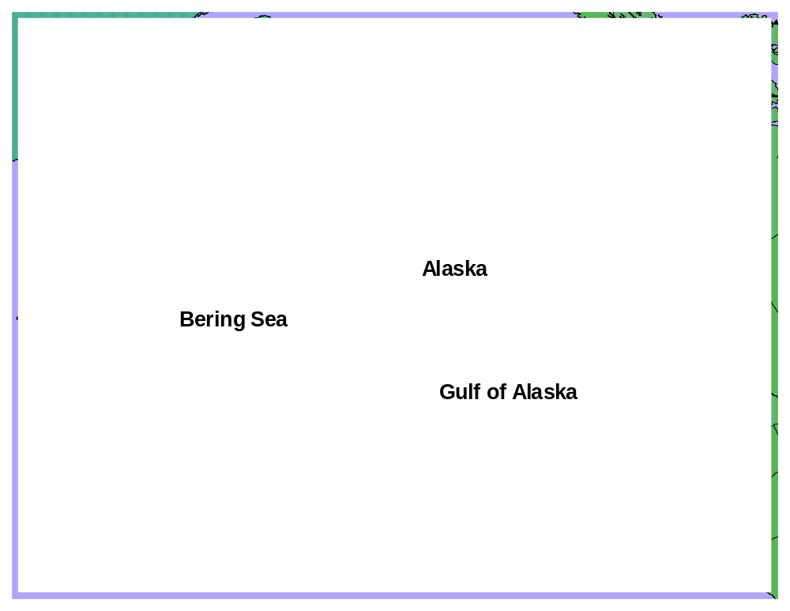
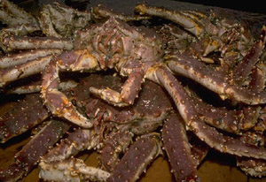
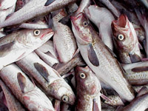

Implementation order by fishery
1 - Newly rationalized crab fisheries
1 - Rationalized Crab Fisheries
2 - Groundfish in the Bering Sea
and Gulf of Alaska
3 - Statewide Shellfish
4 - Salmon and herring

Slide 12
Where We Want To Be
The Vision
Full web-based reporting for all fisheries – catch and production
  Shoreside processors
  At-sea fleet
    Catcher processors
    Motherships
  Tenders
Paperless system
  Electronic signatures
  Bar-coded permit cards
  Electronic quota management

Slide 13
INTERAGENCY COOPERATIVE AGREEMENT
Governance Structure
(Operations Structure)
Agency Directors
Interagency Coordination Committee
Program Facilitators
Interagency Information
Technology Committee
Agency Staff
Industry

Slide 14
Interagency Electronic Reporting
Operations Planning
Memorandum of Agreement (MOA)
Purpose
Establish roles and responsibilities
Staffing and budget
Commitment by Agency Directors for consolidated reporting
Ensure commitment of agency staff
Provide framework and program structure
Agreement on annual program evaluation

Slide 15
Interagency Electronic Reporting
Continuing Challenges
Coordination of program among agencies, including CFEC.
Coordination of program with oversight authorities
  Board of Fish
  North Pacific Fishery Management Council
  International Pacific Halibut Commission
Coordination of program with industry
  Industry Advisory Group
  Processor field representatives
Development of increasingly complex entitlement programs

Slide 16
Interagency Electronic Reporting
Continuing Challenges
The greatest continuing challenges are:
Long-term agency commitment
Long-term adequate funding
Change management

Slide 17
Lessons Learned During Development
Prior to the beginning of system design and programming, the agencies worked to align all data coding systems. This facilitated more rapid development.
The use of Agile Methodology provides a flexible development environment, but requires significant resources for application testing and re-testing.
We all learn by doing. The development of complex systems always require more resources than initially anticipated. Status reports to upper management are vital.

Slide 18
Lessons Learned During Development
Agency coordination significantly increases the workload. Identification of staff resources for the short and long – term are critical to avoid burnout.
Disruption to Seafood Processor’s internal operations systems greater than anticipated.
  ADF&G fish ticket functions as a biological tool and a bill of sale.
  Staged implementation makes industry modifications difficult.

Slide 19
Lessons Learned During Development
Agency staffs and contractor developers did not fully appreciate the complexity of the management program until the season began. This led to post-deployment modification of business rules.
Complex business rules and validation can create some inflexibility for the end user.
Three significant post-deployment modifications identified for the application. Modular design and web platform facilitate application fixes and deployment.

Slide 20
Lessons Learned During
Development
Full-time internet based reporting systems require a careful assessment of what will be required for user management and support.
Good relationships with industry fosters an accepting environment and facilitates positive feedback.
Consultants working with agency programming staff to supervise and mentor has been a very positive production framework.

Slide 21
Program Assessment The Take Home Message
The Interagency Electronic Reporting System is complex and ambitious.
When it functions as envisioned, industry loves the System.
Feedback, generally, has been positive.
The Rationalized Crab Program is complex irrespective of reporting platform.
We are ‘seeing’ the benefits and we are meeting our program goals/standards.

Slide 22
Interagency Electronic Reporting
System overview
Notes:
Micky to start presentation
No special comment about this slide

Slide 23
Existing reporting methods
User
Currently:
Groundfish
and halibut
NOAA Fisheries - SF
groundfish
ADFG
IPHC
groundfish/halibut
NOAA Fisheries – RAM
IFQ
halibut/sablefish
Currently:
Rationalized Crab
User
NOAA Fisheries - SF
NOAA Fisheries – RAM
IPHC
ADFG

Slide 24
Interagency Electronic Reporting System Access
Application
Web-enabled user
Agency Desktop
Client
Processor Desktop
Client
Method
Web session
Web services
Email attachment
Target
Data
Repository

Slide 25
Initial Scoping and Technology Demonstrator
Investigation of existing web reporting and technologies:
  Oracle Forms reported to be slow.
  High Oracle licensing fees – Java being used is open-source.
  Java is a thin-client format. System uses minimized graphics.
  Web connectivity with simple java interface was shown to be acceptable from sites across Alaska.

Slide 26
System setup and process
Web system - access through browser, no setup.
Desktop application steps:
  Installation (one-time)
    Establish directories and email protocols
      Email directory for attachments
      Return receipt directory
  Transmit (can include upload of ticket numbers)
  Process return receipts
  Handle errors
Manual landings – agency data entry
  Central location to handle manual submissions

Slide 27
Install software
Yes:
Correct and retransmit
Obtain valid
ticket numbers
No:
Store submitted data
Errors?
Enter/edit and transmit
a landing
Client receive and
process receipt
Desktop Client
System
Recognize as landing
Email back to client
Return receipt
to mail server
Parse and process attachment
Submit to database
Create return receipt
Check for validity and errors

Slide 28
Transmission requirements
Web session for web application
Email attachment for desktop application
  Specifications – communication system must submit and receive email
  Zip or file attachment, identification method necessary in receiving system
  PERL or similar script to handle attachment
  Extraction of XML
  Web services to pass XML to data repository

Slide 29
Validation
Internal – basic validation on web or desktop client.
Business rules
  Reality checks (non negative, upper/lower limits)
  Relationships - permit/person/fishery; condition/disposition; gear/area/species
  Complicated management programs add extra layers of complexity

Slide 30
Error handling
Internal
  Hard errors -> incorrect data; illogical combinations = no submission.
  Soft errors -> questionable data = warning issued but landing allowed.
External
  Discovered by staff after submission – encourage resubmission by processor
  Agency correction (usually parallel track, dual fields)

Slide 31
Error handling
Error messages are linked to internal business rules
Error messages are increasingly well organized and informative
Better information supplied reduces help desk calls

Slide 32
XML
Extensible markup language.
XML documents are a form of SGML.
“document is composed of declarations, elements, comments, character references, and processing instructions, all of which are indicated in the document by explicit markup”. http://www.w3.org/TR/REC-xml/
Tree structure.

Slide 33
<?xml version="1.0" encoding="UTF-8" standalone="yes"?>
<landing_report
  last_change_user="AMARX">
  <landing_report_id>248</landing_report_id>
  <type_of_landing_report name="Crab">C</type_of_landing_report>
  <status>1</status>
  <header>
    <vessel name="BILLIKIN ">20745</vessel>
    <crew_size>4</crew_size>
    <observers_onboard>0</observers_onboard>
    <port_of_landing ifq_port_code="136" name="Juneau Borough">JNU</port_of_landing>
    <gear name="Pot ">91</gear>
    <proc_code_owner>
      <proc_code processor="WAI Seafoods Juneau">F1234</proc_code>
    </proc_code_owner>
    <date_fishing_began>2005-06-01-08:00</date_fishing_began>
    <days_fished>3</days_fished>
    <date_of_landing>2005-06-05-08:00</date_of_landing>
    <partial_delivery>false</partial_delivery>
    <last_delivery_for_trip>true</last_delivery_for_trip>
    <federal_processor_number name="WAI Seafoods Juneau">12345</federal_processor_number>
    <registered_buyer_number>123456</registered_buyer_number>
    <registered_crab_receiver_number name="WAI Seafoods Juneau">123456</registered_crab_receiver_number>
    <buying_station_name>Harris Dock</buying_station_name>
    <permit_worksheet>
      <cfec_permit holder="Gordon Diaz">
        <fishery>K91TC</fishery>
        <permit_number>19538Z</permit_number>
        <year_seq>0401M</year_seq>
      </cfec_permit>
      <fish_ticket_number>E05 000064</fish_ticket_number>
      <ifq_permit_worksheet>
        <ifq_permit_number>90000</ifq_permit_number>
        <nmfs_person_id>90000</nmfs_person_id>
        <species name="crab, red king">921</species>
      </ifq_permit_worksheet>
    </permit_worksheet>
    <stat_area_worksheet>
      <stat_area fed_area="541" iphc_area="4B">744800</stat_area>
      <percent>100</percent>
      <effort>140.0000</effort>
    </stat_area_worksheet>
  </header>
</landing_report>

Slide 34
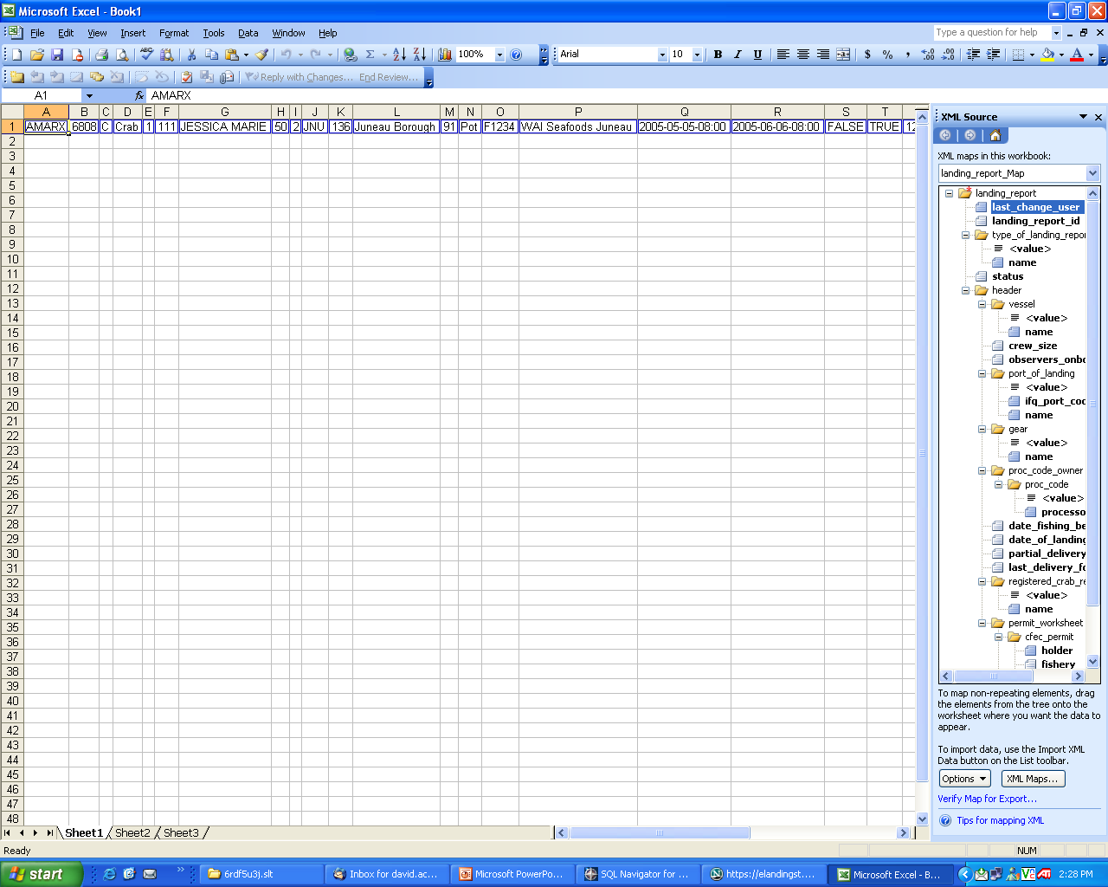

Slide 35
Security
SSL (Secure Socket Layer) transmission
Identification
  User registration and validation
  User ID and password for session
  Unidentified user blocks receipt of data
System logs of all activity
Big Brother

Slide 36
Database and programming languages
Oracle database
SQL for query and scripts/triggers for internal tables
HTML front-end
Java – script behind front-end, business rules, processing language.
PERL/Java – email handling
Web services and SOAP

Slide 37
Reports generated
Fish ticket – PDF paper printout
Searches on account by processor of submitted landings
  Limited users
  Supervisory users
IFQ account access and summary
Agency reports – SQL based on repository
Log files

Slide 38
Problems
User account management – did not match business practices.
Permit and stat areas – Stacking of 9 permits across 14 stat areas was not anticipated
Refresh of CFEC permits not timely
Preliminary problems with IFQ interface and permit updates

Slide 39
Support
Redeployment of fixes for client software (Processor Desktop) takes coordination.
Web application fixes are modular – easier modifications, with staged deployment
Change implemented though 3 environments – test, training and production.

Slide 40

Interagency Electronic Reporting
Questions

