Slide 1
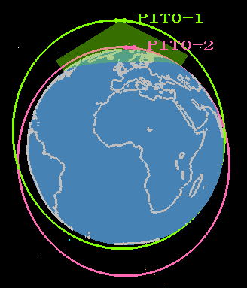
Paired Ionosphere-Thermosphere Orbiters
Science Objectives:
Combine in situ data, imaging and profiling to unravel the complex interplay between process on different scales and in different regions and assess how the I-T system responds to magnetospheric and neutral forcing, including
- The causes of ionospheric density irregularities < 1000 km
- Composition changes in the aurora
- High-latitude electrodynamical control of the global circulation of the atmosphere
Connections between equatorial depletions and atmospheric disturbances
Associated RFAs:
F2, F3, H2,H3,J1,J4
Concept graphic
Mission Implementation Description:
*Number of spacecraft: 2
*Location: LEO (200 x 2000 km)
*Attitude control: 3-axis stabilized
*Number of instruments packages: 4
*Payload resources required: 400 kg
Measurement Strategy:
Paired satellites for simultaneous observation of large and small scale ionosphere-thermosphere phenomena in two regions of the atmosphere and the coupling between them
Enabling and Enhancing Technology Development:
None
Enhancing technology: Spaceborne lidar would enhance the mission

