Slide 1

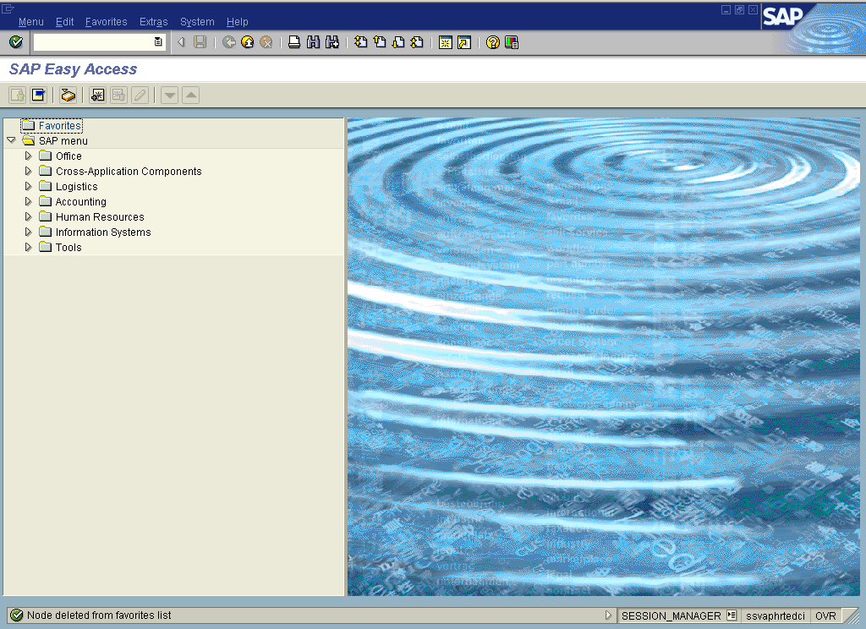

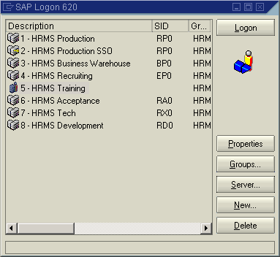
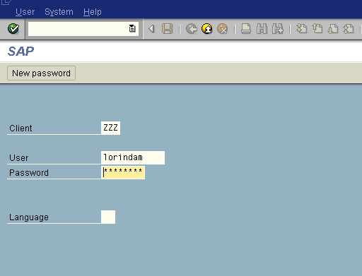
Accessing HRMS
Roles and Access
Your predetermined role determines areas of HRMS you have access to. You are only able to access information and/or complete transactions based on your role.
The SAP Easy Access screen is the point of entry into HRMS after logging on.
Log on to the HRMS using SAP GUI
Double-click the SAPLogon icon from your desktop
SAP Logon dialog box appears, click on the appropriate server and click the Logon button
Enter the Client, User (ID) and Password
Changing Passwords
To change your password, click the New password in the upper left-hand corner of the screen, enter a new password, confirm the new password, then click (Enter) to verify.
Obtaining User IDs and Passwords
Your agency will provide you with your specific log on information.
Language field: leave blank as this defaults to English
March 2007

