Slide 1
Overview of the 401 WQC Process

Slide 2
Main Topics
Relationship between Clean Water Act Sections 404 and 401
State permitting processes
Specifics of Kentucky’s 401 Water Quality Certification program

Slide 3

Clean Water Act
US Environmental Protection Agency administers all of CWA except for:
Section 404 administered by U.S. Army Corps of Engineers
Section 401 administered by KY Division of Water

Slide 4
Relationship between Sections 404 & 401
Section 404 – Permits for dredged or fill material
Section 401 – Certification
  Sec 401(a)(1) Any applicant for a Federal license or permit to conduct any activity, ….which may result in any discharge into the navigable waters, shall provide the licensing or permitting agency a certification from the State in which the discharge originates or will originate

Slide 5

Marriage of 404 & 401
Section 401 is the state oversight of a federal program
KDOW must issue a 401 Water Quality Certification for a 404 DA permit to be valid

Slide 6
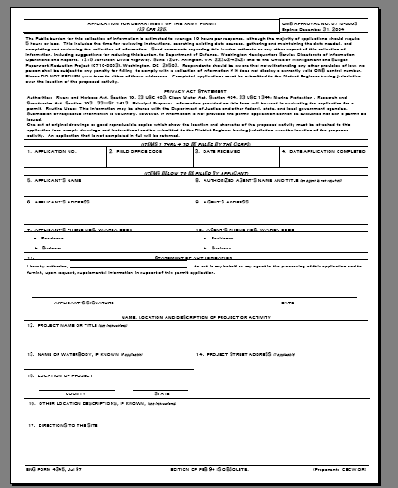
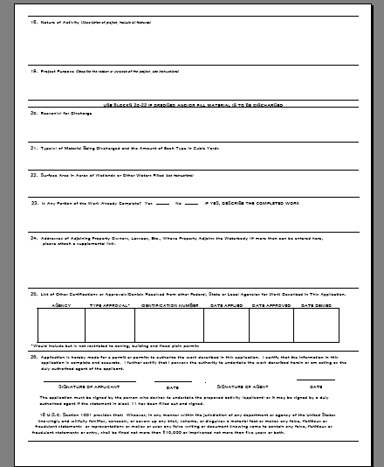
Section 404 Permit Application

Slide 7
USACE 404 Permits
The USACE uses Nationwide Permits (NWP) and Individual Permits (IP) to regulate physical impacts to “waters of the United States”
  Nationwide permits are general permits that cover common activities that have a “minimal” impact
  Individual Permits are issued for larger impacts and involve a public comment period

Slide 8
USACE Individual Permits
“A DA Permit cannot be issued if any legally required Federal, State, or local authorization or certification is denied. A DA Permit, if otherwise warranted, will not be issued until a State of Kentucky Water Quality Certification or waiver is on file at this office.”
      Louisville District Public Notice standard language

Slide 9
Common Nationwide Permits
NW #3 - Maintenance Activities
NW #12 - Utility Line Crossing of Streams
NW #13 - Bank Stabilization
NW #14 - Road Crossing of Streams
NW #21 - Surface Mining Activities
NW #27 - Stream/Wetland Restoration
NW #39 - Development

Slide 10
Goal of the 401 WQC
Pursuant to Section 401 of the Clean Water Act (CWA), the Commonwealth of Kentucky certifies it has reasonable assurances that applicable water quality standards … …, will not be violated by the above referenced project provided that the U.S. Army Corps of Engineers authorizes the activity …, and the following conditions are met:

Slide 11
401 Certification of Nationwide Permits
Options for Certification
  Certified as Written
  Certified with Conditions
  Denied
http://www.water.ky.gov/permitting/wqcert/WQCofNW.htm
http://nrepcapps.ky.gov/special_waters/specialwaters.htm

Slide 12
Individual Water Quality Certifications
Required for
  individual 404 permits
  nationwide permits that are denied
  projects that don’t meet the conditions of a general certification for the appropriate nationwide
May involve mitigation to compensate the Commonwealth for impacts to a stream or wetland

Slide 13
State Permitting Process
Section 401 Water Quality Certification
Permit to Construct Along or Across a Stream (Floodplain Management Section)
KPDES General Storm Water Permit

Slide 14
When do I need a WQC?
Technical Answer
  CWA Section 401
Safe Answer
  Waters of the Commonwealth
Practical Answer
  Tie back to the DA Permit
Notes:
Federal permit for discharge
Any work in a stream or wetland
When a 404 DA permit is required and the activity is not covered under a General Certification

Slide 15
When do I need a Floodplain Permit?
KRS 151.125 and KRS 151.250
Activities within the 100-year floodplain of all streams in the Commonwealth
Typical activities
  Bridges, culverts, placement of fill, stream relocations, buildings
Notes:
Construction (other than dams or other impounding structures) in or along a stream where the watershed is less than one square mile is exempted from the permit requirements of KRS 151.250 by regulation 401 KAR 4:050, except for projects whose construction might pose a threat to life or property due to increased flooding. Therefore, since it appears that the construction you propose meets exemption criteria, a stream construction permit will not be required.

Slide 16
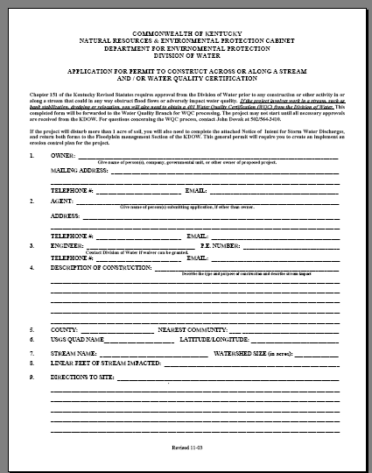
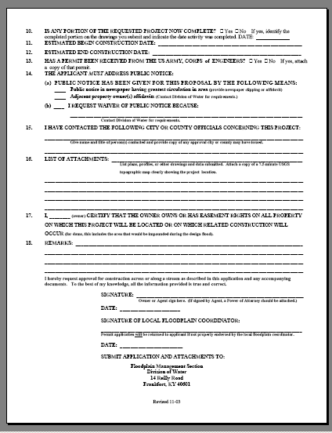
Joint Application Form

Slide 17
DOW Review
Application received
Scanning
Conduct Agency Review

Slide 18
Joint Application
Determination of impact – is a 401 WQC required?
Do we expect the USACE to cover the project under a nationwide permit?
Does it qualify for a General Certification?
Is additional information required?

Slide 19
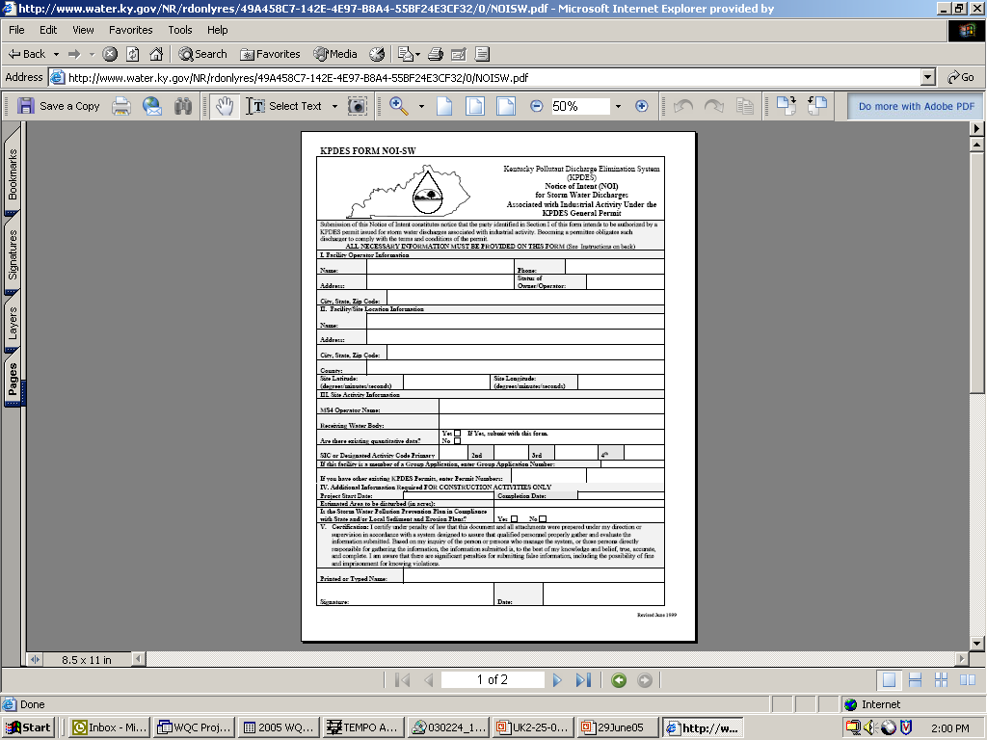
KPDES Storm Water NOI
Construction sites disturbing 1 acre or more
Storm water pollution prevention plan
Notice of Intent

Slide 20
Kentucky’s 401 Water Quality Certification Program

Slide 21
Applications Received
Joint Application Form
Public Notice
Applications from KTC or DNR Coal Permittee

Slide 22
Permit Issuance
General Certification
Standard Water Quality Certification
Agreed Order

Slide 23
General Certification
Specific to a USACE general permit
Does not require application to the state
Source of the 200 linear foot ‘urban legend’

Slide 24
Standard WQC
Used for most individual WQCs
  Projects authorized under a DA Individual Permit
  Projects qualifying for a DA Nationwide Permit but does not meet conditions of the general WQC
Standard language
  Project specific conditions
  General conditions
TEMPO format

Slide 25
Agreed Order
Enforcement cases and resolution of denials
Projects with mitigation that is experimental
Projects that occur over a long time frame or where mitigation won’t occur for several years
Allows all parties to be aware of commitments

Slide 26
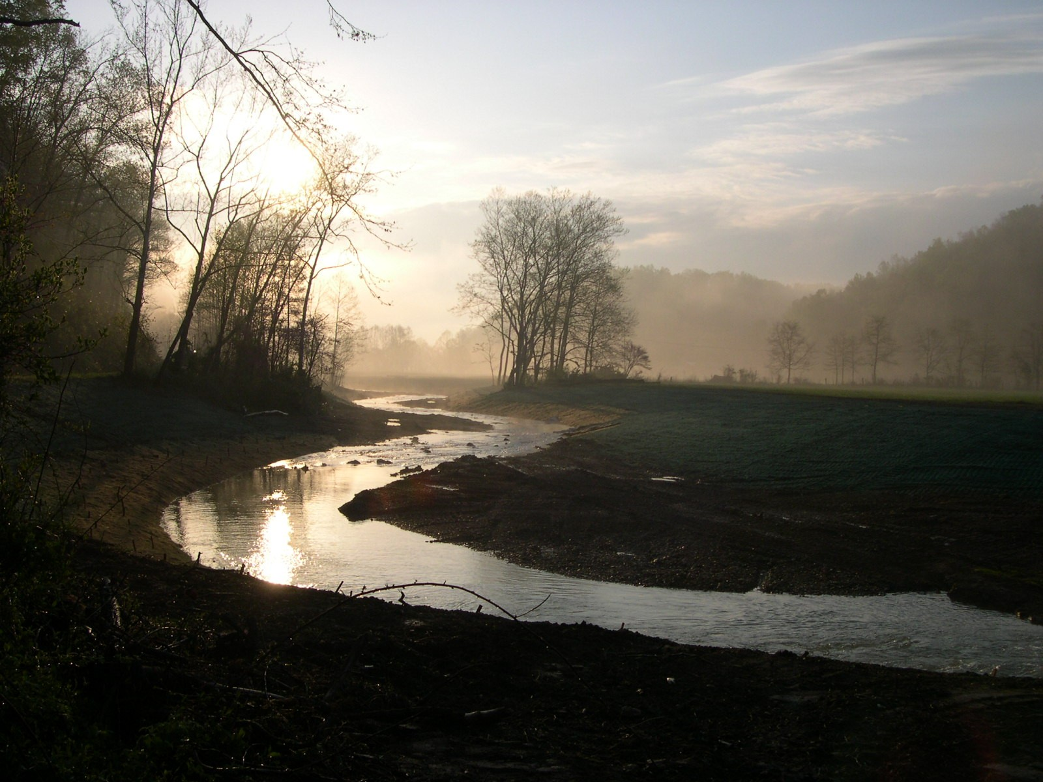
Questions?

