Slide 1

Improving Collection of HIV and AIDS Diagnosis Dates
July, 2011

Slide 2

Improving Data Collection
The State Office of AIDS is now working with providers to improve the quality of data that is collected and entered into ARIES.
Today’s webinar will focus on the HIV and AIDS Diagnosis Dates fields.

Slide 3
Objectives
Importance of HIV/AIDS Diagnosis Dates
How to Enter HIV/AIDS Diagnosis Dates
Tips for Collecting HIV/AIDS Diagnosis Date fields
Running the Fix-It Report
Questions, Answers and Closing

Slide 4
Why is this important?
HIV/AIDS Diagnosis Dates help providers:
  Gauge clients’ disease progressions.
  Assess the severity of clients’ HIV/AIDS disease.
  Obtain critical information for clients’ HIV/AIDS disease management.
  Assists agencies, fiscal agents and the CA OA in tracking and monitoring the HIV/AIDS epidemic in their respective areas.

Slide 5
Why is this important? (cont.)
These fields are also critical because they are required for:
  OA programs: HCP and MCWP
  HRSA’s Ryan White Services Report (RSR);
  HRSA’s Ryan White Data Report (RDR) and
  HAB’s QM Indicator Reports.

Slide 6
Entering HIV/AIDS Diagnosis Dates
We’re going to review the steps for entering HIV and AIDS diagnosis dates.

Slide 7
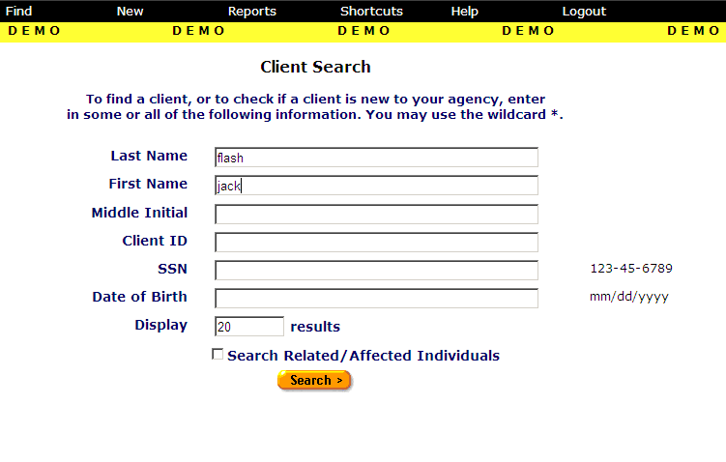
Client Search

Slide 8
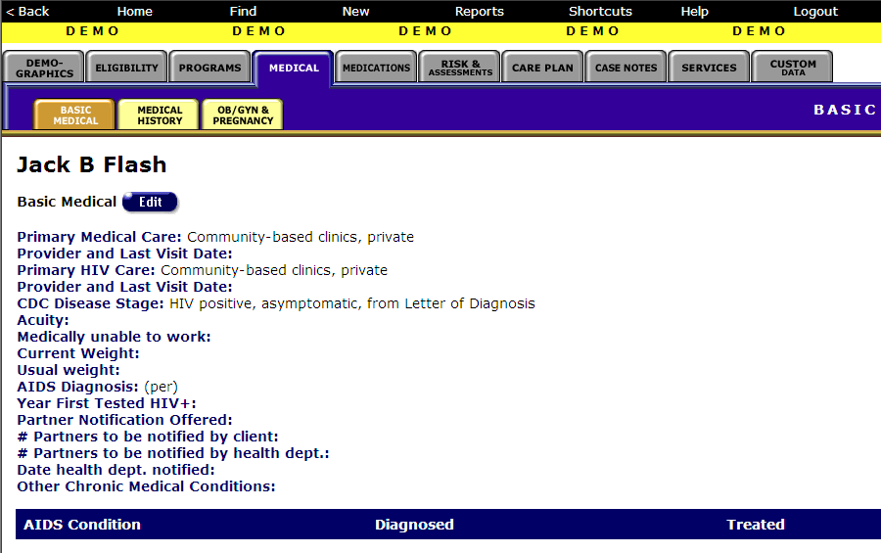
Navigate to the Medical Major Tab…
Please note: the data in the following screens are fictitious client data from our ARIES Demo site

Slide 9
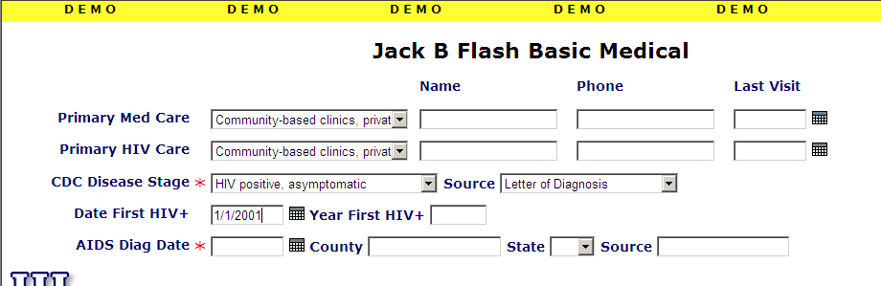
Date First HIV+
Enter the date the client first tested positive for HIV

Slide 10
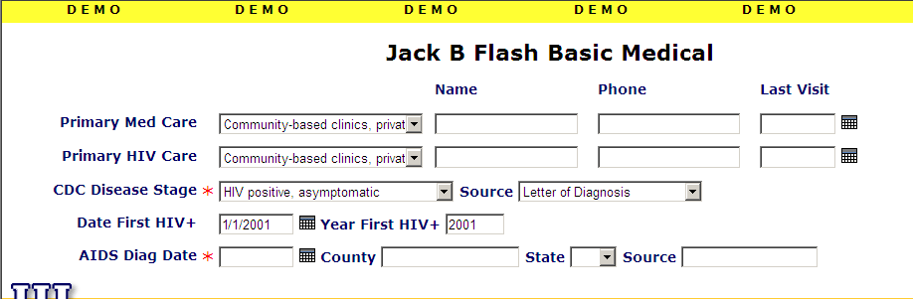
Year First HIV+
The Year First HIV+ field will auto populate

Slide 11
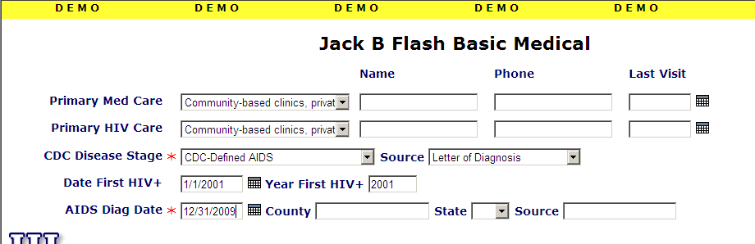
AIDS Diagnosis Date
Enter the client’s AIDS diagnosis date if the client has AIDS

Slide 12
Tips for Collecting
HIV/AIDS Diagnosis Dates
  We’re now going to give tips for collecting and entering these data accurately.

Slide 13
Tips for Collecting
HIV/AIDS Diagnosis Dates
Sometimes, clients may not know their exact date of first HIV-positive diagnosis…
  Approximate month?
  Year?

Slide 14
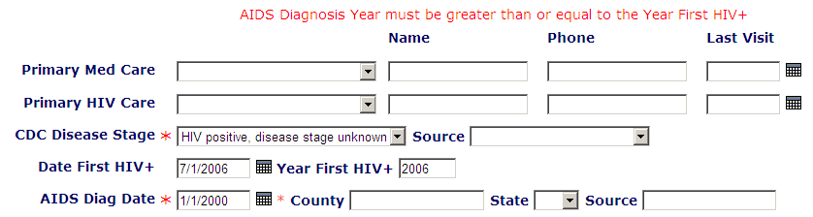
Tips for Collecting
HIV/AIDS Diagnosis Dates
  A date of first HIV-positive diagnosis date cannot be after the AIDS diagnosis date.

Slide 15
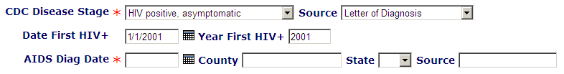
Tips for Collecting
HIV/AIDS Diagnosis Dates
  AIDS Diagnosis Date is not required if client does not have AIDS.

Slide 16
Tips for Collecting
HIV/AIDS Diagnosis Dates
  AIDS Diagnosis Date is required if client has AIDS.
  Does the CDC Disease Stage field indicate AIDS?

Slide 17
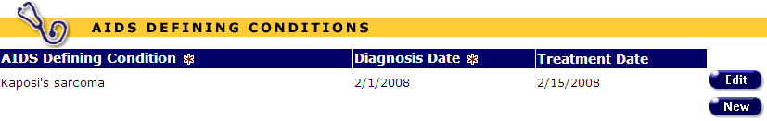
Tips for Collecting
HIV/AIDS Diagnosis Dates
  AIDS Diagnosis Date is required if client has AIDS
  Does the client have any AIDS Defining Conditions listed?

Slide 18

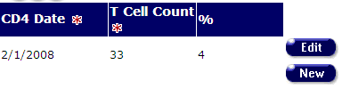
Tips for Collecting
HIV/AIDS Diagnosis Dates
  AIDS Diagnosis Date is required if client has AIDS
  Does the client have any CD4 tests <200?

Slide 19
Running the Fix-It Report
We hope these tips help improve your data collection in the future.
Some of your records need attention now. We have designed a report that will help you find records in your agency that need HIV and AIDS Diagnosis Dates corrected and/or updated.

Slide 20
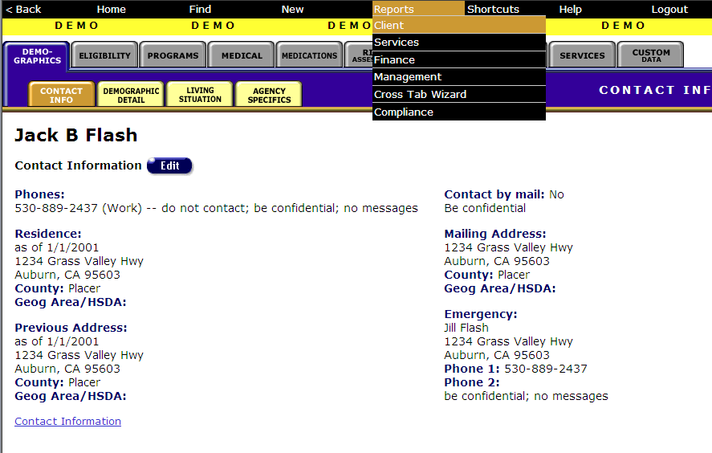
Running the Fix-It Report
Click on “Client” under the Reports menu

Slide 21
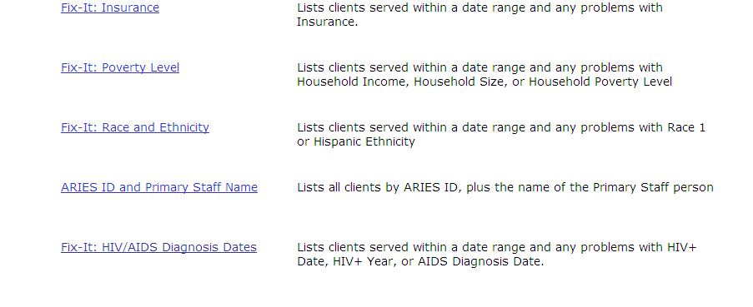
Running the Fix-It Report
Click on the link to the fix-it report

Slide 22
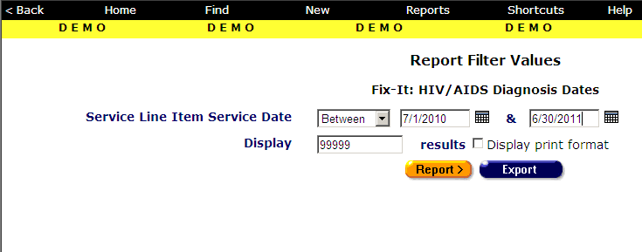
Fix-It Report Filter Values
Set filter dates
Set filter dates
Click “Report”

Slide 23
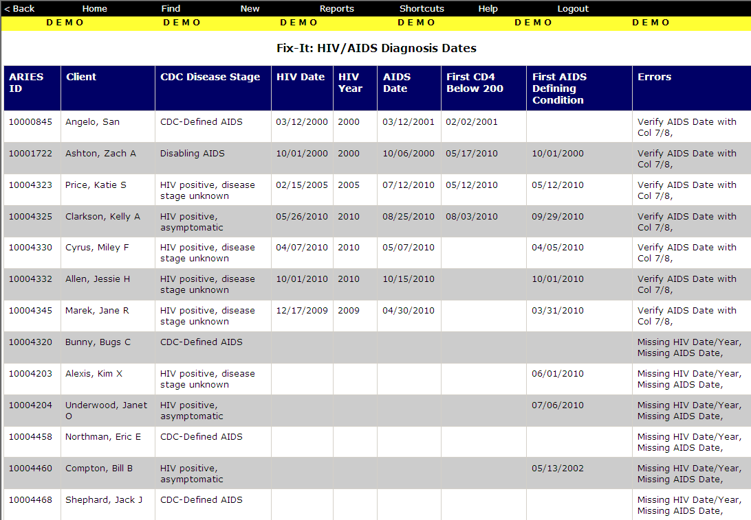
Sample Fix-It Report

Slide 24
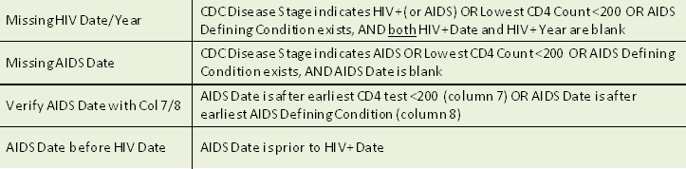
Fix-It Report Error Messages

Slide 25
Running the Fix-It Report
Please look up the clients with error messages using their ARIES ID.
Resolve the errors by looking in clients’ charts and/or assessments for the missing or inaccurate information.
Update ARIES accordingly.
And then…

Slide 26
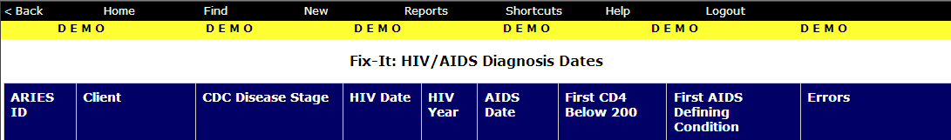
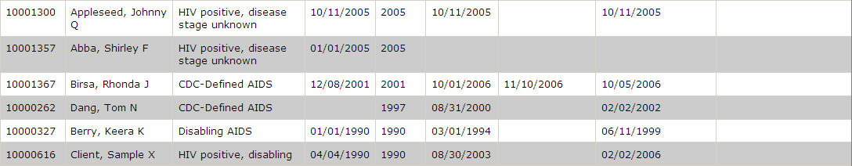
…take a look at the Fix-It records with no errors
What’s inconsistent with these records?

Slide 27
…take a look at the Fix-It records with no errors
What’s inconsistent with these records?
Both records have HIV Statuses with AIDS Dates!!!

Slide 28
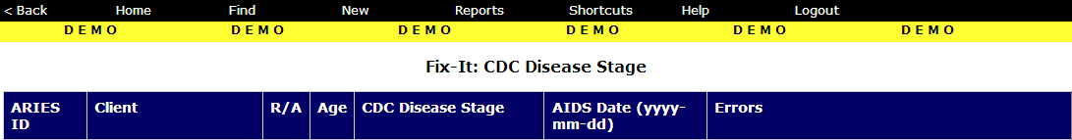
CDC Disease Stage Fix-It Report (August 2010 ARIES FTA)
These records show errors on the CDC Disease Stage fix-it report

Slide 29

Back to the Diagnosis Dates Fix-It Report…
What to do next???
Both records have HIV Statuses with AIDS Dates!!!
…but which one is correct???

Slide 30
Running the Fix-It Report Amended
Please look up the clients with inconsistent NON-error messages using their ARIES ID.
Run the CDC Disease Stage Fix-It Report
  These clients will show errors in the CDC Disease Stage fix-it report.
Resolve these data by looking in clients’ charts and/or assessments for the missing or inaccurate information.
Then update ARIES accordingly.

Slide 31
Questions & Answers
Do you have any questions?
Additional Resources:
  This presentation is posted in the Training section of www.projectaries.org.
  The ARIES User Manual can be accessed by pressing the F1 button while in ARIES.
  The ARIES Help Desk can be reached at 866-411-ARIES (2743).

Slide 32
Thank you!
Thank for participating! We hope that this has been a productive use of your time.
Together we can improve ARIES data quality!

