Slide 1


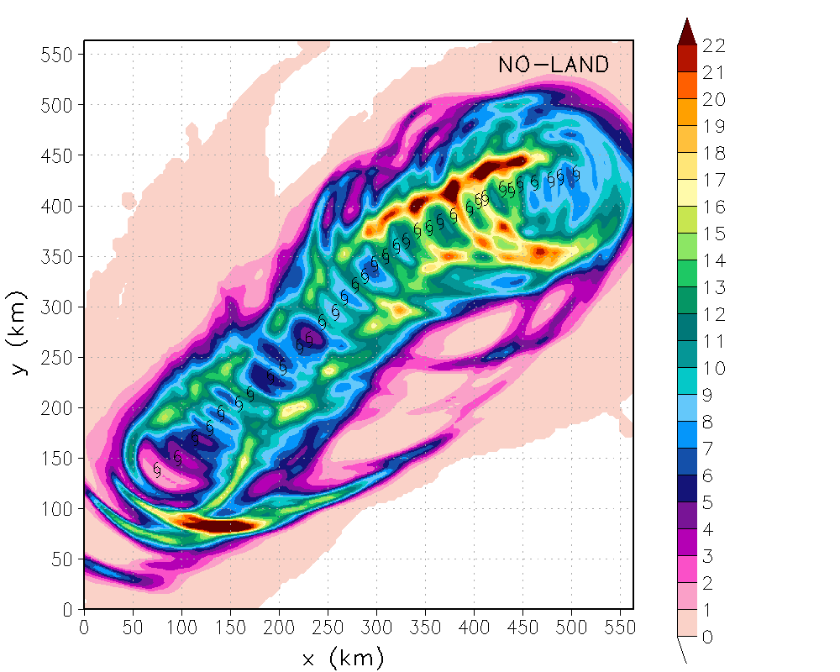
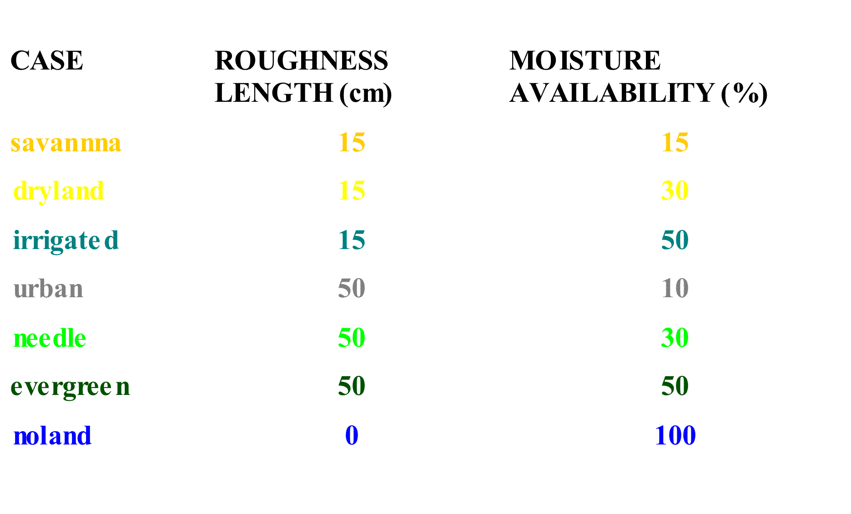
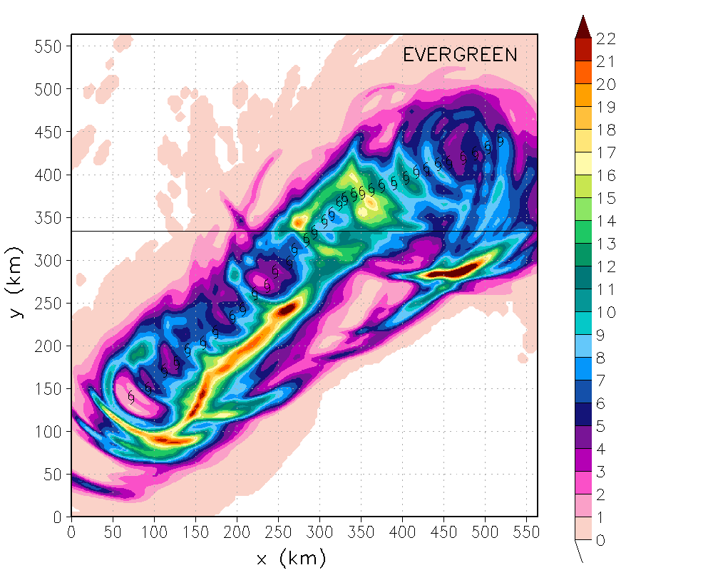
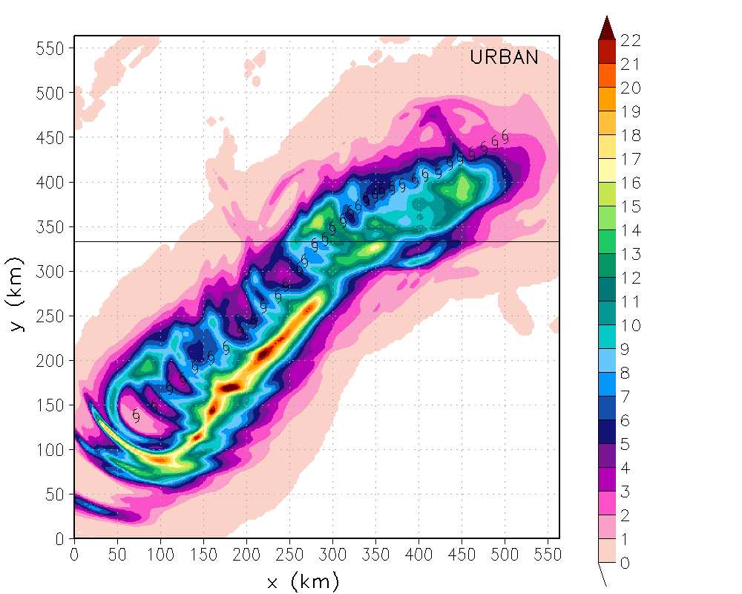
Structure and Evolution of rainfall in
Numerically Simulated Landfalling Hurricanes
Sytske Kimball,
University of South Alabama,
Mobile, AL
Acknowledgements
This works is supported by NSF Award No. ATM-0239492
This work was made possible in part by a grant of high performance computing resources and technical support from the Alabama Supercomputer Authority.
Low RL
High RL

