Slide 1
Uses of Information Theory in Medical Imaging
Wang Zhan, Ph.D.
Center for Imaging of Neurodegenerative Diseases
Tel: 415-221-4810x2454, Email: Wang.Zhan@ucsf.edu
Karl Young (UCSF) and M. Farmar (MSU)
Medical Imaging Informatics, 2009 --- W. Zhan

Slide 2
Topics
Image Registration
  Information theory based image registration (JPW Pluim, et al, IEEE TMI 2003)
Feature Selection
  Information theory based feature selection for image classification optimization (M. Farmer, MSU, 2003)
Image Classification
  Complexity Based Image Classification (Karl Young, USF, 2007)

Slide 3
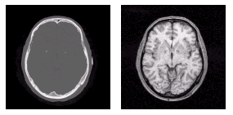
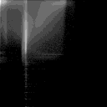
Image Registration
Define a transform T that maps one image onto another image such that some measure of overlap is maximized (Colin’s lecture).
  Discuss information theory as means for generating measures to be maximized over sets of transforms
MRI
CT
MRI
CT

Slide 4
Three Interpretations of Entropy
The amount of information an event provides
  An infrequently occurring event provides more information than a frequently occurring event
The uncertainty in the outcome of an event
  Systems with one very common event have less entropy than systems with many equally probable events
The dispersion in the probability distribution
  An image of a single amplitude has a less disperse histogram than an image of many greyscales
    the lower dispersion implies lower entropy

Slide 5
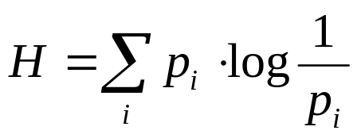
Measures of Information
Hartley defined the first information measure:
  H = n log s
  n is the length of the message and s is the number of possible values for each symbol in the message
  Assumes all symbols equally likely to occur
Shannon proposed variant (Shannon’s Entropy)
    weighs the information based on the probability that an outcome will occur
    second term shows the amount of information an event provides is inversely proportional to its prob of occurring

Slide 6
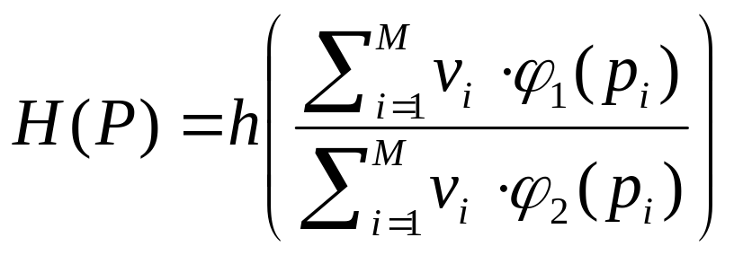
Alternative Definitions of Entropy
The following generating function can be used as an abstract definition of entropy:
Various definitions of these parameters provide different definitions of entropy.
  Actually found over 20 definitions of entropy

Slide 7
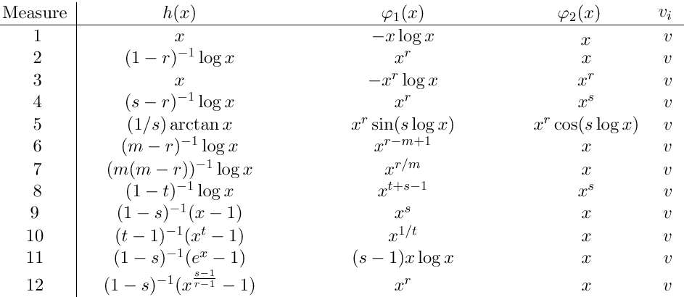

Slide 8
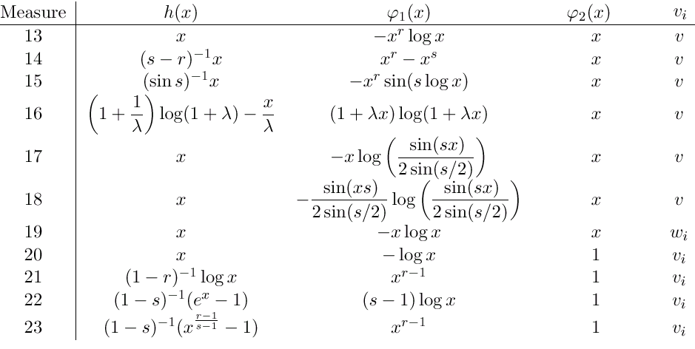

Slide 9
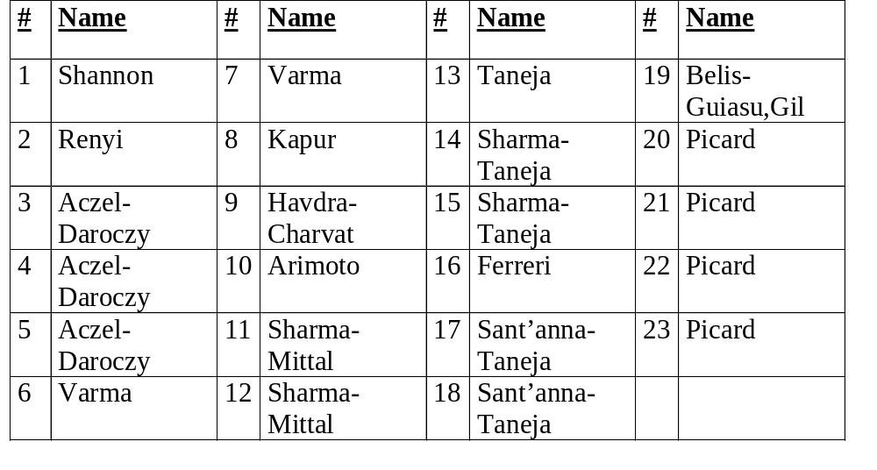
Note that only 1 and 2 satisfy simple uniqueness criteria
(i.e. unique additive functionals of probability
density functions)

Slide 10
Entropy for Image Registration
Define estimate of joint probability distribution of images:
  2-D histogram where each axis designates the number of possible intensity values in corresponding image
  each histogram cell is incremented each time a pair (I_1(x,y), I_2(x,y)) occurs in the pair of images (“co-occurrence”)
  if images are perfectly aligned then the histogram is highly focused; as the images mis-align the dispersion grows
  recall one interpretation of entropy is as a measure of histogram dispersion

Slide 11
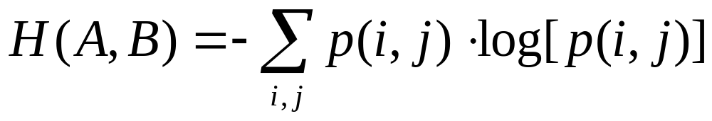
Entropy for Image Registration
Joint entropy (entropy of 2-D histogram):
Consider images “registered” for transformation that minimizes joint entropy, i.e. dispersion in the joint histogram for images is minimized

Slide 12
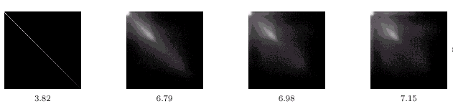
Example
Joint Entropy of 2-D Histogram for rotation of image with respect
to itself of 0, 2, 5, and 10 degrees

Slide 13
Mutual Information for Image Registration
Recall definition(s):
  I(A,B) = H(B) - H(B|A) = H(A) - H(A|B)
    amount that uncertainty in B (or A) is reduced when A (or B) is known.
  I(A,B) = H(A) + H(B) - H(A,B)
    maximizing is equivalent to minimizing joint entropy (last term)
Advantage in using mutual info over joint entropy is it includes the individual input’s entropy
Works better than simply joint entropy in regions of image background (low contrast) where there will be high joint entropy but this is offset by high individual entropies as well - so the overall mutual information will be low
Mutual information is maximized for registered images

Slide 14
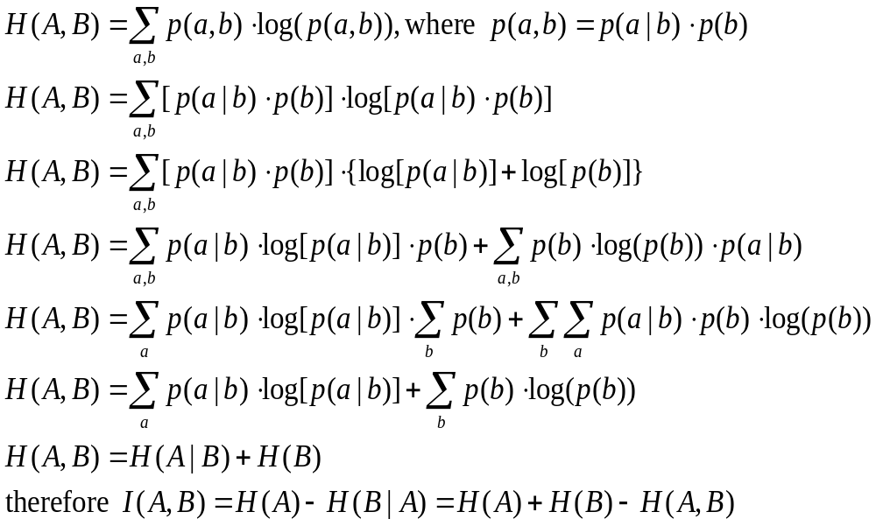
Derivation of M. I. Definitions

Slide 15
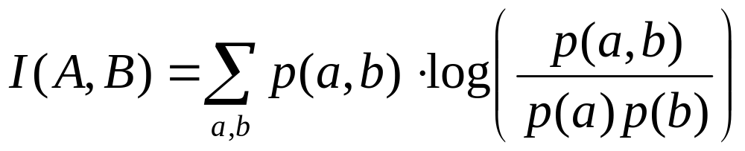
Definitions of Mutual Information II
  3)
    This definition is related to the Kullback-Leibler distance between two distributions
    Measures the dependence of the two distributions
    In image registration I(A,B) will be maximized when the images are aligned
    In feature selection choose the features that minimize I(A,B) to ensure they are not related.

Slide 16
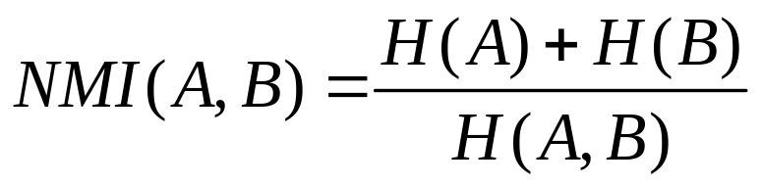
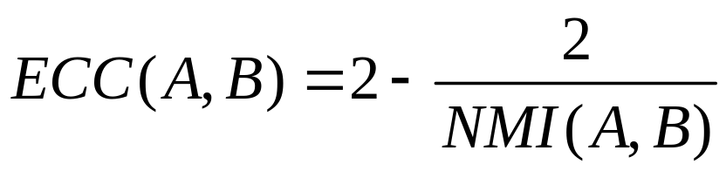
Additional Definitions of Mutual Information
Two definitions exist for normalizing Mutual information:
  Normalized Mutual Information (Colin – improved MR-CT, MR-PET):
  Entropy Correlation Coefficient:

Slide 17
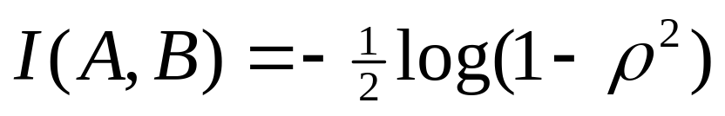
Properties of Mutual Information
MI is symmetric: I(A,B) = I(B,A)
I(A,A) = H(A)
I(A,B) <= H(A), I(A,B) <= H(B)
  info each image contains about the other cannot be greater than the info they themselves contain
I(A,B) >= 0
  Cannot increase uncertainty in A by knowing B
If A, B are independent then I(A,B) = 0
If A, B are Gaussian then:

Slide 18
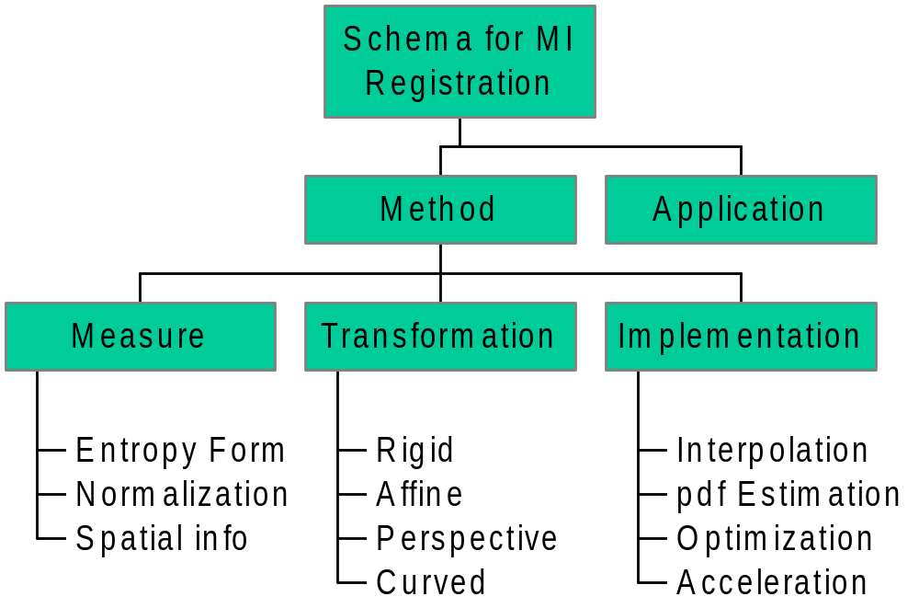
Schema for Mutual Information Based Registration

Slide 19
M.I. Processing Flow for Image Registration
Input
Images
Pre-processing
Probability
Density
Estimation
M.I. Estimation
Image Transformation
Optimization
Scheme
Output
Image

Slide 20
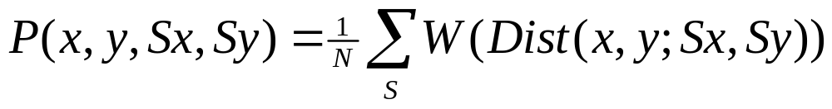
Probability Density Estimation
Compute the joint histogram h(a,b) of images
  Each entry is the number of times an intensity a in one image corresponds to an intensity b in the other
Other method is to use Parzen Windows
  The distribution is approximated by a weighted sum of sample points Sx and Sy
    The weighting is a Gaussian window

Slide 21
M.I. Estimation
Simply use one of the previously mentioned definitions for entropy
  compute M.I. based on the computed distribution function

Slide 22
Optimization Schemes
Any classic optimization algorithm suitable
  computes the step sizes to be fed into the Transformation processing stage.

Slide 23
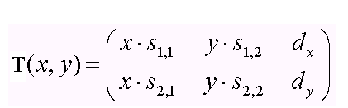
Image Transformations
General Affine Transformation defined by:
Special Cases:
  S = I (identity matrix) then translation only
  S = orthonormal then translation plus rotation
    rotation-only when D = 0 and S orthonormal.

Slide 24
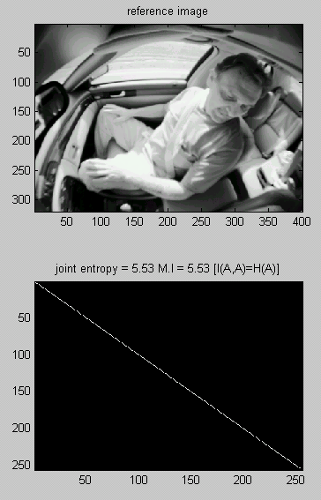

Slide 25
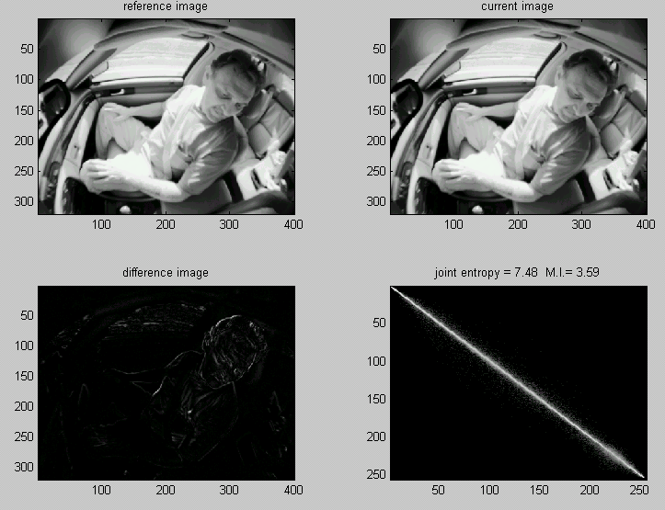

Slide 26
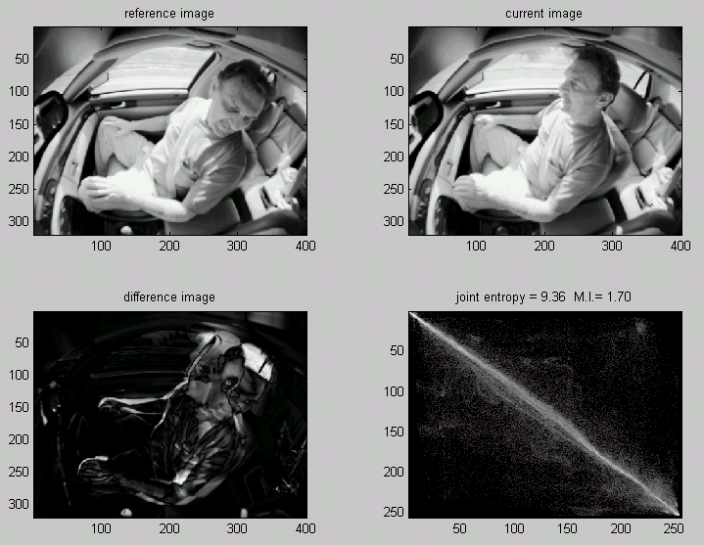

Slide 27
Mutual Information based Feature Selection
Tested using 2-class Occupant sensing problem
  Classes are RFIS and everything else (children, adults, etc).
  Use edge map of imagery and compute features
    Legendre Moments to order 36
    Generates 703 features, we select best 51 features.
Tested 3 filter-based methods:
  Mann-Whitney statistic
  Kullback-Leibler statistic
  Mutual Information criterion
    Tested both single M.I., and Joint M.I. (JMI)

Slide 28
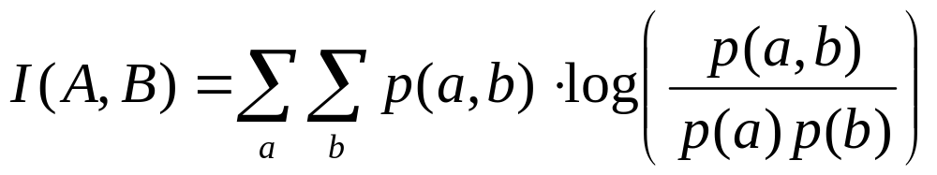
Mutual Information based Feature Selection Method
M.I. tests a feature’s ability to separate two classes.
  Based on definition 3) for M.I.
  Here A is the feature vector and B is the classification
    Note that A is continuous but B is discrete
  By maximizing the M.I. We maximize the separability of the feature
    Note this method only tests each feature individually

Slide 29
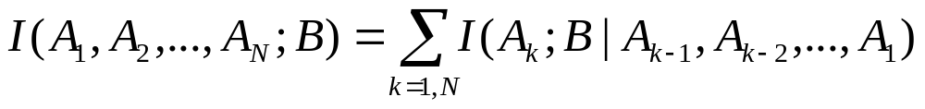
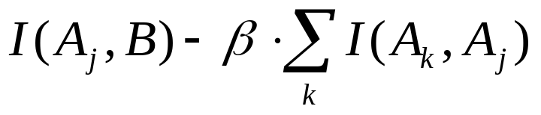
Joint Mutual Information based Feature Selection Method
Joint M.I. tests a feature’s independence from all other features:
Two implementations proposed:
  1) Compute all individual M.I.s and sort from high to low
  Test the joint M.I of current feature with others kept
    Keep the features with the lowest JMI (implies independence)
    Implement by selecting features that maximize:

Slide 30
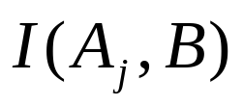
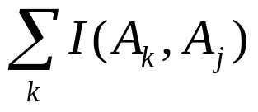
Joint Mutual Information based Feature Selection Method
Two methods proposed (continued):
  2) Select features with the smallest Euclidean distance from:
    The feature with the maximum:
    And the minimum:

Slide 31
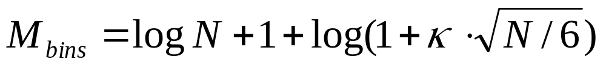
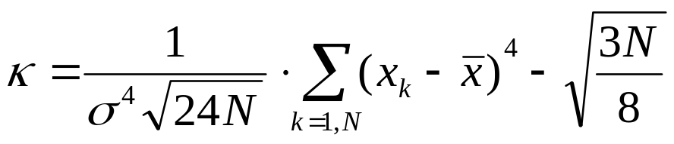
Mutual Information Feature Selection Implementation Issue
M.I tests are very sensitive to the number of bins used for the histograms
Two methods used:
  Fixed Bin Number (100)
  Variable bin number based on Gaussianity of data
  where N is the number of points and k is the Kurtosis

Slide 32
Image Classification
Specifically: Application of Information Theory Based Complexity Measures to Classification of Neurodegenerative Disease

Slide 33
What Are Complexity Measures ?
Complexity
Many strongly interacting components introduce an inherent element of uncertainty into observation of a complex (nonlinear) system
Good Reference:
W.W. Burggren, M. G. Monticino. Assessing physiological complexity. J Exp Biol. 208(17),3221-32 (2005).

Slide 34
Proposed Complexity Measures
(Time Series Based)
Metric Entropy – measures number, and uniformity of distribution over observed patterns
J. P. Crutchfield and N. H. Packard, Symbolic Dynamics of Noisy Chaos ,Physica 7D (1983) 201.
Statistical Complexity – measures number and uniformity of restrictions in correlation of observed patterns
J. P. Crutchfield and K. Young, Inferring Statistical Complexity, Phys Rev Lett 63 (1989) 105.
Excess Entropy – measures convergence rate of metric entropy
D. P. Feldman and J. P. Crutchfield, Structural Information in Two-Dimensional Patterns: Entropy Convergence and Excess Entropy , Santa Fe Institute Working Paper 02-12-065

Slide 35
Proposed Complexity Measures
Statistical Complexity is COMPLIMENTARY to Kolmogorov Complexity
Kolmogorov complexity estimates complexity of algorithms – the shorter the program the less complex the algorithm
“random” string “typically” can be generated by no short program so is “complex” in the Kolmogorov sense = entropy
But randomness as complexity doesn’t jibe with visual assessment of images -> Statistical Complexity
Yet another complimentary definition is standard Computational Complexity = run time

Slide 36
References
J.P.W. Pluim, J.B.A. Maintz, M.A. Viergever, “Mutual Information Based Registration of Medical Images: A Survey”, IEEE Trans on Medical Imaging, Vol X No Y, 2003
G.A. Tourassi, E.D. Frederick, M.K. Markey, and C.E. Floyd, “Application of the Mutual Information Criterion for Feature Selection in Computer-aided Diagnosis”, Medical Physics, Vol 28, No 12, Dec. 2001
M.D. Esteban and D. Morales, “A Summary of Entropy Statistics”, Kybernetika. Vol. 31, N.4, pp. 337-346. (1995)

