Slide 1
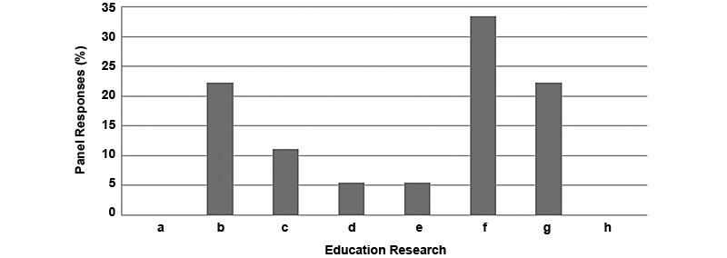

Figure 2. Highest priority education research. (a) Continuing clinical education content/frequency, (b) development of efficacious learning tools for caregiv-ers, (c) development of efficacious learning tools for families, (d) development of efficacious learning tools for inpatient clinical staff, (e) develop-ment of efficacious learning tools for outpatient clinical staff, (f) development of efficacious learning tools for patients, (g) promotion of interdisciplinary team knowledge, and (i) telehealth education. Research topics a and h had 0% response rate.
Henzel MK, Bogie KM, Guihan M, Ho CH. Pressure ulcer management and research priorities for patients with spinal cord injury: Consensus opinion from SCI QUERI Expert Panel on Pressure Ulcer Research Implementation.
J Rehabil Res Dev. 2011; 48(3):xi-xxxii.
DOI:10.1682/JRRD.2011.01.0011
Notes:
Figure 2. Highest priority education research. (a) Continuing clinical education content/frequency, (b) development of efficacious learning tools for caregiv-ers, (c) development of efficacious learning tools for families, (d) development of efficacious learning tools for inpatient clinical staff, (e) develop-ment of efficacious learning tools for outpatient clinical staff, (f) development of efficacious learning tools for patients, (g) promotion of interdisciplinary team knowledge, and (i) telehealth education. Research topics a and h had 0% response rate.

