Slide 1

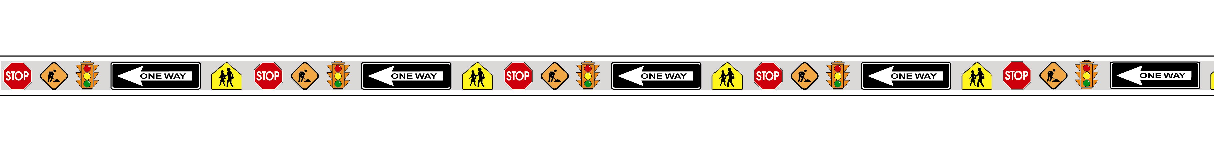
Part 3: Markings
Millennium Edition
Summary of Changes
Notes:
This briefing is for the Final Rule for the Millennium Edition of the MUTCD, Part 3 published December 2000.

Slide 2
Standardization of Application
Not in 1988 MUTCD
Section 3A-2
markings shall conform in all respects to the principles and standards.
Section 3A.2
Yellow Text Denotes a Standard
Notes:
1988 Edition:
Not in the 1988 MUTCD
Millennium Edition:
Standard: Each standard marking shall be used only to convey the meaning prescribed for that marking in this Manual. When used for applications not described herein, markings shall conform in all respects to the principles and standards set forth herein.
Reason:
This wording was proposed by the NCUTCD and was adopted by FHWA

Slide 3
Materials
Not in 1988 MUTCD
Section 3A-3
Object markers and delineators should not present a vertical or horizontal clearance obstacle for pedestrians.
Section 3A.3
Yellow Text Denotes a Standard
Notes:
1988 Edition:
Not in the 1988 MUTCD
Millennium Edition:
GUIDANCE: Object markers and delineators should not present a vertical or horizontal clearance obstacle for pedestrians
Reason:
This wording was proposed by the NCUTCD and was adopted by FHWA

Slide 4
Colors
Pavement markings shall be yellow, white, or red.
Black is permitted in combination with the above colors.
Section 3A-4
Markings shall be yellow, white, red, or blue.
Black in conjunction with one of the above colors shall be a usable color for object markers.
Section 3A.04
Yellow Text Denotes a Standard
Notes:
1988 Edition:
Pavement markings shall be yellow, white, or red in color. The use of black is permitted in combination with the above colors where the pavement itself does not provide sufficient contrast.
Millennium Edition:
STANDARD:
Markings shall be yellow, white, red or blue.
Black shall be a usable color for object markers
The color blue was added to the MUTCD for Handicap markings.
Black in conjunction with one of the above colors shall be a usable color for object markers.
Reason:
Also, black was added as a color to be used with another color to provide contrast to the other color.

Slide 5
General Principles of Longitudinal Pavement Markings
Paragraph D. Not in 1988 MUTCD.
Section 3A-5
shall conform to the following basic concepts (A-D):
D. Blue markings delineate parking spaces for persons with disabilities.
Section 3A.05
Yellow Text Denotes a Standard
Notes:
1988 Edition:
Not in the 1988 MUTCD
Millennium Edition:
STANDARD: Blue markings delineate parking spaces for persons with disabilities.

Slide 6
Widths & Patterns of
Longitudinal Line Markings
Sections 3A-5 and 3A-6.
Section 3A-6
3A-06 (A-G). This section contains the information previously in two sections.
Section 3A.06
Yellow Text Denotes a Standard
Notes:
1988 Edition: The information in the old sections was reorganized in the Millennium edition.
Millennium Edition:
Standard: The widths and patterns of longitudinal lines shall be as follows:
A. A solid line prohibits or discourages crossing.
B. A normal line is 100 to 150 mm (4 to 6 in) wide.
C. A wide line is at least twice the width of a normal line. The width of the line indicates the degree of emphasis.
D. A double line consists of two normal lines separated by a discernible space. A double line indicates maximum or special restrictions.
E. A broken line consists of normal line segments separated by gaps. A broken line indicates a permissive condition.
F. A dotted line shall consist of noticably shorter line segments separated by shorter gaps than used for a broken line. The width of a dotted line shall be at least the same as the width of the line it extends. A dotted line provides guidance.
G. The value of N for a broken or dotted line shall equal the length of one line segment plus one gap. The value of N referenced for solid lines shall equal the N for the broken or dotted lines that might be adjacent to or might extend the solid lines (see Sections 3B.13 and 3B.14).

Slide 7
Widths & Patterns of Longitudinal Line Markings
A dotted line is used to delineate a line extension...shall be the same color as the line it extends.
Section 3A-7
the width shall be at least the same as the width of the line it extends.
Section 3A.6
Yellow Text Denotes a Standard
Notes:
1988 Edition:
A dotted line is formed by short segments, normally two feet in length, and gaps, normally four feet or longer.
Millennium Edition:
STANDARD: A dotted line shall consist of noticably shorter line segments separated by shorter gaps than used for a broken line. The width of a dotted line shall be at least the same as the width of the line it extends. A dotted line provides guidance.

Slide 8
Widths & Patterns of
Longitudinal Line Markings
Sections 3A-6, Paragraph 5: A doted line(s) is formed by short segments, normally two feet in length, and gaps, normally four feet or longer.
Section 3A-6
Option: A dotted line may consist of 0.6 m (2 ft) line segments, and 1.2 m (4 ft) or longer gaps with a maximum segment-to-gap ratio of 1-to-3.
Section 3A.06
Yellow Text Denotes a Standard
Notes:
1988 Edition:
Section 3A-6, Paragraph 5: A doted line(s) is formed by short segments, normally two feet in length, and gaps, normally four feet or longer.
Millennium Edition: A dotted line is defined as a standard, but the segment to gap ratio is an OPTION.
Option: A dotted line may consist of 0.6 m (2 ft) line segments, and 1.2 m (4 ft) or longer gaps with a maximum segment-to-gap ratio of 1-to-3.

Slide 9
Center Line Markings
A center line separates traffic traveling in opposite directions.
Section 3B-1
Centerline pavement markings, when used, shall be the pavement markings used to delineate the separation of traffic lanes that have opposite directions of travel on a roadway and shall be yellow.
Section 3B.01
Notes:
1988 Edition:
A center line separates traffic traveling in opposite directions.
Millennium Edition:
STANDARD: Centerline pavement markings, when used, shall be the pavement markings used to delineate the separation of traffic lanes that have opposite directions of travel on a roadway and shall be yellow.

Slide 10
Markings on Four-or-More Lane, Two-Way Roadways
Not in 1988 MUTCD.
Section 3B-1
The center line markings on undivided two-way roadways with four or more traffic lanes, shall be the two-direction no-passing zone marking.
Section 3B.01
Yellow Text Denotes a Standard
Notes:
1988 Edition:
Not in 1988 MUTCD
Millennium Edition:
STANDARD: The center line markings on undivided two-way roadways with four or more traffic lanes always available, shall b e the two-direction no-passing zone markings consisting of two normal solid yellow lines as shown in Figure 3B-2.

Slide 11
Yellow Center Line and Left Edge
Line Pavement Markings and Warrants
Not in 1988 MUTCD.
Section 3B.1 Version NPA 97
Centerline Edgeline Final Rule
includes the changes from the Final Rule for Center line and Edge lines. It contains STANDARDS, GUIDANCE, and OPTIONS
Section 3B.01
Yellow Text Denotes a Standard
Notes:
1988 Edition: Section 3B-1
Center lines are recommended on paved highways under the following conditions: 1. In rural districts on two-lane pavements 16 feet or more in width with prevailing speeds of greater than 35 MPH, 2. In residence or business districts on all through highways, and on other highways were there are significant traffic volumes, 3. On all undivided pavements of four or more lanes, 4. At other locations where an engineering study…….
Millennium Edition:
See TEXT for STANDARDS, GUIDANCE, and OPTION
Reason:
The changes on the following slides were made to the Millennium Edition to incorporate the changes in the Center Line Edge Line Final Rule that modified the 1988 MUTCD

Slide 12
Yellow Longitudinal Line and Left
Edge Line Pavement Markings and Warrants
Not in 1988 MUTCD.
Urban arterials and collectors with a traveled way width of 6.1 m (20 ft) with ADT>6000
Section 3B.01
Yellow Text Denotes a Standard
Notes:
1988 MUTCD:
Not in 1988 MUTCD
Millennium Edition:
STANDARD: All paved urban arterials and collectors that have a roadway of 6 m (20 ft) or more in width with an ADT of 6000 or greater.
Reason: The warrants in 3B.1 was modified to reflect the changes in the Final Rule for Center line / Edge lines.

Slide 13
Yellow Longitudinal Line and Left
Edge Line Pavement Markings and Warrants
Not in 1988 MUTCD.
… shall also be placed on all two-way streets and highways that have three or more traffic lanes.
Section 3B.01
Yellow Text Denotes a Standard
Notes:
1988 Edition:
Not in MUTCD
Millennium Edition:
STANDARD: Center line markings shall also be placed on the paved two-way streets and highways that have three or more traffic lanes.
Reason:
Based on the Final Rule dated January 2000 adopting changes to Centerline / Edge Line Markings.

Slide 14
Yellow Longitudinal Line and Left
Edge Line Pavement Markings and Warrants
Not in 1988 MUTCD.
. . . marking should be placed . . . Urban arterials and collectors . . . > 4000 ADT.
Section 3B.01
Yellow Text Denotes a Standard
Notes:
1988 MUTCD:
Not in 1988 MUTCD
Millennium edition:
GUIDANCE: Centerline markings should be placed on paved urban arterials and collectors that have a traveled width of 6.1 m (20 ft) or more and an ADT of 4,000 vehicles per day or greater.
Reason:
The warrants in 3B.1 was modified to reflect the changes in the Final Rule for Center line / Edge lines.

Slide 15
Yellow Longitudinal Line and Left
Edge Line Pavement Markings and Warrants
Not in 1988 MUTCD.
Rural arterials and collectors that have a traveled way width of 5.5 m (18 ft) and ADT of 3000 or greater
Section 3B.01
Yellow Text Denotes a Standard
Notes:
1988 MUTCD:
Not in 1988 MUTCD
Millennium Edition:
GUIDANCE: All rural arterials and collectors that have a traveled way width of 5.5 m (18 ft) or more with an ADT of 3000 or greater.
Reason:
The warrants in 3B.1 was modified to reflect the changes in the Final Rule for Center line / Edge lines.

Slide 16
Yellow Longitudinal Line and Left
Edge Line Pavement Markings and Warrants
Not in 1988 MUTCD.
Centerline markings should also be placed on other traveled ways where an engineering study indicates such a need.
Section 3B.01
Yellow Text Denotes a Standard
Notes:
1988 MUTCD:
Not in 1988 MUTCD
Millennium Edition:
GUIDANCE: Centerline markings should also be placed on other traveled ways where an engineering study indicates such a need.
Reason:
The warrants in 3B.1 was modified to reflect the changes in the Final Rule for Center line / Edge lines.

Slide 17
Yellow Longitudinal Line and Left
Edge Line Pavement Markings and Warrants
Not in 1988 MUTCD.
Paragraph a.4). engineering study should . . . traveled ways < 4.8m / 16 ft
Section 3B.01
Yellow Text Denotes a Standard
Notes:
1988 MUTCD: Not in the 1988 MUTCD
1988 text reads:
Center lines shall be placed on all paved roadway surfaces that will retain pavement markings under the following conditions:
1. In rural districts on two-lane pavements 16 feet or more in width with prevailing speeds of greater than 35 MPH.
2. In residence or business districts on all through highways, and on other highways where there are significant traffic volumes.
3. On all undivided pavements of four or more lanes.
Millennium Edition:
GUIDANCE: Engineering study should be used in determining whether to place center line markings on a traveled way less than 4.8 m (16 ft) wide due to traffic encroaching on the pavement edges, traffic being affected by parked vehicles, and due to traffic encroachment into the lane of opposing traffic where edge line markings are used.
Reason:The warrants in 3B.1 was modified to reflect the changes in the Final Rule for Center line / Edge lines.

Slide 18
Yellow Longitudinal Line and Left
Edge Line Pavement Markings and Warrants
In rural districts on two-lane pavements 16 feet or more in width with prevailing speeds of greater than 35 MPH.
OPTION: Centerline markings may be placed on other paved two-way traveled ways that are 4.9 m (16 ft) or more in width.
Section 3B.01
Yellow Text Denotes a Standard
Notes:
1988 MUTCD:
1988 text reads:
Center lines shall be placed on all paved roadway surfaces that will retain pavement markings under the following conditions:
1. In rural districts on two-lane pavements 16 feet or more in width with prevailing speeds of greater than 35 MPH.
2. In residence or business districts on all through highways, and on other highways where there are significant traffic volumes.
On all undivided pavements of four or more lanes.
Millennium Edition:
OPTION: Centerline markings may be placed on other paved two-way traveled ways that are 4.9 m (16 ft) or more in width.
Reason:
The warrants in 3B.1 was modified to reflect the changes in the Final Rule for Center line / Edge lines.

Slide 19
Yellow Longitudinal Line and Left
Edge Line Pavement Markings and Warrants
Not in 1988 MUTCD
OPTION: If a traffic count is not available, the ADTs described in this Section may be estimates that are based on engineering judgment.
Section 3B.01
Yellow Text Denotes a Standard
Notes:
1988 MUTCD:
Not in the 1988 MUTCD.
Millennium Edition:
GUIDANCE: Engineering study should be used in determining whether to place center line markings on a traveled way less than 4.8 m (16 ft) wide due to traffic encroaching on the pavement edges, traffic being affected by parked vehicles, and due to traffic encroachment into the lane of opposing traffic where edge line markings are used.
Reason:
The warrants in 3B.1 was modified to reflect the changes in the Final Rule for Center line / Edge lines.

Slide 20
Longitudinal Markings
They shall be used on all Interstate Highways
Lane line markings shall be used on all Interstate highways and freeways.
Section 3B.04
Yellow Text Denotes a Standard
Notes:
1988 MUTCD:
They (lane line markings) shall be used on all Interstate Highways.
Millennium Edition:
STANDARD: Lane line markings shall be used on all Interstate highways and freeways.
Reason:
Interstate highways was in the 1988 MUTCD.
Editorial correction to the 97 NPA.

Slide 21
No-Passing Zone Markings
Not in 1988 MUTCD.
Standard: No-passing zone markings shall be used on approaches to highway-rail grade crossings (see Section 8B.16) and at other locations where the prohibition of passing is appropriate.
Yellow Text Denotes a Standard
Notes:
1988 Edition: Not in 1988 MUTCD
Millennium Edition:
Standard:
No-passing zone markings shall be used on approaches to highway-rail grade crossings (see Section 8B.16) and at other locations where the prohibition of passing is appropriate.
Reason:
This standard is added to conform with Part 8.

Slide 22
No-Passing Zone Markings
On a three-lane highway .., a
no-passing buffer zone shall be provided by transitioning the centerline markings.
Section 3B-4
On three‑lane roadways … the center lane transitions from one direction to the other, a no-passing buffer zone shall be provided in the center lane.
Yellow Text Denotes a Standard
Notes:
1988 Edition: On a three-lane highway where the single lane is being moved from one side of the road to the opposite side, a no-passing buffer zone shall be provided by transitioning the centerline markings diagonally across the center lane to the beginning of the no-passing buffer zone, and thence along this location to the end of the buffer zone (fig. 3-7a).
Millennium Edition:
STANDARD: On three‑lane roadways where the direction of travel in the center lane transitions from one direction to the other, a no-passing buffer zone shall be provided in the center lane as shown in Figure 3B-4. A lane transition shall be provided at each end of the buffer zone.

Slide 23
No-Passing Zone Markings
On a three-lane highway .., a
no-passing buffer zone shall be provided by transitioning the centerline markings.
Section 3B-4
The buffer zone shall be a lane transition, a minimum of a 15 m (50 ft) buffer zone… where no- passing zones are required … distances, the buffer zone shall be between the no-passing zones.
Yellow Text Denotes a Standard
Notes:
1988 Edition: On a three-lane highway where the single lane is being moved from one side of the road to the opposite side, a no-passing buffer zone shall be provided by transitioning the centerline markings diagonally across the center lane to the beginning of the no-passing buffer zone, and thence along this location to the end of the buffer zone (fig. 3-7a).
Millennium Edition:
STANDARD: The buffer zone shall be a median island consisting of a lane transition in each direction and a minimum of a 15 m (50 ft) buffer zone. In areas where no- passing zones are required because of limited passing sight distances, the buffer zone shall be the distances between the beginnings of the no-passing zones in each direction.

Slide 24
No-Passing Zone Markings
Not in 1988 MUTCD.
Section 3B-8
The minimum taper length shall be 30 m (100ft) in urban areas and 60 m (200ft) in rural areas.
Section 3B.2
Yellow Text Denotes a Standard
Notes:
1988 Edition: not in MUTCD.
Millennium Edition:
STANDARD: The minimum taper length shall be 30m(100 ft) in urban areas and 60m (200 ft) in rural areas.

Slide 25
Warrants for
No-Passing Zones at Curves
it should be so marked where the sight distance is equal or less than listed for the prevailing off-peak 85 percentile speed or the speed limit.
Section 3B-5
shall be used at curves where the sight distance is less then the minimum for safe passing at the 85th percentile or posted or statutory speed limit limit.
Section 3B.02
Yellow Text Denotes a Standard
Notes:
1988 Edition: Where center lines are installed and a curve warrants a no-passing zone, it should be so marked where the sight distance is equal to or less than that listed below for the prevailing off-peak 85 percentile speed or the posted speed limit, whichever is higher.
Millennium Edition:
STANDARD: On roadways with center line markings, a no-passing zone marking shall be used at a horizontal or vertical curve where the sight distance is less than the minimum necessary for safe passing at the 85th percentile or posted or statutory speed limit, as shown in Table 3B-1.

Slide 26
Lane Line Markings
Not in 1988 MUTCD.
Section 3B-2
When used, lane line pavement markings delineating the separation of traffic lanes that have the same direction of travel shall be white.
Section 3B.04
Yellow Text Denotes a Standard
Notes:
1988 Edition: not in MUTCD.
Millennium Edition:
STANDARD: When used, lane line pavement markings delineating the separation of traffic lanes that have the same direction of travel shall be white.

Slide 27
Broken Lane Line Markings
are usually normal broken white lines which permit lane changing with care.
Section 3B-2
Where crossing the lane line markings with care is permitted, the lane line markings shall consist of a normal broken white line.
Section 3B.04
Yellow Text Denotes a Standard
Notes:
1988 Edition: Lane lines are usually normal broken white lines which permit lane changing with care.
Millennium Edition:
STANDARD: Where crossing the lane line markings with care is permitted, the lane line markings shall consist of a normal broken white line.

Slide 28
Solid Lane Line Markings
A normal solid white line may be used as the lane line in critical areas where it is advisable to discourage lane changing.
Section 3B-2
Where crossing the lane line markings is discouraged, the lane line markings shall consist of a normal solid white line.
Section 3B.2-2
Yellow Text Denotes a Standard
Notes:
1988 Edition:
A normal solid white line may be used as the lane line in critical areas where it is advisable to discourage lane changing.
Millennium Edition:
STANDARD: Where crossing the lane line markings is discouraged, the lane line markings shall consist of a normal solid white line.

Slide 29
Edge Line Marking Warrants
shall be provided on all Interstate highways, on rural multilane divided highways, and may be used on other classes of roads.
Section 3B-2
shall be placed on all freeways, expressways, and on all rural arterials which have a traveled way width of 6.1 m (20ft)and and ADT of 6000.
Section 3B.07
Yellow Text Denotes a Standard
Notes:
1988 Edition:
Edge lines shall be provided on all Interstate highways, on rural multilane divided highways, and may be used on other classes of roads.
Millennium Edition:
STNADARD: Edge line markings shall be placed on all freeways, expressways, and on all rural arterials which have a traveled way width of 6.1 m (20ft)and and ADT of 6000.

Slide 30
Edge Line Marking Warrants
Not in 1988 MUTCD.
Section 3B-2
should be placed on paved streets or highways with … rural arterials and collectors with a traveled way width 6.1 m (20ft) and and ADT of 3000 or greater.
Section 3B.07
Yellow Text Denotes a Standard
Notes:
1988 Edition:
not in MUTCD.
Millennium Edition:
GUIDANCE: Edge line markings should be placed on paved streets or highways with the following characteristics:
A. Rural arterials and collectors with a traveled way of 6.1 m (20 ft) or more in width and an ADT of 3,000 vehicles per day or greater.
B. At other paved streets and highways where an engineering study indicates a need for edge line markings.
Reason:
The warrants in the 3B.07 was modified to reflect the changes in the Final Rule for Center line / Edge lines

Slide 31
Edge Line Marking Warrants
Not in 1988 MUTCD.
Section 3B-2
should be placed on paved streets or highways with … At other paved streets and highways where an engineering study indicates a need for edge line markings.
Section 3B.07
Yellow Text Denotes a Standard
Notes:
1988 Edition:
Not in MUTCD.
Millennium Edition:
GUIDANCE: Edge line markings should be placed on paved streets or highways with the following characteristics:
A. Rural arterials and collectors with a traveled way of 6.1 m (20 ft) or more in width and an ADT of 3,000 vehicles per day or greater.
B. At other paved streets and highways where an engineering study indicates a need for edge line markings.
Reason:
The warrants in 3B.07 were modified to reflect the changes in the Final Rule for Center line / Edge lines

Slide 32
Edge Line Marking Warrants
Not in 1988 MUTCD
Edge line markings should not be placed where an engineering study or engineering judgment indicates that providing them would decrease safety.
Yellow Text Denotes a Standard
Notes:
1988 Edition:
Not in 1988 MUTCD
Millennium Edition:
GUIDANCE: Edge line markings should not be placed where an engineering study or engineering judgment indicates that providing them would decrease safety.
Reason:
The warrants in the proposed 3B.3 was modified to reflect the changes in the Final Rule for Center line / Edge lines.

Slide 33
Edge Line Marking Warrants
Not in 1988 MUTCD
Option: Edge line markings may be placed on streets and highways that do not have centerline markings.
Yellow Text Denotes a Standard
Notes:
1988 Edition: Not in 1988 MUTCD
Millennium Edition:
Option: Edge line markings may be placed on streets and highways that do not have centerline markings.
Edge line markings may be excluded, based on engineering judgment, for reasons such as if the traveled way edges are delineated by curbs, parking, bicycle lanes, or other markings.
Reason:
The warrants in 3B.07 were modified to reflect the changes in the Final Rule for Center line / Edge lines

Slide 34
Edge Line Marking Warrants
Not in 1988 MUTCD
Option: Edge line markings may be excluded, based on engineering judgment, for reasons such as if the traveled way edges are delineated by curbs, parking, bicycle lanes, or other markings.
Yellow Text Denotes a Standard
Notes:
1988 Edition: Not in 1988 MUTCD
Millennium Edition:
Option:
Edge line markings may be placed on streets and highways that do not have centerline markings.
Edge line markings may be excluded, based on engineering judgment, for reasons such as if the traveled way edges are delineated by curbs, parking, bicycle lanes, or other markings.
Reason:
The warrants in 3B.07 were modified to reflect the changes in the Final Rule for Center line / Edge lines

Slide 35
Extensions Through
Intersections or Interchanges
a dotted line may be used to extend markings as necessary through the interchange or intersection.
Section 3B.7
shall be the same color and at least the same width as the line markings they extend.
Section 3B.08
Yellow Text Denotes a Standard
Notes:
1988 Edition:
Where road design or reduced visibility conditions make it desirable to provide control or to guide vehicles through an interchange or intersection, a dotted line may be used to extend markings as necessary through the interchange or intersection.
Millennium Edition:
STANDARD: Pavement markings extended into or continued through an intersection or interchange area shall be the same color and at least the same width as the line markings they extend.
Reason:
This change was was recommended in the Older Driver handbook to stipulate the line color and increase emphasis for the width of the line for older drivers.

Slide 36
Extensions Through
Intersections or Interchanges
Section 3B-7 is an Option
This Option was changed to GUIDANCE.
Yellow Text Denotes a Standard
Notes:
1988 Edition:
Section 3B-7 is an Option
Millennium Edition: This Option was changed to GUIDANCE.
Guidance: Where highway design or reduced visibility conditions make it desirable to provide control or to guide vehicles through an intersection or interchange, such as at offset, skewed, complex, or multi-legged intersections, on curved roadways, or where multiple turn lanes are used, dotted line markings should be used to extend longitudinal line markings through an intersection or interchange area.
Where greater restriction is required, solid lane lines or channelizing lines should be extended into or continued through intersections.
Reason:
Change to Guidance to increase emphasis for older drivers. No change in text, just a change in the emphasis from Option to Guidance.

Slide 37
Marking Approach to an Obstruction
L=WS²/60 should be used to compute taper length where speeds are ⬄40 mph.
Section 3B-13
… should be computed by L=.62WS, (L=WS) for roadways with speed limit of 45 mph or greater.
Section 3B.10
Yellow Text Denotes a Standard
Notes:
1988 Edition:
The formula L=WS²/60 should be used to compute taper length on urban, residential, and other streets where the posted speeds are 40 mph or less.
Millennium Edition:
GUIDANCE: For roadways having a posted or statutory speed limit of 70 km/h (45 mph) or greater, the transition taper length for a lane reduction should be computed by the formula L = 0.62 WS for speeds in km/h (L = WS for speeds in mph). For roadways where the posted or statutory speed limit is less than 70 km/h (45 mph), the formula L = WS²/155 for speeds in km/h (L = WS²/60 for speeds in mph) should be used to compute taper length.

Slide 38
Raised Pavement Markers
Not in 1988 MUTCD.
Section 3B-15
The color shall conform to the color of the marking for which they serve as a positioning guide, or for which they supplement or substitute.
yellow denotes a standard.
Section 3B.11
Yellow Text Denotes a Standard
Notes:
1988 Edition:
not in MUTCD.
Millennium Edition:
STANDARD: The color of raised pavement markers under both daylight and nighttime conditions shall conform to the color of the marking for which they serve as a positioning guide, or for which they supplement or substitute.

Slide 39
Raised Pavement Markers
Not in 1988 MUTCD.
Section 3B-15
Raised pavement markers not retroreflective should not be used alone, as a substitute for other types of pavement markings.
Section 3B.11
Yellow Text Denotes a Standard
Notes:
1988 Edition:
not in MUTCD.
Millennium Edition:
GUIDANCE: Non-retroreflective raised pavement markers should not be used alone, without supplemental retroreflective or internally-illuminated markers, as a substitute for other types of pavement markings. Directional configurations should be used to maximize correct information and to minimize confusing information provided to the road user. Directional configurations also should be used to avoid confusion resulting from visibility of markers that do not apply to the road user.

Slide 40
Raised Pavement Markers
Not in 1988 MUTCD.
Section 3B-15
Directional configurations should be used to maximize correct and minimize confusing info..should be used to avoid confusion.
Section 3B.11
Yellow Text Denotes a Standard
Notes:
1988 Edition:
not in MUTCD.
Millennium Edition:
GUIDANCE: Non-retroreflective raised pavement markers should not be used alone, without supplemental retroreflective or internally-illuminated markers, as a substitute for other types of pavement markings. Directional configurations should be used to maximize correct information and to minimize confusing information provided to the road user. Directional configurations also should be used to avoid confusion resulting from visibility of markers that do not apply to the road user.

Slide 41
Transverse Markings
Word and symbol markings on the pavement..shall be white in color.
Section 3B-20
shoulder markings, word and symbol markings, stop lines, crosswalk lines, speed markings, parking space markings .., shall be white unless specified.
Section 3B.15
Yellow Text Denotes a Standard
Notes:
1988 Edition:
Word and symbol markings on the pavement may be used for the purpose of guiding, warning, or regulating traffic. They should be limited to no more than a total of three lines of information. They shall be white in color.
Millennium Edition:
STANDARD: Transverse markings, which include shoulder markings, word and symbol markings, stop lines, crosswalk lines, speed measurement markings, parking space markings and others, shall be white unless otherwise specified herein.

Slide 42
Transverse Markings
All letters, numerals and symbols should be in conformance with the Standard Alphabets for Highway Signs and Pavement Markings.*
Section 3B-20
shall be installed in accordance with the “Standard Alphabets for Highway Signs and Pavement Markings.”
Section 3B.15
Yellow Text Denotes a Standard
Notes:
1988 Edition:
All letters, numerals and symbols should be in conformance with the Standard Alphabets for Highway Signs and Pavement Markings.
Millennium Edition:
STANDARD: Pavement marking letters, numerals, and symbols shall be installed in accordance with the A Standard Alphabets for Highway Signs and Pavement Markings.

Slide 43
Stop and Yield Lines
Stop lines are solid white lines, normally 12” to 24” wide..
Section 3B-17
Stop lines should be 12” to 24” wide.
Section 3B.16
Yellow Text Denotes a Standard
Notes:
1988 Edition:
Stop lines are solid white lines, normally 12 to 24 inches wide, extending across all approach lanes.
Millennium Edition:
GUIDANCE: Stop lines should be 300 to 600mm (12 to 24 in) wide.

Slide 44
Stop and Yield Lines
Not in 1988 MUTCD.
Yield lines consist of a row of isosceles triangles extending across approach lanes, and pointing toward approaching vehicles ….
Section 3B.16
Yellow Text Denotes a Standard
Notes:
1988 Edition:
Not in 1988 MUTCD
Millennium Edition:
Yield lines consist of a row of isosceles triangles extending across approach lanes, and pointing toward approaching vehicles to indicate the point at which the yield is intended or required to be made.
Reason:
The optional marking where it is important to indicate the point behind which vehicles are required to yield. Changes were also made to Figure 3-24.

Slide 45
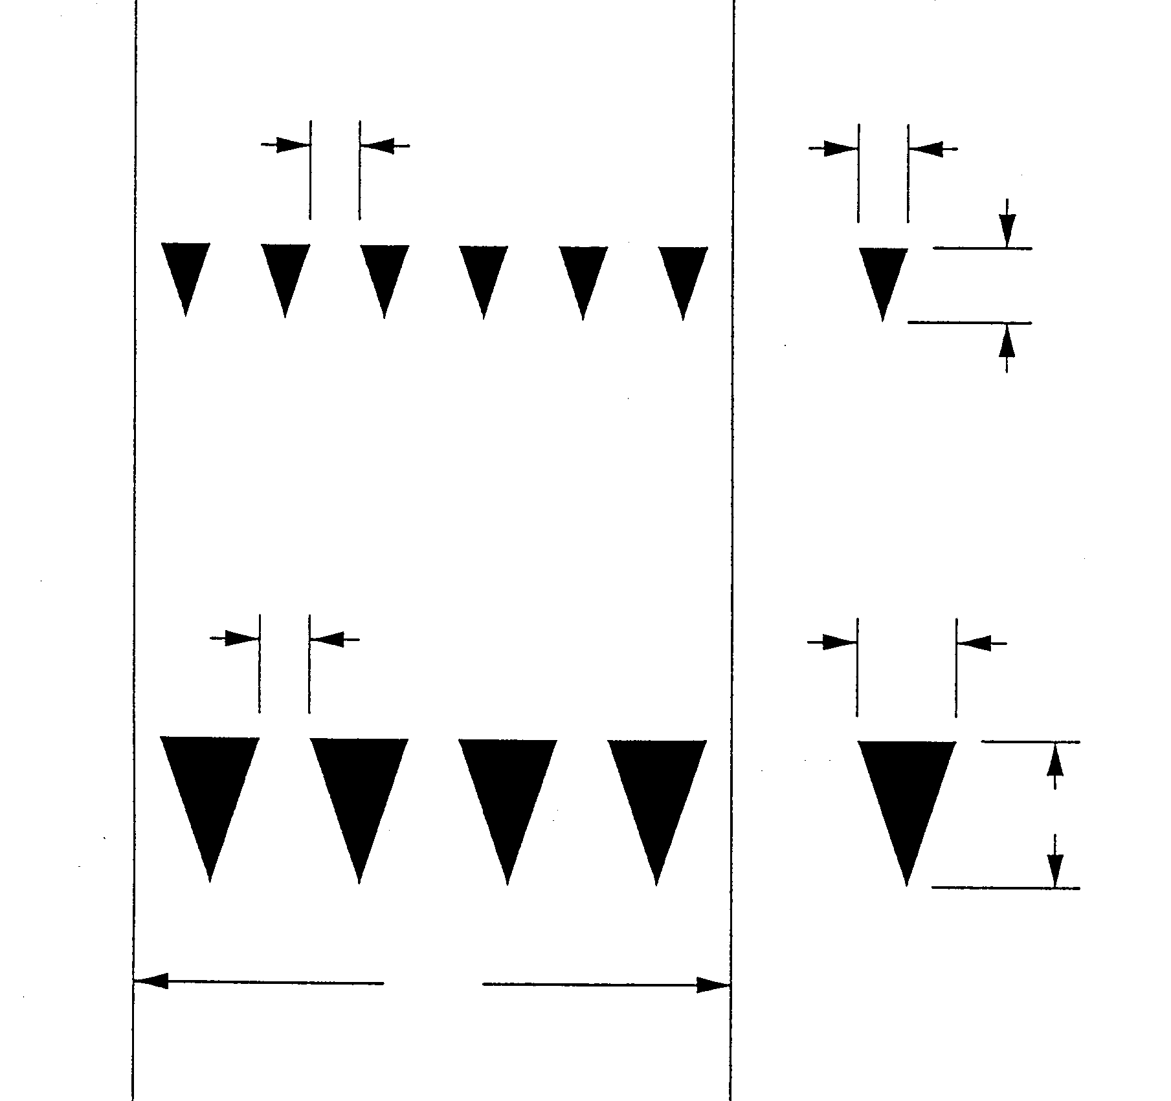
Yield Line Markings
Minimum
Dimensions
3” - 12”
12”
18”
Maximum
Dimensions
3” - 12”
24”
36”
Note:
Triangle length is equal
to 1 1/2 times the base
dimension.
12’
Notes:
1988 Edition:
Not in the 1988 MUTCD
Millennium Edition:
Figure 3B-14
Reason:
This new Figure 3B-14 was proposed by the NCUTCD as a typical drawing for Yield Line Markings.

Slide 46
Stop and Yield Lines
Not in 1988 MUTCD.
The individual triangles comprising the yield line should have a base of 0.3 m to 0.6 m (12” to 24”).
Section 3B.16
Yellow Text Denotes a Standard
Notes:
1988 Edition:
Not in the 1988 MUTCD
Millennium Edition:
GUIDANCE: The individual triangles comprising the yield line should have a base of 0.3 m to 0.6 m ( 12 in to 24 in) wide and a height equal to 1 1/2 times the base. The space between the triangles should be 75 mm to 300 mm (3 in to 12 in). See Figure 3B-14.
Reason:
The optional marking where it is important to indicate the point behind which vehicles are required to yield.

Slide 47
Stop and Yield Lines
Not in 1988 MUTCD.
OPTION: Yield lines may be used where it is important to indicate the point behind which vehicles are required to yield in compliance with a YELD sign.
Section 3B.16
Yellow Text Denotes a Standard
Notes:
1988 Edition:
Not in the 1988 MUTCD
Millennium Edition:
OPTION: Yield Lines may be used where it is important to indicate the point behind which vehicles are required to yield in compliance with a YIELD Sign.
Reason:
This optional marking may be used where it is important to indicate the point behind which vehicles are required to yield.

Slide 48
Stop and Yield Lines
Not in 1988 MUTCD.
Section 3B.16 Stop and Yield Lines, . . . should be placed 1.2 m ( 4 ft) in advance of and parallel to the nearest crosswalk line, except at roundabouts as . . in Section 3B.24.
Yellow Text Denotes a Standard
Notes:
1988 Edition:
Not in the 1988 MUTCD.
Millennium Edition:
GUIDANCE: Stop and yield lines, where used, should be placed 1.2 m ( 4 ft) in advance of and parallel to the nearest crosswalk line, except at roundabouts as provided for in Section 3B.24.
Reason:
The optional marking where it is important to indicate the point behind which vehicles are required to yield.

Slide 49
Stop and Yield Lines
Not in 1988 MUTCD.
. . . absence of a marked crosswalk, stop line or yield line should be placed at the desired stopping or yielding point, ….
Section 3B.16
Yellow Text Denotes a Standard
Notes:
1988 Edition:
Not in the 1988 MUTCD
Millennium Edition:
Section 3B.16
GUIDANCE: In the absence of a marked crosswalk, the stop line or yield line should be placed at the desired stopping or yielding point, but should be placed no more than 9 m (30 ft) nor less than 1.2 m (4 ft) from the nearest edge of the intersecting traveled way.
Reason:
The optional marking where it is important to indicate the point behind which vehicles are required to yield.

Slide 50
Pavement Word and Symbol Markings
Not in 1988 MUTCD.
A yield-ahead triangle symbol or “YIELD AHEAD” word pavement markings may be used on approaches to intersections… encounter a yield sign.
Yellow Text Denotes a Standard
Notes:
1988 Edition:
Not in the 1988 MUTCD
Millennium Edition:
OPTION: A yield-ahead triangle symbol or YIELD AHEAD word pavement marking may be used on approaches to intersections where the approaching traffic will encounter a YIELD sign at the intersection (see Figure 3B-24).
Reason: These word and symbol markings were added to complement the new Yield Line Markings in Section 3B.16.

Slide 51
Pavement Word and Symbol Markings
Not in 1988 MUTCD
Added two optional warning pavement markings: Yield Ahead & Yield Ahead triangle symbol Figure 3B-24.
Section 3B.19
Yellow Text Denotes a Standard
Notes:
1988 Edition:
Not in the 1988 MUTCD
Millennium Edition:
3B.19, OPTION, paragraph b. Add YIELD AHEAD and Yield Ahead Triangle Symbol to the list of word and symbol markings.
Reason: These new Figures were recommended by the NCUTCD as a typical drawings for Yield Line Markings and Yield Ahead Pavement markings

Slide 52
Pavement Word and Symbol Markings
Not in 1988 MUTCD
Figures 3B-14 and 3B-24 for Yield Line and Yield Ahead pavement markings.
Section 3B.19
Yellow Text Denotes a Standard
Notes:
1988 Edition:
Not in the 1988 MUTCD
Millennium Edition:
Two new figures added. Read text and look at figures.
Reason:
This new Figures 3B-14 and 3B-24 were recommended by the NCUTCD as a typical drawing for Yield Line Markings.

Slide 53
Pavement Word and Symbol Markings
Not in 1988 MUTCD
The yield-ahead triangle symbol of “YIELD AHEAD” word pavement marking shall not be used unless a YIELD sign is in place...
Section 3B.19
Yellow Text Denotes a Standard
Notes:
1988 Edition:
Not in the 1988 MUTCD
Millennium Edition:
STANDARD: The yield-ahead triangle symbol or YIELD AHEAD word pavement marking shall not be used unless a YIELD sign (see Section 2B.08) is in place at the intersection. The yield-ahead symbol marking shall be as shown in Figure 3B-24.
Reason:
The optional marking where it is important to indicate the point behind which vehicles are required to yield. Changes were also made to Figure 3-24.

Slide 54
Pavement Word and
Symbol Markings
Large letters and numerals should be used, 8 ft or more in height.
Section 3B-20
Large letters and numerals should be 6ft or more in height.
Section 3B.19
Yellow Text Denotes a Standard
Notes:
1988 Edition:
Large letters and numerals should be used, 8 feet or more in height;
Millennium Edition:
Large letters and numerals should be 1.8m (6 ft) or more in height.

Slide 55
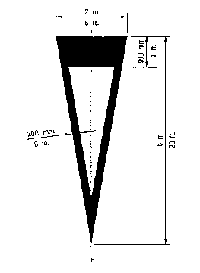
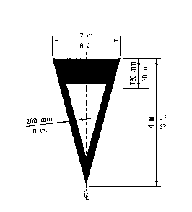
Pavement Symbol Markings
Figure 3-25. Typical Yield Ahead Triangle Symbols.
Notes:
1988 Edition:
Not in the 1988 MUTCD
Millennium Edition:
Figure 3B-24
Reason:
This new Figure 3B-14 was recommended by the NCUTCD as a typical drawing for Yield Line Markings.

Slide 56
Pavement Word and
Symbol Markings
Not in 1988 MUTCD.
Section 3B-20
OPTION: International symbol of accessibility parking space marking with blue background and white border options.
Section 3B-19
Yellow Text Denotes a Standard
Notes:
1988 Edition:
not in MUTCD.
Millennium Edition:
OPTION: The International Symbol of Accessibility parking space markings may be placed in each parking space designated for use by persons with disabilities. A blue background with white border may supplement the wheelchair symbol as shown in Figure 3B-18.
Reason: Use symbol that is easily recognized by most highway users.

Slide 57
Pavement Word and
Symbol Markings
Not in 1988 MUTCD.
Section 3B-20
Lane-Use, Lane Reduction and Wrong-Way Arrows for Pavement Markings. Shall be designed as shown in Figure 3B-20.
Section 3B.19
Yellow Text Denotes a Standard
Notes:
1988 Edition:
not in MUTCD.
Millennium Edition:
STANDARD: Lane use, lane reduction, and wrong-way arrow markings shall be designed as shown in Figure 3B-20.
Reason: Figure 3B-20 was in the 1988 MUTCD, however, it was not a shall condition to design the arrows in compliance with the figure.

Slide 58
Pavement Word and
Symbol Markings
Not in 1988 MUTCD.
Section 3B-20
Where channelization or ramp geometrics do not make wrong-way movements difficult, a lane-use arrow should be placed clearly visible to road user.
Section 3B.19
Yellow Text Denotes a Standard
Notes:
1988 Edition:
not in MUTCD.
Millennium Edition:
Guidance:
Where crossroad channelization or ramp geometrics do not make wrong-way movements difficult, a lane-use arrow should be placed in each lane of an exit ramp near the crossroad terminal where it will be clearly visible to a potential wrong-way road user (see Figure 3B-22).

Slide 59
Pavement Word and
Symbol Markings
Not in 1988 MUTCD.
Section 3B-20
Arrow markings at entrance ramp terminals where design does not clearly indicate the direction of flow.
Section 3B.19
Yellow Text Denotes a Standard
Notes:
1988 Edition:
not in MUTCD.
Millennium Edition:
OPTION:
The wrong-way arrow markings shown in Figure 3B-20 may be placed near the downstream terminus of a ramp as shown in Figures 3B-22 and 3B-23 to indicate the correct direction of traffic flow and to discourage drivers from traveling in the wrong direction.

Slide 60
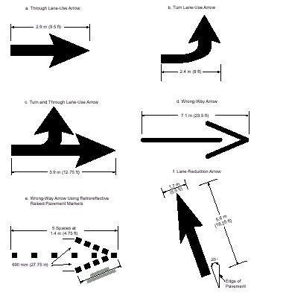
Pavement Symbol Markings
Notes:
1988 Edition:
In the 1988 MUTCD
Millennium Edition:
Revised Figure 3B-20 (f) is added,” Lane Reduction Arrow”

Slide 61
Curb Markings
when local authorities prescribe special colors for curb markings as supplemental to standard signs, they may be used.
Section 3B-21
Signs shall be used with curb markings where curb markings are obliterated by snow and ice.. curb colors shall conform to general principles of markings.
Section 3B.21
Yellow Text Denotes a Standard
Notes:
1988 Edition:
However, when local authorities prescribe special colors for curb markings as supplemental to standard signs, they may be used
Millennium Edition:
STANDARD: Signs shall be used with curb markings in those areas where curb markings are frequently obliterated by snow and ice accumulation. Where curbs are marked, the colors shall conform to the general principles of markings (Section 3A.5).

Slide 62
Preferential Lane Word and Symbol Markings
Not in 1988 MUTCD
Preferential lane marking shall consist of white lines formed in a diamond shape. The Diamond shall be at least 750 mm x 3.6 m (2.5 ft x 12 ft).
Section 3B.22
Yellow Text Denotes a Standard
Notes:
1988 Edition:
Not in the 1988 MUTCD
Millennium Edition
STANDARD: The preferential lane marking shall consist of white lines formed in a diamond shape. The Diamond shall be at least 750 mm (2.5 ft) in width and 3.6 m ( 12 ft) in length.
Reason:
This section establishes standards for preferential lane word and symbol markings

Slide 63
Preferential Lane Word and Symbol Markings
Not in 1988 MUTCD
SUPPORT: Preferential lanes may be designated to identify a wide variety of special uses.
Section 3B.22
Yellow Text Denotes a Standard
Notes:
1988 Edition:
Not in the 1988 MUTCD
Millennium Edition:
SUPPORT: Preferential lanes may be designated to identify a wide variety of special uses. This could include, but is not limited to HOV ( High Occupancy Vehicle) lanes, bicycle lanes, buss only lanes, taxicab only lanes, etc.
Reason:
This section makes the use of a diamond symbol exclusive for HOV lanes and other word or symbols for other preferential lanes.

Slide 64
Preferential Lane Word and Symbol Markings
Not in 1988 MUTCD.
Four paragraphs added to specify the preferential lane marking (HOV, bicycles, bus, taxi, etc.)
Section 3B.22
Yellow Text Denotes a Standard
Notes:
1988 Edition:
Not in the 1988 MUTCD
Millennium Edition:
Standard: Where a preferential lane use is established, the preferential lane shall be marked with one of the following symbol or word markings for the preferential lane use specified:
HOV lane - the preferential lane use marking for high-occupancy vehicle lanes shall consist of white lines formed in a diamond shape….
Bicycle lane - the preferential lane use marking for a bicycle lane shall consist of a bicycle symbol or the word marking BIKE LANE …
Bus Only Lane - the preferential lane use marking for a bus only lane shall consist of the word marking BUS ONLY.
Taxi Only Lane - the preferential lane use marking for a taxi only lane shall consist of the word marking TAXI ONLY.
Other preferential lane use markings shall be identified in accordance with Section 3B.23.

Slide 65
Preferential Lane Longitudinal Line Markings for Motorized Vehicles
Not in 1988 MUTCD.
Preferential lane longitudinal markings shall be marked with the appropriate word or symbol pavement markings.
Yellow Text Denotes a Standard
Notes:
1988 Edition:
Not in the 1988 MUTCD
Millennium Edition:
Standard: Preferential lane longitudinal markings for motorized vehicles shall be marked with the appropriate word or symbol pavement markings in accordance with Section 3B.22.

Slide 66
Preferential Lane Longitudinal Line Markings for Motorized Vehicles
Not in 1988 MUTCD.
The STANDARD addresses Physically-separated, reversible, non-reversible, and concurrent flow preferential lanes.
Yellow Text Denotes a Standard
Notes:
1988 Edition:
Not in the 1988 MUTCD
Millennium Edition:
Standard: The following four sections are presented in tabular form in Table 3B-2:
a. Physically-separated, non-reversible preferential lane - the longitudinal pavement markings for preferential lanes that are physically separated ….
b. Physically-separated, reversible preferential lane - the longitudinal pavement markings for reversible preferential lanes that are physically separated ….
c. Concurrent flow (left side) preferential lane - the longitudinal pavement markings for a full-time or part-time preferential lane on the left side …..
d.Concurrent flow (right side) preferential lane - the longitudinal pavement markings for a full-time or part-time preferential lane on the right of the other travel lanes….

Slide 67
Preferential Lane Longitudinal Line Markings for Motorized Vehicles
Not in 1988 MUTCD.
Table 3-2 was made to graphically repeat the 4 paragraphs in this STANDARD.
Yellow Text Denotes a Standard
Notes:
1998 Edition:
Not in the 1988 MUTCD
Millennium Edition:
Table 3-2 was made to graphically repeat the 4 paragraphs in this STANDARD.
Standard: The following four sections are presented in tabular form in Table 3B-2:
a. Physically-separated, non-reversible preferential lane - the longitudinal pavement markings for preferential lanes that are physically separated ….
b. Physically-separated, reversible preferential lane - the longitudinal pavement markings for reversible preferential lanes that are physically separated ….
c. Concurrent flow (left side) preferential lane - the longitudinal pavement markings for a full-time or part-time preferential lane on the left side …..
d.Concurrent flow (right side) preferential lane - the longitudinal pavement markings for a full-time or part-time preferential lane on the right of the other travel lanes….

Slide 68
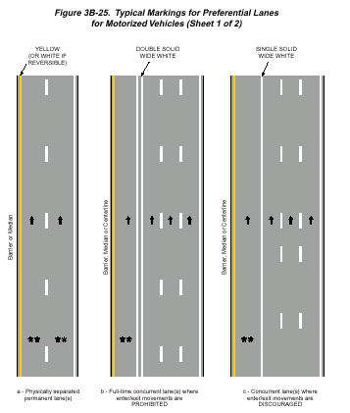
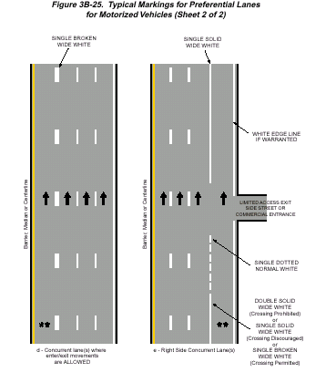
Preferential Lane Longitudinal
Line Markings for Motorized Vehicles
Notes:
1988 Edition:
Not in the 1988 MUTCD
Millennium Edition:
Figure 3B-25 sheets 1 and 2 of 2
Reason:
New figure added as recommended by the NCUTCD.

Slide 69
Markings for Roundabouts
Not in 1988 MUTCD.
SUPPORT: Roundabouts are distinctive circular roadways.
Yellow Text Denotes a Standard
Notes:
1988 Edition:
Not in the 1988 MUTCD
Millennium Edition:
Support: Roundabouts are distinctive circular roadways that have the following three critical characteristics:
A. A requirement to yield at entry which gives a vehicle on the circular roadway the right-of-way; and
B. A deflection of the approaching vehicle around the central island; and
C. A flare or widening of the approach to match the width of the circular roadway.
Reason: New section added as recommended by the NCUTCD

Slide 70
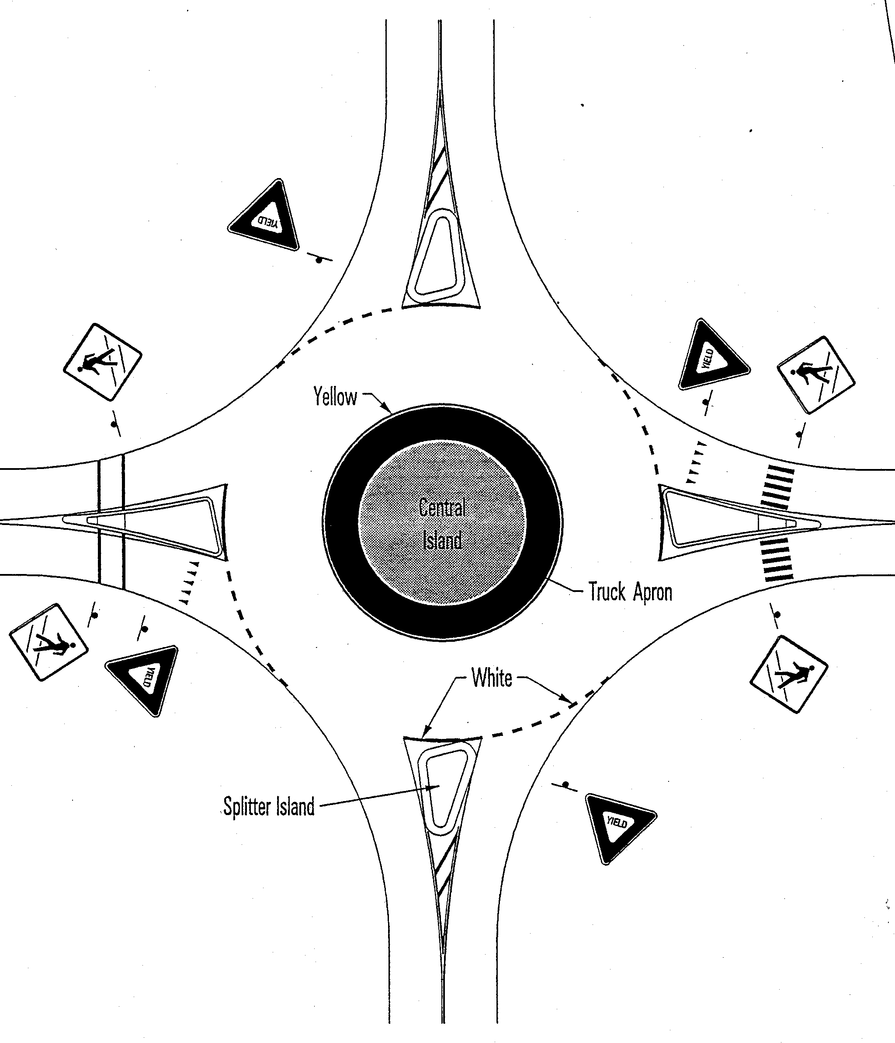
Roundabout Markings (cont.)
Note:
Pavement markings illustrated in this typical drawing are optional.
Notes:
1988 Edition: This Figure was not in the 1988 MUTCD.
Millennium Edition:
Figure 3B-26
Reason:
New figure added as recommended by the NCUTCD.

Slide 71
Markings for Other Circular Intersections
Not in 1988 MUTCD.
SUPPORT: Other circular intersections include but are not limited to rotaries, traffic circles, and residential traffic calming designs.
Yellow Text Denotes a Standard
Notes:
1988 Edition:
Not in the 1988 MUTCD
Millennium Edition:
Support: Other circular intersections include but are not limited to rotaries, traffic circles, and residential traffic calming designs.
Reason:
New section added as recommended by the NCUTCD

Slide 72
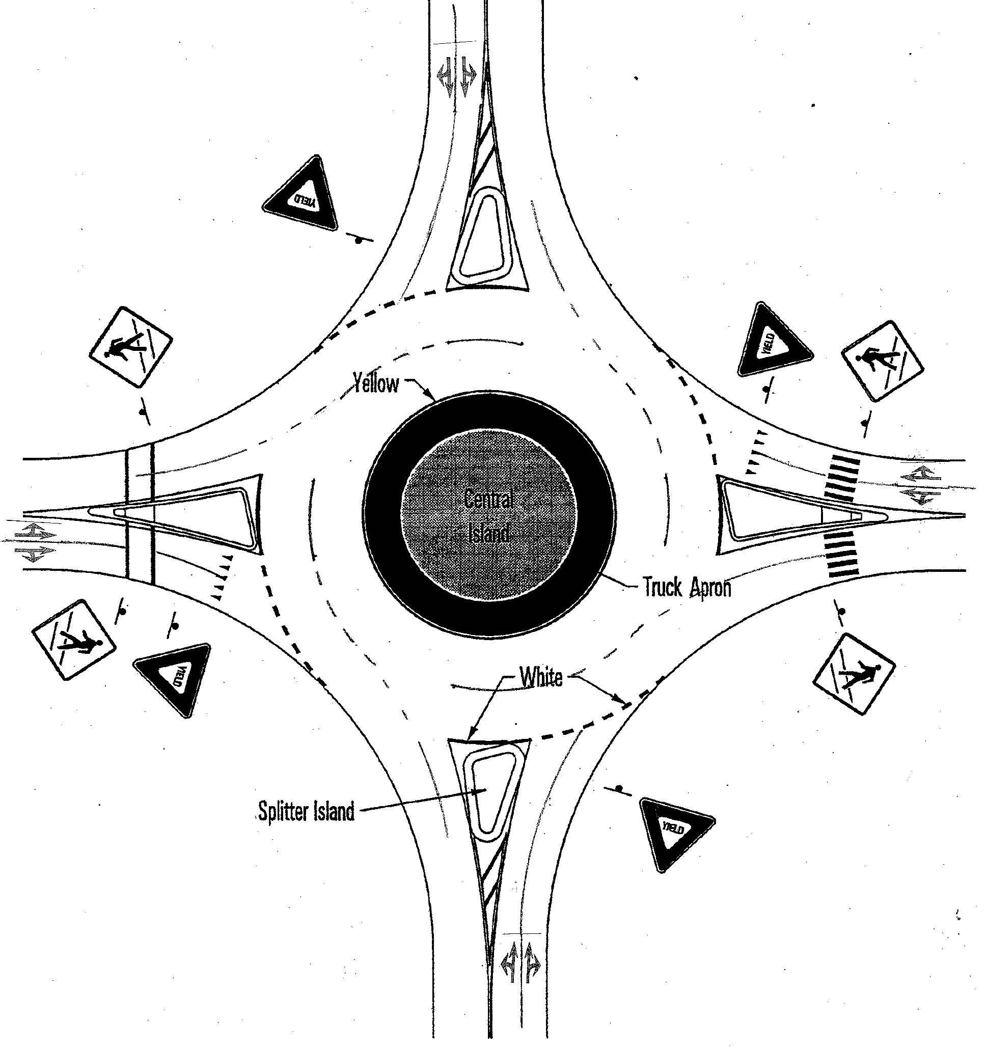
Markings for Other Intersections
Note:
Pavement markings illustrated in
this typical drawing are optional.
(Australian Design)
Notes:
1988 Edition:
Not in 1988 MUTCD
Millennium Edition:
Figure 3B-27
Reason:
New figure added as recommended by the NCUTCD.

Slide 73
Speed Hump Markings
Not in 1988 MUTCD.
Speed hump markings shall be a series of white markings placed on a speed hump to identify its location.
Yellow Text Denotes a Standard
Notes:
1988 Edition:
Not in the 1988 MUTCD
Millennium Edition:
Standard: If used, speed hump markings shall be a series of white markings placed on a speed hump to identify its location.
Reason: Section 3B.26 is a new section recommended by the NCUTCD. The text proposed by the NCUTCD was not modified by FHWA.

Slide 74
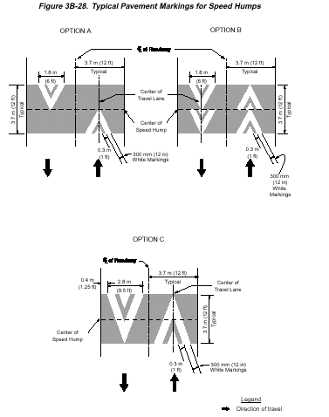
Speed Hump Markings
Notes:
1988 Edition:
Not in the 1988 MUTCD
Millennium Edition:
Figure 3B-28
Reason: Figure 3B.28 is a new section recommended by the NCUTCD.

Slide 75
Advance Speed Hump Markings
Not in 1988 MUTCD.
Advance speed hump markings shall be a special white marking placed in advance of speed humps...
Yellow Text Denotes a Standard
Notes:
1988 Edition:
Not in the 1988 MUTCD
Millennium Edition:
Standard: If used, advance speed hump markings shall be a special white marking placed in advance of speed humps or other engineered vertical roadway deflections such as dips.
Reason:
Section 3B.27 is a new section recommended by the NCUTCD.

Slide 76
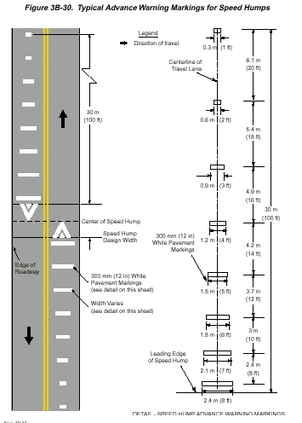
Advance Speed Hump Markings
Notes:
1988 Edition:
Not in the 1988 MUTCD
Millennium Edition:
Figure 3B-30

Slide 77
Delineators
Road delineators are light-reflecting devices mounted at the side of the roadway, in series, to indicate the roadway alignment.
Section 3D-1
Delineators shall be retroreflective devices mounted above the roadway surface along the side of the roadway..
Section 3D.1
Yellow Text Denotes a Standard
Notes:
1988 Edition:
Road delineators are light-reflecting devices mounted at the side of the roadway, in series, to indicate the roadway alignment
Millennium Edition:
STANDARD: Delineators shall be retroreflective devices mounted above the roadway
surface along the side of the roadway in a series to indicate the alignment of the roadway.

Slide 78
Delineator Application
Not in 1988 MUTCD.
Section 3D-4
shall be on the right of expressways, freeways and.. interchange ramps, except :
b. sections where continuous lighting is between interchanges.
Section 3D.3b
Yellow Text Denotes a Standard
Notes:
1988 Edition:
not in MUTCD.
Millennium Edition:
STANDARD: Single delineators shall be provided on the right side of expressways and freeways and on at least one side of interchange ramps, except in the following cases:
a. On tangent sections of expressways and freeways when all of the following conditions are met:
1) Raised pavement markers are continuously used.
2) Where whole routes or substantial portions of routes have large sections of tangent alignment.
3) Roadside delineators are used to lead into all curves as shown in Table III-2.
b. On sections of roadways where continuous lighting is in operation between interchanges.

Slide 79
Delineator
Placement and Spacing
Not in 1988 MUTCD.
Section 3D-5
Delineators should be spaced 200 to 528ft apart on mainline tangent sections. Delineators should be spaced 100ft apart on ramp tangent sections.
Section 3D.4
Yellow Text Denotes a Standard
Notes:
1988 Edition:
not in MUTCD.
Millennium Edition:
GUIDANCE: Delineators should be spaced 60 to 160m (200 to 528 ft) apart on mainline tangent sections. Delineators should be spaced 30m (100 ft) apart on ramp tangent sections.

Slide 80
Barricades
Red and white barricades are to warn drivers of the terminous of a road,.., in other than construction or maintenance areas.
Section 3F-1
Red and white barricades shall be the marking device used to warn road users of the terminous of a roadway in other than construction or maintenance areas.
Section 3F.1
Yellow Text Denotes a Standard
Notes:
1988 Edition:
Red and white barricades are to warn and alert drivers of the terminous of a road, street or highway in other than construction or maintenance areas.
Millennium Edition:
STANDARD: When used to warn and alert road users of the terminus of a roadway in other than temporary traffic control zones, barricades shall meet the design criteria of Section 6F.60 for a Type III barricade, except that the colors of the stripes shall be retroreflective white and retroreflective red

Slide 81
Channelizing Devices
The color of cones and tube markers used outside construction and maintenance areas shall be the same as the pavement marking which they supplement
Section 3F-2
The color of channelizing devices used … traffic control zones shall be either orange or the same color as the marking that they supplement, or substituted
Section 3F.2
Yellow Text Denotes a Standard
Notes:
1988 Edition:
Twenty-eight inches should be the minimum height of cones used on freeways and other high speed roadways and on all facilities during hours of darkness or whenever more conspicuous guidance is needed.The color of cones and tube markers used outside construction and maintenance areas shall be the same as the pavement marking which they supplement or for which they are ubstituted. They should be kept clean and bright for maximum target value. For nighttime use they shall be reflectorized. Reflectorization of tubular markers shall be a minimum of two, 3-inch bands placed a maximum of 2 inches from the top with a maximum of 6 inches between the bands.
Millennium Edition:
STANDARD: The minimum height of cones shall be 700mm (28 in) for use on freeways and other high speed roadways and on all facilities during hours of darkness or whenever more conspicuous guidance is needed. The color of channelizing devices used outside of temporary traffic control zones shall be either orange or the same color as the pavement marking that they supplement, or for which they are substituted. Retroreflection of cones shall be provided by a minimum 150mm (6 in) white band placed a minimum of 75mm (3 in) but no more than 100mm (4 in) from the top.

Slide 82
Channelizing Devices
Reflectorization of tubular markers shall be a minimum of two, 3” bands placed a max of 2” from the top with a max of 6”between the bands.
Section 3F-2
Retroreflection of cones shall be provided by a minimum 6” white band placed a minimum of 3” but no more than 4” from the top.
Section 3F.2
Yellow Text Denotes a Standard
Notes:
1988 Edition:
Twenty-eight inches should be the minimum height of cones used on freeways and other high speed roadways and on all facilities during hours of darkness or whenever more conspicuous guidance is needed.The color of cones and tube markers used outside construction and maintenance areas shall be the same as the pavement marking which they supplement or for which they are substituted. They should be kept clean and bright for maximum target value. For nighttime use they shall be reflectorized. Reflectorization of tubular markers shall be a minimum of two, 3-inch bands placed a maximum of 2 inches from the top with a maximum of 6 inches between the bands.
Millennium Edition:
The minimum height of cones shall be 700mm (28 in) for use on freeways and other high speed roadways and on all facilities during hours of darkness or whenever more conspicuous guidance is needed.The color of cones and tubular markers used outside construction and maintenance areas shall be the same color as the pavement marking which they supplement, or for which they are substituted, or they shall be orange. Retroreflection of cones shall be provided by a minimum 150mm (6 in) white band placed a minimum of 75mm (3 in) but no more than 100mm (4 in) from the top.

Slide 83
General
An island is..defined area between lanes for control..in an intersection, a median or outer separation is considered to be an island.
Section 5A-1
An island shall be the area between lanes for control… in an intersection, a median or outer separation shall be an island.
Section 3G.1
Yellow Text Denotes a Standard
Notes:
1988 Edition:
A traffic-control island is a defined area between traffic lanes for control of vehicle movements or for pedestrian refuge. Within an intersection area, a median or an outer separation is considered to be an island. An island may be designated by paint, raised bars, mushroom buttons, curbs, guideposts, pavement edge, or other devices.
Millennium Edition:
An island for traffic control purposes shall be the defined area between traffic lanes for control of vehicular movements or for pedestrian refuge. Within an intersection area, a median or an outer separation shall be an island.

Slide 84
Approach-End Treatment
Higher raised bars or buttons may be used in advance of islands having barrier curbs, but they should not be used where they constitute an unexpected hazard.
Section 5C-2
Bars or buttons, when used in advance of islands having raised curbs, shall not be placed in such a manner as to constitute an unexpected obstacle.
Section 3G.2
Yellow Text Denotes a Standard
Notes:
1988 Edition:
Higher raised bars or buttons may be used in advance of islands having barrier curbs, but they should not be used where they constitute an unexpected hazard.
Millennium Edition:
Bars or buttons, when used in advance of islands having raised curbs, shall not be placed in such a manner as to constitute an unexpected obstacle.

Slide 85
Island Marking Application
Markings, as related to islands, consist of pavement and curb markings, object markers and delineators.
Section 5F-2
Markings, as related to islands, shall consist only of pavement and curb markings, object markers, and delineators.
Section 3G.3
Yellow Text Denotes a Standard
Notes:
1988 Edition:
Markings, as related to islands, consist of pavement and curb markings, object markers and delineators.
Millennium Edition:
STANDARD: Markings, as related to islands, shall consist only of pavement and curb markings, object markers, and delineators.

Slide 86
Island Delineators
Each travel path through an intersection must be considered separately in positioning delineators to assure maximum effectiveness.
Section 5F-5
Each roadway through an intersection shall be considered separately in positioning delineators to assure maximum effectiveness.
Section 3G.6
Yellow Text Denotes a Standard
Notes:
1988 Edition:
Each travel path through an intersection must be considered separately in positioning delineators to assure maximum effectiveness.
Millennium Edition:
STANDARD: Each roadway through an intersection shall be considered separately in positioning delineators to assure maximum effectiveness.

