Slide 1
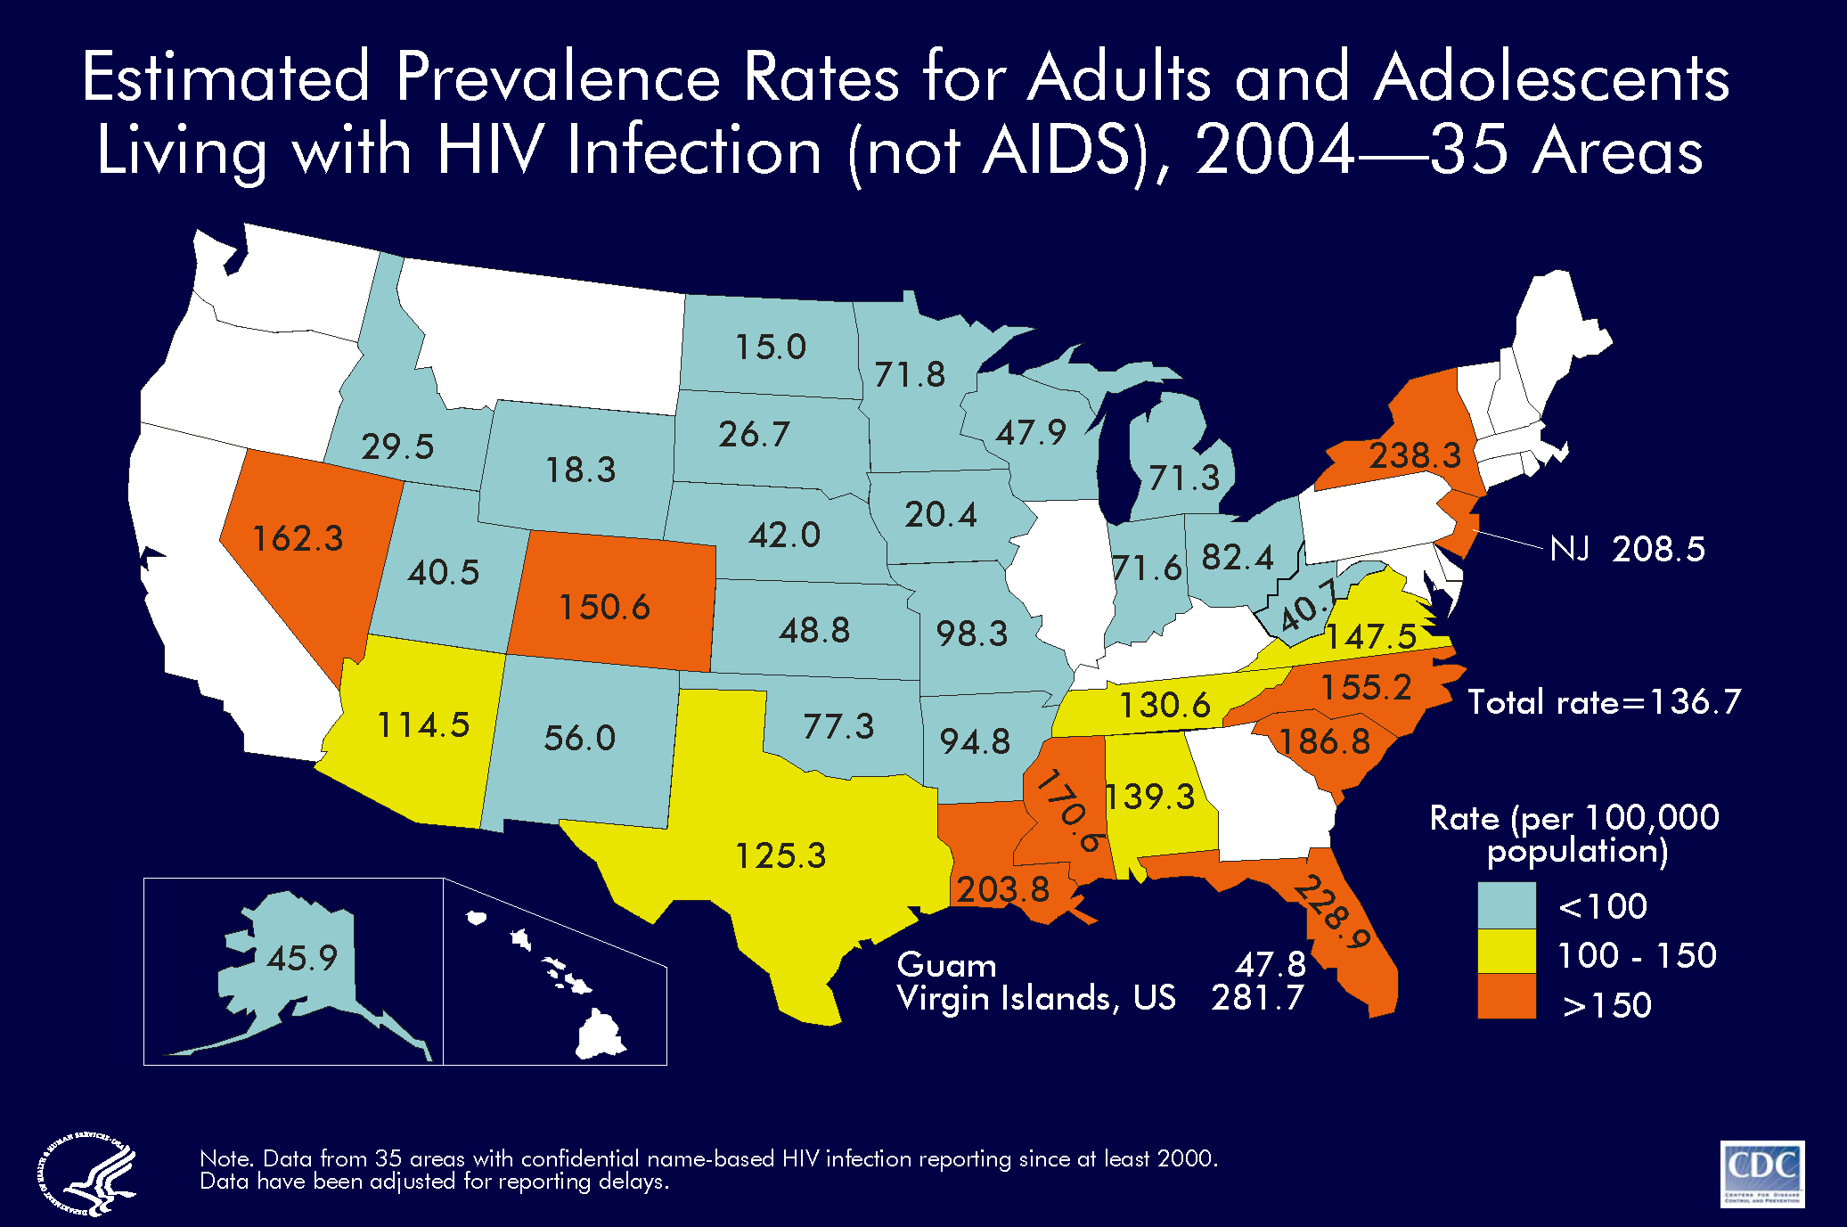
Notes:
For adults and adolescents living with HIV/AIDS, prevalence rates per 100,000 population are shown for 35 areas with confidential name-based HIV infection surveillance.
Areas with the highest prevalence rates in 2004 were the US Virgin Islands, New York, Florida, New Jersey, Louisiana, and South Carolina.
The following 35 areas have had laws or regulations requiring confidential name-based HIV infection surveillance since at least 2000: Alabama, Alaska, Arizona, Arkansas, Colorado, Florida, Idaho, Indiana, Iowa, Kansas, Louisiana, Michigan, Minnesota, Mississippi, Missouri, Nebraska, Nevada, New Jersey, New Mexico, New York, North Carolina, North Dakota, Ohio, Oklahoma, South Carolina, South Dakota, Tennessee, Texas, Utah, Virginia, West Virginia, Wisconsin, Wyoming, Guam and the US Virgin Islands.
The data have been adjusted for reporting delays.

