Slide 1
THE HIV/AIDS PANDEMIC
Focus on Africa
By Dr. David Elkins
HIV/AIDS Prevention and Care Project
Nairobi, Kenya
September 2002

Slide 2
Global summary of the HIV/AIDS epidemic,
December 2001
  Number of people living with HIV/AIDS Total 40 million
  Adults 37.2 million
  Women 17.6 million
  Children under 15 years 2.7 million
  People newly infected with HIV in 2001 Total 5 million
  Adults 4.3 million
  Women 1.8 million
  Children under 15 years 800 000
  AIDS deaths in 2001 Total 3 million
  Adults 2.4 million
  Women 1.1 million
  Children under 15 years 580 000

Slide 3
Regional HIV/AIDS statistics and features, end of 2001
Epidemic
started
Adults & children
living with HIV/AIDS
Adults & children newly infected
with HIV
Adult prevalence
rate *
% of HIV-positive adults who are women
Main mode(s) of transmission for those living with HIV/AIDS **
Sub-Saharan Africa
North Africa & Middle East
South and South-East Asia
East Asia & Pacific
Latin America
Caribbean
Eastern Europe & Central Asia
Western Europe
North America
Australia & New Zealand
TOTAL
late ’70s
early ’80s
late ’80s
late ’80s
late ’80s
late ’70s
early ’80s
late ’70s
early ’80s
early ’90s
late ’70s
early ’80s
late ’70s
early ’80s
late ’70s
early ’80s
28.1 million
440 000
6.1 million
1 million
1.4 million
420 000
1 million
560 000
940 000
15 000
40 million
3.4 million
80 000
800 000
270 000
130 000
60 000
250 000
30 000
45 000
500
5 million
8.4%
0.2%
0.6%
0.1%
0.5%
2.2%
0.5%
0.3%
0.6%
0.1%
1.2%
55%
40%
35%
20%
30%
50%
20%
25%
20%
10%
48%
Hetero
Hetero, IDU
Hetero, IDU
IDU, Hetero, MSM
MSM, IDU, Hetero
Hetero, MSM
IDU
MSM, IDU
MSM, IDU, Hetero
MSM
* The proportion of adults (15 to 49 years of age) living with HIV/AIDS in 2001, using 2001 population numbers
** Hetero: heterosexual transmission – IDU: transmission through injecting drug use – MSM: sexual transmission among men who
have sex with men

Slide 4
Global estimates for adults and children end 2001
People living with HIV/AIDS
New HIV infections in 2001
Deaths due to HIV/AIDS in 2001
40 million
5 million
3 million

Slide 5

Adults and children estimated to be living with HIV/AIDS as of end 2001
Eastern Europe
& Central Asia
1 million
Western Europe
560 000
North America
940 000
East Asia & Pacific
1 million
North Africa
& Middle East
440 000
Caribbean
420 000
South
& South-East Asia
6.1 million
Latin America
1.4 million
Sub-Saharan Africa
28.1 million
Australia
& New Zealand
15 000
Total: 40 million

Slide 6
Estimated number of adults and children newly infected with HIV during 2001
Eastern Europe
& Central Asia
250 000
Western Europe
30 000
North America
45 000
East Asia & Pacific
270 000
North Africa
& Middle East
80 000
Caribbean
60 000
South
& South-East Asia
800 000
Latin America
130 000
Sub-Saharan Africa
3.4 million
Australia
& New Zealand
500
Total: 5 million

Slide 7
Estimated adult and child deaths from HIV/AIDS during 2001
Eastern Europe &
Central Asia
23 000
Western Europe
6 800
North America
20 000
East Asia & Pacific
35 000
North Africa
& Middle East
30 000
Caribbean
30 000
South
& South-East Asia
400 000
Latin America
80 000
Sub-Saharan Africa
2.3 million
Australia
& New Zealand
120
Total: 3 million

Slide 8
Children (<15 years) estimated to be living with HIV/AIDS as of end 2001
Eastern Europe &
Central Asia
15 000
Western Europe
4 000
North America
10 000
East Asia & Pacific
7 000
North Africa
& Middle East
20 000
Caribbean
20 000
South
& South-East Asia
200 000
Latin America
40 000
sub-Saharan Africa
2.4 million
Australia
& New Zealand
< 200
Total: 2.7 million

Slide 9
Estimated deaths in children (<15 years) from HIV/AIDS during 2001
Eastern Europe &
Central Asia
< 100
Western Europe
< 100
North America
< 100
East Asia & Pacific
1 500
North Africa
& Middle East
6 000
Caribbean
5 000
South
& South-East Asia
40 000
Latin America
8 000
sub-Saharan Africa
500 000
Australia
& New Zealand
< 100
Total: 580 000

Slide 10
Estimated number of children (<15 years) newly infected with HIV during 2001
Eastern Europe &
Central Asia
1 000
Western Europe
< 500
North America
< 500
East Asia & Pacific
3 000
North Africa
& Middle East
12 000
Caribbean
6 000
South
& South-East Asia
65 000
Latin America
10 000
sub-Saharan Africa
700 000
Australia
& New Zealand
< 100
Total: 800 000

Slide 11
About 14 000 new HIV infections a day in 2001
More than 95% are in developing countries
2000 are in children under 15 years of age
About 12 000 are in persons aged 15 to 49 years, of whom:
  almost 50% are women
  about 50% are 15–24 year olds

Slide 12
End-2001 global HIV/AIDS estimates
Children (<15 years)
Children living with HIV/AIDS
New HIV infections in 2001
Deaths due to HIV/AIDS in 2001
2.7 million
800 000
580 000

Slide 13
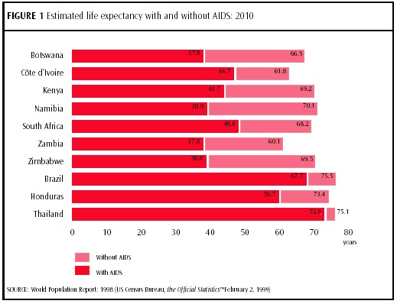

Slide 14
Leading causes of death in sub-Saharan Africa
1. HIV/AIDS 20.6%
2. Acute Lower Resp. Inf’ct 10.3%
3. Malaria 9.1%
4. Diarrhoeal diseases 7.3%
5. Perinatal disease 5.9%
6. Measles 4.9%
7. Tuberculosis 3.4%

Slide 15
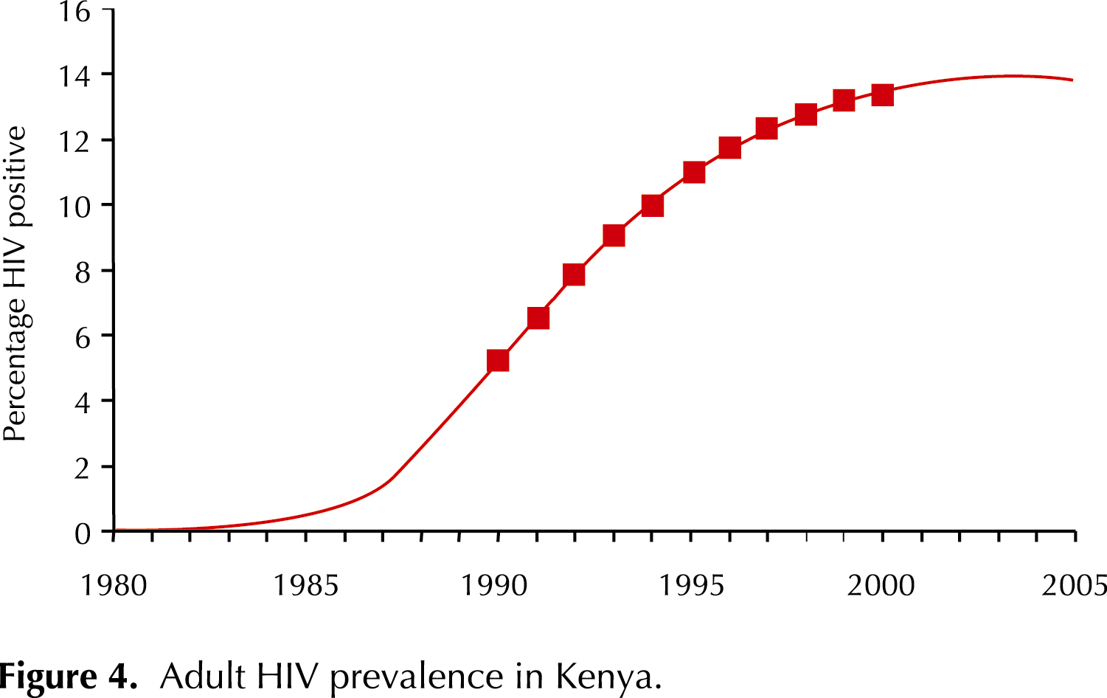
The Challenge of HIV/AIDS - Adult Prevalence in Kenya

Slide 16
Profile of HIV/AIDS in Kenya
2.2 million Kenyans are now living with HIV infection. Out of every eight adults in rural Kenya, one is infected. In urban areas, nearly one out of every five adults is infected.
About 200,000 have AIDS, the acquired immune deficiency syndrome.
Of the remaining 2 million, most do not know they are infected.

Slide 17
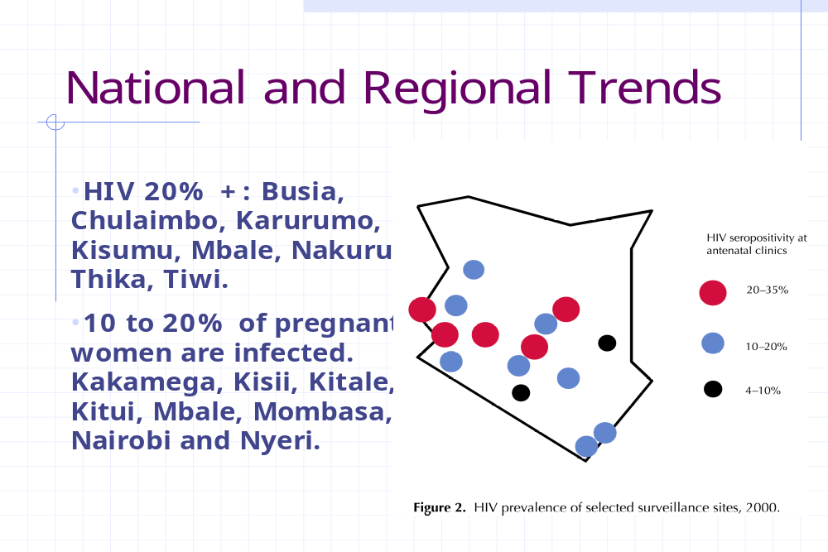

Slide 18
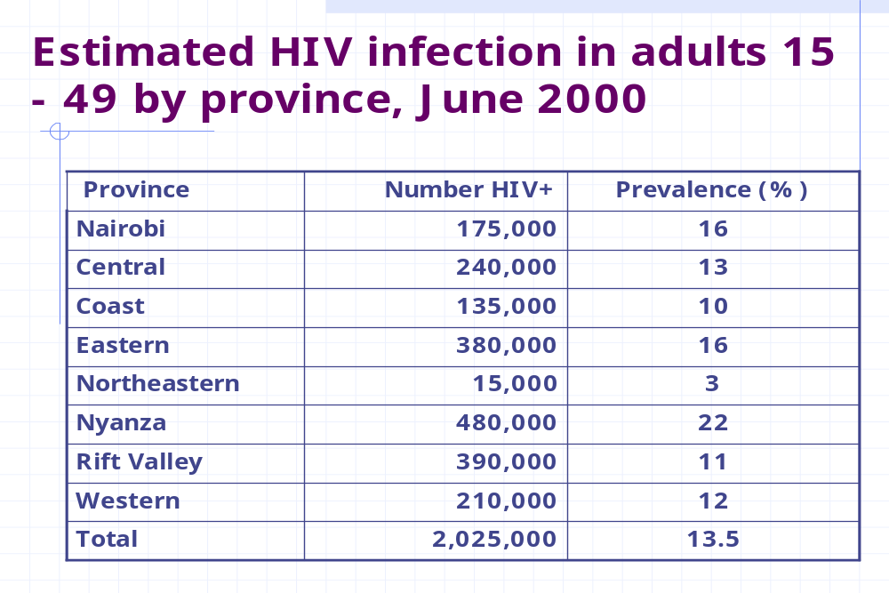

Slide 19
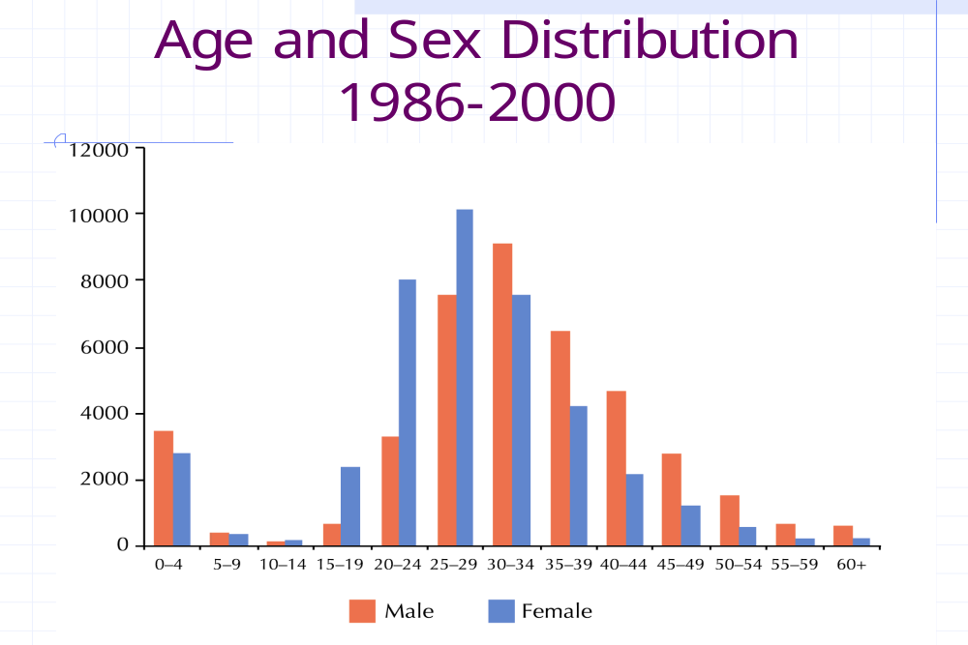

Slide 20
