Slide 1
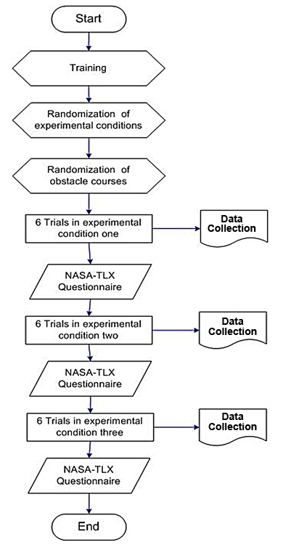

Figure 2. Study protocol. NASA-TLX = National Aeronautics and Space Administration-Task Load Index.
Sharma V, Simpson RC, LoPresti EF, Schmeler M. Clinical evaluation of semiautonomous smart wheelchair architecture (Drive-Safe System) with visually impaired individuals. J Rehabil Res Dev. 2012;49(1):35–50.
http://dx.doi.org/10.1682/JRRD.2010.03.0022
Notes:
Figure 2. Study protocol. NASA-TLX = National Aeronautics and Space Administration-Task Load Index.

