Slide 1
Virginia Reentry Conference
April 30, 2007
Norfolk, Virginia
Roger H. Peters, Ph.D., University of South Florida, Tampa, Florida; Peters@fmhi.usf.edu_x000b_
Health, Mental Health, and Substance Abuse – Working with Offenders who have Co-occurring Disorders

Slide 2
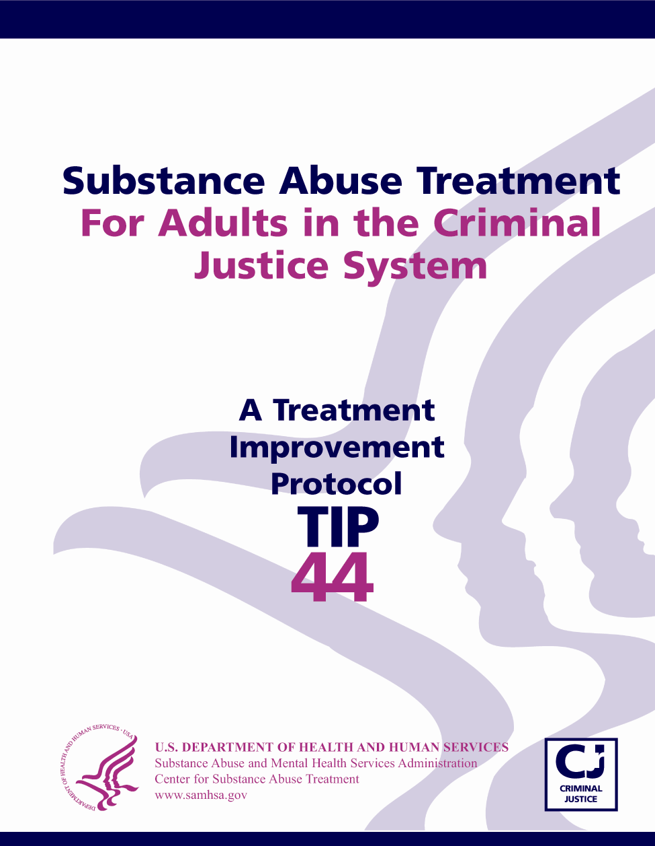
TIP 44: Substance Abuse Treatment
for Adults in the Criminal Justice System

Slide 3
To Order TIP 44 and
Products Based on TIP 44
To obtain free copies:
  Call SAMHSA’s National Clearinghouse for Alcohol and Drug Information (NCADI) at:
  800-729-6686
  Visit NCADI’s Web site at www.ncadi.samhsa.gov
  Request items BKD 526 (TIP 44)
    QGCT44 (Quick Guide)
    KAPT44 (KAP Keys)

Slide 4

http://coce.samhsa.gov/

Slide 5
Goals of this Presentation
Review:
How to access relevant resources
Specialized screening and assessment strategies for CODs
Modifications to clinical approaches for CODs
Programmatic modifications for CODs

Slide 6
Defining “Co-Occurring Disorders”
The presence of at least two disorders:
One being substance abuse or dependence
The other being a DSM-IV major mental disorder, usually Major Depression, Bipolar Disorder, or Schizophrenia

Slide 7
Offenders with Co-Occurring Disorders
  Persons with CODs repeatedly cycle through the criminal justice and treatment systems
  Likely to experience problems when not taking medication, not in treatment, experiencing mental health symptoms, using alcohol or drugs
  Use of even small amounts of alcohol or drugs may trigger recurrence of mental health symptoms

Slide 8

Typical Location of Services for Different Co-Occurring Populations
III
Substance abuse
system
IV
State hospitals,
Jails/prisons,
emergency
rooms, etc.
High
Severity
I
Primary health
care settings
Substance Use Disorders
II
Mental health
system
Low
Severity
High
Severity
Mental Health Disorders

Slide 9
Prevalence of Mental Problems in Justice Settings by Gender
Gender State Prison Fed. Prison Jail
Male 55% 44% 63%
Female 73% 61% 75%
* Based on a modified clinical interview for the DSM-IV, describing experiences during the “past 12 months”. (U.S. Department of Justice, 2006)

Slide 10
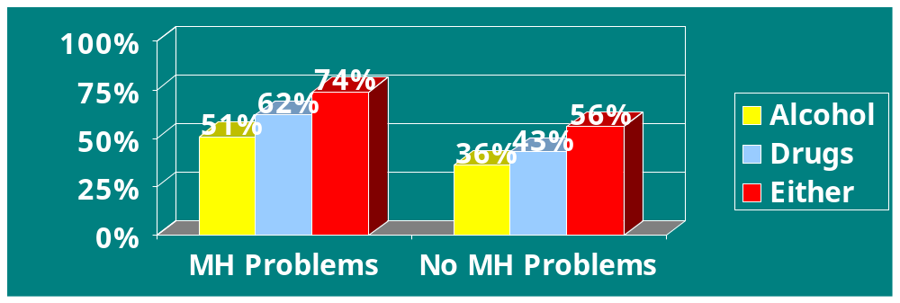
Rates of Substance Abuse or Dependence Among Inmates with Mental Problems
74% of state prisoners with mental problems also have substance abuse or dependence problems
(U.S. Department of Justice, 2006)

Slide 11
Challenges in Addressing CODs
At risk for relapse
Criminality/criminal thinking
Housing needs
Transportation needs
Family reunification
Greater psychological impairment (e.g., trauma)
Job skills deficits
Educational deficits
Stigma related to criminal history and SA and MH disorders
Scarce prevention and treatment resources

Slide 12
Outcomes Related to CODs
  More rapid progression from initial use to substance dependence
  Poor adherence to medication
  Decreased likelihood of treatment completion
  Greater rates of hospitalization
  More frequent suicidal behavior
  Difficulties in social functioning
  Shorter time in remission of symptoms

Slide 13
Behavioral Characteristics
  Difficulty comprehending or remembering important information (e.g., verbal memory)
  Not recognize consequences of behavior (e.g., planning abilities)
  Poor judgment
  Disorganization
  Limited attention span
  Not respond well to confrontation

Slide 14
Clinical Features
Cognitive impairment
Reduced motivation
Impairment in social functioning
(Bellack, 2003)

Slide 15
Why Traditional MH Programs are not Effective for Offenders with CODs
Unaddressed and ongoing SA interferes with individuals’ ability to follow MH treatment recommendations
Active substance use interferes with effectiveness of MH treatment (i.e., medications, etc.)
MH treatment may not focus on changing substance use and other maladaptive behaviors

Slide 16
Why Traditional SA Programs are not Effective for Offenders with CODs
Absence of accurate MH diagnosis prevents effective treatment
Cognitive impairment detracts from understanding and processing information
Confrontational approaches used in SA treatment are not well tolerated
Frustration and dropout may result from requirements of abstinence

Slide 17
Why Screen and Assess for CODs?
  High prevalence rates of mental health and substance abuse disorders in justice settings
  Persons with undetected disorders are likely to cycle back through the criminal justice system
  Allows for treatment planning and linking to appropriate treatment services

Slide 18
Enhancing Accuracy of Screening and Assessment
Maintain high index of suspicion for both disorders
Use non-judgmental approach and motivational interviewing techniques
Gather substance abuse information before mental health information
Supplement self-report with collateral information

Slide 19
Mental Health Screens
Brief Symptom Inventory (BSI)
Symptom Checklist-90 (SCL-90-R)
MINI Structured Interview (MINI)
Mental Health Screening Form – III
Trauma Symptom Inventory (TSI)
Global Appraisal of Individual Needs (GAIN)
Notes:
Pink text identifies recommended screens
Identify which screens are brief and which are in-depth—make distinction between screening vs. assessment vs. evaluation instruments.
GAIN designed to screen for MH and SA

Slide 20
Substance Abuse Screens
Simple Screening Instrument (SSI)
Texas Christian University Drug Screen (TCUDS)
Addiction Severity Index (ASI) – Alcohol and Drug Abuse section
Alcohol Dependence Scale (ADS)
Alcohol Use Disorders Identification Test (AUDIT)
Global Appraisal of Individual Needs (GAIN)
Notes:
Identify which screens are brief and which are in-depth—make distinction between screening vs. assessment vs. evaluation instruments.
The ASI can be used to screen for COD to some extent

Slide 21
New and Specialized Screens
BASIS-24
Brief Jail Mental Health Screen (BJMHS)
Centre for Addiction and Mental Health Concurrent Disorders Screener (CAMH-CDS)
Dartmouth Assessment of Lifestyle Instrument (DALI)
Psychiatric Research Interview for Substance and Mental Disorders (PRISM)
Notes:
Identify which screens are brief and which are in-depth—make distinction between screening vs. assessment vs. evaluation instruments.
The ASI can be used to screen for COD to some extent

Slide 22
Screening for Trauma/PTSD
All women should be screened for trauma history across different justice settings
Initial screen does not have to be conducted by a mental health clinician; doesn’t require discussion of specific details
Many simple, non-proprietary screening instruments are available
Positive screens should be referred for more comprehensive assessment

Slide 23
Key Assessment Information
Scope and severity of MH and SA disorders
Pattern of interaction between the disorders
Conditions associated with occurrence and maintenance of the disorders
Other problems related to the disorders or affecting treatment
Motivation for treatment
Family and social relationships
Physical health status and medical history
Areas for treatment interventions

Slide 24
Assessment Considerations
Substance abuse can mimic all major mental health disorders
Several strategies will help to gauge the potential effects of SA on MH disorders
  Use drug testing to verify abstinence
  Take a longitudinal history of MH and SA symptom interaction
  Compile diagnostic impressions over a period of time
  Repeat assessment over time
Notes:
Pink text identifies recommended screens
Identify which screens are brief and which are in-depth—make distinction between screening vs. assessment vs. evaluation instruments.
GAIN designed to screen for MH and SA

Slide 25
The Importance of Data
Capturing data reflecting the
complexity of the population you
serve can be persuasive to
staff and funders.

Slide 26
Core COD Treatment Interventions for Offenders
Mental health disorders
Substance abuse disorders
Criminal thinking/cognitions
Developing non-corrosive peer supports
Educational and vocational skills
Family interventions
Reentry services

Slide 27
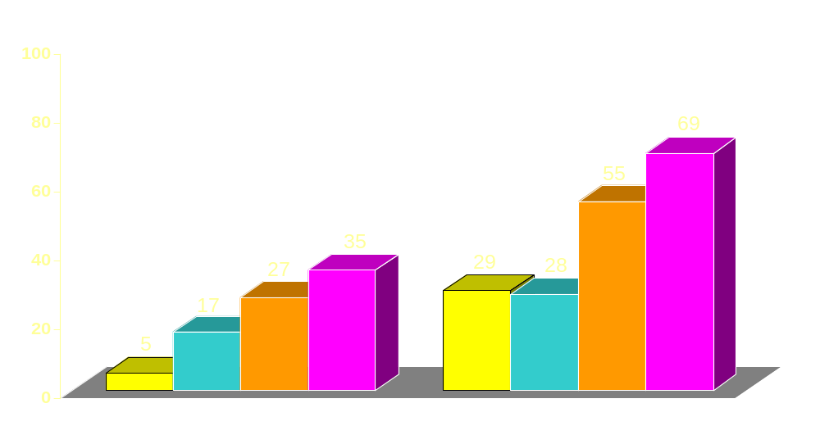
Effectiveness of Prison SA Treatment and Reentry – 3 Years Post-Release
Drug-Free
Arrest-Free
*
*
*
*
*
Work Release Completers + Aftercare
Work Release Completers + Aftercare
No Treatment
Work Release Completers
Work Release Dropouts
No Treatment
Work Release
Dropouts
Work Release Completers
* p < .05 from Comparison
Martin, Butzin, Saum, & Inciardi (1999), The Prison Journal
Notes:
Treatment works and aftercare is essential
Three years after release from prison, still see significant reduction in drug use and criminal activity for individuals who participated in prison-based treatment, community-based residential treatment, and outpatient aftercare.
448 subjects

Slide 28

Effectiveness of Prison COD Treatment and Reentry – 1 Year Reincarceration
33%
MH
TC +
after-care
16%
5%
TC only
Total n= 139 n=64 n=32 n=43
Sacks, S., Sacks, J., et al. 2004

Slide 29
Role of Criminal Justice Staff in Treatment
Often the first line of defense in detecting problems in non-treatment settings
Crisis management
Treatment and court liaison
Part of treatment team in many institutional and community settings
Co-lead psychoeducational groups

Slide 30
Treatment Modifications for CODs
  Longer duration of treatment
  More extensive assessment
  Emphasis on psychoeducational and supportive approaches
  Higher staff ratio, more MH staff

Slide 31
Treatment Modifications for CODs
Shorter meetings and activities
Information presented gradually, in small units, and with repetition
Supportive versus confrontational approach
More time provided for engagement and stabilization

Slide 32
Modifying Treatment for
Cognitive Impairment
Minimize need for abstraction (e.g., use concrete, specific scenarios)
Have demonstrate skills
Keep instructions brief
Use audiovisual aids
Keep role plays short and focused (Bellack, 2003)

Slide 33
Key Features of Offender COD Treatment Programs
  Highly structured therapeutic approach
  Destigmatize mental illness illness
  Focus on symptom management vs. cure
  Education regarding individual diagnoses and interactive effects of CODs
  “Criminal thinking” groups
  Basic life management and problem-solving skills

Slide 34
Structural Features of Offender Treatment Programs
  Therapeutic communities
  Isolated treatment units
  Program phases
  Blending of MH and SA services
  Assessment
  Specialized mental health services
  Transition and reentry services

Slide 35
Phases of Justice Treatment Programs
  Orientation
  Intensive treatment
  Relapse prevention/transition

Slide 36
Treating Female Offenders with CODs
Focus on trauma and spousal abuse
Emphasis on education and job training
Parenting skills
Female role models and peer support
Assertive outreach and crisis intervention

Slide 37
Trauma-Specific Therapies and Treatment Approaches
Seeking Safety (Najavits, 2002)
Trauma Recovery and Empowerment (TREM) (Harris, 1998)
Treating concurrent PTSD and cocaine dependence (Brady et al, 2001)
Substance Dependence Posttraumatic Stress Disorder Therapy (Triffleman, Carrol, & Kellogg, 1999)

Slide 38
Pharmacological Interventions
Medications are routinely and effectively prescribed for individuals with CODs
Medications serve to successfully:
- Decrease drug cravings
- Reduce reinforcing effects of drugs
- Assist in acute withdrawal

Slide 39
Pharmacological Interventions
Abuse of illicit drugs and alcohol can impair the action of medications
Toxic effects can occur if alcohol or illicit drugs are used while taking certain medications (e.g., lithium, tricyclic antidepressants, MOI inhibitors)
Medications with addictive potential should be avoided, or used with caution

Slide 40
Peer Support Interventions
Traditional 12-step programs have not always meshed well with the needs of individuals with co-occurring disorders
12-step models such as AA and NA have been adapted for co-occurring disorders
“Double Trouble” and similar groups have been developed throughout the U.S.

Slide 41
Key Transition Services
Development of re-entry or transition plan
Assistance to engage in community-based SA and MH treatment
Engagement in peer support and self-help networks to assist in recovery
Stable housing
Vocational training and employment support
Case management and community supervision

Slide 42
Supervision and Sanction Approaches
  Recognition of special needs
  Supportive vs. confrontative approach
  Support small successes and indicators of progress
  Modify expectations regarding response to supervision
  Flexibility in responding to infractions

Slide 43
Supervision and Sanction Approaches
  Provide concrete directives, repeat directives, assess comprehension
  Promote structure in daily activities, support use of planning skills
  Take initiative to make appointments and to monitor scheduled activities
  Ongoing monitoring to identify recurrence of MH symptoms

