Slide 1
Diagnosing diurnal convection signals in the NCEP GFS
Hua-Lu Pan and Ruiyu Sun
EMC/NCEP

Slide 2
Nocturnal precipitation maximum over the great plains
Lee et al (2008) examined the diurnal convection signals over North America for several models and found the GFS to exhibit nocturnal convection signal similar to observations.
Five AMIP runs for northern summer were made for each model.
The GFS convection signal over the Southeast US is too early compared to observations.

Slide 3
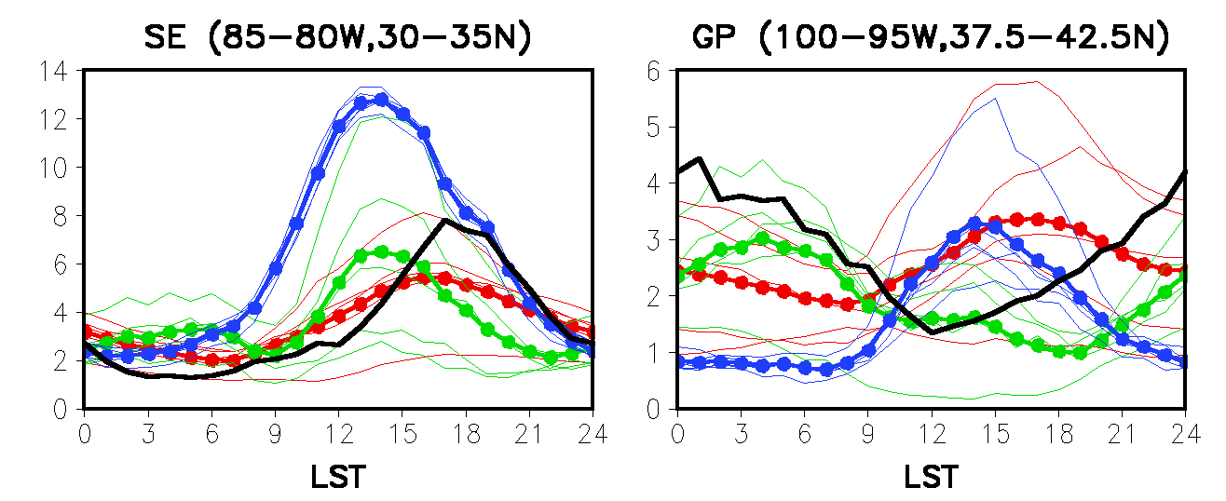
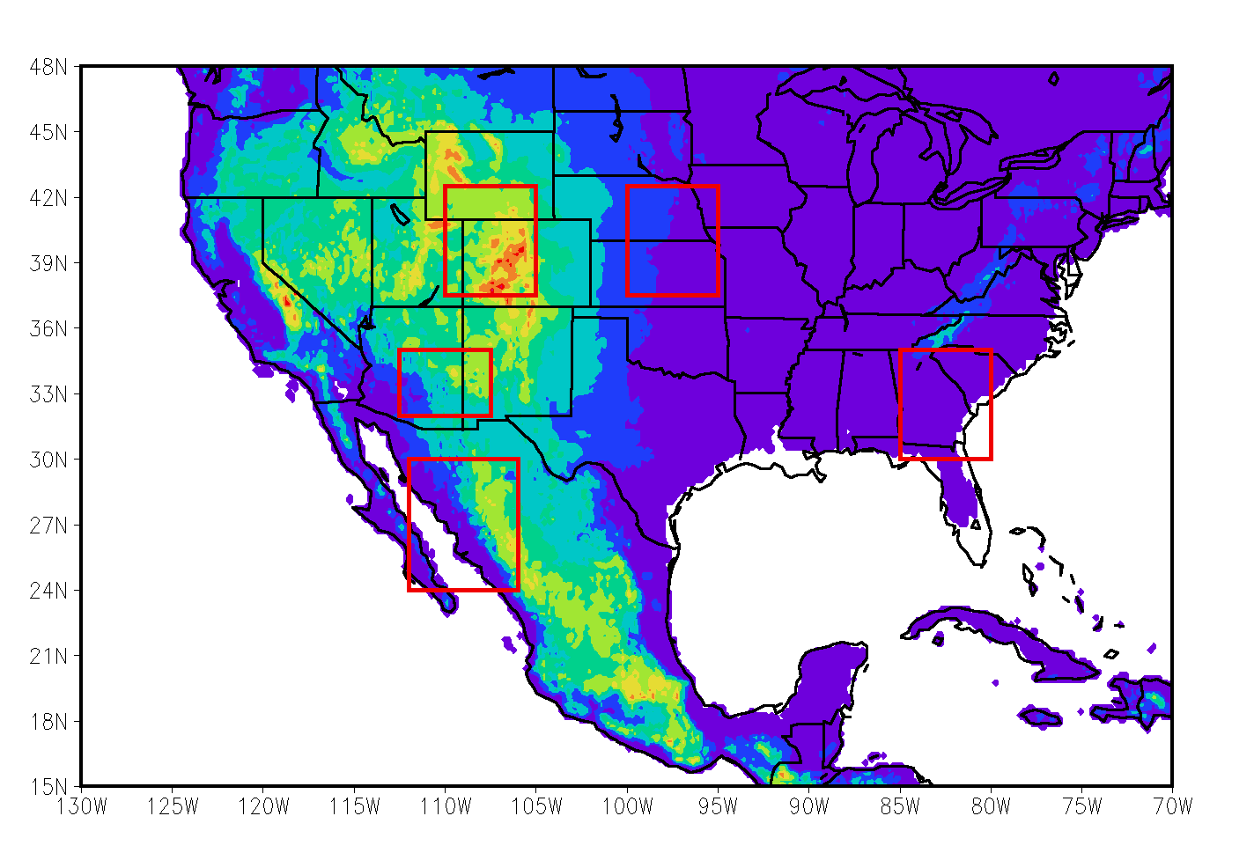
Diurnal Cycle of Rainfall – Ensemble Mean and Spread
GP
Obs(HPD)
GFDL
NCEP
NASA
SE
(spread) (ensemble
mean)

Slide 4
Primary reason for the nocturnal signal
Trigger function was able to choose parcels above the inversion to initiate convection.
Weakening of the nocturnal jet and turbulent mixing actually reduces convection during the day.

Slide 5
Diurnal signal over Rondonia, Brazil
A. Betts compared diurnal precipitation signal over Amazon region for February and found a significant afternoon maximum while some of the models do not produce it.
Three-hourly GFS forecasts (to 48 hours) for the day 30-58 period for 2010 for the similar area were averaged to examine the diurnal signal.
The GFS forecasts do exhibit early afternoon maximum.

Slide 6
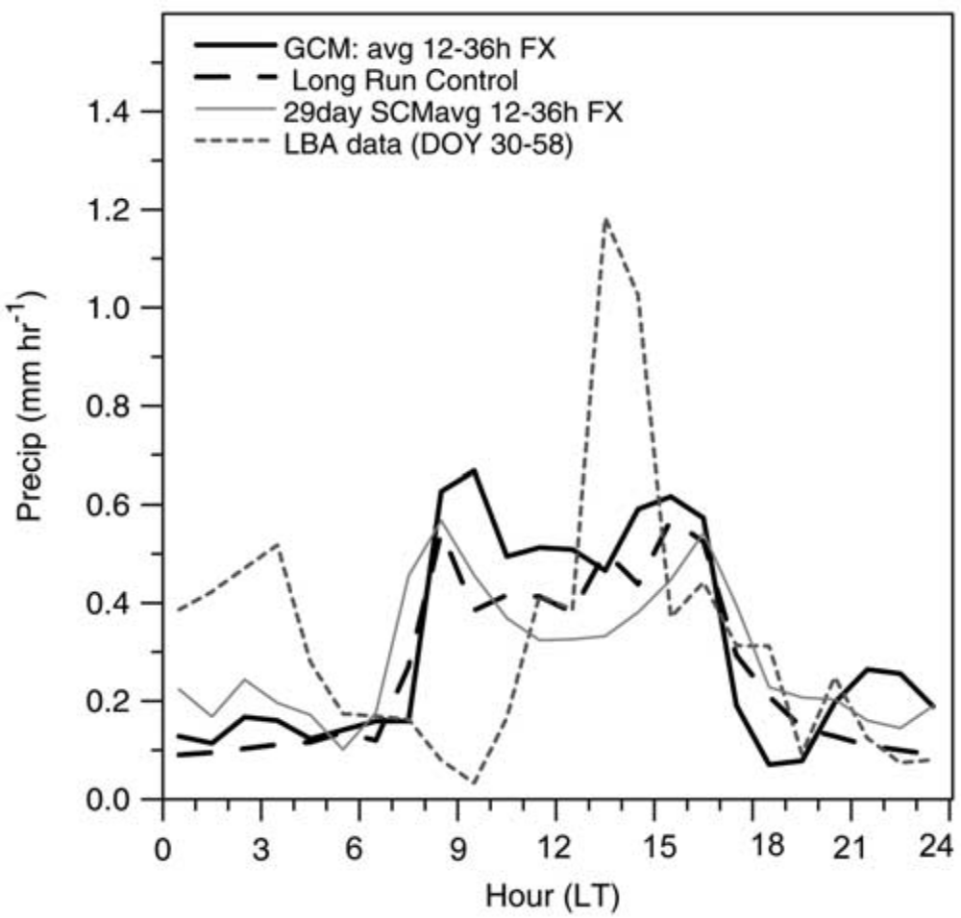

Slide 7
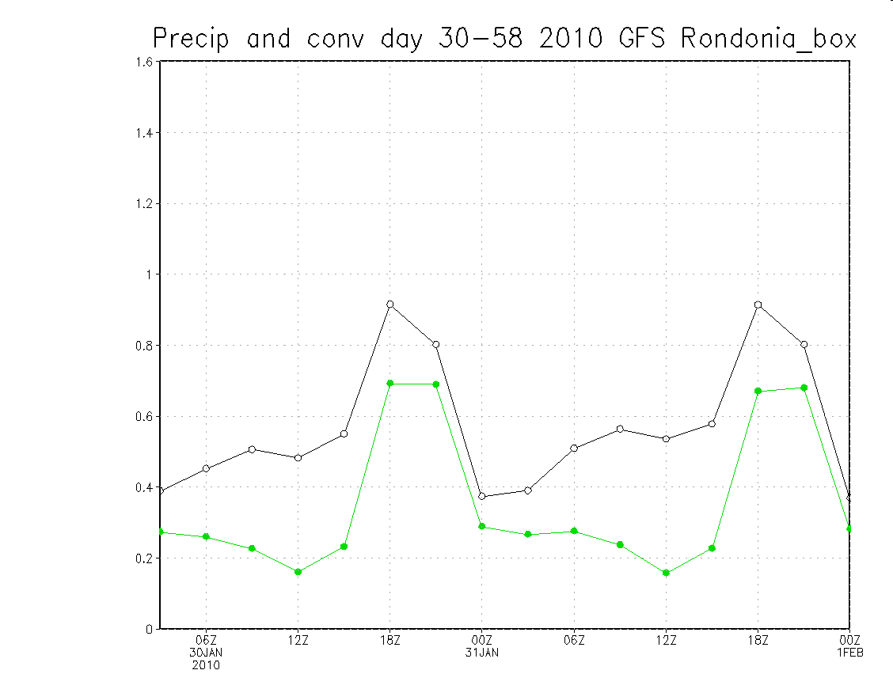
Box domain
5S-15S
65W-55W
Mm/hr unit
LT
02
08
14
20
02
08
14

Slide 8
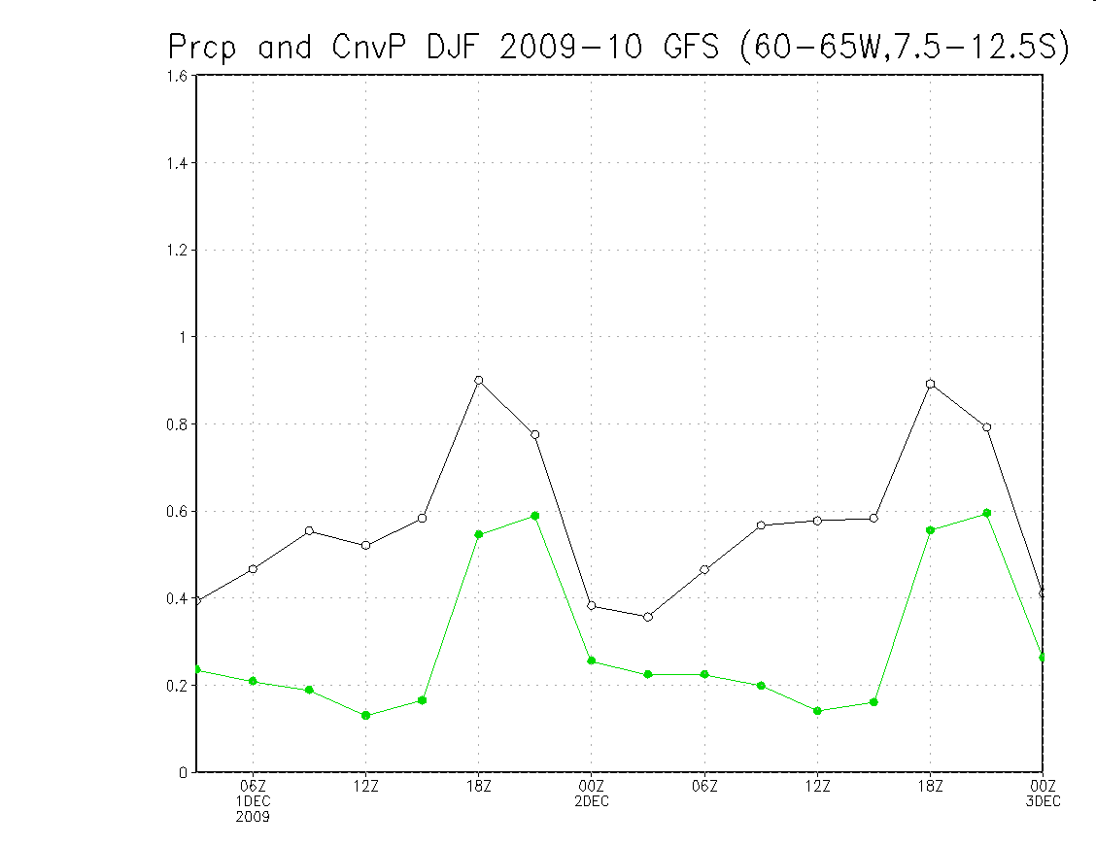
Prcp rate
(Mm/hr)

Slide 9
Maritime continent convection
J. Slingo has examined several GCMs for the diurnal convection over the maritime continent and found the models missing the signal.
A four-month coupled run using the CFS v.2 starting 1 May 1981 was made. Four-times daily precip amount was archived and averaged for the Jun-Aug period. Daily mean was subtracted at each grid point to obtain the anomaly from the daily mean (mm/day).
An afternoon maximum and early morning minimum over land with a reversal of signal off the coast.

Slide 10
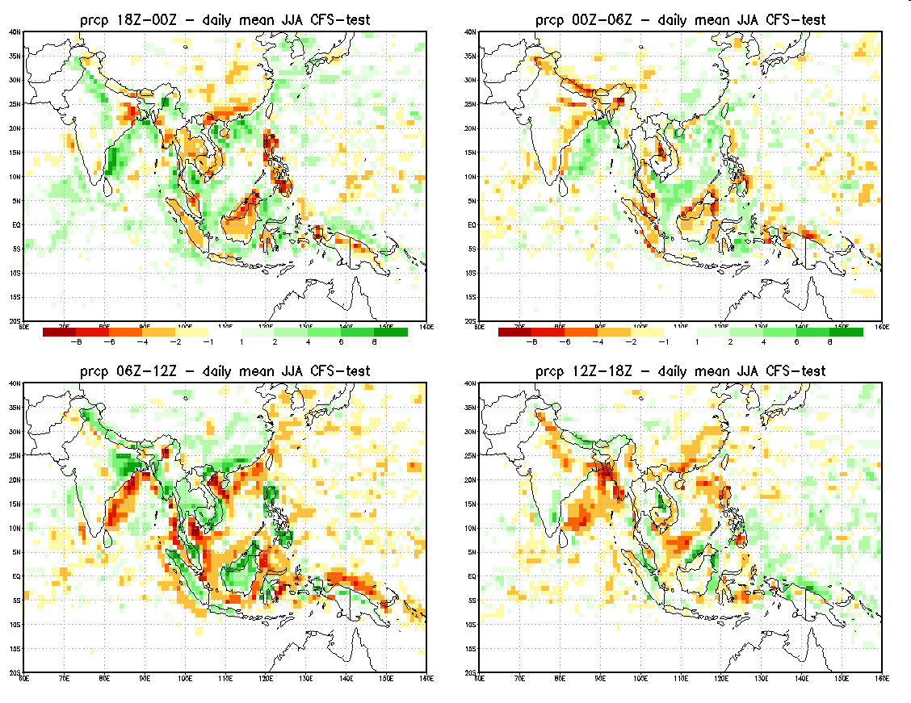
~ 01-07 LT
~ 07-13 LT
~ 13-19 LT
~ 19-01 LT

Slide 11
Conclusion
Diurnal convection signal in the GFS appears reasonable. Afternoon convection may still trigger too soon for Southeast US.
We suggest that the timing of convection over land has a strong dependence on the trigger parameterization.

