Slide 1
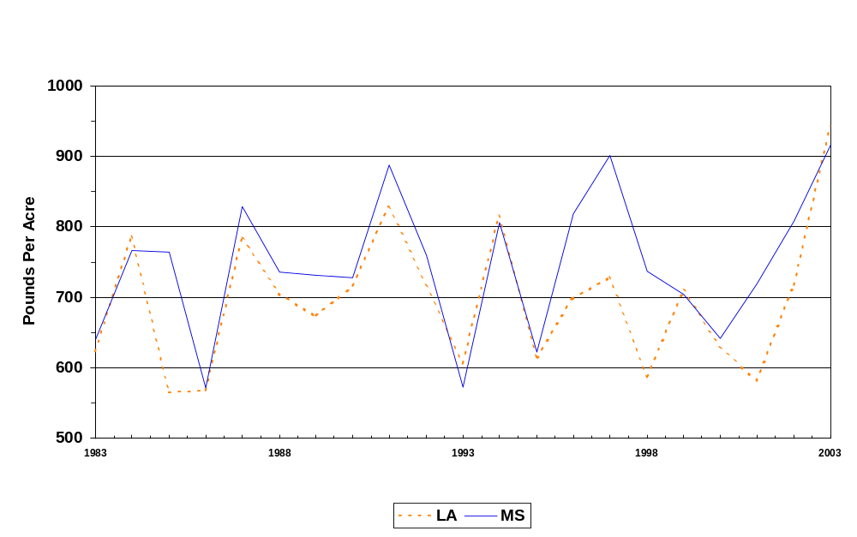
Upland Cotton: Mississippi and Louisiana Yield Per Acre, 1983-2003

