Slide 1
Cellular and Gene Therapies for Retinal Disorders
Samuel B. Barone, M.D.
Office of Cellular, Tissue, and Gene Therapies
Center for Biologics Evaluation and Research
samuel.barone@fda.hhs.gov
Cellular, Tissue, and Gene Therapy
Advisory Committee Meeting
June 29, 2011

Slide 2
Products in the Office of Cellular, Tissue, and Gene Therapies (OCTGT)
Cellular therapies
Gene therapies
Tumor vaccines and immunotherapy
Devices used for cells and tissues
Human cells and tissues for transplant
Combination products

Slide 3
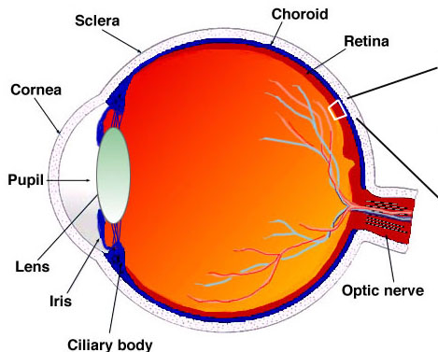
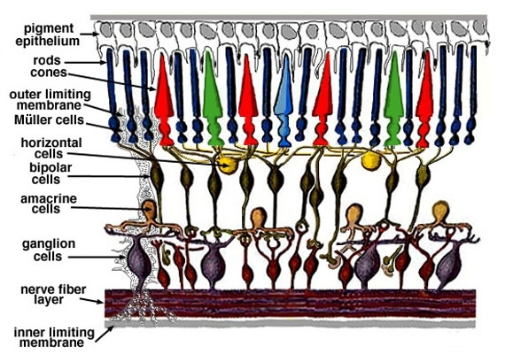
Retina
Kolb H, Simple Anatomy of the Retina, 2005. http://www.ncbi.nlm.nih.gov/books/NBK11533/

Slide 4
Clinical Indications
Inherited Retinal Disorders
  Retinitis pigmentosa
    100,000 affected in US Pagon, et al, Gene Reviews 2000, 2005.
  Stargardt disease
    30,000 affected in US Riveiro-Alvarez et al., BJO, 2009; 93(10):1359.
  Leber congenital amaurosis
    4,000 affected in US Stone, AJO, 2007; 144(6):791.

Slide 5
Clinical Indications (cont.)
Acquired Retinal Disorders
  Age-related macular degeneration
    7.3 million affected in US Friedman, Arch Ophthalmol, 2004; 122(4):564.
      1.75 million in US with advanced disease
  Diabetic retinopathy
    4.1 million affected in US Kempen, Arch Ophthalmol, 2004; 122(4):552.
      900,000 in US with advanced disease

Slide 6
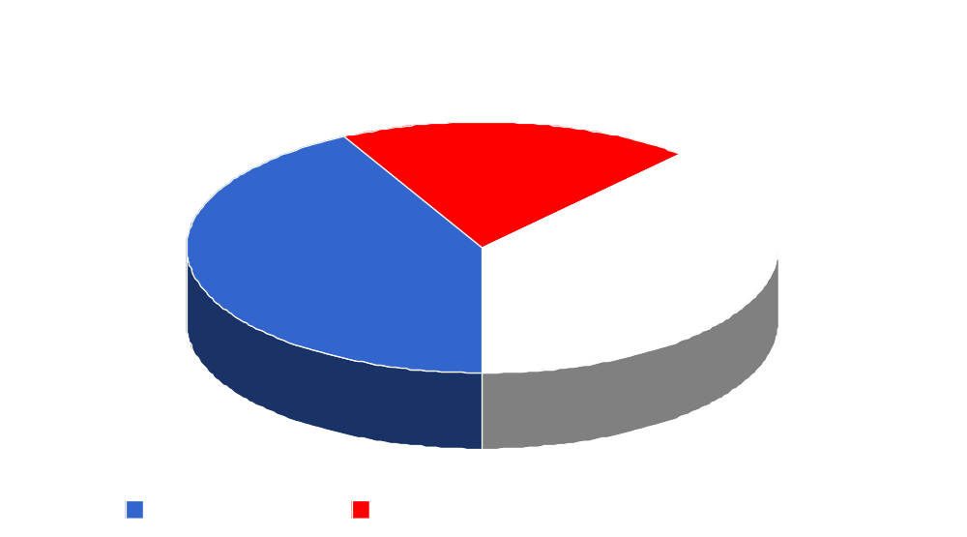
OCTGT Ophthalmic Product Submissions (26)
5
11
10

Slide 7
Development Considerations
Selection of appropriate endpoints for retinal disorders
Assessment of potential risks with novel therapeutic agents, particularly in regard to contralateral eye or repeat administration
Evaluation of delivery of the therapeutic agent to target tissues in back of eye

Slide 8
Efficacy Endpoints for
Retinal Disorders

Slide 9
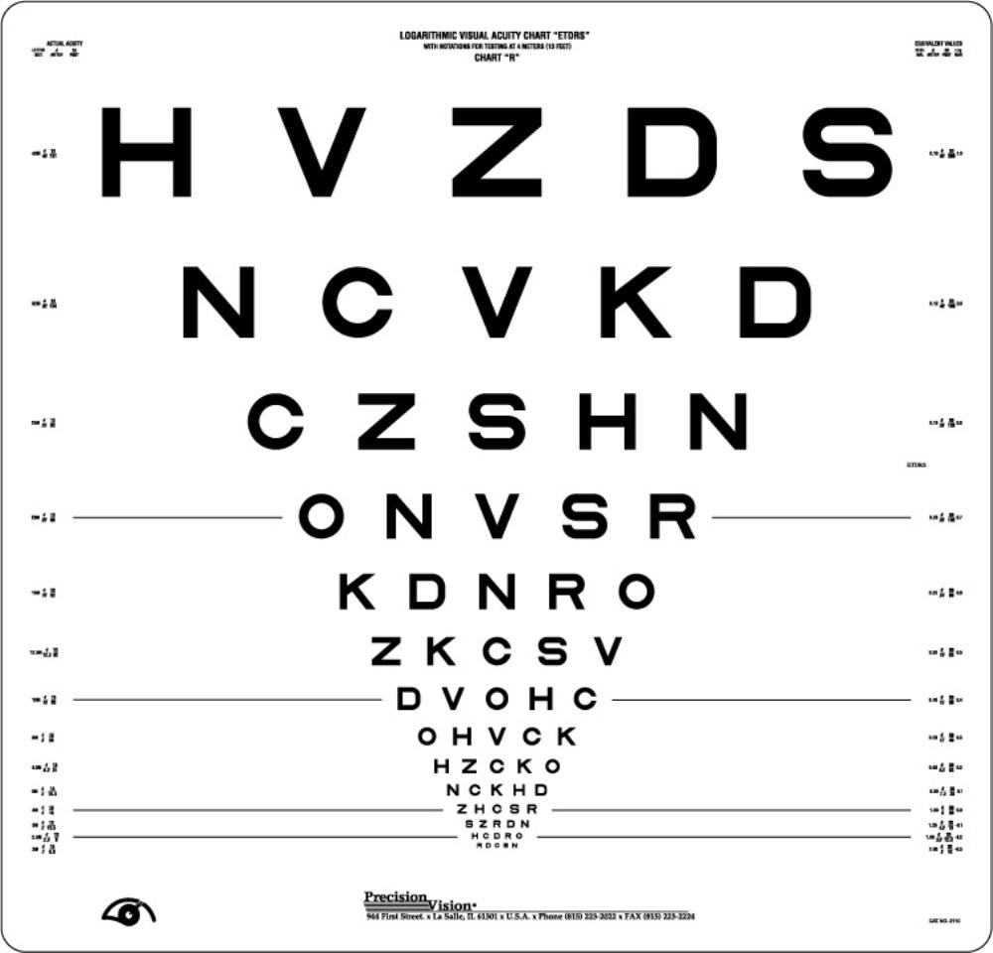
Accepted Efficacy Endpoints
Visual Acuity: a 3-line (15-letter) change
  clinically meaningful benefit in comparison between treatment arms
Visual Field
Color Vision
Area of Non-Seeing
Retina

Slide 10
Efficacy Endpoints
Challenges in clinical trials for cellular and gene therapy products:
  Rare diseases with smaller sample size
    Difficult to power studies to capture efficacy
  Measuring endpoints in pediatric population
    Current endpoints may not be feasible
  Assessing benefit in patients with low vision
    May be beyond limits of current testing methods (i.e., floor effect or ceiling effect)

Slide 11
Developing Efficacy Endpoints
Measures of Visual Function
  limited utility in some populations
Anatomic Measures
  clinical meaningfulness may not be well established
Measures of Functional Vision
  ability to reflect real-world function is uncertain
Patient-Reported Outcome Instruments
  may not be well characterized for use in all retinal disorders

Slide 12
Example: Maguire, High, et al.
Measured improvement in retinal function:
  Dark adaptometry
  Pupillometry
  Electroretinography
  Nystagmus/eye movement measurements
  Ambulatory behavior
Lancet, 2009; 374(9701): 1597-605.

Slide 13
Discussion: Efficacy Endpoints
Ability of existing and novel outcome measures to assess product efficacy in both adult and pediatric populations and their roles in clinical trials
Methods to assess the clinical meaningfulness of these measures

Slide 14
Safety Concerns with
Contralateral Eye or Repeat Administration

Slide 15
Surgical Considerations
Attempt to maximize vision in both eyes to improve binocular function
Time interval to surgery on the second eye
  Avoids simultaneous impairment
    During normal post-operative course
    In event of complications
    (e.g. infection, sympathetic ophthalmia)
  Facilitates surgical plan for second operation

Slide 16
Preclinical Assessment of
Immune Response
Immune response varies with:
  Animal species
  Specific product
  Site of injection (intravitreal vs. subretinal)
  Injection technique and instrumentation
  Host immune response to the product prior to or after first eye administration
  Timing of readministration
  Disease state of the eye (i.e., local environment of cell administration)
  Use of immunosuppressive agents

Slide 17
Mitigating Immune Risks
General safety/adverse reaction surveillance
Specific monitoring for immune response
Limited or staggered patient enrollment
Single, low-dose administration
Adjusted administration intervals
Immunosuppressive therapy

Slide 18
Discussion: Safety Concerns with Repeat Administration
Factors that may influence the recommended timing of administration, particularly considering any safety concerns
Clinical or laboratory tests to guide the timing of the second eye or repeat administration
Merits and limitations of preclinical studies to model relevant immunological responses

Slide 19
Ophthalmic Administration Procedures

Slide 20
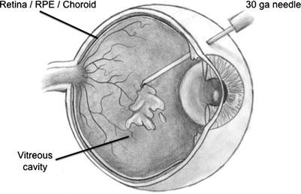
Intravitreal Administration
Routine clinical procedure
Low complication rate
Rapid elimination of drugs
Limited transduction of viral vectors into target tissue
    Stout et al., Hum Gene Ther, 2011; 22(5):531.

Slide 21
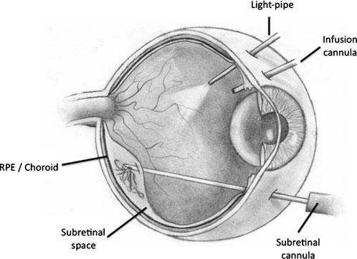
Subretinal Administration
Efficient transduction of photoreceptors and RPE
Technically more challenging
Higher complication rates
    Stout et al., Hum Gene Ther, 2011; 22(5):531.

Slide 22
Preclinical Data
Spectrum of animal species / models for assessing product administration
  Different delivery devices and techniques
  Range of eye sizes
  Comparative ocular anatomy
  (e.g., fovea exists only in some non-human primates)
  Ethical considerations

Slide 23
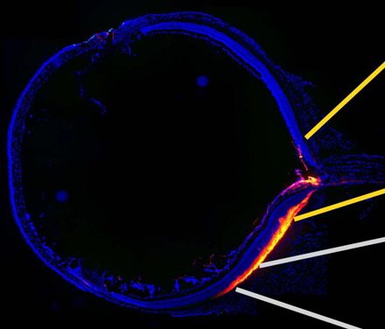
Preclinical Data (cont.)
Determining successful delivery to target
  Quantitative real-time polymerase chain
    reaction (qPCR)
  Immunohisto-
    chemistry (IHC)
  Exam and imaging
  Genetically expressed
    markers
Johnson et al., Molecular Vision, 2008; 14: 2211–2226.

Slide 24
Discussion: Ophthalmic Administration Procedure
Methods to optimize the product delivery procedure and assess the accuracy of product delivery
Utility of available animal species to assist in addressing concerns

Slide 25
Invited Speakers
Albert Maguire, M.D.
  University of Pennsylvania
Tim Stout, M.D., Ph.D., M.B.A.
  Oregon Health and Science University
Peter Campochiaro, M.D.
  Johns Hopkins University
Pete Coffey, BSc., DPhil.
  University College London

Slide 26
Planning Committee
Changting Haudenschild (co-chair)
Patrick Au (co-chair)
Celia Witten
Wilson Bryan
Mercedes Serabian
Kimberly Benton
Bruce Schneider
Agnes Lim
Lilia Bi
Alex Bailey
Wei Liang
Renee Rees
Terrolyn Thomas
Fa-ry Grant
Gail Dapolito
Robert Kramm
Wiley Chambers

