Slide 1
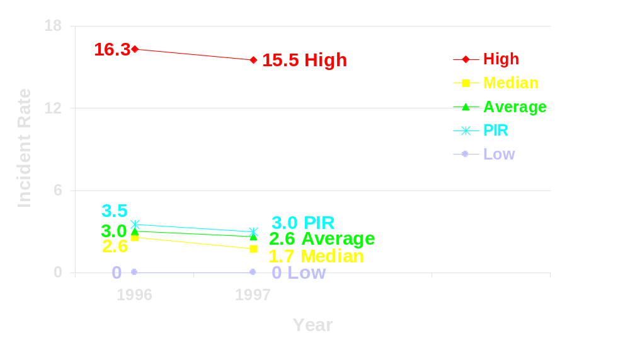
OCS Performance Measures
Production Operations Employees’
Recordable Incident Rate*
53 Participants
72% BOE Production
65% Wells Spudded 65% Platforms
*[(Annual number of production operations employees’ OSHA recordable injuries/illnesses)/
(Annual total number of production operations employee hours worked)] x 200,000

Slide 2
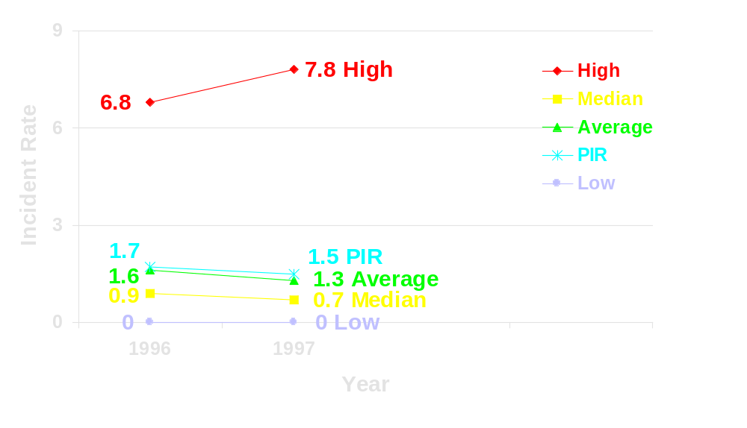
OCS Performance Measures
Production Operations Employees’
Lost Workday Incident Rate*
53 Participants
72% BOE Production
65% Wells Spudded 65% Platforms
*[(Annual # of production operations employees’ OSHA recordable injuries/illnesses for which there were lost workdays)/
(Annual total number of production operations employee hours worked)] x 200,000

Slide 3
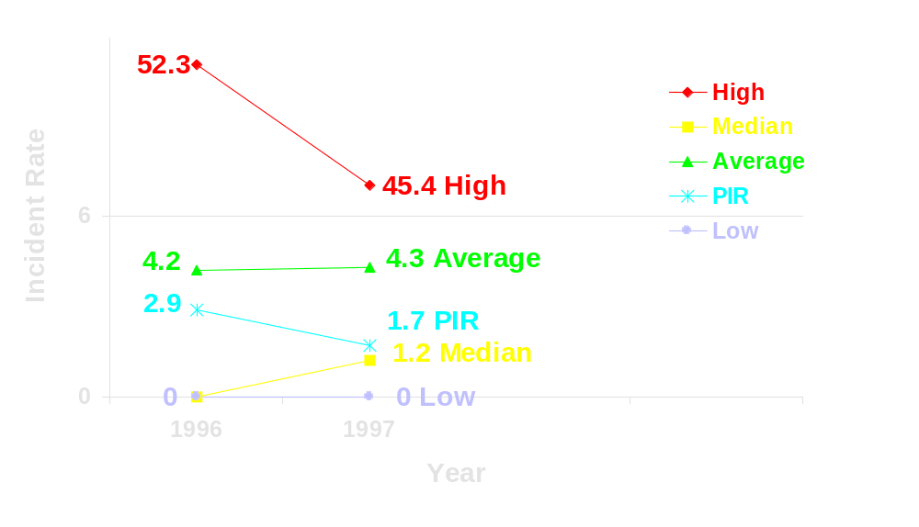
OCS Performance Measures
Construction Operations Employees’
Recordable Incident Rate*
54
37 Participants
60% BOE Production
57% Wells Spudded 50% Platforms
*[(Annual number of construction operations employees’ OSHA recordable injuries/illnesses)/
(Annual total number of construction operations employee hours worked)] x 200,000

Slide 4
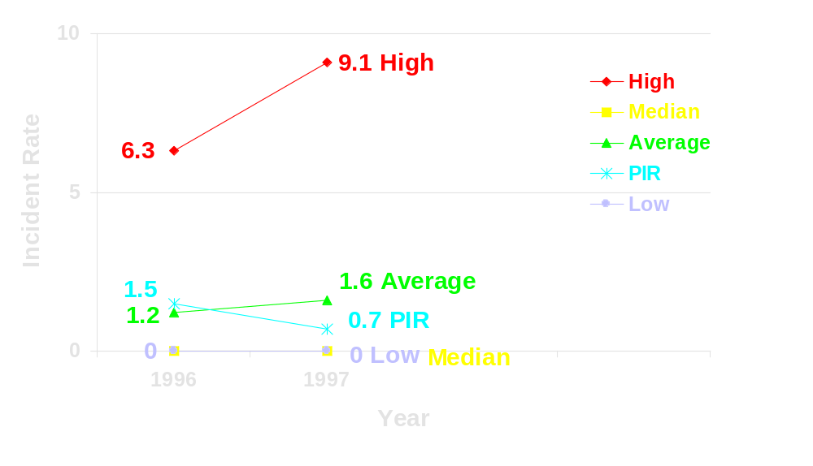
OCS Performance Measures
Construction Operations Employees’
Lost Workday Incident Rate*
37 Participants
60% BOE Production
57% Wells Spudded 50% Platforms
*[(Annual # of construction operations employees’ OSHA recordable injuries/illnesses for which there were lost workdays)/
(Annual total number of construction operations employee hours worked)] x 200,000

Slide 5
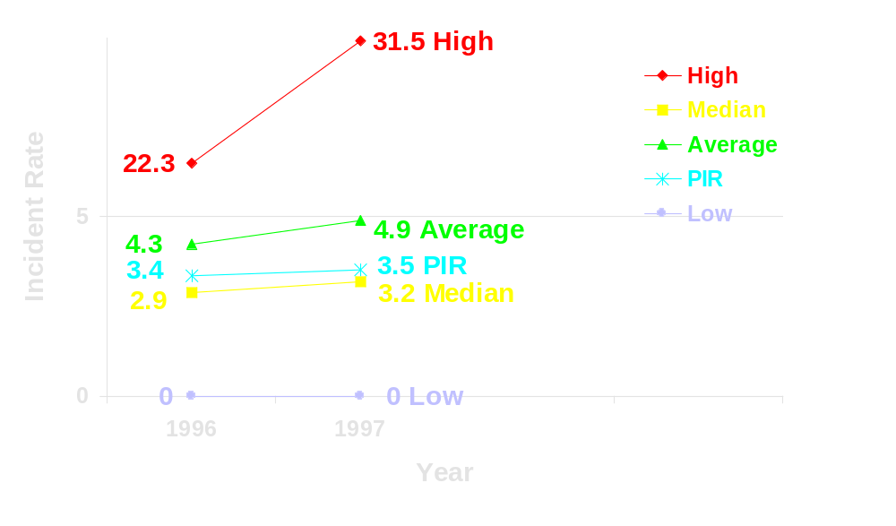
OCS Performance Measures
Drilling, Workover, & Allied Services Employees’
Recordable Incident Rate*
30
43 Participants
71% BOE Production
66% Wells Spudded 61% Platforms
*[(Annual number of drilling, workover & allied services employees’ OSHA recordable injuries/illnesses)/
(Annual total number of drilling, workover & allied services employee hours worked)] x 200,000

Slide 6
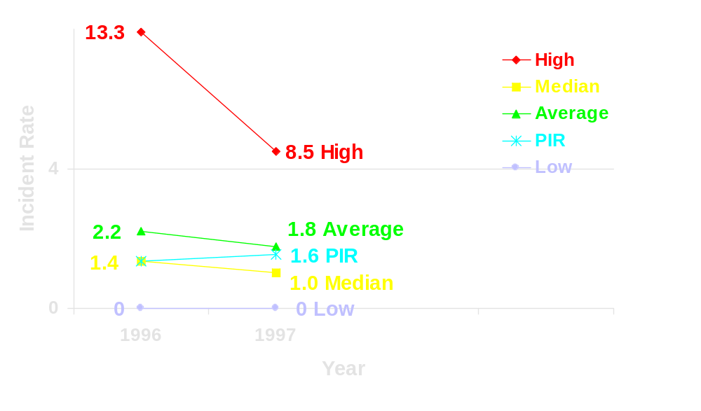
OCS Performance Measures
Drilling, Workover, & Allied Services Employees’
Lost Workday Incident Rate*
12
43 Participants
71% BOE Production
66% Wells Spudded 61% Platforms
*[(Annual number of drilling, workover & allied services employees’ OSHA lost workday cases)/
(Annual total number of drilling, workover & allied services employee hours worked)] x 200,000

Slide 7
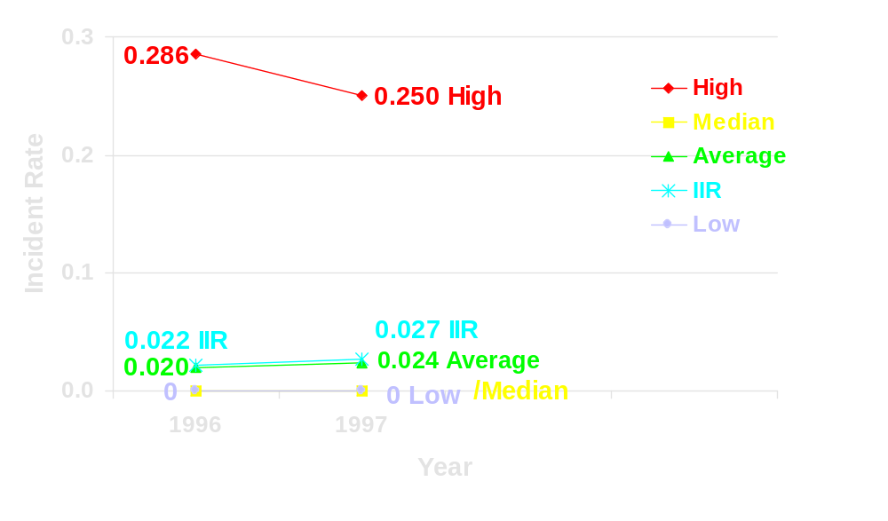
OCS Performance Measures
Fire/Explosion Incident Rate*
Data Provided by MMS
100% Participants
100% BOE Production
100% Wells Spudded 100% Platforms
*(Annual No. of Fires and Explosions)/
(No. of Major Platforms + 0.5(No. of Minor Platforms) + No. of Wells Spudded for Drilling During the Year)

Slide 8
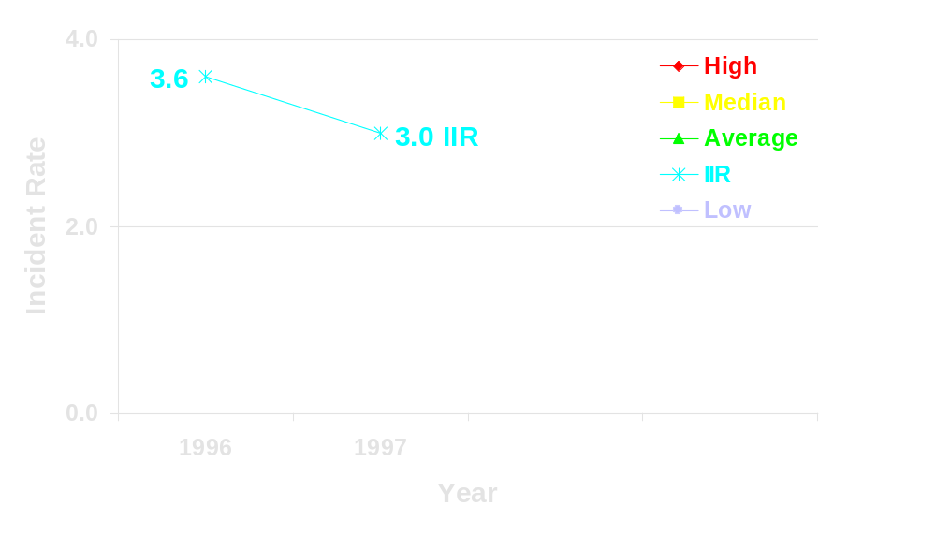
OCS Performance Measures
Industry Blow-out Incident Rate*
Per 1000 Wells Spudded
Data Provided by MMS
100% Participants
100% BOE Production
100% Wells Spudded 100% Platforms
*[(Annual No. of Total Industry Blow-outs)/
(Total Wells Spudded for Drilling During the Year)] x 1000

Slide 9
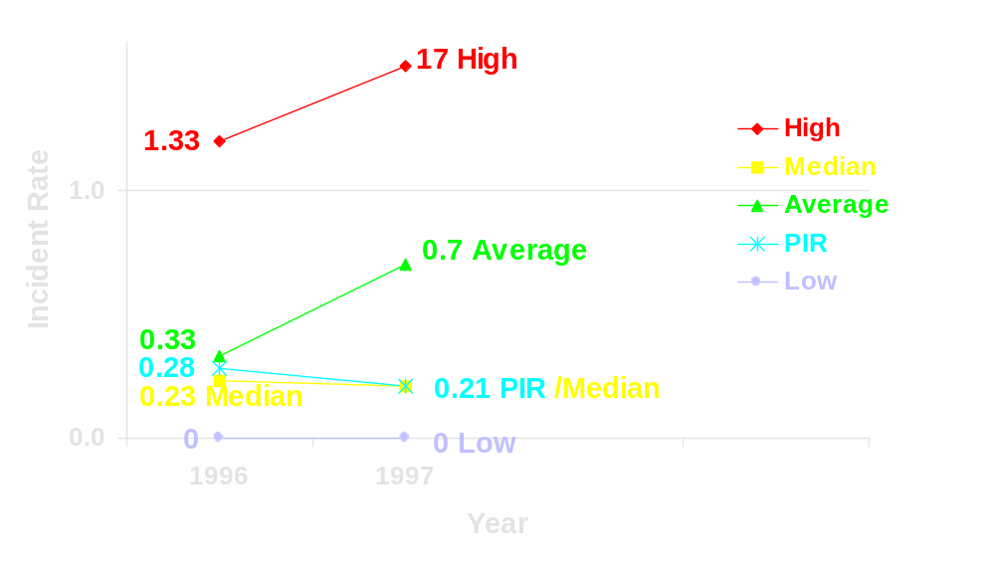
OCS Performance Measures
EPA NPDES Discharge Exceedence Rate*
17
59 Participants
80% BOE Production
73% Wells Spudded 75% Platforms
*Number of reported exceedences on EPA NPDES Discharge Monitoring Reports on OCS for the reporting year/
(Number of Major Platforms + Number of Wells Spudded for drilling during the year)

Slide 10
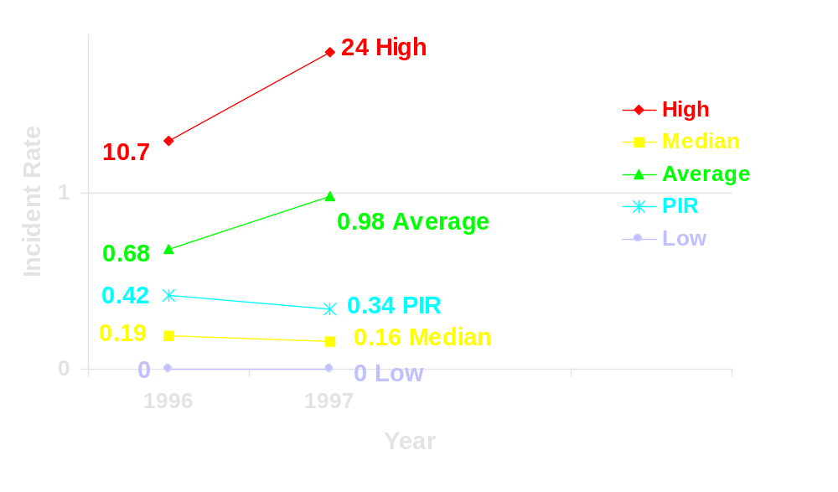
OCS Performance Measures
Oil Spill Number Incident Rate*
For Spills < 1bbl
24
56 Participants
70% BOE Production
73% Wells Spudded 78% Platforms
*Annual number of spills < 1bbl on the OCS/
(Number of Major Platforms + Number of Wells Spudded for drilling during the year)

Slide 11
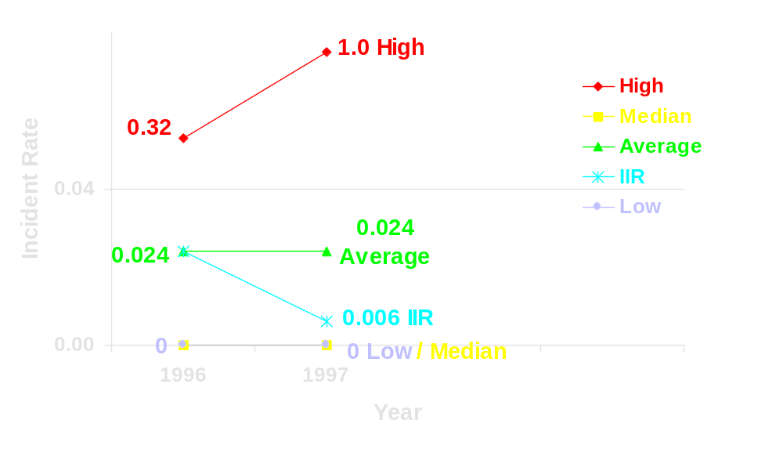
OCS Performance Measures
Oil Spill Number Incident Rate*
For Spills 1 to <10 bbl
1.0
Data Provided by MMS
100% Participants
100% BOE Production
100% Wells Spudded 100% Platforms
*Annual number of spills 1 to <10 bbl on the OCS/
(Number of Major Platforms +(0.5 x No. of Minor Platforms) + No. of Wells Spudded for drilling during the year)

Slide 12
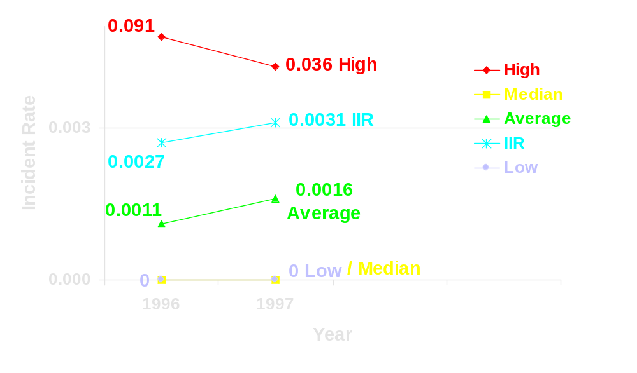
OCS Performance Measures
Oil Spill Number Incident Rate*
For Spills >10 bbl
0.090
Data Provided by MMS
100% Participants
100% BOE Production
100% Wells Spudded 100% Platforms
*Annual number of spills >10 bbl on the OCS/
(Number of Major Platforms +(0.5 x No. of Minor Platforms) + No. of Wells Spudded for drilling during the year)

Slide 13
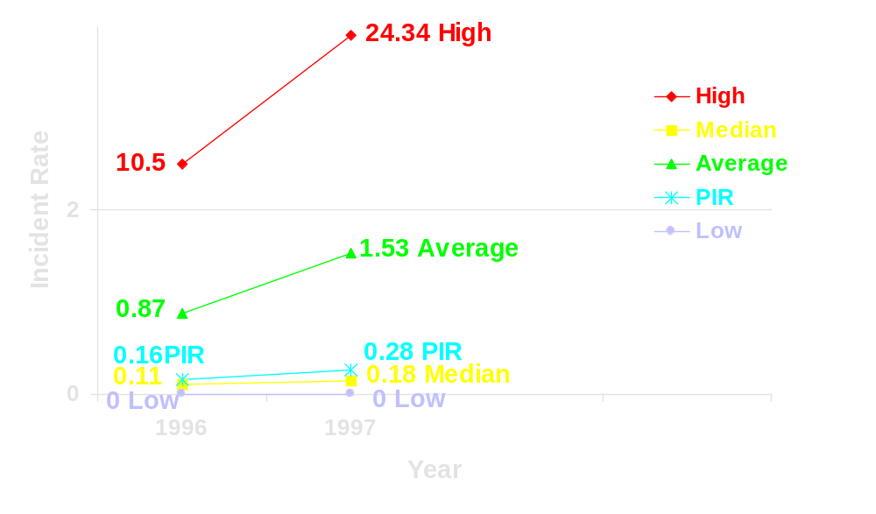
OCS Performance Measures
Oil Spill Volume Incident Rate*
For Spills <1 bbl
24
56 Participants
70% BOE Production
73% Wells Spudded 78% Platforms
*Annual total volume of all spills <1 bbl on the OCS/
Gross operated crude oil condensate production on the OCS in millions of barrels

Slide 14
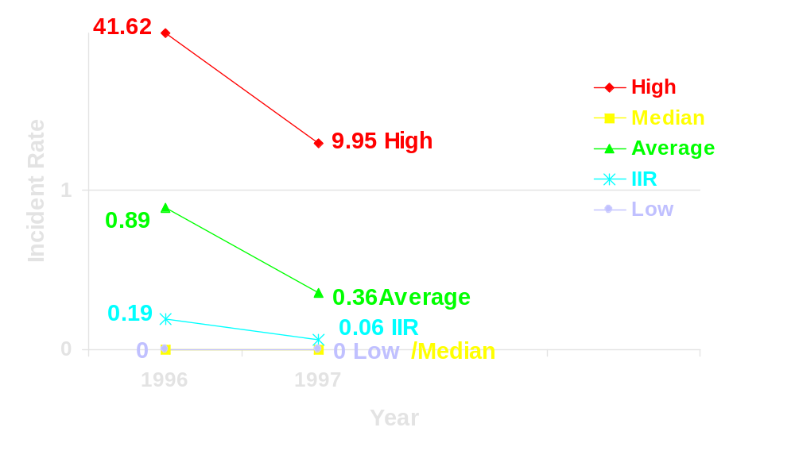
OCS Performance Measures
Oil Spill Volume Incident Rate*
For Spills 1 bbl to <10 bbl
40
Data Provided by MMS
100% Participants
100% BOE Production
100% Wells Spudded 100% Platforms
*Annual total volume of all spills 1 bbl to <10 bbl on the OCS/
Gross operated crude oil condensate production on the OCS in millions of barrels

Slide 15
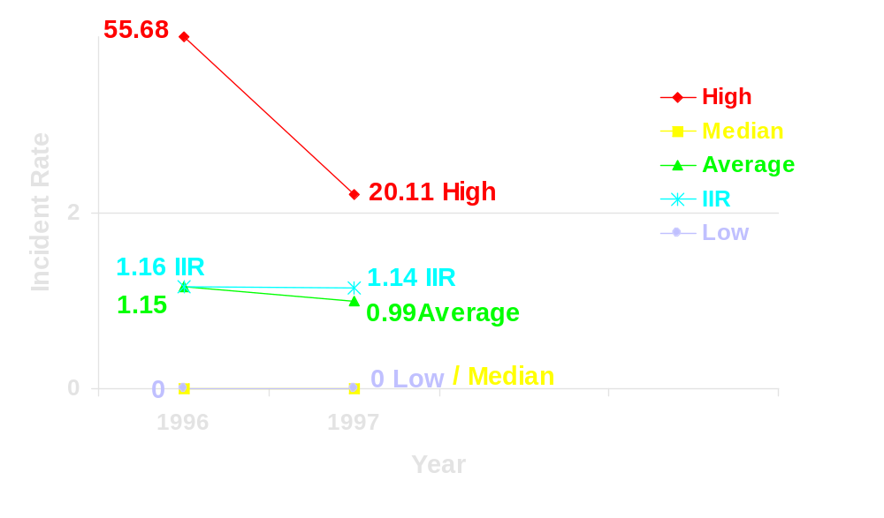
OCS Performance Measures
Oil Spill Volume Incident Rate*
For Spills >10 bbl
55
Data Provided by MMS
100% Participants
100% BOE Production
100% Wells Spudded 100% Platforms
*Annual total volume of all spills >10 bbl on the OCS/
Gross operated crude oil condensate production on the OCS in millions of barrels

Slide 16
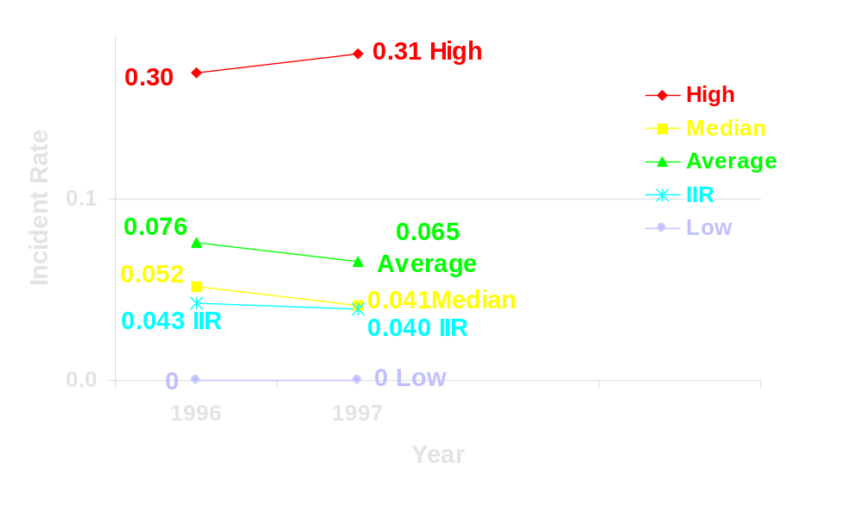
OCS Performance Measures
Production INC Incident Rate*
0.3
Data Provided by MMS
100% Participants
100% BOE Production
100% Wells Spudded 100% Platforms
*Annual number of MMS Production INCs/
Annual number of Components Inspected by MMS

Slide 17
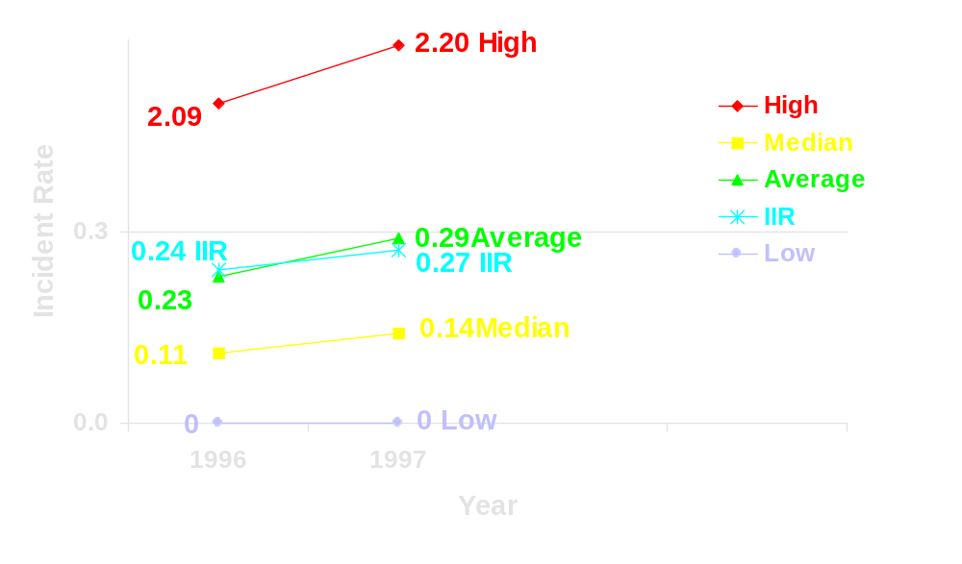
OCS Performance Measures
Drilling/Workover INC Incident Rate*
2.2
Data Provided by MMS
100% Participants
100% BOE Production
100% Wells Spudded 100% Platforms
*Annual number of MMS Drilling, Workover, Completion, and Well Plugging & Abandonment INCs/
Annual number of MMS Rig Inspections

