Slide 1
Implementing Policy Evaluation Measures Using the BRFSS:
The Example of Food Stamps, Food Insecurity and Federal Guideline Criteria
_{Presented by:}
_{Patrick R. Mitchell, Dr.PH}

Slide 2
Acknowledgements
CDPH CPNS - Sharon Sugerman
Ca Survey Research Group
Marta Induni, Joan Epstein
USDA
Telephone number for Food Stamps in California is 1-888-328-3483

Slide 3
CPNS, the Network
Promote food stamps, fruit and vegetable consumption, physical activity and the prevention of diet related chronic diseases.
Restricted to target population of low income Californians (<= 130% FPL)
BRFSS provides statewide estimates that are nationally comparable

Slide 4
Desires
Measure statewide prevalence of fruit and vegetable consumption, physical activity, Food Insecurity and Food Stamp use in the 130% and 185% Federal poverty Level (FPL) adult population

Slide 5
Challenges
Questions not asked
Questions periodically and systematically missing
Small sample size for “rare” events
No 130% and 185% FPL Indicator

Slide 6
Federal Poverty Level Estimates
Existing BRFSS variable only for 100%, 200% and 300% based on Federal Guideline Criteria
Based on household income and household size
Needed imputation to the 130% and 185% FPL criteria using the Federal Register’s Federal Guidelines

Slide 7
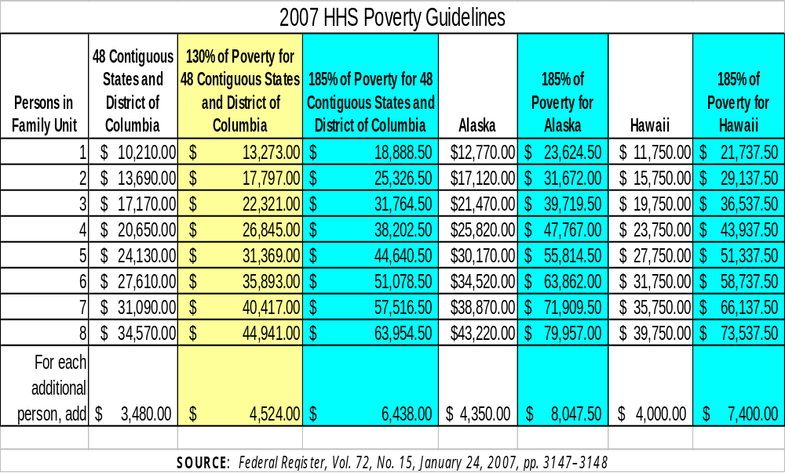
HHS Federal Guidelines

Slide 8
BRFSS Income Categories
Which of the following categories best describes your annual household income from all sources? Less than $10,000; $10,000 to less than $15,000; $15,000 to less than $20,000; $20,000 to less than $25,000; $25,000 to less than $35,000; $35,000 to less than $50,000; $50,000 to less than $75,000; $75,000 to $100,000 or over $100,000?
1. Less than $10,000
2. $10,000 to less than $15,000
3. $15,000 to less than $20,000
4. $20,000 to less than $25,000
5. $25,000 to less than $35,000
6. $35,000 to less than $50,000
7. $50,000 to less than $75,000
8. $75,000 to $100,000
9. more than $100,000
77. Don’t know/Not sure
99. Refused

Slide 9
Food Insecurity Questions
The food that I bought just didn’t last, and I didn’t have money to get more. Was that OFTEN, SOMETIMES, or NEVER true for you in the last 12 months?
I couldn’t afford to eat balanced meals. Was that OFTEN, SOMETIMES, or NEVER true for you in the last 12 months?
In the last 12 months, did you ever cut the size of your meals or skip meals because there wasn’t enough money for food?
How often did this happen--almost every month, some months but not every month, or in only one or two months?
In the last 12 months, did you ever eat less than you felt you should because there wasn’t enough money to buy food?
In the last 12 months, were you ever hungry but didn’t eat because you couldn’t afford enough food?

Slide 10
Food Security Scale
3 levels
0-1 = Food Secure
2-4 = Low Food Security
5-6 = Very Low Food Security
http://www.fns.usda.gov/fsec/FILES/FSGuide.pdf
(general discussion)
http://www.ers.usda.gov/Briefing/FoodSecurity/surveytools/short2006.doc
(Six Item Scale discussion, revised January 2008)

Slide 11
Food Stamp Use Question
In the last twelve months, have you or other adults in your household received Food Stamps or Food Stamp benefits through the EBT card?

Slide 12
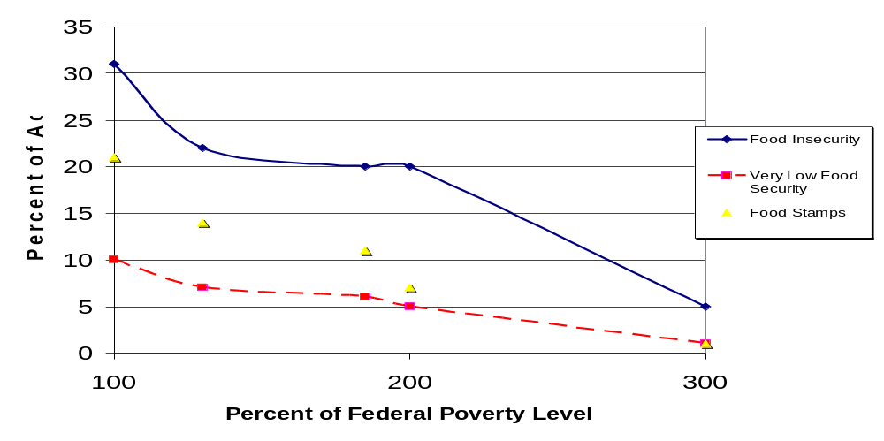
Estimated Prevalence of Food Stamp Use and Food Insecurity by Federal Poverty Levels

Slide 13
Staying ahead
Buying questions for inclusion and continuity
Aggregating multiple years of data
Constructing indicators from existing variables
Institutionalizing 130% and 185% Federal Poverty Level Indicators
Making available questions on food security
Promoting the national use of 130% and 185% Federal Poverty Level indicators to specifically target USDA funded low-income populations.

