Slide 1

State of California
Public Information Officers’ Meeting
September 1, 1999
The information provided in this document is a Year 2000 Readiness Disclosure pursuant to the Year 2000 Information and Readiness Disclosure Act (Public Law 105-271).

Slide 2
Agenda
State Y2K status
Communication and outreach activities
Office of Emergency Services - emergency public information
Key dates and next steps for PIOs
Outreach efforts of the Department of Water Resources
Questions

Slide 3
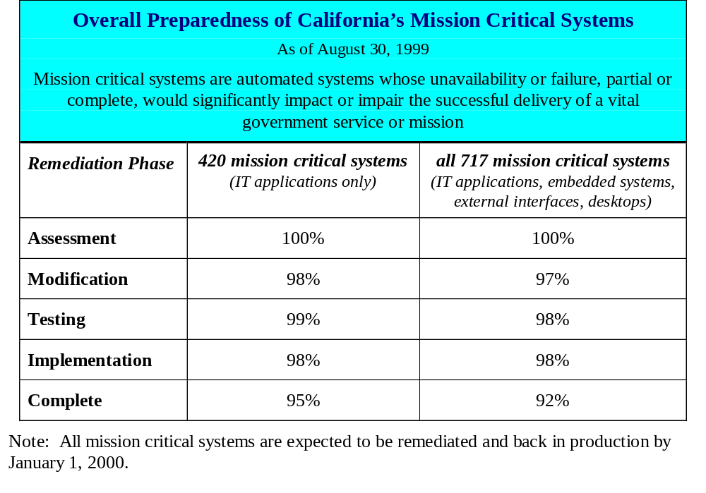
Overall Status of Mission Critical Systems

Slide 4
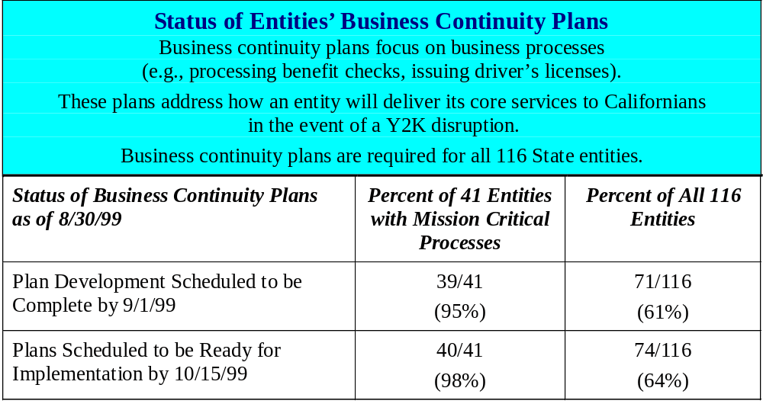
Status of Business Continuity Plans

Slide 5
Communications and Outreach Accomplishments
  Communicated intent and expectations of executive order
  Developed Y2K website
  Coordinated weekly CIO meetings
  Hosted or participated in more than a dozen conferences, presentations, briefings aimed at the public
  Participated in a half dozen informational hearings
  Co-sponsored 12 industry roundtables
  Participated in legislative briefings
  Developed Y2K key messages
  Developed communications and outreach plan
  Met with editorial boards upon request
  Developed working relationship with media interested in Y2K
  Gathered information about state entity communication and outreach activities
  Coordinated monthly PIO meetings

Slide 6
Upcoming Communications and Outreach Activities
Develop materials (e.g., FAQs, fact sheets, articles, brochures, toolkits, inserts for mailers, etc.) to support the communication and outreach efforts of:
  State entities
  Local governments
  Legislative district offices
Establish regional resource teams
Sponsor/participate in ongoing conferences and briefings
Initiate outreach activities to targeted populations
Continue ongoing reporting activities
Enhance web site to facilitate outreach efforts

Slide 7
Key Dates to Remember
1999
2000
1999
2000
Aug Sept Oct Nov Dec Jan Feb March
Aug Sept Oct Nov Dec Jan Feb March
8/18
Ca. State
Auditor
Progress
Report
9/16
Legislative Hearing
10/15
12/1
1/15
Quarterly
Report
Due
2/18
Quarterly
Report Due
DOIT Annual
Ca. State
Auditor
Progress Report
COMMUNICATIONS
Report
COMMUNICATIONS
11/15
12/28
EMC
EMC Control
Follow the Sun
3/31
EMC
Strategy
CONTROL
Center Ready
EMC
CONTROL
CENTER
Center
CENTER
Shut-down
9/9
11/30
12/31
2/29
Computer
Interface
Testing
Complete
Event
Weekend
Leap Year
TESTING
Default Date
Day
TESTING
11/1
Clean
Management
Environment
9/1
10/15
CPB
CPBs
Complete
CPB
Tested &
Ready
CPB
8/1
CAPS complete
9/1
CAP Actions Complete
CAP
CAP
9/30
Remaining MC Complete IV&V
12/1
Documentation
PMO TRANSITION
Due Diligence
PMO TRANSITION
Complete

Slide 8
Next Steps for PIOs
Ensure you are well versed on your entity’s Y2K progress and status
  - Detailed departmental assessments (DDA)
  - Corrective action plans (CAP)
  - Continuity plans for business (CPB)
  - Any potential Y2K impacts on services
Submit your entity’s communications plan to DOIT (if not already submitted)
Coordinate “roundtable” dialogues to discuss service specific issues
Develop Y2K specific materials and continue or initiate activities to reach key stakeholders such as the public, departmental staff, etc.
Incorporate the state’s overall key messages and materials into your entity’s communication efforts
Anticipate increased Y2K contact from stakeholders as we approach key milestones
Identify your staff’s availability for the weeks preceding and following Y2K

