Slide 1
Intercontinental Transport of Aerosols: Implications for Regional Air Quality
Acknowledgments:
IMPROVE data
MODIS data
NASA funding
Mian Chin, Paul Ginoux¹, Thomas Diehl
Atmospheric Chemistry and Dynamics Branch
NASA Goddard Space Flight Center
¹Currently at GFDL

Slide 2
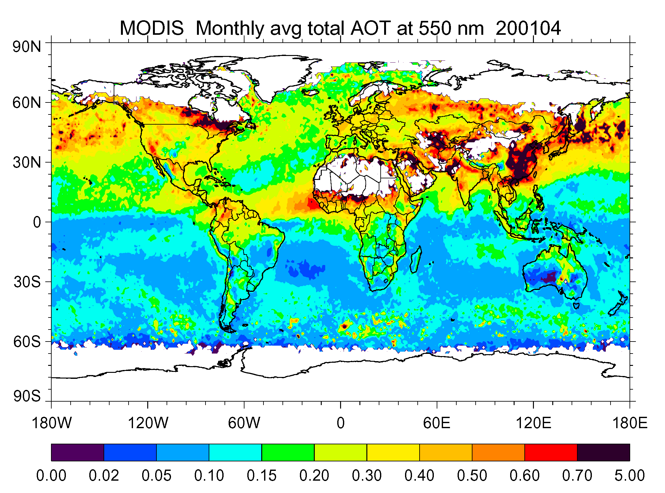
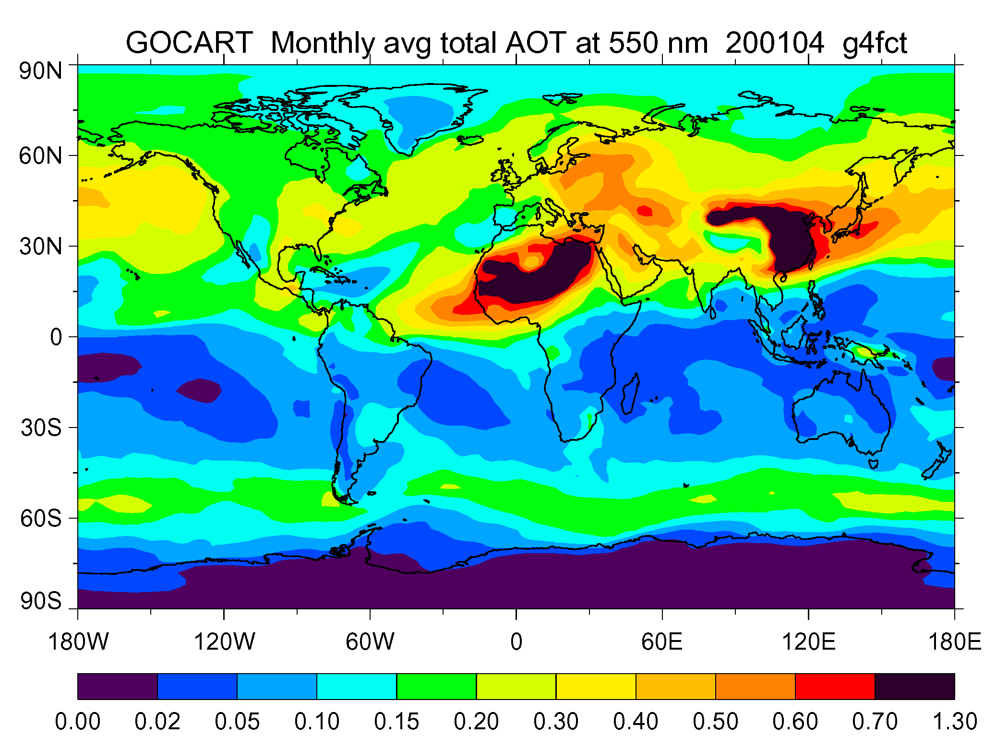
Introduction
Concentration of aerosol particles, also known as particulate matter (PM), is one of the major components that determine ambient air quality
While local and regional emission sources are the main cause of air pollution problems, aerosols can be transported on a hemispheric or global scale
MODIS
GOCART

Slide 3
Introduction (2)
We use the global model GOCART to answer the following questions:
  What is the contribution of regional anthropogenic emission to the PM2.5 concentrations over the U.S.?
  What is the contribution of long-range transport to the surface PM2.5 concentrations over the U.S. ?
  What is the seasonal variation of the “background” PM2.5?
AQI values, categories, and pollutant concentration values for ozone, PM_{2.5}, and PM₁₀ (source: EPA, http://www.epa.gov/airnow/aqibroch/aqi.html)
AQI | Air Quality | Color Scale | Ozone |  | PM_{2.5} | PM₁₀
 |  |  | (8 hr ppb) (1 hr ppb) |  | (µg m⁻³) | (µg m⁻³)
0 – 50 | Good | Green | 0 – 64 | - | 0 – 15 | 0 – 54
51 – 100 | Moderate | Yellow | 65 – 84 | - | 16 – 40 | 55 – 154
101 – 150 | Unhealthy for sensitive groups | Orange | 85 – 104 | 125 – 164 | 41 – 65 | 155 – 254
151 – 200 | Unhealthy | Red | 105 – 124 | 165 – 204 | 66 – 150 | 255 – 354
201 – 300 | Very unhealthy | Purple | 125 – 374 | 205 – 404 | 151 – 250 | 355 – 424

Slide 4
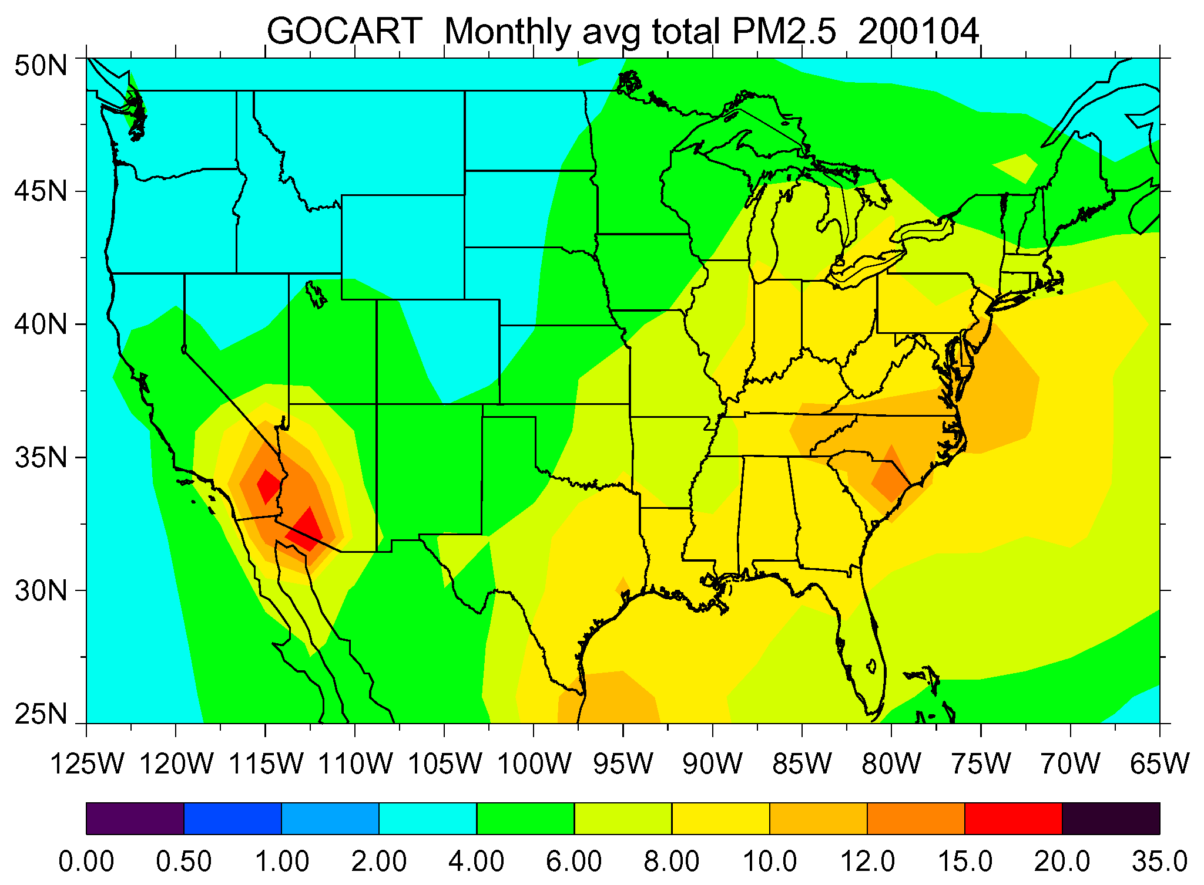
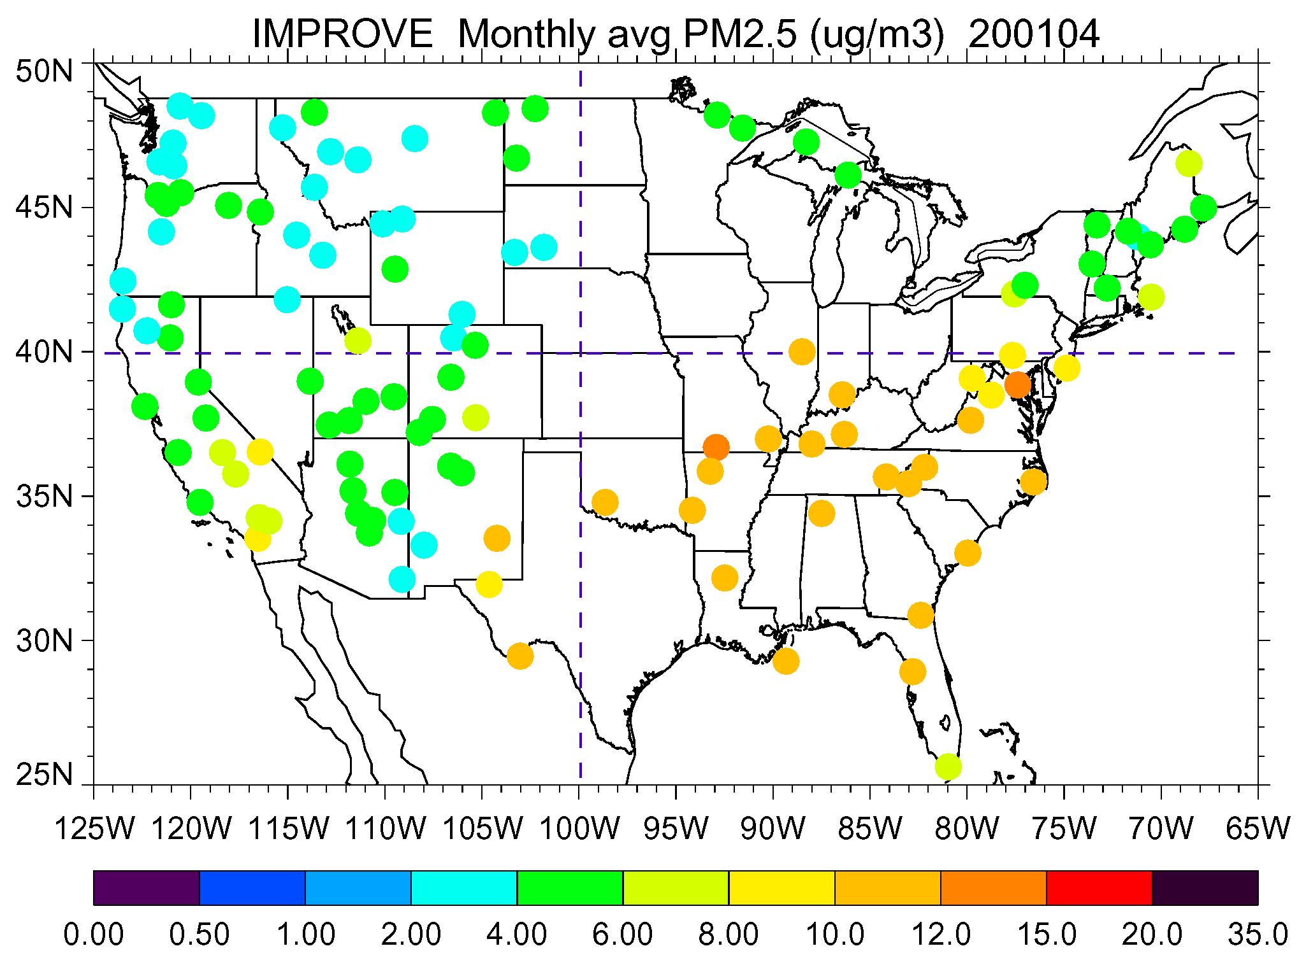
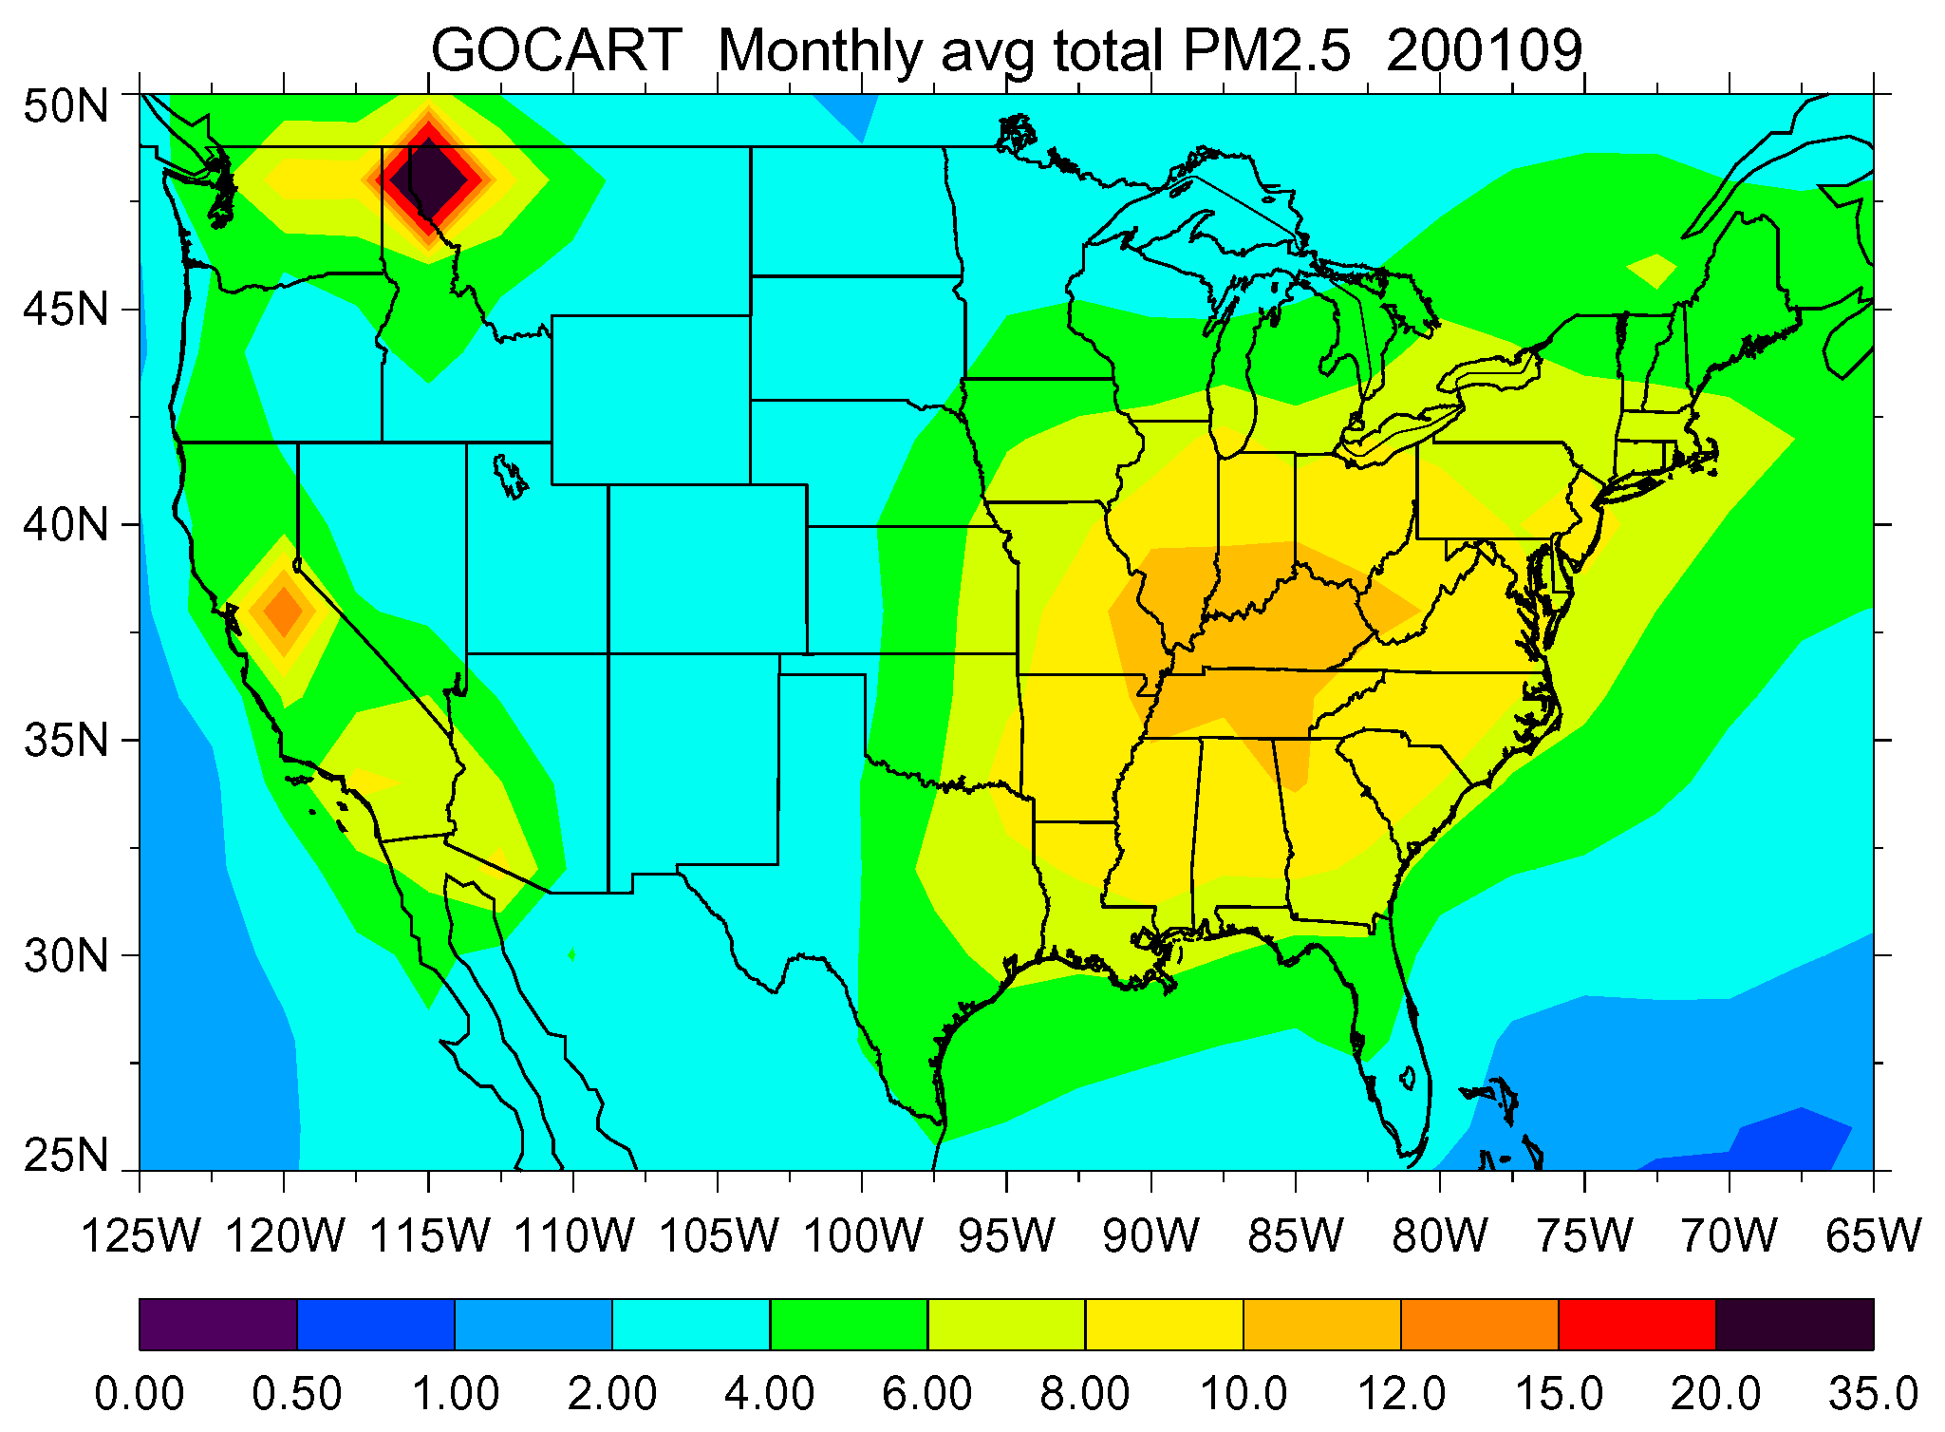
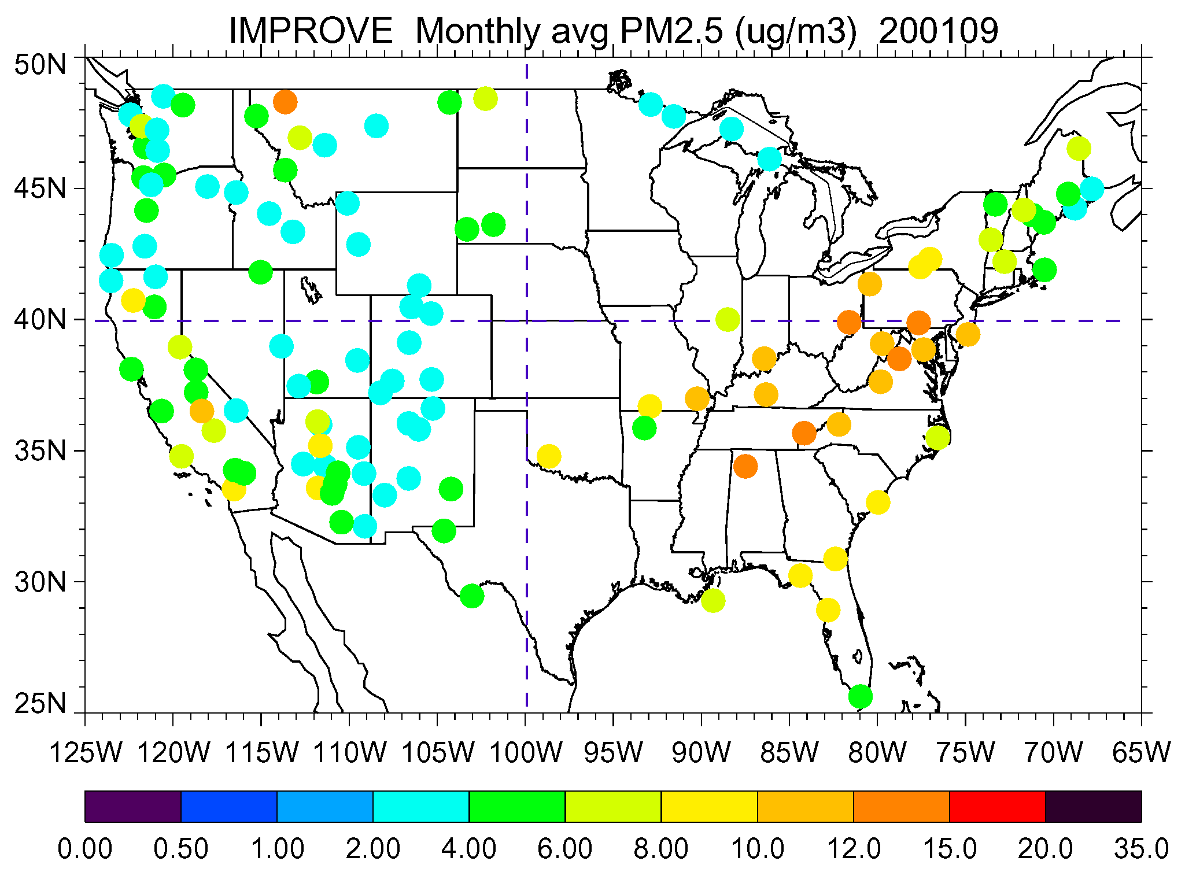
Comparison with the IMPROVE data of surface PM2.5 concentrations
PM2.5 composition assumed in the model:
  Sulfate
  BC
  OC
  Fine mode dust
  Fine mode sea-salt
NW
NE
200104
SW
SE
Model
Surface data
NW
NE
200109
SW
SE
Model
Surface data

Slide 5
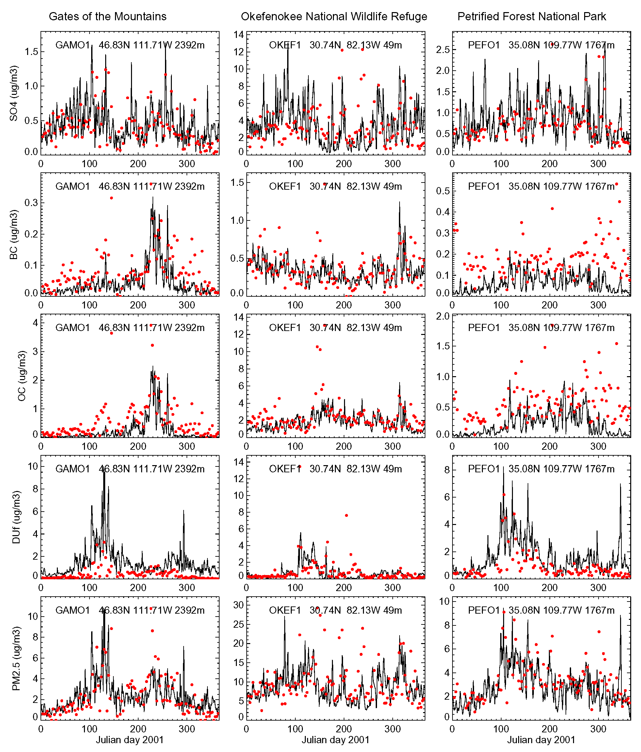
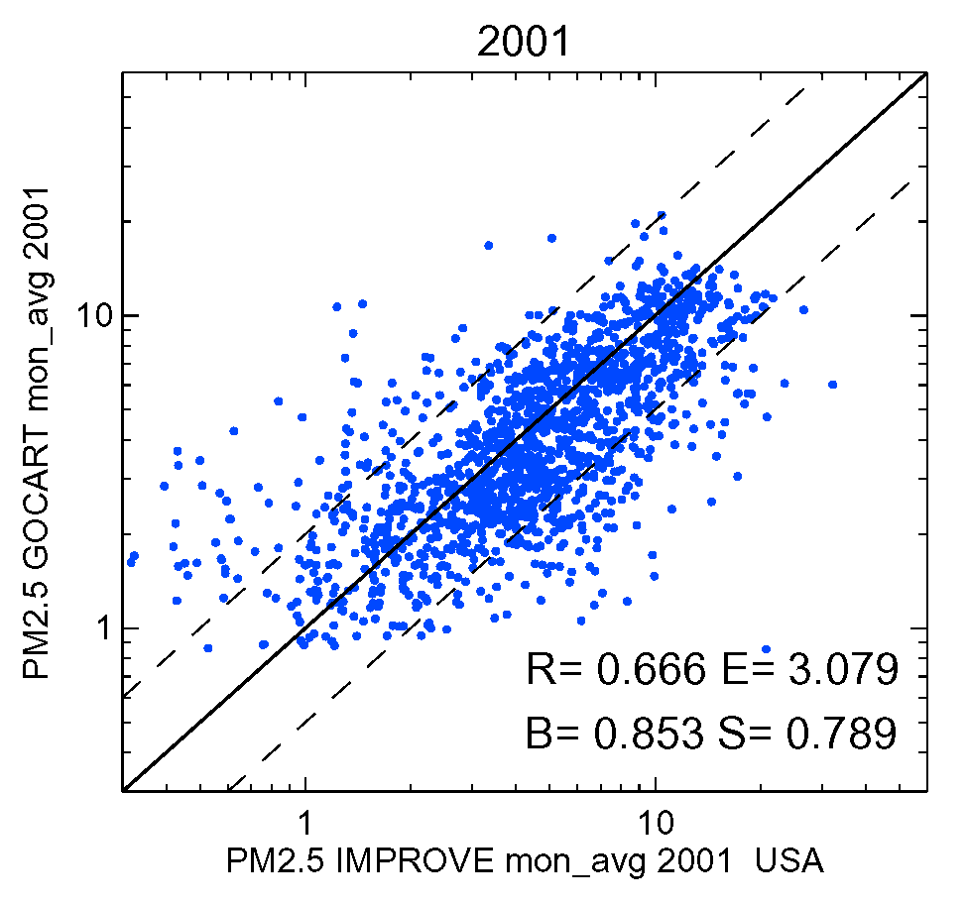
Surface aerosol concentrations at IMPROVE sites
Sulfate
BC
GOCART
OC
Fine Dust
Overall comparison of monthly mean PM2.5 concentrations at all IMPROVE sites for 2001
PM2.5
Comparisons of daily average aerosol concentrations at 3 IMPROVE sites for 2001.
Red circles: IMPROVE data. Black lines: GOCART model

Slide 6
Model Experiments
(for US air quality study)
Exp. | Definition | Model setup
ALL | PM2.5 from all sources, including anthropogenic, biomass burning, and natural emissions | Standard model run
BKG | Background PM2.5 – from sources we cannot control, e.g. dust, volcanoes, trees, long-range transport from other regions | Model run without North America anthropogenic emissions
NAT | PM2.5 from natural sources only | Model run without all anthropogenic emission
NAM ASA EUR | Pollution aerosols from North America (NAM), Asia (ASA), or Europe (EUR) anthropogenic emissions | Differences between standard run and the run without anthropogenic emissions in a selected region
AFR ASA MDE | Dust aerosol from Africa (AFR), Asia (ASA), or Middle East (MDE) | Differences between standard run and the run without emissions in a selected region
SU
BC
OC
DU

Slide 7
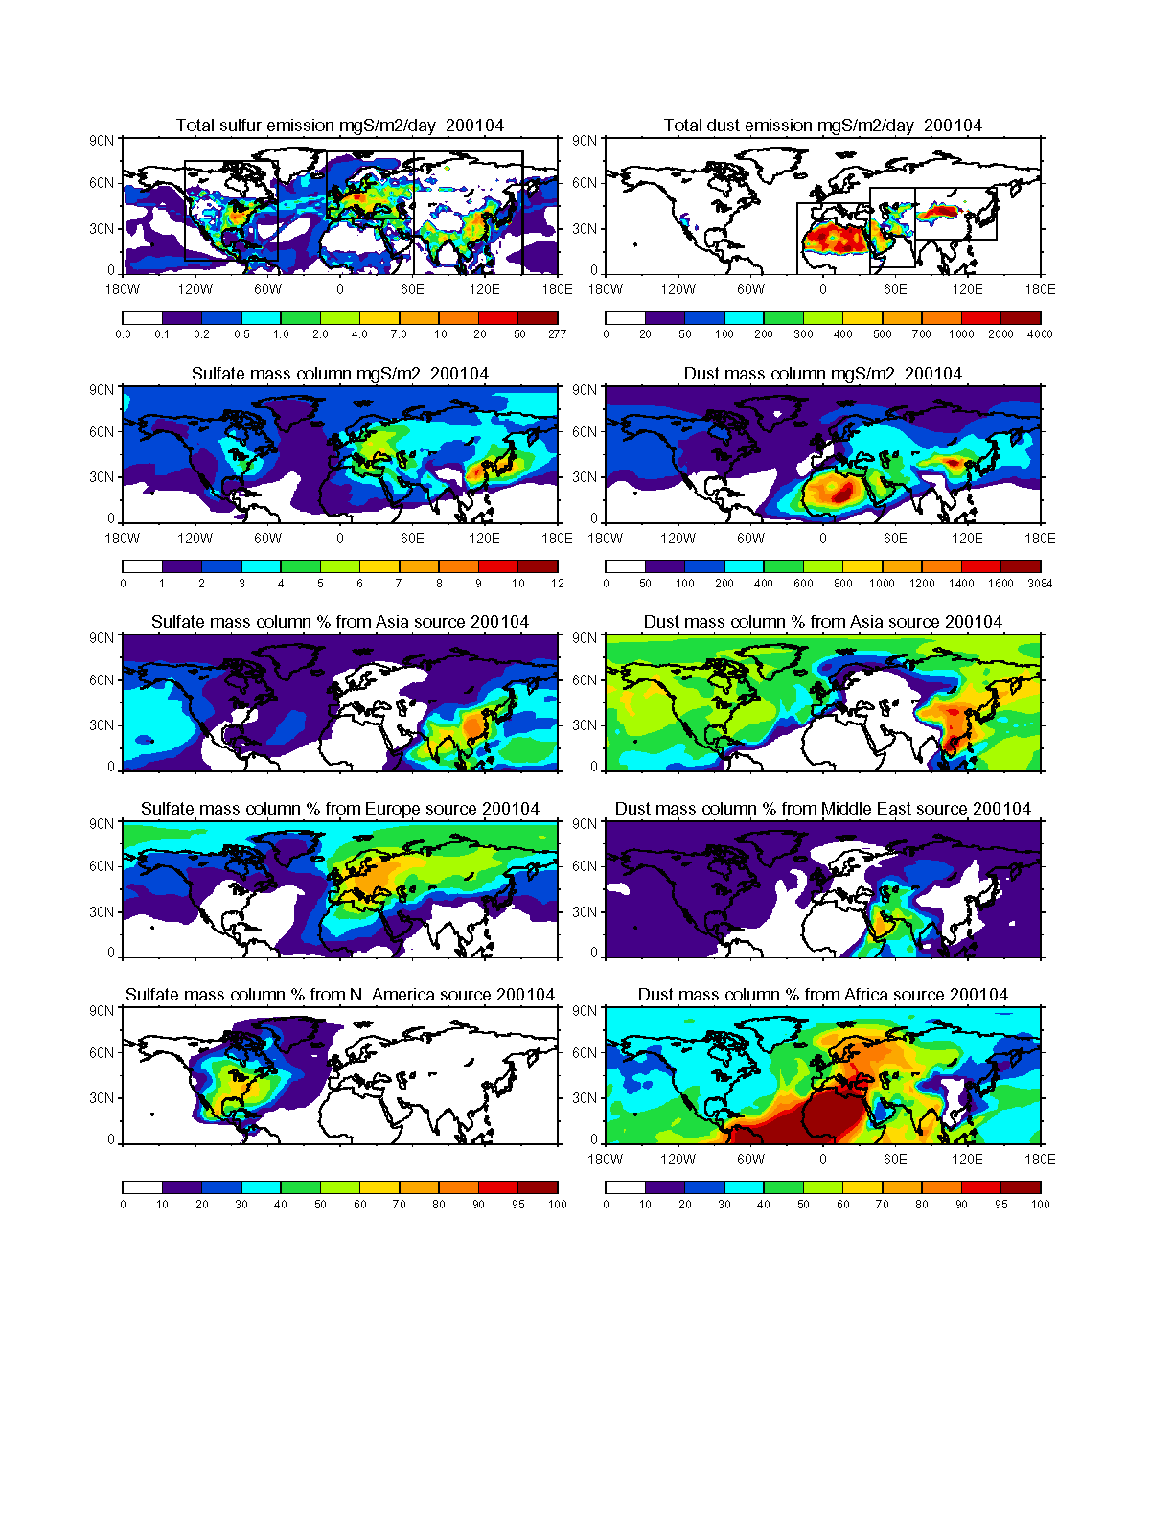
Major Aerosol Source Regions
Sulfur
NAM
EUR
ASA
Dust
AFR
MDE
ASA

Slide 8
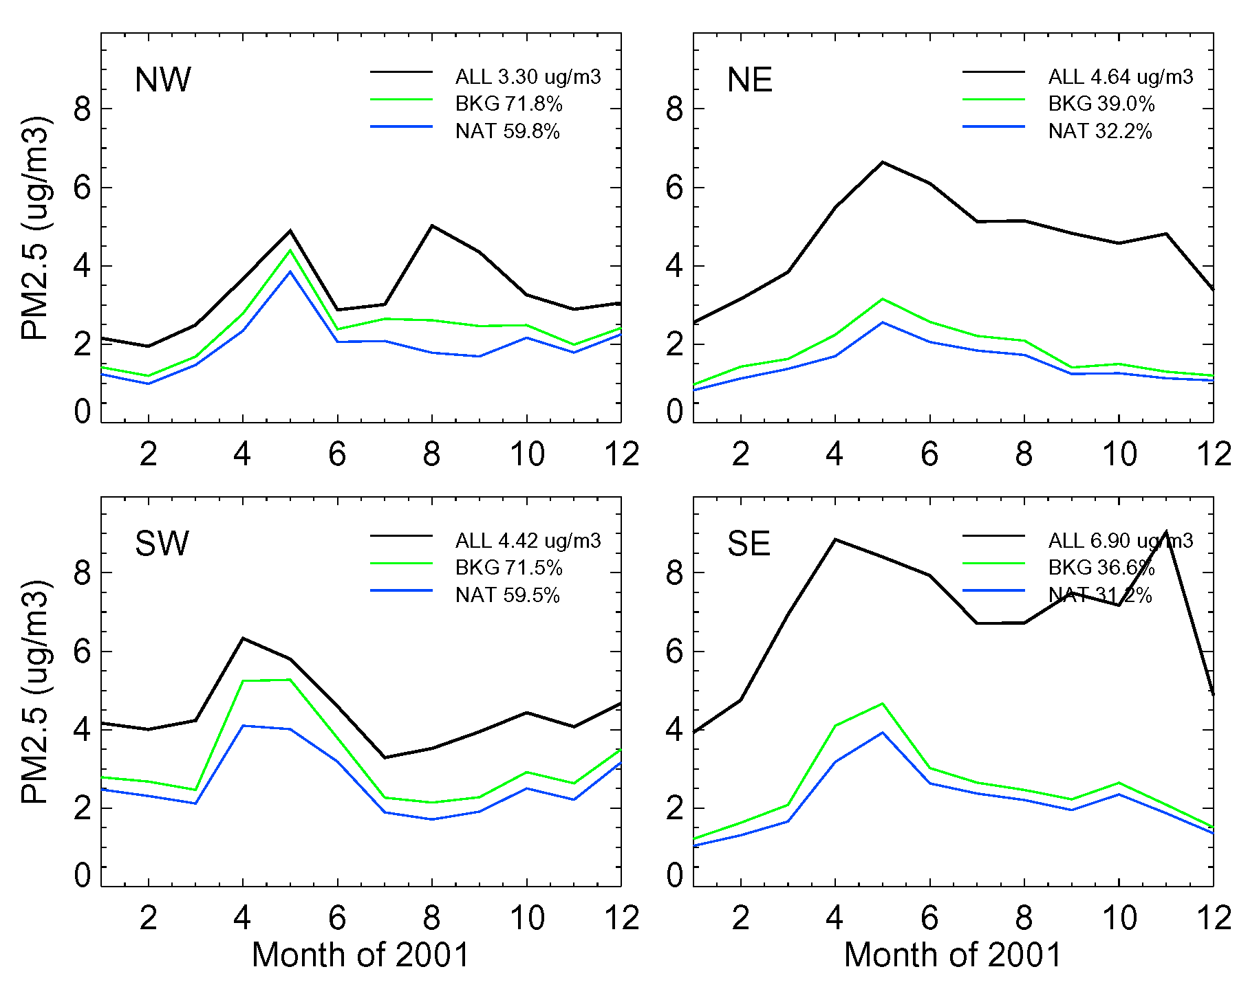
Surface PM2.5 Concentrations
NW
NE
SW
SE
Local anthrop.
Western:
About 70% PM2.5 is “background”
Nearly 60% is “natural” (dust, biogenic aerosols)
Local anthrop.
Eastern:
Less than 40% PM2.5 is “background”
Nearly 1/3 is “natural” (dust, biogenic aerosols)
Int. anthrop.
Int. anthrop.
Total natural.
Total natural.
Int. anthrop.
Local anthrop.
Local anthrop.
Int. anthrop.
Total natural.
Total natural.
Monthly average surface layer PM2.5 concentrations in 2001 from the GOCART model (see earlier pages for experiment definition). Annual average concentrations and contributions from different sources are shown.
ALL – BKG = NAM pollution
BKG – NAT = pollution from other regions

Slide 9
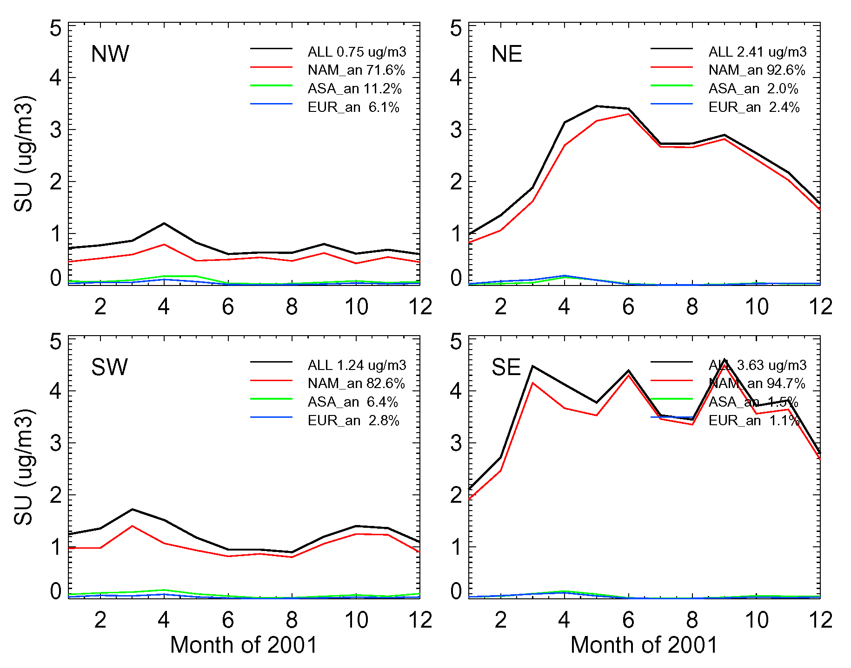
Surface Sulfate Concentrations
NW
NE
SW
SE
Western:
70 – 80% sulfate is from NAM local/ regional pollution
Eastern:
More than 90% sulfate is from NAM local/ regional pollution
Monthly average surface layer sulfate concentrations in 2001 from the GOCART model (see earlier pages for experiment definition). Annual average concentrations and contributions from different sources are shown.

Slide 10
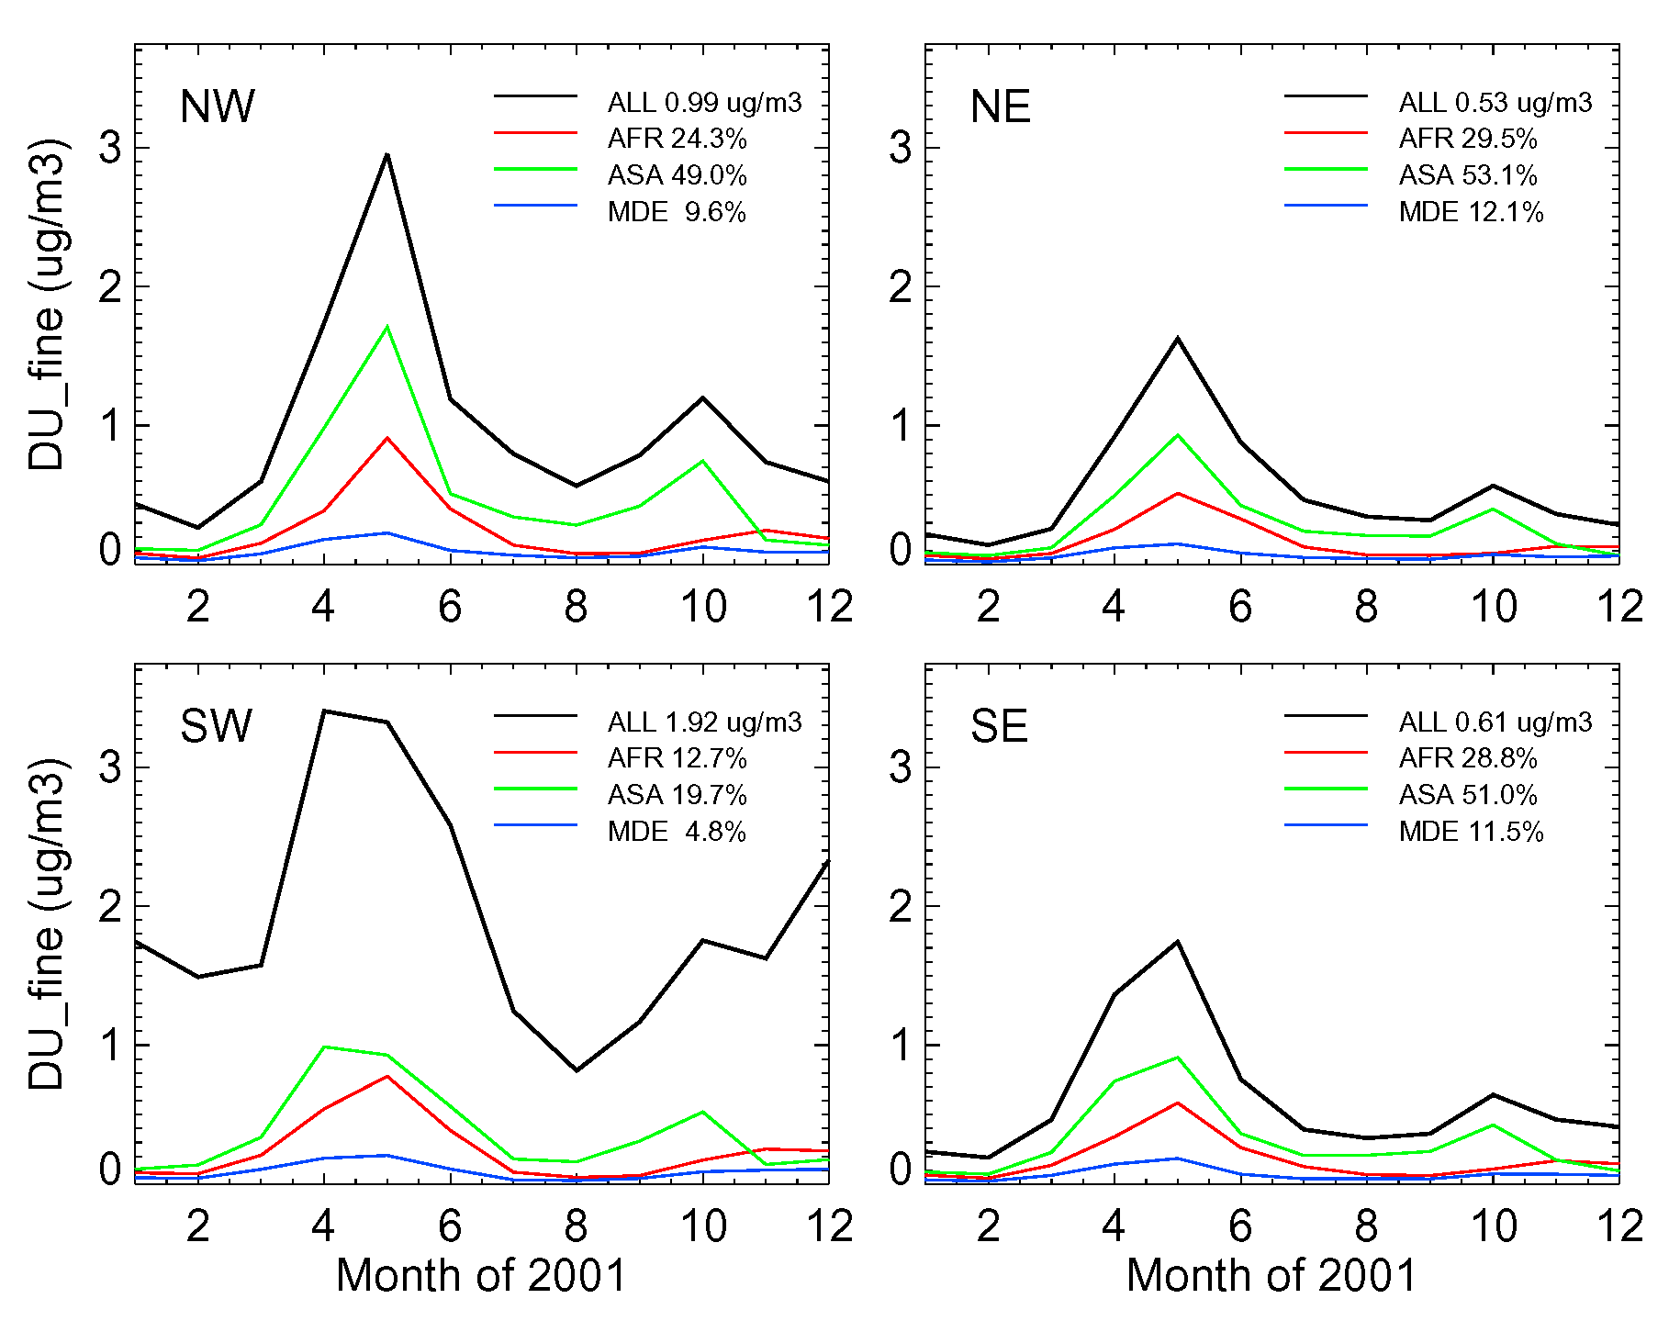
Surface Fine Mode Dust Concentrations
NW
NE
SW
SE
NW:
1/2 fine mode dust is from Asia, 1/4 from Africa
Eastern:
About 1/2 fine mode dust is from Asia
Nearly 30% fine mode dust is from Africa
SW:
About 60% fine mode dust is “local” (20% Asia, 13% Africa, 5% Middle East
Monthly average surface layer find mode dust concentrations in 2001 from the GOCART model (see earlier pages for experiment definition). Annual average concentrations and contributions from different sources are shown.

Slide 11
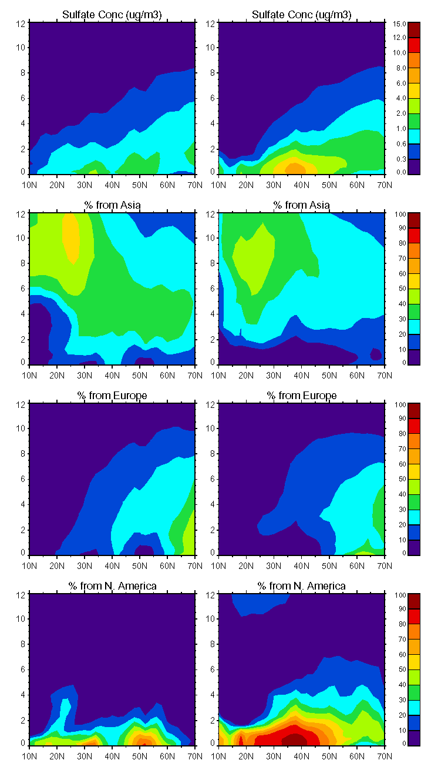
Hemispheric Transport – How do the “foreign sources” affect US air quality? (April 2001 as an example)
West Coast
East Coast
Altitude (km)
Sulfate Over North America:
Most sulfate stays in the boundary layer
Pollution from Asia can travel around the hemisphere at higher altitudes above BL
European pollution makes its way over N. America at higher latitudes
In the BL over North America, most sulfate is from is own regional source
SO₄⁼
µg m⁻³
Altitude (km)
% from
Asia
Altitude (km)
% from
Europe
Altitude (km)
% from
N America
Latitude

Slide 12
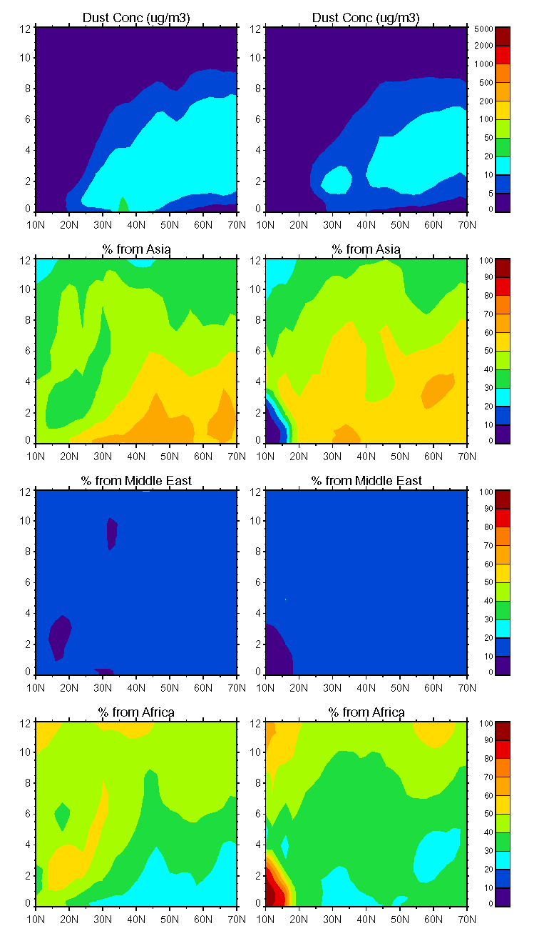
Hemispheric Transport – How do the “foreign sources” affect US air quality? (April 2001 as an example)
West Coast
East Coast
Dust Over North America:
Dust plume has broad vertical extension above the BL
Most dust below 6 – 7 km is from Asia
Dust from the Middle East contributes to about 10% dust loading
African dust is an important contributor to the dust level in the tropics and at high altitudes above 6 – 7 km
Altitude (km)
Dust
µg m⁻³
Altitude (km)
% from
Asia
Altitude (km)
% from
Middle East
Altitude (km)
% from
Africa
Latitude

Slide 13
Conclusions
Surface PM2.5:
  Western:
    30% domestic anthropogenic
    60% “natural”
    10% anthropogenic from other continents
  Eastern:
    60% domestic anthropogenic
    30% natural
    10% anthropogenic from other continents
Surface sulfate:
  Western:
    70-80% domestic anthropogenic
  Eastern:
    90% domestic anthropogenic
Surface fine mode dust:
  Southwestern:
    60% from local desert
  Other regions:
    50% from Asia
    25-30% from Africa
The “background” PM2.5 has large seasonal variations, with the highest values in April-May-June

