Slide 1



MODEL:
Managing On-Site Discipline for Effective Learning
An approach which involves the whole school community teaching and rewarding appropriate behaviors.

Slide 2

Where MODEL Came From…
PENT – Southern Conference
    Diana Browning Wright
      Evaluating a School’s Behavior Support Capacity
    Dr. George Sugai, University of Oregon -- PBIS.org
PBS – Positive Behavioral Supports
    University of California – Riverside
    Dr. Frank Gresham and Dr. Mike Vanderwood
BEST – Building Effective Schools Together
    Desert Mountain SELPA

Slide 3
Three-Tiered Model of School-Wide Discipline
High-Risk Students
Individual Interventions
(3-5% of students)
Intensive social skills teaching
Individual behavior management plans
Parent training and collaboration
Multi-agency collaboration
Targeted Intensive
Selected
At-Risk Students
Classroom & Small Group
Strategies
(7-10% of students)
Intensive social skills teaching
Self-management programs
Adult mentors (checking in)
Increased academic support
Universal Supports
MODEL Program
All Students
School-wide Systems
of Support
(85-90% of students)
Social skills teaching
Positive, proactive discipline
Teaching school behavior expectations
Active supervision and monitoring
Positive reinforcement systems
Firm, fair, and corrective discipline
Sprague, J. and Walker, H. (1999) Institute on Violence and Destructive Behavior
Diana Browning Wright, DCS 2002

Slide 4
How much time is spent handling discipline problems?
(20 minutes per suspension)
SBCUSD 2001-2002 | Number of Suspensions | Time in Days (6 hrs)
High School | 2112 | 117
Middle School | 1967 | 109
Elementary | 5115 | 284
Totals | 9,194 | 510
This data does not include office referrals.

Slide 5

MODEL Goals
Increase instructional time
Reduce office referrals and suspensions
Improve communication between home and school
Create a positive environment for EVERYONE

Slide 6

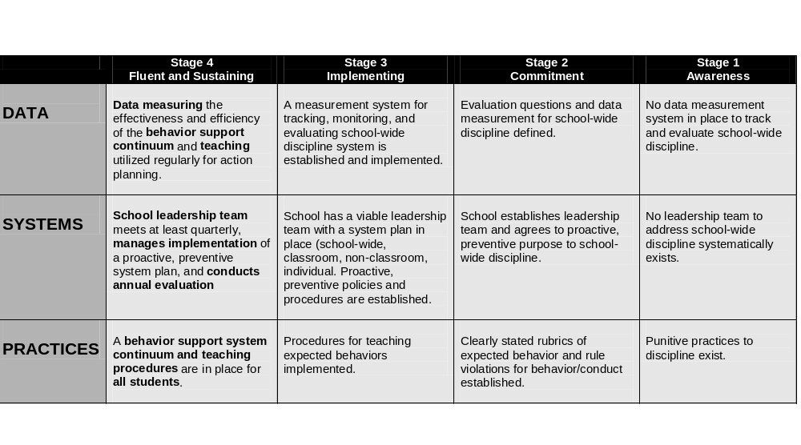
What would a school-wide MODEL discipline program look like?
A site-based team evaluates and leads change
Adapted from Hawaii DOE Rubrics, Permission of Jean Nakasato (12/02) to Diana Browning Wright, PENT Summit, 2003

Slide 7
What would a school-wide MODEL discipline program look like?
“School-wide” means EVERYBODY
Administrators
Teachers & Assistants
Support Staff
Clerical
Custodians, Librarians, etc.
Campus Security
Parents

Slide 8
What would a school-wide MODEL discipline program look like?
The rules are taught, practiced & rewarded throughout the year by ALL staff
Rules Posted Throughout Campus
Behavior Lesson Plans
Modeling & Role Plays
Rewards & Recognition

Slide 9
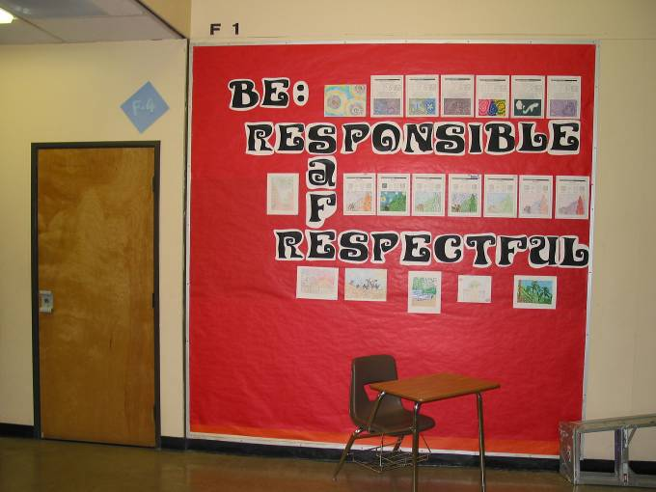
Serrano Hallway

Slide 10
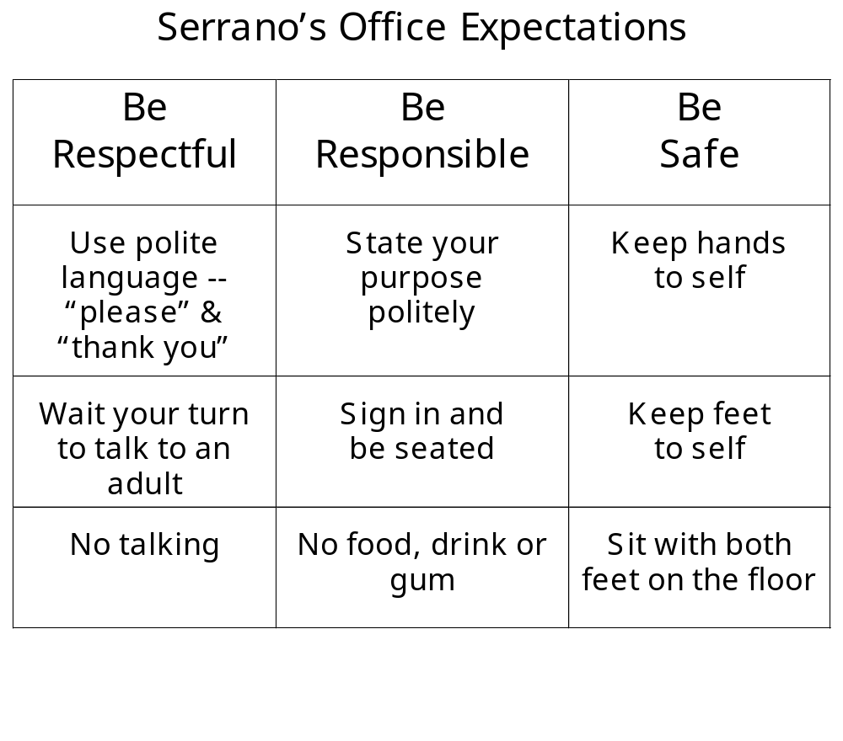

Slide 11
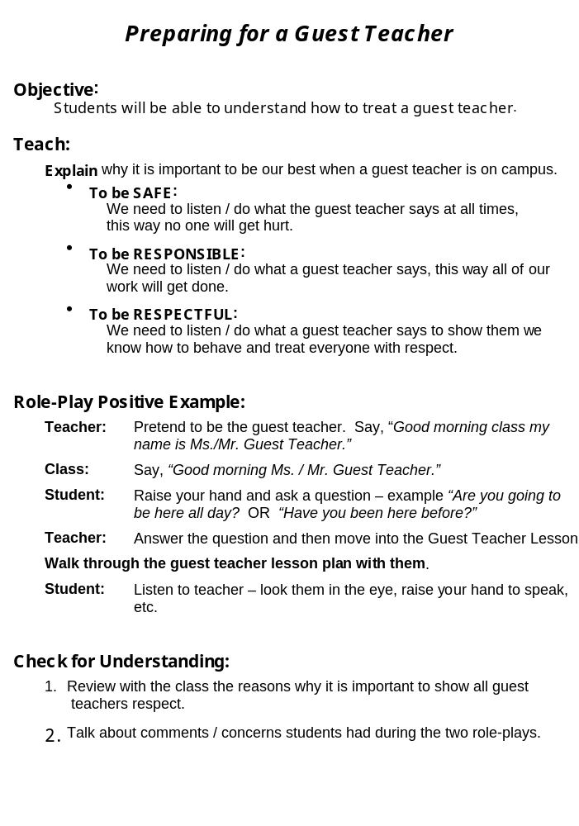

Slide 12
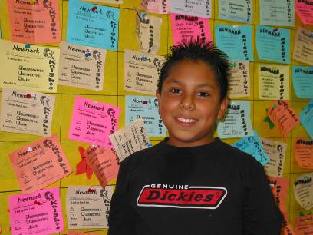
What would a school-wide MODEL discipline program look like?
Emphasis on positive interactions
Five positives
for every negative

Slide 13
What would a school-wide MODEL discipline program look like?
There is a shift of emphasis from WHAT the behavior is to WHY it is happening
Functional Behavioral Assessment (FBA)

Slide 14
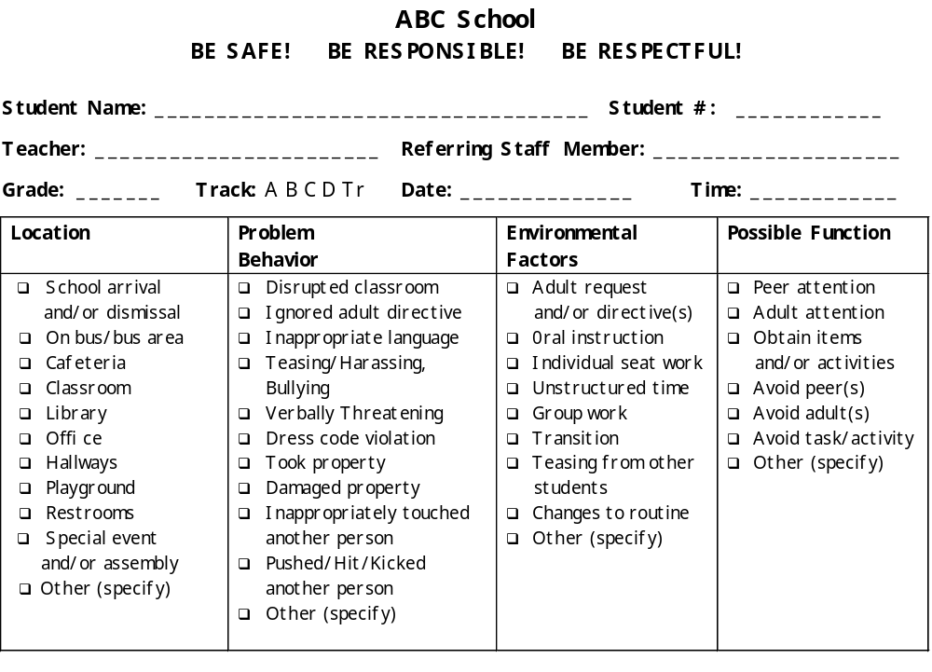
Referral Form

Slide 15
What would a school-wide MODEL discipline program look like?
Decisions are made based on data
New SBCUSD Data Base
SWIS – School-Wide Information System

Slide 16
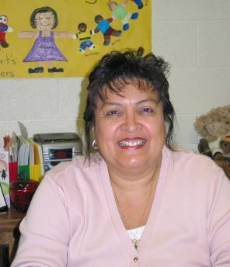
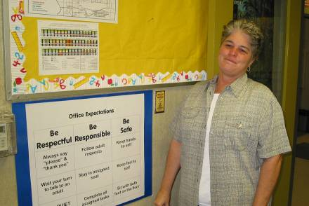
Wilson Administration
Janie Morales, Principal
“Students, staff and teachers have a common behavior language which promotes a more cohesive school climate.”
“ We enjoy looking for the positive and good in kids.”
Mary Kay DeCrescenzo, Vice Principal

Slide 17
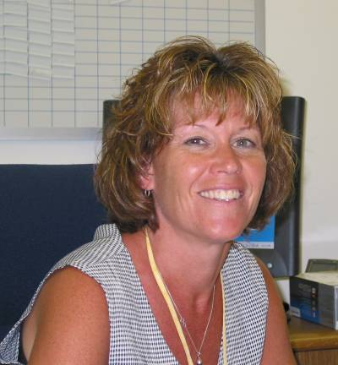
Serrano Principal: Julie Swan
“The key to academic success is a safe campus with common rules and consequences.
When we work together -- administrators, teachers, support staff, students and parents -- for a common goal, success comes naturally!”

Slide 18
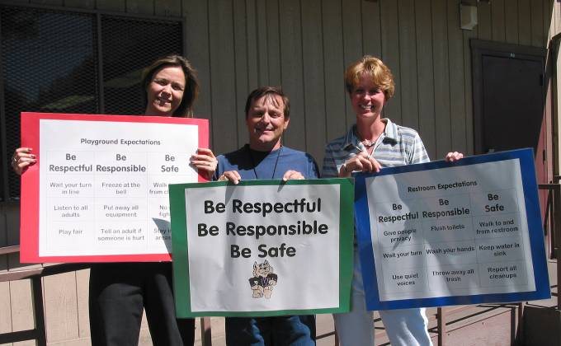
MODEL Coaches
Suzy Johns, John Oliveri & Jackie Patrick

Slide 19




Site-Based Trainings
Day One:
Day Two:
1: MODEL Overview
2: Leadership &
Problem- Solving
3: Defining Expectations
4: Site Self-Assessment
5: First Steps
6: Site Specifics
7: Site Self-Assessment Review
8: Expectations of Site Weekly Meetings
9: Creating Communication Systems
10: Defining School-Wide Rules & Expectations
11: Referral System
12: Positive Reward System
Day Three:
Day Four:
17: Program Review
18: Staff Reinforcement
19: Program Durability
13: Rubric Review
14: Teaching School-Wide Rules
15: School-Wide Infractions/ Interventions
16: Available Presentations

Slide 20

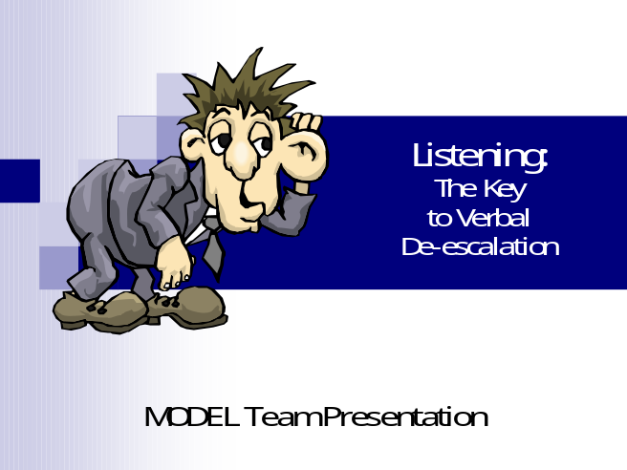

MODEL Presentations

Slide 21
Brochures – Student/Parent
Your Child
Attends a
MODEL
School
How Can
I be a
Responsible Student?

Slide 22

Sources of Inspiration:
Diana Browning Wright, Director Positive Environment Network of Trainers (PENT)
Dr. Frank Gresham/Dr. Mike Vanderwood, UCR
Dr. Jeffrey Sprague, University of Oregon
Building Effective Schools Together (BEST)
Hesperia USD – Cottonwood Elementary (BEST)
Victor Valley USD – Hook Jr. High (BEST)

